Slide 2
Recognizing 2019 & 2020 Long Term service awards
September 2021

Slide 3
From your Interim CEO, Dr. Michael Gardam
I am so pleased to congratulate you on your Long Service Award for your significant contribution to Health PEI and the health and wellness of Islanders. As a dedicated staff member, you have served people throughout the health care system over many years and have affected the lives and health of many, either directly or indirectly.
We all have a role to play in ensuring the health system runs smoothly, with our patients, residents and clients always at the forefront of our efforts. Health PEI is complex, and the mission to provide the best possible care as one Island health system is difficult. It is only through the steady and determined efforts of people such as yourself – people who stay the course and contribute day-in and day-out – that we are able to keep pursuing our ideal of offering the best care and service to Islanders.
Thank you for your professionalism, expertise, and longstanding commitment to the work you do.
Sincerely,
Dr. Michael Gardam
Interim Chief Executive Officer

Slide 4
20 YEAR MILESTONES

Slide 5
RECOGNIZING 20 YEAR AWARDS
Andrea McTavish
Andrew Macleod
Angela Arsenault
Angela Pierce
Anita MacKenzie
Anita McCabe
Anita Young
Anna Crabbe
Anna Gallant
Anne Marie MacPhee
Anne Monaghan
Arlene Dockendorff-Carpente
Audrey Barrett
Barbie Lavers
Bernadette Donovan
Bethany Lynn MacIsaac
Bethany MacDonald
Bonnie MacPhail
Boyd Peardon
Brad Scheuerman
Brenda Munro
Brent Barbrick
Calvin Joudrie
Carla Martin
Carol Buchanan
Carol Sellar
Carolyn Knox
Carolyn Ross
Catherine Fischer
Catherine Norris-MacKenzie
Cathy Anne Guitare
Cathy DesRoches
Darlene Everett
Darrell Chaisson
David Wong
Dawn Jones
Deborah Gregory
Debra Donovan
Della Arsenault
Donna Bell
Donna Giddings
Donna MacEwen
Douglas Hines
Douglas Sherren
Elaine Flemming
Ellen Martin
Ethel Ferguson-Brown
Etta MacInnis
Cathy Vaniderstine
Chris Campbell
Chris Lewis
Chris McCabe
Christa McAlduff
Christa Murphy
Christine Wilson
Christopher Lee
Claudette Ward
Claudia Bruce
Colleen Outhouse
Crystal Dumville
Crystal Gallant-Gaudet
Crystal Praught
Dana Harris
Danielle Mill

Slide 6
RECOGNIZING 20 YEAR AWARDS
Eva Mol
Faye Crawford
Filly Gill
Fonda Inman
Frank Connolly
Gerald Creelman
Gwen MacLean
Heather Boutler
Heather Cairns
Heather Cyr
Heather Dorsey
Heather MacCormack
Heather Peardon
Heather Worth
Holly Morrison
Jackie Affleck
Jacqueline A’Hearn
Jamie Gallant
Jana Corish
Janey Dykerman
Janice Fenner
Janice McCabe
Jason Rendell
Jean Arsenault
Jean Morrison
Jennifer Doyle
Jennifer MacKinnon
Jennifer Shea
Jo-Ann MacDonald
Jocelyn Phillips
Jody Jeffery
John MacDonald
Judy Downe
Julie Chisholm
Karen Burke
Karen Moore
Katherine MacInnis
Kathleen Gauthier
Kathy Valley-Walsh
Kellie Hawes
Kelly Blanchard
Kent Gordon
Kimberley MacPhail
Kimberley Proude
Kimberly Hutchinson
Kimberly Reid
Kirsch Smith-Arsenault
Krista Cantwell
Kristine Heer
Laura Steele
Laurie McNally
Lilian Humphrey
Linda Brehault
Linda Cameron
Linda Doucette
Linda Mahood
Lisa Dawn Durley
Lisa Hill
Lisa King
Lisa Oliver
Lorena LaFrance
Loretta McCabe
Lori Matters
Lorilei Hann-Levy
Madeleline McQuaid
Margaret MacDonald
Marion MacDonald
Mary Beth MacDonald
Mary Roberts
Melissa Pitre
Melissa Thorne
Mervyn McNally
Michael Kok
Michael MacLean
Michael Walsh

Slide 7
RECOGNIZING 20 YEAR AWARDS
Michelle Lynn Hogan
Michelle Pursey
Miranda Driscoll
Nancy Flemming
Nancy Holland
Nancy McDonald
Nancy Power
Nancy Wells
Nancy Woodington
Natalie Coughlin-McInnis
Nicole Peters-Vuozzo
Nora McKenna
Noreen Landrigan
Pamela Handrahan
Pamela Wright
Paul Zakem
Paula Triantifillou
Rebecca Jean MacDonald
Rennie Perry
Rhonda Johnston
Rhonda MacPherson
Richard Arsenault
Rizpah Kennedy
Robbie Shaw
Robin Laird
Rochelle Cochrane
Sally Costain
Sandra MacKay
Sandra MacKinnon
Sandra Miller
Sarah Jones
Sasha O’Hanley
Scott Gallant
Sharon Curley-Gosse
Sharon MacDougall
Shauna MacKinley
Shelley MacFadyen
Shelley Morrell
Sherri MacKinnon
Sherry Kingman
Shirley Boulet
Sonia Wallace
Sonya Bladerstone
Susan Clory
Susan Doucette
Tammy Smith
Tanya MacDonald
Tara Arsenault
Terri Doucette
Tracy MacKay
Tracy Richards-Cole
Trina Tremere
Virgina Duncan
Wade Norquay
Wilfred Butler

Slide 8
25 YEAR MILESTONES

Slide 9
RECOGNIZING 25 YEAR AWARDS
Annette Hollis
Anthony Coker
Betty Auld
Betty Jean Wedge
Betty MacDougall
Candi Mackey
Carl Burke
Cathy Williams
Charlene Drake
Charlene Somers
Cheryl Cahill
Dawna Ramsay
Deborah Campbell
Denise Arsenault
Dianne Holland
Gail Weatherbie
Jeannie Burden
Jeannie MacKenzie
Jennifer Shea
Joanne Dennis
Joanne Gillis
John Gaudet
Joy Palmer
Karen Kelly
Kathryn Bigsby
Kim Creelman
Kimberley Hagan
Krista Paquet
Krista Silliker
Lisa Ferguson
Lisa MacDougall
Lorelei Zakem
Lori McKenna
Lyndon Pineau
Margaret Duffy-Landry
Marie Schurman
Marsha Frost
Martha St.Pierre
Mary MacDonald
Mary McBride
Mary Sullivan
Melody Ellis
Michele Vloet-Miller
Michelle Garnhum
Mildred McCormack
Rebecca Doiron
Reta Kelly
Rosanne Murnaghan
Rose Duffenais
Ruth Nelson
Sandra Clements
Sandra MacNevin
Susan Stewart
Tammy MacFadyen
Tammy Palmer
Tanya Fitzpatrick
Tina Lowther
Trena Ferron
Victoria Doucette
Yvonne Thompson

Slide 10
30 YEAR MILESTONES

Slide 11
RECOGNIZING 30 YEAR AWARDS
Anne Keuper
Annette MacInnis
Arlene Powers
Audra McCarville
Barbara Myers
Beth MacDonald
Beverley Ashley
Beverley Stavert
Blaine Bruce
Bobby Steele
Bonnie MacLean
Brenda Arsenault
Brian Read
Brian Timmons
Carol Anne Dingwell
Carol Graham
Carolyn Muttart
Cathy Stewart
Cathy Wilkie
Cheryl Banks
Cheryl Hackett
Chris Spenceley
Claire Matheson
Colleen McIntyre
Danny Brawn
Darla Smith
Darlene Dunn
Darlene MacNeill-Veld
Darlene Molyneaux
Darren Arbing
Dawna-Lee Perry
Dean Roberston
Debbie Acorn
Debbie Thompson
Deborah Dixon
Deborah Flood-Vickerson
Debra Smith
Denise Reeves
Donald Chevarie
Donna Butler
Donna Dehmel
Donna McAleer
Dwane Johnson
Edith Kelly
Edna Miller
Elaine McInnis
Elizabeth Lynn Delong
Elizabeth McNeill
Esther Currie
Faye McCarthy
Gayle Lamont
Gaylene Albert
Gerard MacCormack
Gina MacDonald
Heather MacKenzie
Jacalyn Noonan
Jacqueline Vloet- Koughan
James Lamphier
Janet Hodder
Janette Conklin

Slide 12
RECOGNIZING 30 YEAR AWARDS
Jeanna McIntosh
Joanne Donahoe
JoAnne MacKendrick Pinkham
Joanne Malone
Jodi Arsenault
John Doyle
John Whitty
Joseph Callaghan
Judy Adams
Judy Connell
Julie Arsenault
Kara McQuaid-Duffy
Karen Holland
Karen MacLaren
Karen MacLean
Katherine Wood
Kathryn Murray
Kathryn Wilson
Kelley Power
Kerry Gautreau
Kevin MacNeill
Kevin Smith
Kimberley Williams
Kimberly Harris
Kimberly Macdonald
Lana McDonald
Leona MacIntosh
Linda McClumpha
Lisa Campbell
Lisa Fraser
Lisa McCarville
Lisa Michelle Campbell
Lori Annear
Lorna Harris
Marilyn Enman
Mary Jane Callaghan
Mary McInnis
Mary Nisbet
Melanie Campbell
Michelle Nelson
Michelle Sheperd
Mike Lund
Nancy Cooke
Nancy Lamont
Nancy Paquet
Nora Jean Wallace
Pamela Laird
Patti Woodside
Paula Docksteader
Philip Crawford
Rebecca MacAdam
Rhonda Deagle
Sandra Arsenault
Sharlene Fennell
Shawn Noonan
Shawna MacDonald
Sheila Wallace
Shelley Carmichael
Shelley Heron
Shelley MacLean
Shelly Higgins

Slide 13
RECOGNIZING 30 YEAR AWARDS
Stella O’Connor
Susan MacKinnon
Sylvia Ellis
Tami MacKinnon
Tamilyn Ferguson
Tammy Driscoll
TaraRose Stewart
Teresa McInnis
Teresa Morton
Terry Gaudet
Tracey Hagan-O’Connor
Tracey MacDonald
Tracey Stead
Trudy Myatt
Valerie O’Rourke
Vanda DesRoches
Verna McInnis
Wendy Cooke
Wendy Koughan

Slide 14
35 YEAR MILESTONES

Slide 15
RECOGNIZING 35 YEAR AWARDS
Angela Webb
Arlene Gallant –Bernard
Barbara Ellsworth
Bonnie Fraser
Carol Anne Matheson
Cathy Carragher
Cathy Gaudet
Cathy Hughes
Celie Walsh-Gallison
Cindy Dawson
Cindy Johnston
Colleen McCullough
Danita McInnis
Darlene Casford
Dawna Woodside
Deborah Yeo
Dianne Young
Donna L. Heron
Donna Stewart
Earla Jay
Edith Stevens
Elizabeth MacEwen
Emanuel Bernard
Gaelyne Ramsay
Gail Tuplin
Gary Wood
Heather Beaton
Heather Bulger
Heather Gavin
James Handrahan
Janet Read
Joanne Sullivan
Joy Gallant
Karen Kelly
Kathleen Koughan
Kathleen MacDonald
Kelley Rhynes
Kelly Johnson
Kevin Doucette
Lloyd Burke
Maisie McCarthy
Marcia Graham
Margaretha Byrne
Marina Trainor
Marvin Tersch
Mary Lee Larkin
Michael Arsenault
Muriel MacLeod
Myrna LeClair
Myrtle MacPhee
Nora Johnston
Pamela Cousins
Patsy Fullerton
Patty Flinn
Stirling Smith
Vicki MacLean
Winnie Moores

Slide 16
40 YEAR MILESTONES

Slide 17
RECOGNIZING 40 YEAR AWARDS
Barbara Dugay
Blair Darrach
Cathy Cahill
Charles Sherry
Debra Bradley
Donna Stanley
George McInnis
Judy Arsenault
Kathy Larter
Kendra Harper
Leigh Oliver
Lori Hughes
Paula Kennedy
Ruth Mills
Sandra Bernard
Westley Hood

Slide 18
45 YEAR MILESTONES

Slide 19
RECOGNIZING 45 YEAR AWARDS
Edna Poirier
Elaine Smith
Janice Trowsdale

Slide 20
50 YEAR MILESTONES

Slide 21
RECOGNIZING 50 YEAR AWARDS
Donna Hayden
Gloria MacFadyen
Pauline Redmond
Valerie Robinson

Slide 22
Special memories and stories

Slide 23
We asked our long-term service award recipients to
send along a photo, special story or share a positive
memory or experience working with Health PEI
throughout their career thus far. Here are some of
the great memories we received!

Slide 24
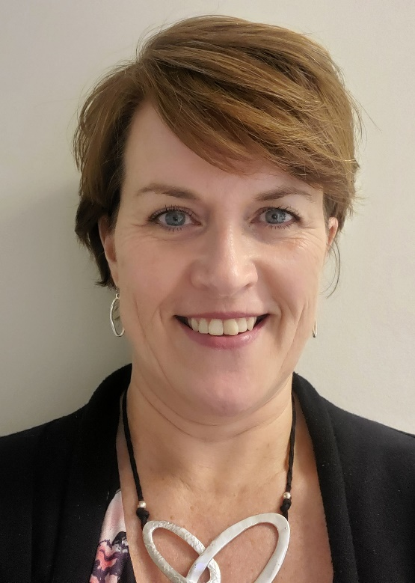
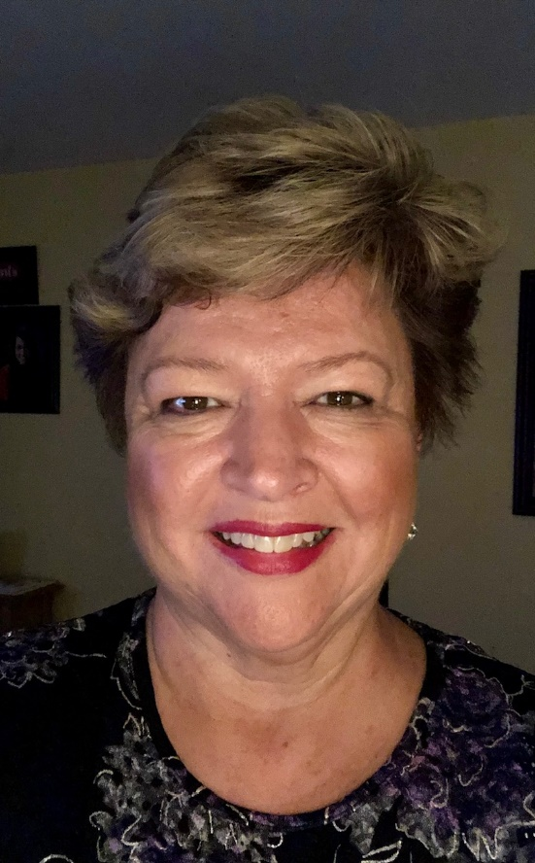
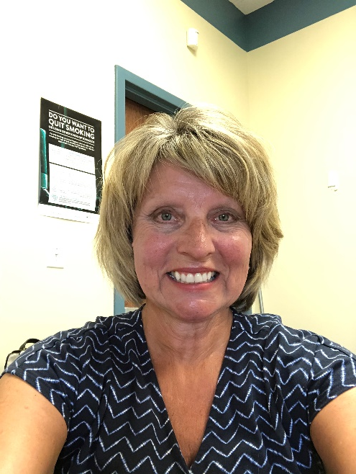
Michelle Vloet-Miller – 25 Years
Martha St. Pierre – 25 Years
Sandy Bernard – 40 Years

Slide 25
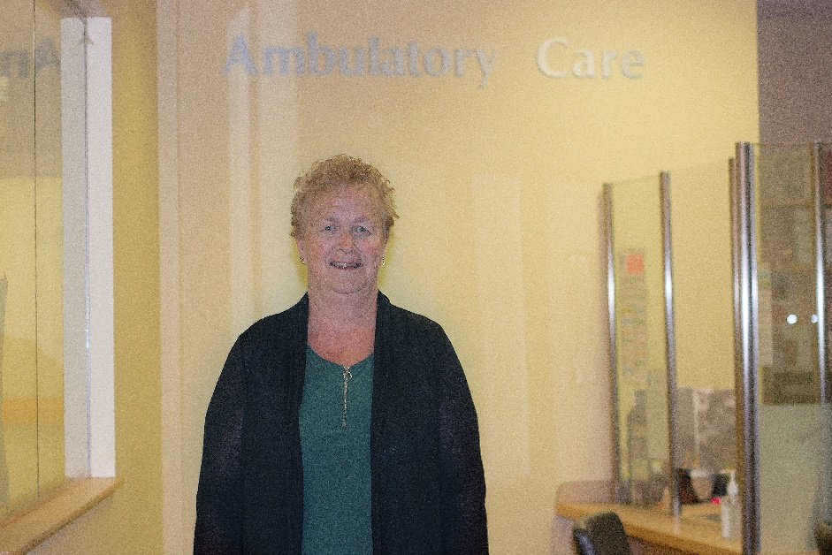
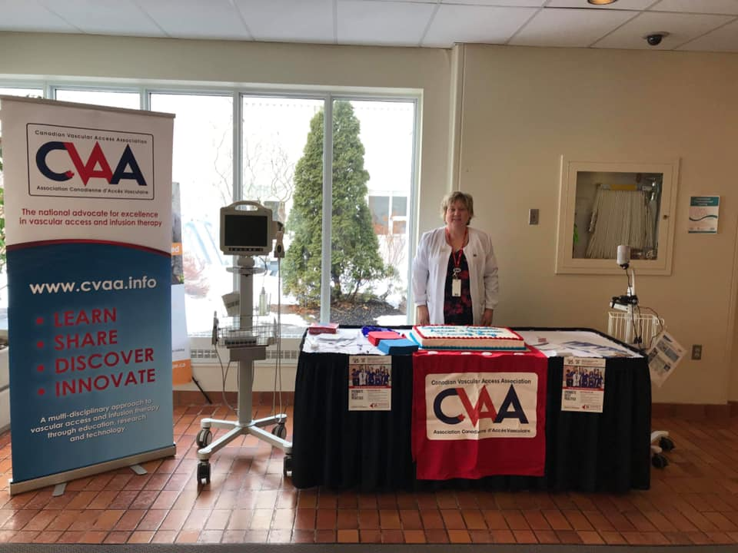
Edna Poirier – 45 Years
Tracey Hagan-O’Connor – 30 Years

Slide 26
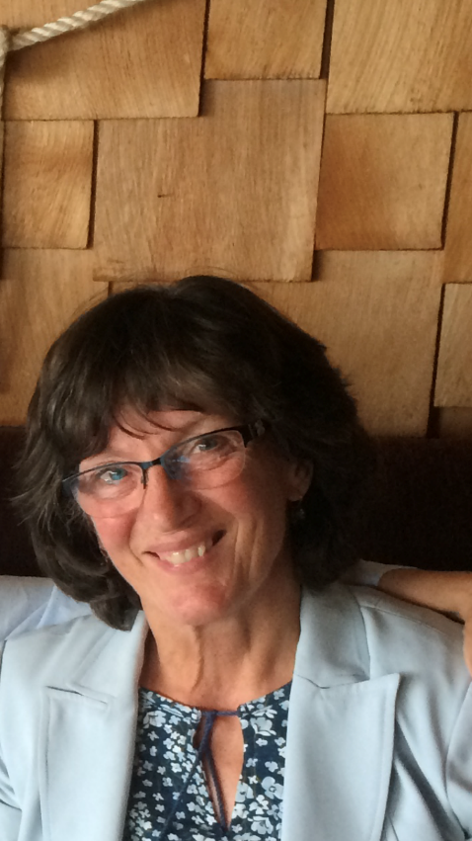
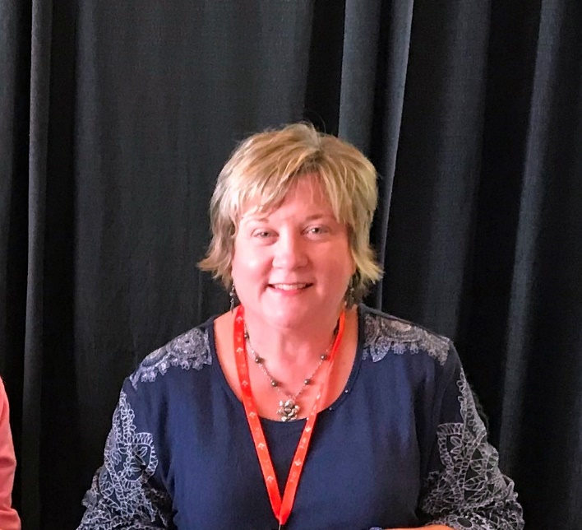
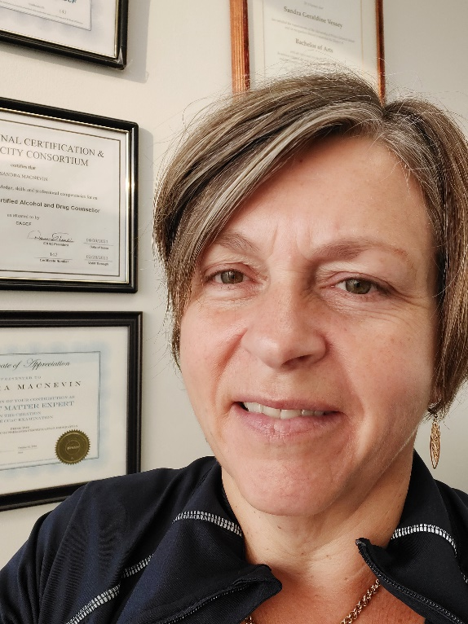
Tracey Hagan-O’Connor – 30 Years
Sandra MacNevin – 25 Years
Ellie Martin – 20 Years

Slide 27
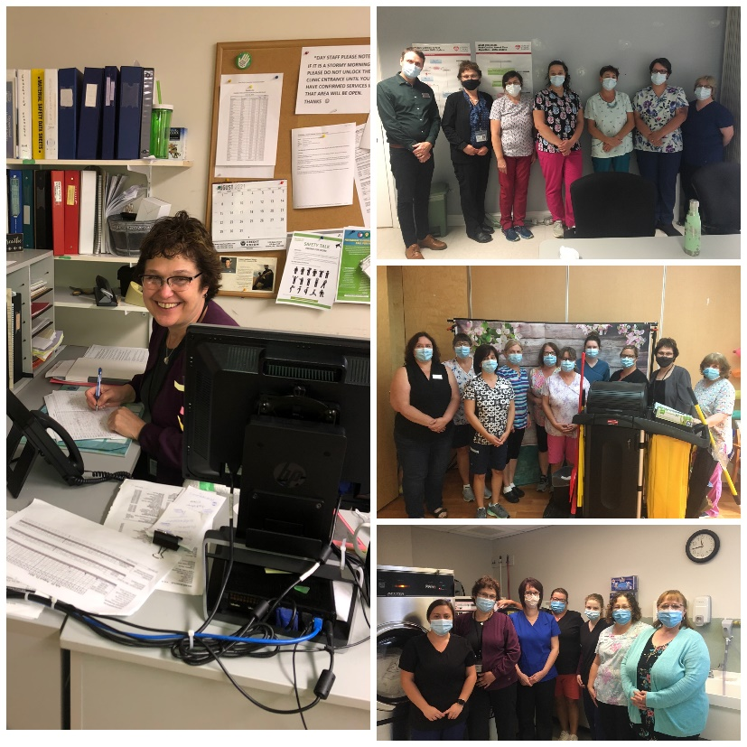
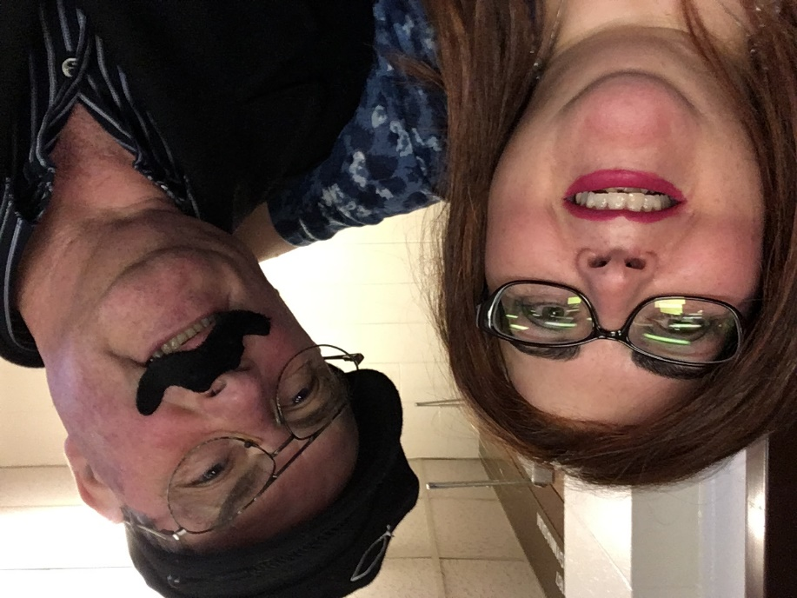
Mary Lee Larkin – 35 Years
Faye McCarthy– 30 Years

Slide 28
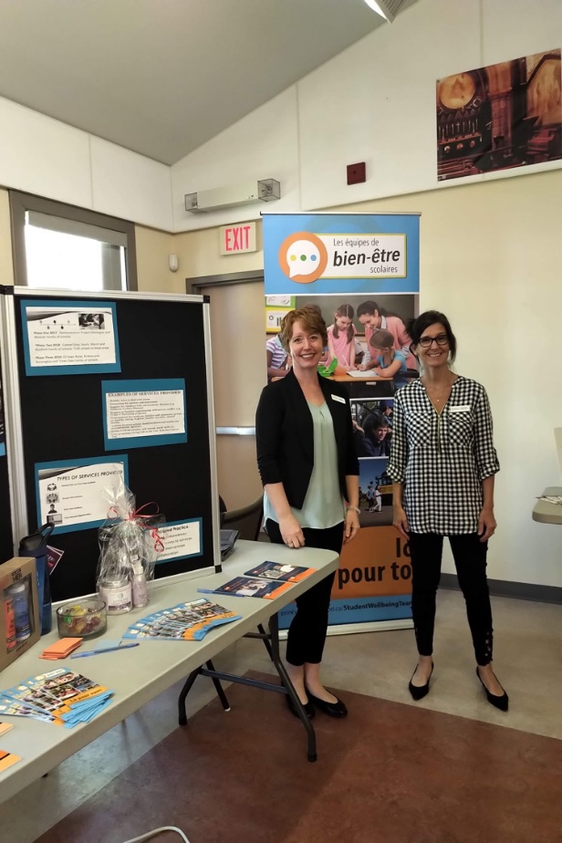
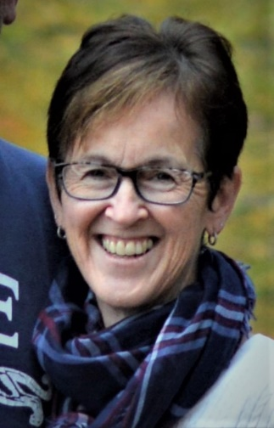
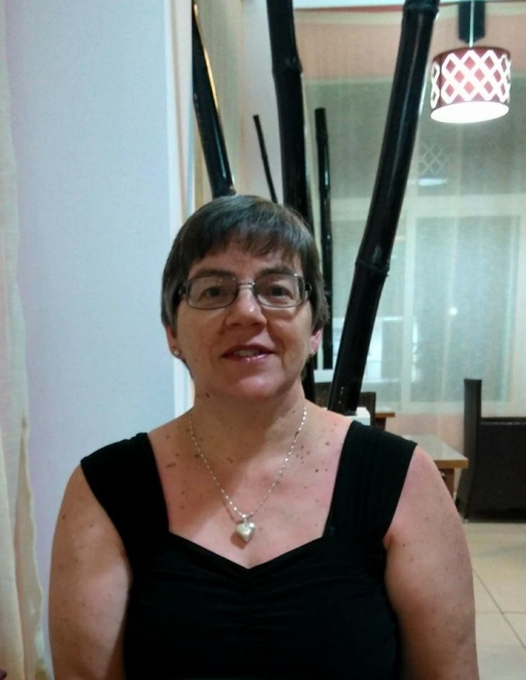
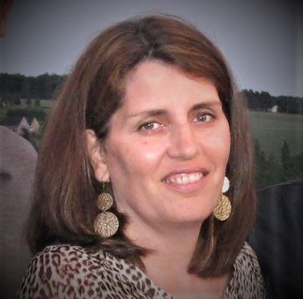
Dawna Woodside – 35 Years
Lorena LaFrance – 20 Years
Linda Mahood – 20 Years
Jeanna McIntosh – 30 Years

Slide 29
Memories and Stories
In 1986 when I was working at the QEH you could smoke anywhere (and I mean anywhere) in the hospital - staff, patients, nursing stations, patient rooms, cafeteria, etc. Nurses all wore "duty" shoes and we (therapists) had to wear casual dress shoes. I asked if I could wear sneakers because I needed to wear orthotics and they were difficult to fit into women's shoes. I was told I could not because wearing sneakers was "unprofessional"!
-Dawna Woodside – 35 Years

Slide 30
Memories and Stories
My favorite memory of working with Health PEI is the fun celebrations with co-workers whether it was nurses week, the QEH staff appreciation BBQ, Christmas dances / parties etc.... it was always a great way to bring people together to celebrate and have fun. It was / is so important in promoting staff wellness and workplace enjoyment!
-Martha St. Pierre – 25 Years

Slide 31
Memories and Stories
My first employment with Health PEI was on Unit 2 at the Queen Elizabeth Hospital in May, 1995. I had worked in Ottawa for 4 years on a busy surgical unit before returning home to PEI. I was so impressed with the nursing care on Unit 2, (general surgery unit) when I worked there. The staff were amazing, worked as a team and provided excellent care to the 40+ patients on that unit. Much of the credit has to be given to Colleen Sharbell, the nurse manager on that unit. Colleen was a wonderful leader. She had high expectations and everyone was expected to meet those expectations and thus we worked as a team. She was very well respected by her nursing staff, the surgeons and hospital senior management. She was fair, consistent and a strong advocate for the nursing profession. She is enjoying a well deserved retirement these days! I learned so much from her and have many fond memories of my 14 years at the Queen Elizabeth Hospital, before I moved to my current position in Health PEI Primary Care and Chronic Disease.
-Martha St. Pierre – 25 Years

Slide 32
Memories and Stories
Looking back one of my favorite memories was being chosen to participate in the creation of the Canadian Addiction Certification Counselor exam in Ottawa in 2016. The Canadian Addiction Counselor Certification Federation forwarded a National call out looking for Subject Matter Experts to attend a Writing and Validation Workshop to create the exam. I, along with 7 others from across the country, were chosen from hundreds of applicants. Had I not worked in multiples capacities within Addiction Services since 1994, acquiring my own certification within the CACCF as an International Certified Alcohol and Drug Counsellor, I would not have had this experience which I considered an achievement of sorts.
-Sandra MacNevin – 25 Years

Slide 33
Memories and Stories
My favorite memory was in my HR Coordinator role when I was meeting with employees who had chosen to retire. Employees generally retire once and I always enjoyed assisting them with the process. There were always mixed emotions, a few sad tears were shed because it was the end of a long chapter in their career, but there were happy tears as well with the excitement of starting a new chapter in their retired life. I would sometimes see them a year later, and they always commented, with a big smile on their face, on how much they were enjoying their retirement and wished they had retired sooner. Definitely a favorite memory in my HR role!
-Jeanna McIntosh – 30 Years

Slide 34
Memories and Stories
I love Nursing and always have even though there are challenging days particularly in the past few years. Twenty years ago I was given the opportunity to become educated and competent in inserting Peripherally Inserted Central catheters and it has enabled myself to have a specialized nursing role for the QEH but also for PEI as a Vascular Access Nurse. This has provided myself with so many wonderful stories and I have met such spectacular patients in this role. Many have impacted myself in so many ways with the challenges in their lives. As well, I have the opportunity to work with staff throughout the QEH as well as Home care, KCMH, Souris and PCH.
-Tracey Hagan-O’Connor – 30 Years

Slide 35
Memories and Stories
My first Nurse Manager influenced my career in Nursing. She believed in me and
gave me the opportunity to be a leader and a nursing educator fairly early in my career (10 years). She is the reason I am the RN /Nursing leader that I am today. I have so many stories about patients and families but the main thing is we are given the privilege of entering people's lives at the most challenging times and they trust us and put their confidence in us. I feel that is a true honor. One thing I really enjoy is the students and when I orientate new nurses as a nurse educator...they always bring a fresh and positive attitude.
-Tracey Hagan-O’Connor – 30 Years

Slide 36
Memories and Stories
Working at Prince County Hospital gives me a sense of belonging to a team of health care providers doing our best for patients. Whether they are having an ultrasound to see their new baby, or needing testing for helpful diagnosis of health issues and treatment, we always do our best for quality and timely appointments and reporting. We have had lots of social functions as Radiology and Laboratory departments from luncheons, baby showers, weddings, Christmas or retirement parties, and also supporting each other through the hard times in life. In the late 1990's we were on the planning committee for the successful Prince County Hospital Christmas Party/Dance at the Silver Fox Curling Club. This was one of the last hospital wide social functions at PCH, Beattie Avenue. What a great time that was. Now we enjoy teas and staff appreciation barbeques but don't know nearly as many staff in other work areas of our facility. Thank you to the new social committee who comes up with unique ideas through COVID for tree/door decorating, Valentines and Easter contests, etc. Each year my husband and I volunteer at the Grass Roots and Cowboy Boots PCH fundraiser serving suppers to approx. 1000 people. Everyone has such a great time for a worthy cause. What a great career choice!
-Lorena LaFrance – 20 Years

Slide 37
Memories and Stories
The people contact, the one on one, seeing them grow and seeing generations of families.
These are the special things that I find make the memories, it is the personal touch.
Being from here, you know of them or can make a connection. The sharing of someone they know or can make a new connection with new people.
Being locked out of the hospital with an RCMP and two patients comes to mind. I had to run around the old hospital and come in the back door of the boiler room to the switchboard and to the ringing phone of the supervisor alerting of someone running around the building. When I first started we had manual typewriters with carbon copies. Time has brought a lot of changes as progress continues.
-Edna Poirier – 45 Years

Slide 38
Memories and Stories
I am very proud to work for Health P.E.I. When I think of such a rewarding career in nursing I am very proud of my co workers, including myself for numerous efforts to raise money for equipment for our hospital. Western Hospital has had numerous variety shows over the years to raise money for equipment such as a lab chair for blood draws, bladder scanner, etc. I remember it being some of the most rewarding experiences and fun. We would donate our time, make fudge, sell tickets etc. My two sons even helped out one year at the door giving out agendas. It was definitely a family affair. The doctors would help out with acting as well and even buy us pizza on the last night. Many coworkers helped out from service workers, laundry, lab, medical records, administrator of the hospital, head nurse, nursing staff, primary care, maintenance, central stores and volunteer from the community. On our last variety show in November 2019 we raised money that was even matched by a member in our community. My favorite memory is seeing one doctor dressed up as a baby, another as Dolly Parton, and another doctor dressed as a train conductor. These precious times together as a work family I will always hold dearly in my heart forever.
-Faye McCarthy – 30 Years

Slide 39
Memories and Stories
For me over my long career it has always been the wonderful people that have made my job enjoyable. I consider my biggest and best achievement to be the sharing and learning I've had the privilege to be a part of. I have had the pleasure of working with many awesome patients, families and staff and will be forever grateful to each and every one of them for what they have taught me and for what they've allowed me to share with them.
-Mary Lee Larkin – 35 Years

Slide 40
Memories and Stories
I have many, many wonderful memories and some sad memories too with my 41 years of service to my employer. That is what it is like to work in a hospital setting. I started with the Prince Edward Island Hospital in 1979 and moved to the Queen Elizabeth Hospital shortly after. I’ve made many friends and have never forgotten the friends that have passed before me or retired before me. It has been a life long learning experience and I am very grateful for being able to serve. Retirement is around the corner for me and I wish you all many blessing and good health. Cheers!
-Sandy Bernard – 40 Years

Slide 41
Congratulations and thank you to all of our recipients for 2019 & 2020!

