Slide 1
DIS Training Guide
Prepared July 28, 2022
Notes:
Welcome to the DIS Training Guide.

Slide 2
DIS access through the Medigent Provider Portal is only accessible through the government internet network
For technical issues, including password and username issues, please contact Service Centre
Notes:
This page will appear when DIS is searched within a web browser.
On the left-hand side of the page is the logon function.
You will need to enter your username and password and click logon in order to enter the DIS and begin searching for client information.

Slide 3
Only patients with a valid PEI Health Card can be searched.
Notes:
Once you have successfully logged on, the page will automatically redirect to the “Client Lookup” page.
This page can always be accessed no matter where you are within the DIS by selecting the “client lookup” function.
When searching for a profile, there are a few different ways to search. Either the identifier number, also known as a health card number, or client name should always be included within the search, whereas gender and date of birth can be used to narrow the search if necessary
A reason as to why the client’s profile is being accessed will also need to be selected from a drop-down list before continuing.

Slide 4
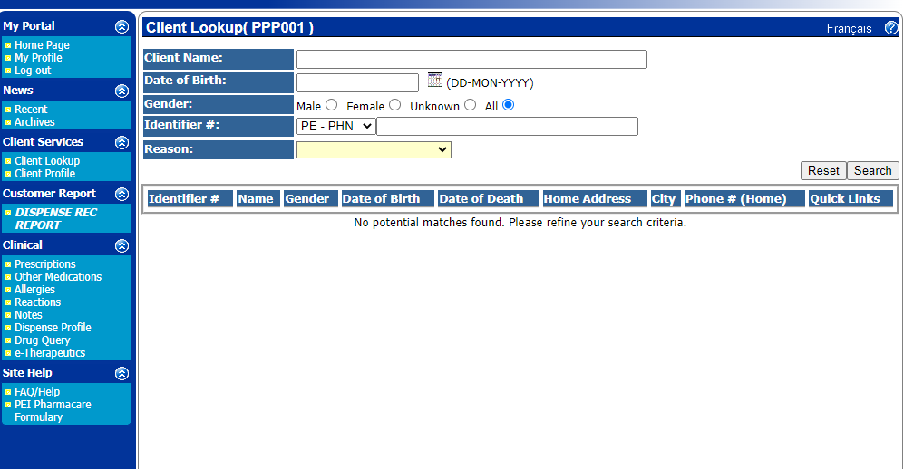
Surname, First name, Middle name
Notes:
Just a reminder if using client name, enter name as surname, first name and then middle name

Slide 5
Notes:
If using date of birth, enter this as day, month, and then year

Slide 6
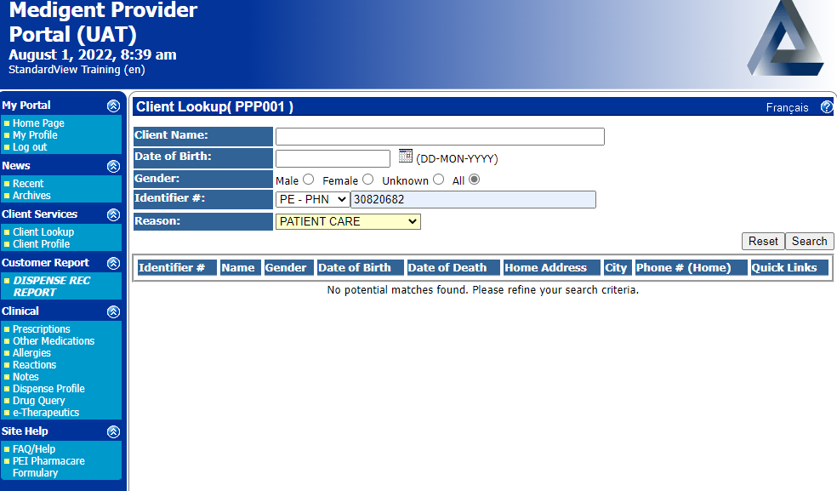
Notes:
And if searching with an identifier number, select the correct identifier type from the drop-down list and then enter the 8-digit health card number.

Slide 7
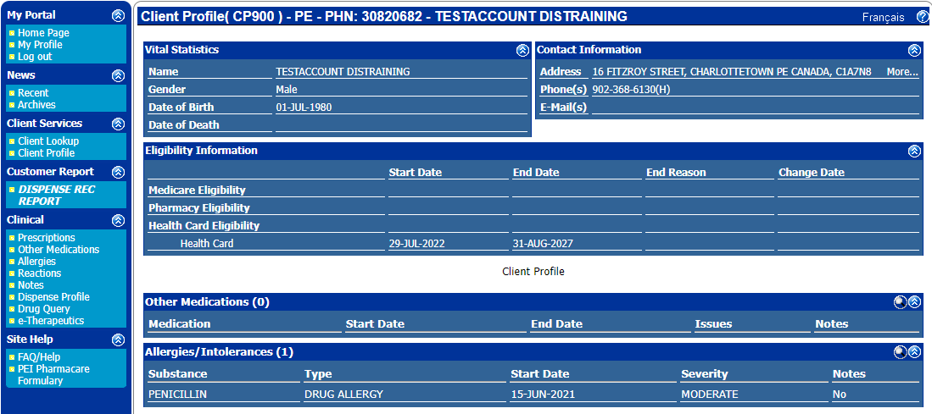
Notes:
Once the search is complete, the client profile page will automatically appear.
The client profile is where basic information such as name, gender, date of birth, address, phone number, medication and allergy information is found.

Slide 8
Dispense Rec Report only contains information related to prescription medications filled at a PEI community pharmacy
Notes:
In addition to the client’s profile, information about a client’s medications can be viewed within the dispense rec report.
The dispense rec report provides information about prescription medications filled by a client’s community pharmacy. It is important to note that although very useful, this is not a complete record of all medications as it does not track over the counter products, vitamins, minerals or medications dispensed from a hospital admission.

Slide 9
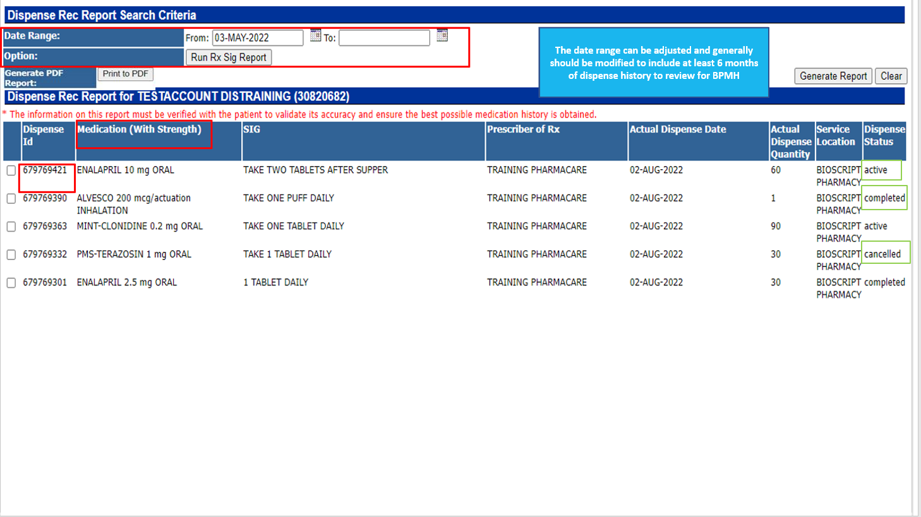
When you are on this page,
Generate the report
Print to PDF
This will download the report when you can view and print to a hard copy
Notes:
An example of a dispense rec report is shown here.
Included within this report is basic information about a prescription such as medication name, strength and SIG as well as the prescriber, dispense date and quantity and location in which the prescription was dispensed.
The dispense status is listed as either active, completed or cancelled.
Active means the prescription has been filled by the community pharmacy but not yet picked up by the client.
Completed means the prescription has been filled and picked up and cancelled means the client is not receiving this prescription from the community pharmacy.
If additional details surrounding a prescription are needed, the dispense ID of that prescription can be selected to view more about it.
Additionally, selecting the column heading called “Medication” reorganizes the medication names into alphabetical order for better grouping of the same medications.
Finally, if there are many medication entries in the report, filtering by date at the top of the page an option as well to either narrow or widen the search.

Slide 10
Notes:
Similarly, to the dispense rec report is the dispense profile or summary.
The dispense profile also contains information about prescription medications filled by a client’s community pharmacy
Just a reminder that like the dispense rec report, this summary will not include any over the counter medications, vitamins, minerals or medications dispensed from a hospital admission.

Slide 11
Dispense Profile/Summary Report only contains information related to prescription medications filled at a PEI community pharmacy
Notes:
The dispense profile contains basic information about a prescription such as the name, strength and formulation of the medication, the date the medication was dispensed and picked up, the quantity dispensed and the location where it was dispensed. It also contains any documented notes about the prescriptions.
The current state of the prescription is also included and is listed as one of three options.
Dispensed means the prescription is filled but not picked up.
Picked up means the prescription is filled and picked up and cancelled means the prescription is not being filled for the client.
If additional details surrounding a prescription are needed, the dispense ID of that prescription can be selected to view more.
Additionally, selecting the column heading called “Drug name” reorganizes the medication names into alphabetical order.
Finally, filtering by date at the top of the page is an option to either narrow or widen the search.

Slide 12
“Other Medications” only includes medications manually entered by other healthcare providers and should NOT be considered an exhaustive list.
Notes:
As previously mentioned, over the counter medications, minerals and vitamins are not listed within the dispense rec report or summary but these products are found within the “other medications” tool within DIS.
Other medications encompass all over-the-counter products as well as samples from a doctors’ office.

Slide 13
“Allergies” only includes those entered by healthcare providers. The allergies found on DIS:
should NOT be considered an exhaustive list
do NOT mirror allergies listed in Cerner (CIS), CHR/EMR or other sources.
Notes:
Allergies and intolerances are also important to note when dealing with medication. Within the DIS, existing allergies and intolerances can be viewed, and new ones can be added.
It is important to note that only allergens with a DIN or NPN can be added.

Slide 14
Notes:
Drug monographs are available through the drug query tool within the DIS.

Slide 15
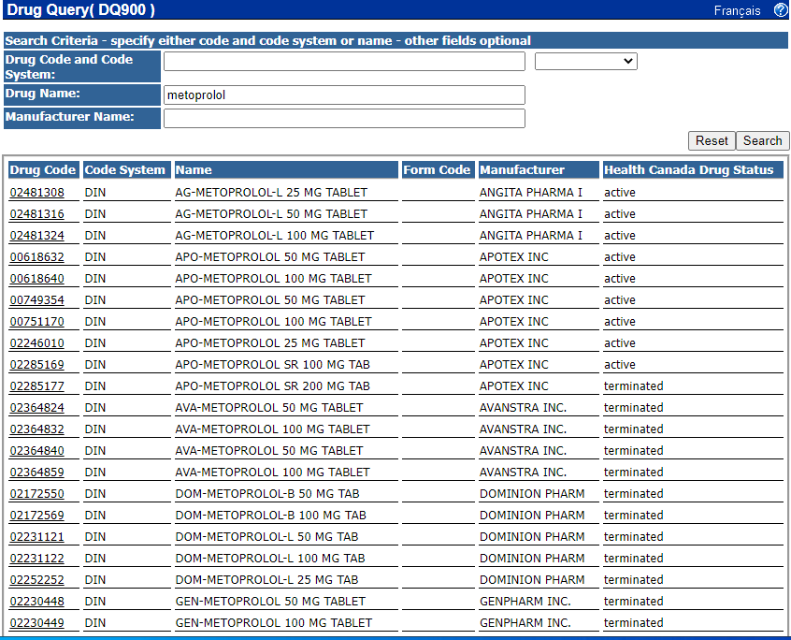
Notes:
To search for a drug monograph, enter the drug code or name of the drug. The manufacturer name is optional.
Once the search is complete, select the appropriate drug code to read its monograph.

Slide 16
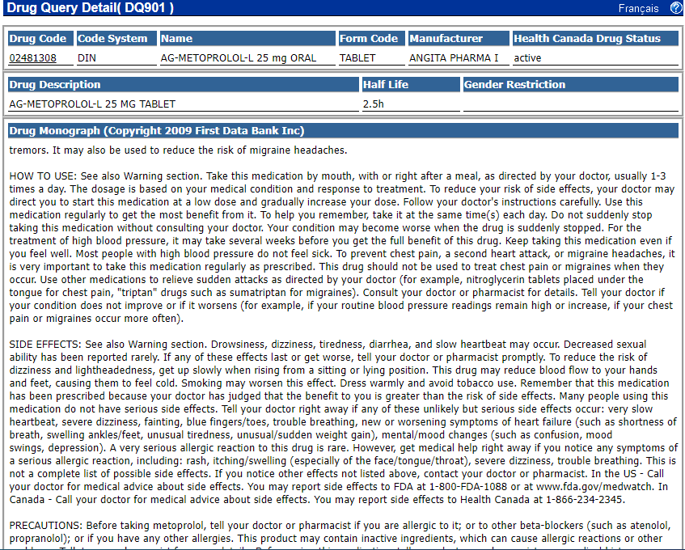
Notes:
A drug monograph is a useful tool for drug information question as it provides information about medication use, side effects, precautions, interactions and more.

Slide 17
Notes:
One of the tools within the DIS not related to a client search but important to note for password changes.
The “My Profile” function contains basic account information. Here, personal information such as display name, email and password can be edited without having to use ITSS services.
In order to change a password:
Enter a new password into the “password” field
Select “Password (confirm)”
Select update
Log out and log back in

Slide 18
Notes:
Finally, if there are ever any questions about the DIS, there is a help tool where commonly asked questions are answered.
Additionally, there is a question mark within the corner of each page which serves as a quick reference on how to navigate each page of DIS.
There is also a link to the PEI Pharmacare Formulary for quick access to drug coverage information

