Slide 1
{Insert Facility Name} Exercise: Fire/Code Red
MM/DD/YYYY

Slide 2
Overview
Introductions
Ground Rules
Exercise Goals
Exercise Scenario and Discussion
Hot Wash

Slide 3
Ground Rules
One person speaks at a time
Everyone gets a chance to speak
Limit side bars please
Not testing you, testing the plan/procedures
Refer to your plan
There are not wrong answers
Ask questions and make observations
Put phones on silent/vibrate
Please leave room to text, e-mail, phone calls
Return as quickly as possible
Some questions may be skipped
Don’t fight the scenario

Slide 4
Exercise Goals
Walk through the plan, provide a chance for discussion and/or clarification and to gain familiarity with the plan and its updates.
Review internal procedures covering:
Initial Fire Response
Partial/Initial Evacuation
Alerting and connecting with the Fire Department
Clearing the Code
Identify gaps/issues in the new plan and methods of improvement

Slide 5
Phase #1
It is 2:00 pm on windy and cold Tuesday in February and the hospital is at capacity with several people waiting in the emergency department and other clients receiving services throughout the building. After a loud noise, nursing staff observe smoke begin to seep out from the open door of a utility closest.

Slide 6
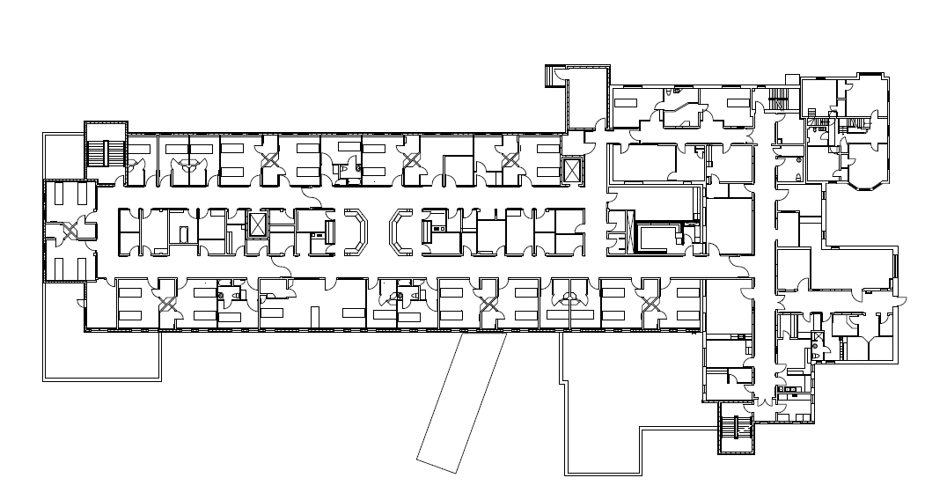
Insert graphics as desired

Slide 7
Discussion Questions
What steps are the staff who discover the smoke, and those in the immediate area taking?
How does the facility alarm system function? E.G. How is it activated? Where are the fire panels? What information do they provide? What are the different stages? Etc.
Who is in charge/assumes command when the alarm is activated and what steps do they take?
How is the rest of the facility notified of the fire location?
How is the fire department informed of the fire and are there any specific steps that staff should take to ensure the fire department has been alerted?

Slide 8
Phase #2
The fire alarm continues to ring and the fire department has been notified. The Incident Commander has reported to the fire panel and staff have been notified of the fire location.

Slide 9
Discussion Questions
Who responds to the fire area and what are their roles?
What are other staff, who are not in the area impacted by the fire, doing once they become aware of the fire and its location?
How are staff, patients and visitors accounted for? Who gathers this information, how is it shared and with who?
Are there any building systems which need to be taken into account (air circulation, propane system, oxygen) what is done with them?

Slide 10
Phase #3
The fire has been extinguished by staff in the area. It was small, but generated a lot of smoke which has spread through the area and down the hall. The inpatient area requires evacuation. The fire department has not yet arrived.

Slide 11
Discussion Questions
Who is responsible to determine if patients need to be evacuated? How is this communicated?
How is the area cleared of patients, visitors and staff? Where would they go?
Is there any equipment, supplies or information that must move with the patients?
What information is communicated to patients and visitors?
How do staff communicate with one another during the fire (between areas, within areas and back to the incident commander)? How does this work? Are their specific protocols?

Slide 12
Phase #4
While patients are being moved from the area, the fire department arrives. All patients have been accounted for and those in danger moved to safety. A good deal of clean up is still required.

Slide 13
Discussion Questions
Who will meet and provide information to the fire department?
What information will they need and how is that shared? Who has this/where is it located?
If extra staff are called in how does this happen? Where will they report? Who will direct them?
How is the Code Red cleared and how are staff updated on the ongoing situation?
Who would make the decision it is safe to reoccupy the area and how is this communicated?

Slide 14
Hot Wash
What worked well/were you confident with?
What could be improved/were you less confident with?
Are there specific gaps in the plan?
Other suggestions for improvement?

