Slide 1
Long Term Care - Introduction to Facility Emergency Plans
Code Green - Evacuation

Slide 2
What is a “Code Green”
Code Green is called when there is a need to evacuate all or part of the facility to another area within the facility, or out of the facility all together.
Some of the key objectives of the plan include alerting staff of the need to evacuate, identifying the type of evacuation and the evacuation “collection area,” accounting for residents and moving residents from the area being evacuated to the “collection area.”
There are various types of evacuation which can be called under the Code Green Plan.

Slide 3
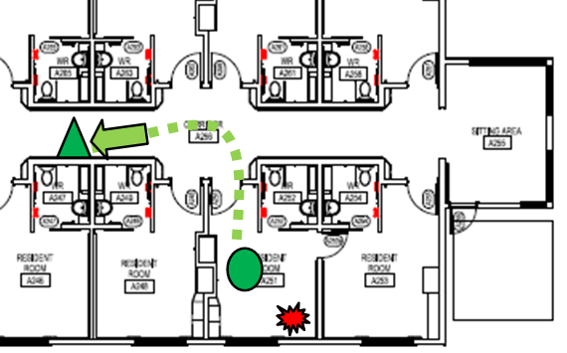
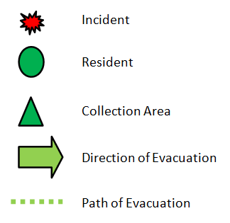
Types of Evacuation Under Code Green
Partial evacuation: Residents are moved within the building to an area away from the immediate threat. This can be out of a room to another, beyond the nearest fire door, to another area of the building etc. This is usually triggered by an initial threat (e.g. fire, hazardous materials spill, disruptive or violent individual) and can be triggered by any staff member observing a threat to safety in the area.

Slide 4
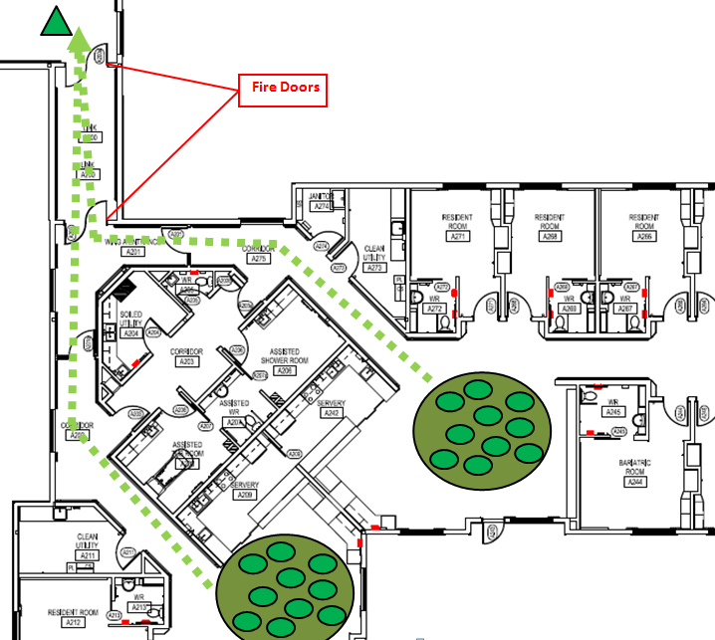
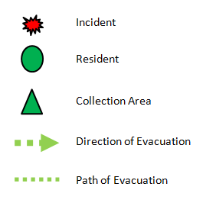
Types of Evacuation Under Code Green
Horizontal Evacuation: This is the movement of residents horizontally out of one area to another beyond the nearest fire door or to the exterior of the building. Usually called by the Incident Commander or area Team Leader.

Slide 5
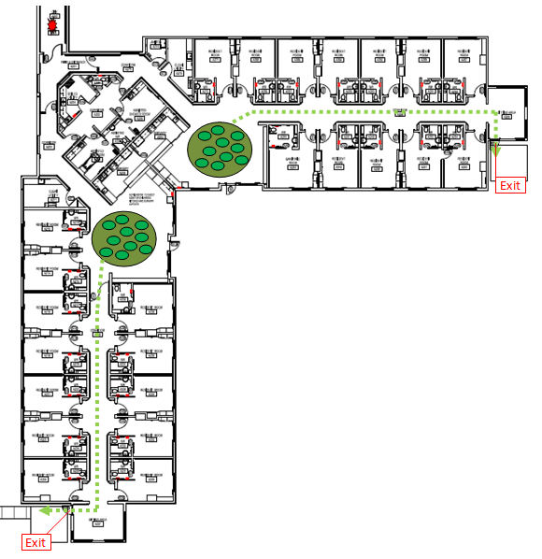
Types of Evacuation Under Code Green
Total Evacuation: This is an evacuation of all residents to the exterior of the building. This is usually called by the Incident Commander in conjunction with first responders.

Slide 6
What to do if Code Green is Called
If not engaged in other emergency duties, return to your neighbourhood once notified of “Code Green”
Neighbourhood team leaders will initiate a roll call to account for their staff and other staff in the neighbourhood
Undertake any additional assignments including accounting for residents
Begin preparing residents for evacuation including
Transfer residents to wheel chairs
Gather blankets if safe to do so
Gather other materials eg. charts, oxygen tanks, census etc. required for evacuation
Evacuate residents as directed/as necessary

Slide 7
Things To Remember
You are free to evacuate residents, visitors and yourself from an area if it becomes unsafe
Move residents in order of most to least ambulatory
Follow the Incident Commanders instructions regarding evacuation, if provided
Account for residents before and after evacuation of an area
When evacuating an area remember to activate red door tags – place in up position if room is vacant, leave down if occupied
Use wheel chairs to evacuate residents if they are available and time permits

Slide 8
Know Your Facility
You know the location of:
Facility Exit Doors and Pathways
Site evacuation maps
Blue Door lock override pull stations (in some sites)
Predetermined gathering, collection or muster stations
Wheel chairs and other evacuation aids
Site All Hazards/Emergency Plan

Slide 9
Where to go to learn more!
Site All Hazards/Emergency Plan
Supervisor
www.healthpei.ca/scr/ltc
Contact Emergency Health and Planning Services

Slide 10
Thank you!

