Slide 1

Management Essentials
LEADING WITH IMPACT - YOUR PROFESSIONAL IMPACT AND DEVELOPMENT PLAN (PIDP)
Notes:
Welcome, everyone
Today we’re diving into the refreshed Professional Impact and Development Plan (PIDP).
Whether you are leading operational teams, corporate functions, or clinical units, this session is designed to give you clarity on how to align personal growth with our broader organizational priorities.
We ask that you please mute your mic when you are not speaking, and turn on your camera if you can.
Send a thumbs up if you completed the PIDP last fiscal.
Good news is that we have greatly reduced the PIDP Form from 16 pages to 4 and have streamlined the approach to make it easier and more attainable for you to complete.

Slide 2

Review refreshed PIDP Form
Outcomes for Today
Setting SMART Goals
Introduction to LEADS
The PIDP Cycle
Notes:
By the end of our time together today, you will:
Understand the updated PIDP form structure.
Be equipped to write effective, actionable SMART goals.
Explore how our values and the LEADS framework integrate into day-to-day leadership.
Walk away with a clear roadmap of the annual PIDP cycle.

Slide 3

Leading with High Impact
Aligns Daily Effort
Seamlessly connects individual focus areas with Health PEI’s broader strategic priorities.
Fosters Accountability
Establishes fair, evidence-based evaluations based on transparent metrics.
Cultivates Excellence
Grows individual capabilities grounded in values and the LEADS leadership framework.
Notes:
Why the refreshed PIDP? It’s not just paperwork—it’s a dynamic tool built on three pillars:
Aligns Daily Effort: Connects individual work directly to Health PEI’s strategic priorities so everyone sees their impact.
Fosters Accountability: Establishes clear, objective evaluation standards across the board.
Cultivates Excellence: Supports continuous growth rooted in our organizational values and the LEADS leadership framework.

Slide 4
Annual PIDP Cycle: Follow the Fiscal Year
Q1
Q2 & Q3
Q4
Q4
Q1
Annual Planning
Check Ins
Annual Review
Close Out
Start New Cycle
Complete Parts 1 & 3, Review Values-Led LEADS Capabilities
(For 2026-27 complete by Sept. 30, for future years complete in April)
Discuss progress. Note successes and document unforeseen barriers.
(For 2026-27 Oct 2026 - March 2027, for future years throughout the fiscal year)
Reflect on learning goals. Managers assign achievement ratings for goals and LEADS behaviours.
(End of fiscal year, March-April 2027)
Add signatures to verify reviews and send completed forms to Employee Services Assistance (ESA) for filing in PeopleSoft
(April 2027)
Build on goals, Pivot for new priorities, Look at opportunities and complete Parts 1 & 3
(April 2027)
Notes:
Q1/Annual Planning: Complete Parts 1 & 3, review LEADS capabilities. (Note the transitional timeline: for 2026–27, complete by Sept 30; in future years, this will align with April)
Q2 & Q3: Ongoing check-ins to track progress, celebrate wins, and adjust for unexpected barriers.
Q4: Annual review, ratings, final closeout, and submitting forms to ESA for PeopleSoft filing.

Slide 5

PIDP Form
Core Components:
Employee Information
Part 1: Strategic Goals
Part 2: Values-Led LEAD Capabilities
Part 3: Personal Development & Learning Plan
Part 4: Annual Review – Employee & Manager Feedback
Notes:
PIDP Form is broken into key functional parts.

Slide 6
PIDP Parameters
Who Participates?
Time Commitments
All excluded managers, directors, executive directors and chief executives, including those without direct reports, are required to complete a PIDP.
Note: Unionized staff continue using the Performance Development Plan via the Staff Resource Centre.
Employees:
Annual Planning: Block 40 minutes to determine objectives, draft SMART goals, and map your learning activities
Annual Review: Block 40 minutes to complete the annual review
Managers:
Annual Planning: Block 15 minutes to review the plan
Annual Review: Block 25 minutes for the annual review.
Notes:
Applies to all excluded managers, directors, executive directors, and chief executives—including those without direct reports.
Note: Unionized staff will continue using the standard Performance Development Plan via the Staff Resource Centre.
Employees: ~40 mins for Annual Planning (drafting goals/learning activities) and ~40 mins for the Annual Review.
Managers: ~15 mins to review plans in Q1 and ~25 mins for the final Q4 review conversation.

Slide 7
Understanding Achievement Ratings
Exceptional (E) | Demonstrates consistently outstanding performance with a level of quality, impact, or contribution well beyond what is expected.
Exceeds (X) | Demonstrates strong, reliable performance that is above expected standards.
Delivers (D) | Demonstrates consistent, dependable performance that meets expected standards.
Developing (DV) | Demonstrates partial or inconsistent performance relative to expected standards.
Did Not Deliver (N) | Performance does not meet expected standards.
Notes:
D (delivers) is what we aim for.
Exceptional (E): Outstanding quality and impact well beyond expectations.
Exceeds (X): Strong, reliable work consistently above standards.
Delivers (D): Dependable, solid performance meeting all expected standards.
Developing (DV): Inconsistent or partial achievement—indicates growth area.
Did Not Deliver (N): Performance fell below expected standards.
Originally came from McLean and Co as a best practice.

Slide 8
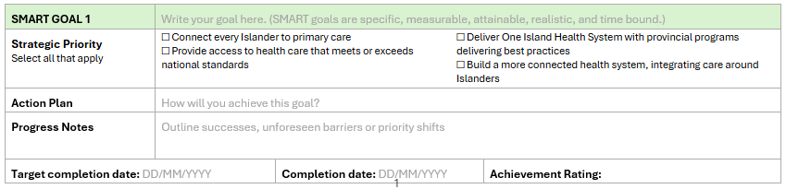
PIDP FORM
Part 1: Strategic Goals

Slide 9
SMART Goals
Specific
Measurable
Attainable
Relevant
Time Bound
Plan effectively with specific targets in mind.
Track your progress and reevaluate along the way.
Set realistic goals that are challenging but achievable.
Ensure the goal serves a relevant purpose.
Specify a deadline, monitor progress and reevaluate.
Notes:
Good goals give clear direction and make evaluation at year-end objective and fair.

Slide 10
SMART Goal Makeover
I will work to improve employee well-being on my clinical unit because everyone is feeling very burned out.
Establish a healthy, safe, and high-performing workplace by launching two social connection programs reaching 50 participants for staff across all portfolios by March 2028.
Strengths
  Specific action - launching social connection programs
  Measurable (2 distinct programs with 50 participants)
  Attainable
  Relevant to goals of organization
  Timebound
Major Pitfalls:
  No specific action
  No defined measure of success
  No concrete target dates

Slide 11
Breakout Rooms: Goal Architect
Scenario
Draft & Map
(7 Min)
Peer Feedback
Your group has been tasked with opening a new skin‑check clinic aimed at early detection and education of skin cancer.
Draft one SMART goal relevant to the scenario. Highlight which of the 4 strategic priorities it supports.
Elect a spokesperson to pitch your goal to the larger group for feedback on improving SMART goal.

Slide 12
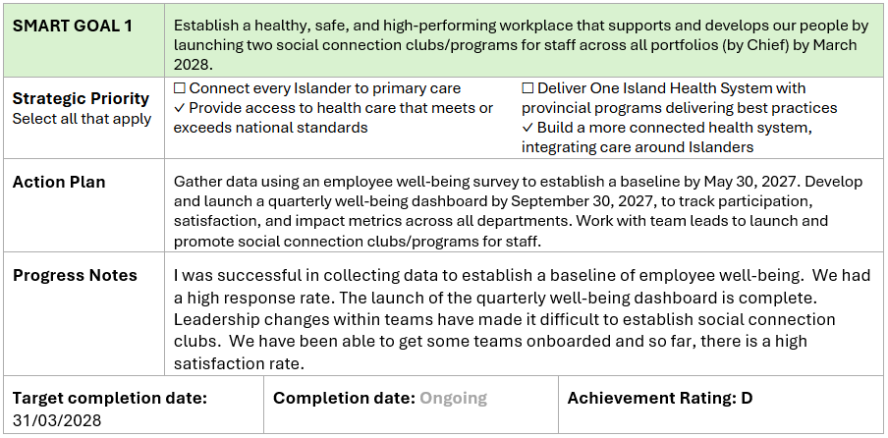
PIDP FORM
Part 1: Strategic Goals
Notes:
Fully complete form – What it looks like at end of year.

Slide 13
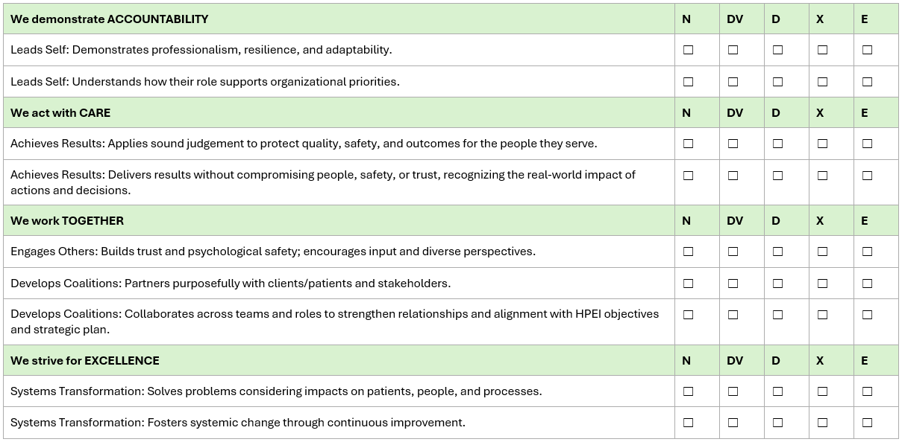
PIDP FORM
Part 2: Values-Led LEADS Capabilities
Notes:
Our work is guided by our core values: Accountability, Care, Together, Excellence.
Grounded in these values are the 5 LEADS capabilities: Lead Self, Engage Others, Achieve Results, Develop Coalitions, and Systems Transformation.

Slide 14
Our Values
Core beliefs at Health PEI
We demonstrate accountability.
We are collectively and individually responsible for achieving our vision, and we answer to all Islanders.
We act with care.
We care for Islanders, for each other, and the quality, safety, and outcomes of our work and its impacts on individuals and communities.
We work together.
We build trusting relationships to achieve common goals. Our patients come first. We listen to and involve patients, communities and staff in the services we deliver and the challenges we solve.
We strive for excellence.
We hold ourselves to national standards, measure and report transparently, and continually learn and improve. We accept feedback, sharing our progress and our shortfalls.
Accountability
Care
Togther
Excellence
4

Slide 15
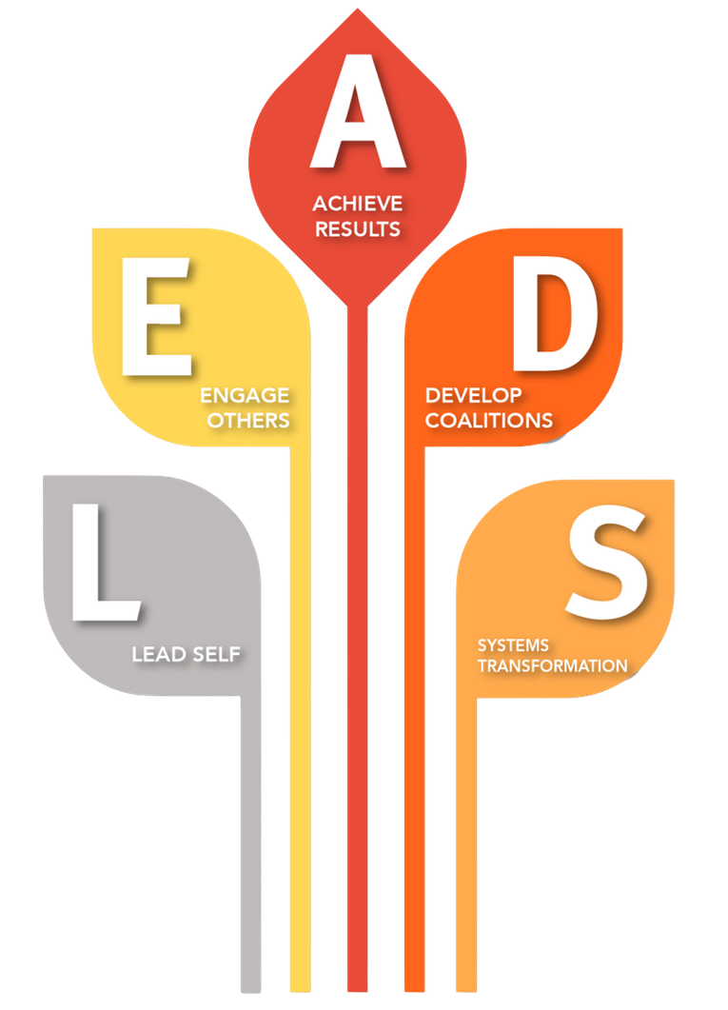
LEADS in a Caring Environment
1. Lead Self
Self-directed leaders are self-aware, guide themselves, develop themselves, & demonstrate character.
​
2. Engage Others​
Relational leaders communicate effectively, facilitate collaboration, foster development of others , & nurture healthy workplace cultures.​
​
3. Achieve Results​
Outcome-oriented leaders bring vision to life, strategically align decisions, take action and create conditions for implementation, & assess and improve.​
​
4. Develop Coalitions​
Collaborative leaders purposefully build coalitions of diverse voices, demonstrate a commitment to service, mobilize knowledge, & navigate socio-political environments.
​
5. Shapes Systems
Systems oriented leaders practice adaptive systems thinking, create conditions for continuous learning and innovation, orient themselves strategically to the future, & champion and contribute to sustainable change
0

Slide 16
LEADS in a Caring Environment
1. Lead Self
Self-directed leaders are self-aware, guide themselves, develop themselves, & demonstrate character.
​
2. Engage Others​
Relational leaders communicate effectively, facilitate collaboration, foster development of others , & nurture healthy workplace cultures.​
​
3. Achieve Results​
Outcome-oriented leaders bring vision to life, strategically align decisions, take action and create conditions for implementation, & assess and improve.​
​
4. Develop Coalitions​
Collaborative leaders purposefully build coalitions of diverse voices, demonstrate a commitment to service, mobilize knowledge, & navigate socio-political environments.
​
5. Shapes Systems
Systems oriented leaders practice adaptive systems thinking, create conditions for continuous learning and innovation, orient themselves strategically to the future, & champion and contribute to sustainable change.

Slide 17
Breakout Rooms: LEADS Activity
The Scenario (10 Minutes)
Instructions
Identify which two LEADS capabilities are most critical to deploy here to navigate the change successfully.
Translate those capabilities into concrete behaviours.
E.g., What does “Engage Others” look like in practice during a major systems shift? How does a leader model “Shape Systems while keeping day-to-day operations safe and stable?
Your department is shifting to a new centralized patient scheduling platform. Staff are highly resistant and anxious about workflow changes.
Notes:
Put LEADS in the chat.

Slide 18
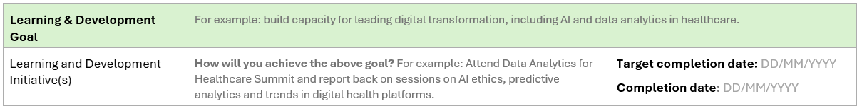
PIDP FORM
Part 3: Personal Development & Learning
Notes:
Fully complete form at end of year

Slide 19

Personal Development
& Learning
Leaders should use a mix of learning methods, not just formal courses, to build skills in practical, flexible ways. A varied approach ensures development is relevant, applied, and sustained.
Examples of initiatives to include:
  Formal learning: courses, workshops, conferences, certifications
  Coaching or mentoring: mentor check-ins, peer coaching
  On‑the‑job learning: stretch assignments, job shadowing
  Self‑learning: books, webinars, podcasts
  Real‑world practice: leading projects, piloting new processes

Slide 20
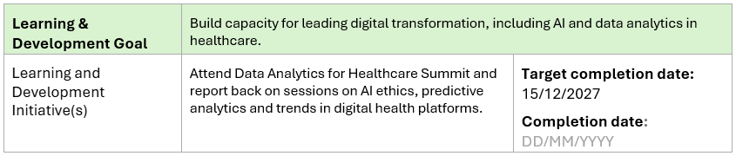
PIDP FORM
Part 3: Personal Development & Learning
Notes:
Fully complete

Slide 21
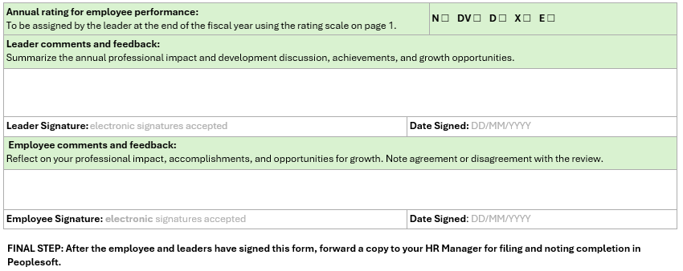
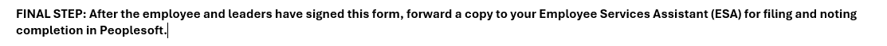
PIDP FORM
Part 4: Annual Review
Notes:
mphasize that conversations throughout Q2/Q3 make this Q4 review smooth with no surprises. Both leader and employee document comments and sign off electronically before submitting to ESA for PeopleSoft filing.

Slide 22
Annual PIDP Cycle: Follow the Fiscal Year
Q1
Q2 & Q3
Q4
Q4
Q1
Annual Planning
Check Ins
Annual Review
Close Out
Start New Cycle
Complete Parts 1 & 3, Review Values-Led LEADS Capabilities
(For 2026-27 complete by Sept. 30, for future years complete in April)
Discuss progress. Note successes and document unforeseen barriers.
(For 2026-27 Oct 2026 - March 2027, for future years throughout the fiscal year)
Reflect on learning goals. Managers assign achievement ratings for goals and LEADS behaviours.
(End of fiscal year, March-April 2027)
Add signatures to verify reviews and send completed forms to Employee Services Assistance (ESA) for filing in PeopleSoft
(April 2027)
Build on goals, Pivot for new priorities, Look at opportunities and complete Parts 1 & 3
(April 2027)

Slide 23
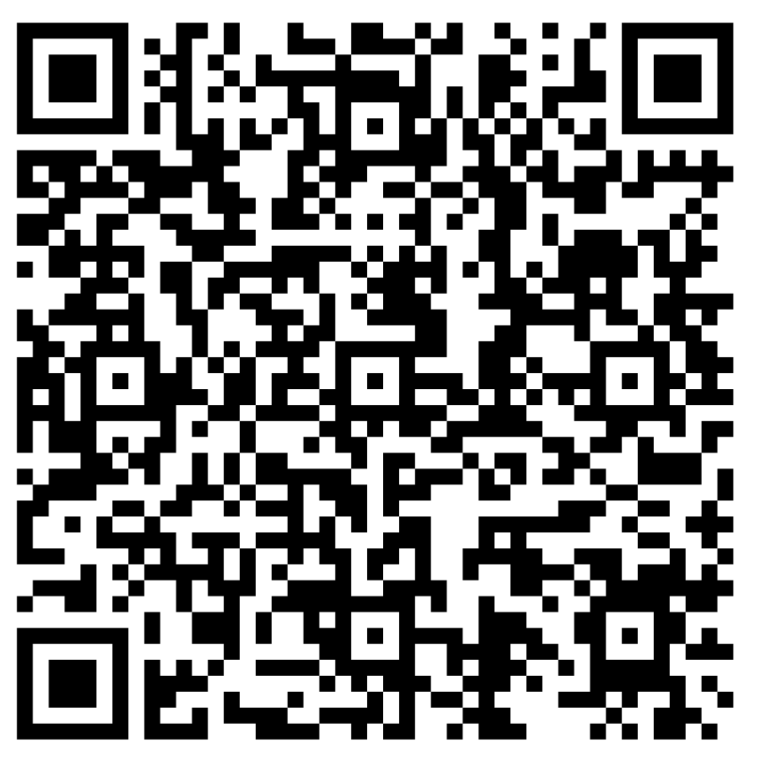
How was this training?
Notes:
We ask that everyone complete the training evaluation before we move into wrapping up. Scan QR Code.

Slide 24
Questions & Support
Contact:
HR Coordinator/Manager or
Learning & Development Consultants (learning@ihis.org)

Slide 25
Thank You
Next Session
September 9 – Leadership Townhall @ Credit Union Place

