Slide 1
Which type of difficult conversation are you most likely to avoid or delay?
Talking about poor performance
Addressing conflict between team members
Disagreeing with an executive director or chief executive
Managing resistance to change
Other (specify in the chat)
Welcome to Difficult Conversations. We will start momentarily. In the meantime:
ANSWER IN
THE CHAT

Slide 2

Difficult Conversations
To get the most out of today please
Turn on your camera
Focus on the session
Use the reactions in the toolbar
Use the chat panel or raise your hand to speak
Mute yourself when not talking
Take part in the discussions
June Morrow
Learning & Development Consultant
Notes:
Welcome. Thank you for coming today. Introduce self and Olivia.
Housekeeping:
Please avoid the temptation to check your emails or do work while in this webinar
If you have questions, put them in the chat or raise your hand, I may have to defer to the end
I will be sharing the deck
If you are here today, you will also get a certificate of completion

Slide 3
Give a👍if you've ever delayed
a conversation because you hoped
the issue would resolve itself.

Slide 4
Give a👍if you had a difficult conversation in the past three months
or have one coming up.
Notes:
Seems like that’s a lot of us, so let’s get started so we can learn some tools to help us navigate such challenging situations.

Slide 5
OBJECTIVES
Learn how to approach difficult conversations with more confidence.
How to prepare for the conversation
Behaviours that can create barriers in difficult conversations
A practical four-step model to navigate difficult conversations more effectively
Notes:
Today we’ll be drawing
on a bit of information from Harvard Manage Mentor’s course Difficult Interactions,
information from MacLean & Company which is a global HR consultancy and training provider,
the Courage to Connect, which is Health PEI’s in-house training for staff and managers on how to provide respectful feedback and navigate conflict.

Slide 6
Which type of difficult conversation are you most likely to avoid or delay?
Talking about poor performance
Addressing conflict between team members
Disagreeing with an executive director or chief executive
Managing resistance to change
Other (specify in the chat)
Notes:
Review some answers

Slide 7

It’s human nature to want to avoid difficult conversation.
The conversation could ruin my relationship with that person.
They might get emotional. They might even cry!
I have no idea how to approach this conversation!
Maybe someone else will handle it.
Notes:
Difficult conversations can feel uncomfortable, stressful, and intimidating.
Managers face unique communication challenges because they represent the organization, not just themselves.
Leaders cannot avoid awkward or difficult conversations; addressing challenging issues is part of the role. Managers may need to discuss:
Performance concerns
Inappropriate comments or behavior
Employee complaints
Sensitive topics such as harassment or substance abuse
Ignoring issues on the team means not fully meeting leadership responsibilities.
Common reasons for avoiding these conversations include:
Feeling unprepared or lacking confidence
Not knowing what to say
Uncertainty about how the other person will react
People often anticipate the worst possible outcome.
While difficult conversations can sometimes be challenging, they can also strengthen relationships when handled effectively.

Slide 8
Give a👍 if you've had a difficult conversation that strengthened
a relationship afterward.

Slide 9
Give a ❤️ if you've ever experienced someone reacting much better than expected during a difficult conversation.
Notes:
One way to

Slide 10
When handled well, difficult conversations build trust and safety.
Notes:
One of the hallmarks of high-performing teams.
To handle difficult conversations well, it helps to have a structure.

Slide 11
Think of difficult conversations as a three-step process
Initiate and direct
Follow up
Prepare
Notes:
A structured three-step process can make difficult conversations more manageable.
Step 1: Prepare Plan for the conversation in advance.
Reflect on why the conversation is necessary.
Step 2: Define the Purpose Clarify what outcome or result you hope to achieve.
Identify the key message you want to communicate.
Step 3: Initiate and Guide the Conversation Start the conversation with a clear purpose.
Keep the discussion focused
Direct the conversation toward resolving the issue or achieving the goal.
Understanding each step in more detail can help managers handle difficult conversations more effectively.

Slide 12
RAISE YOUR HAND OR ANSWER IN THE CHAT
What are some things to consider when preparing for a difficult conversation?
Notes:
The first step is preparation.

Slide 13
Questions to answer before a difficult conversation:
Do I need to have this conversation? What will happen if I don’t have this conversation?
What is the purpose of this conversation?
What outcome do I want from this conversation?
What are the facts? Are any pieces missing?
What, if any, assumptions am I making about the other person or the situation?
What might be going on for the other person?
Do I need to involve Human Resources?

Slide 14

Involve your HR Manager for
Any performance management, or event that requires investigation, that may lead to any level of discipline.
Managing requests or situations related to family status, religious, or other non-illness/injury related workplace
Addressing employee relations or conflict issues
Handling harassment, discrimination, or respectful workplace concerns
Responding to attendance or leave concerns
Interpreting collective agreements, employment contracts, or HR policies
Addressing organizational restructuring, layoffs, or position changes
Have HR present when…
Notes:
If you don’t know who you’re HR manager is, you can connect with Olivia or I and we can let you know.

Slide 15
Involve Occupational Health Safety and Wellness
workplace accommodations
return to work issues
workplace violence
Injury prevention
safety-related employee concerns
Notes:
Is anyone from OHS&W here? Any others? Find contact for OHSW on SRC or reach out to your HR manager and they can connect you.
Let’s look at some other facets of preparation.

Slide 16
TRUE OR FALSE?
Spending time clarifying your goal
is just another way of putting off the conversation.
Answer: False
Notes:
Answer: False
Without preparation, conversations often drift, become emotional, or focus on the wrong issue—this is why having a goal and a structure around the conversation is so important.

Slide 17
TRUE OR FALSE?
If I'm feeling emotional, I should wait until I feel no emotion at all before having a difficult conversation.
Answer: False-ish
Notes:
Answer: False-ish
You should be regulated and professional, but not wait for perfect emotional conditions.

Slide 18
TRUE OR FALSE?
I should create a script before a difficult conversation.
Answer: False-ish
Notes:
Answer: False-ish
Memorizing a detailed script is usually ineffective and can backfire.
It is impossible to predict exactly how another person will react during a conversation.
Difficult conversations require flexibility rather than a rigid, rehearsed response.
When discussing sensitive topics, careful preparation is essential. Failing to think through the impact of your words can be careless and unproductive.
Consider the potential consequences of what you say before the conversation begins. Plan your opening remarks carefully.
Think in advance about how to communicate key messages respectfully and clearly.
Focus on preparing your approach and main points rather than memorizing a script.

Slide 19
Set up the Conversation
Select an appropriate timing.
Book an in-person (or virtual on-camera for remote teams) meeting.
Provide the purpose but don’t get into specifics.
Notes:
Once you have decided a conversation is necessary and clarified your goals, the next step is to set up the conversation.
Choose the right timing
Consider carefully when the conversation should take place.
Avoid scheduling the meeting while emotions are running high. If you are upset, give yourself time to calm down before meeting.
Allow the other person enough time to prepare as well.
Meet in person when possible
Important conversations are best handled face-to-face: in person or for virtual teams by video
While some topics can wait for a regular one-on-one meeting, avoid catching people off guard.
As the importance or sensitivity of the topic increases, it becomes more appropriate to schedule a dedicated meeting.
Inform the other person in advance
Provide context about the purpose of the meeting whenever possible.
Avoid vague messages such as “We need to talk,” which can create unnecessary anxiety or “Unacceptable Performance in Q1” put someone on the defensive.
Be thoughtful about the level of detail you provide
In some situations, it is appropriate to be specific about the topic. This is especially true when the person is already aware of the issue being discussed.
In others you might just want to put them at ease, that it’s a discussion and not a punishment.
Here’s an example

Slide 20
You need to have a private conversation with an employee about their personal hygiene.
Which of the following is the most appropriate way to tell the employee you need to meet with them?
Several people have complained about your hygiene. We need to talk about it this afternoon.
I'd like to schedule a private meeting with you to discuss a workplace matter that I'd like your help addressing. Is there a time today that works for you?
Don't worry, you're not in trouble, but there's something awkward I need to talk to you about.
I need to discuss a personal issue that has been affecting the team. Please meet me in my office at 2:00 PM.
ANSWER IN THE CHAT
Notes:
Option B is the best choice because it is professional, respectful, and preserves the employee's dignity.
It provides enough information to avoid surprising them with an urgent meeting while not revealing sensitive details in advance or causing unnecessary anxiety. The actual feedback should be delivered privately and directly during the conversation.
Why the others are less effective:
A: Shares sensitive information prematurely and may make the employee feel embarrassed or defensive.
C: Suggests the topic is awkward before the conversation even begins, which can increase anxiety.
D: Implies there is a personal problem affecting others and may cause the employee to speculate or feel singled out before the meeting.

Slide 21
The D.E.A.R. Model
D
Describe
Why you are meeting.
The behaviour or situation
as observed.
“I noticed you missed two deadlines…”
E
Empathize
Acknowledge the human challenge.
“I imagine things might have been overwhelming…”
A
Ask
Get their perspective
“Can you walk me through what’s been going on?”
R
Respond
Explain the impact and explore
“Here’s how this impacts things. What can we do moving forward?”
Notes:
We’ve prepared and new we are about to have a difficult conversation. How do we do this?
The DEAR framework, which gives us four steps to structure the conversation: describe, empathize, ask, and respond
Following these steps makes it easier to
organize what you want to say
maintain ownership of the conversation.
ensure the other person feels respected and heard
end with a mutually satisfactory outcome
The DEAR Model
starts with neutrally describing why you are meeting
Showing empathy for the other person
Asking them for more information about why they are behaving the way they are and really listening to their response
And then responding with the impacts of their behaviour and exploring ways to move forward
It’s a process that open rooms for dialogue which builds rather than dismantles relationships

Slide 22
RAISE YOUR HAND OR ANSWER IN THE CHAT
WHAT DO YOU NOTICE ABOUT THESE STATEMENTS?
I noticed you’ve been late three times this week.
I noticed you often have your camera off during meetings.
I noticed that you are using the old referral form instead of the new one.
I noticed that you told us to change the process but then told us to revert to the original process.
On a few occasions recently, I noticed a strong body odour.
Notes:
The first step is to describe the situation or behaviour as observed. Here’s some examples.

Slide 23
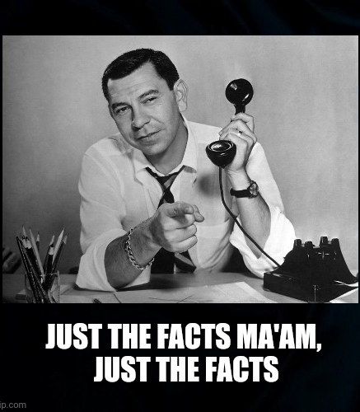
The D.E.A.R. Model
DESCRIBE
The behaviour or situation as observed
Start with “I noticed” rather than “You…”
Be specific. What? When? Where?
Use concrete language.
Remain emotionally neutral.
Focus on the behavior and not the assumed intent.

Slide 24
ANSWER IN THE CHAT
As you are giving an update on a controversial policy change, one of your staff rolls his eyes. What is the staff doing?
Rolling his eyes
Disagreeing with what you are saying.
Being disrespectful.
Trying to get others on the team to agree with him.
All of the above.
Answer: A
Notes:
The challenge is it is really easy for us to fill in the blanks between the facts with assumptions.
For example: As you are giving an update on a controversial policy change, one of your staff rolls his eyes. What is the staff doing?
Answer A.
The rest are assumptions.
You don’t know the person’s intent until you ask them.
Maybe they had some thing in their eye.

Slide 25
The D.E.A.R. Model
Describe Don’t Assume
Notes:
Another example:
June’s colleague asked me why I always looked like I disagreed with him when I spoke. Was he not explaining himself well? No. that’s how her face looks when she’s thinking.
Avoid assuming. When we do, we make… in the words of my sixth grade teacher.

Slide 26
The D.E.A.R. Model
Describe Don’t Assume

Slide 27
The D.E.A.R. Model
Describe Don’t Assume

Slide 28
The D.E.A.R. Model
Describe Don’t Assume

Slide 29
The D.E.A.R. Model
D
Describe
Why you are meeting.
The behaviour or situation
as observed.
“I noticed you missed two deadlines…”
E
Empathize
Acknowledge the human challenge.
“I imagine things might have been overwhelming…”
A
Ask
Get their perspective
“Can you walk me through what’s been going on?”
R
Respond
Explain the impact and explore
“Here’s how this impacts things. What can we do moving forward?”
Notes:
The second part of the DEAR model is to show empathy to the other person.

Slide 30
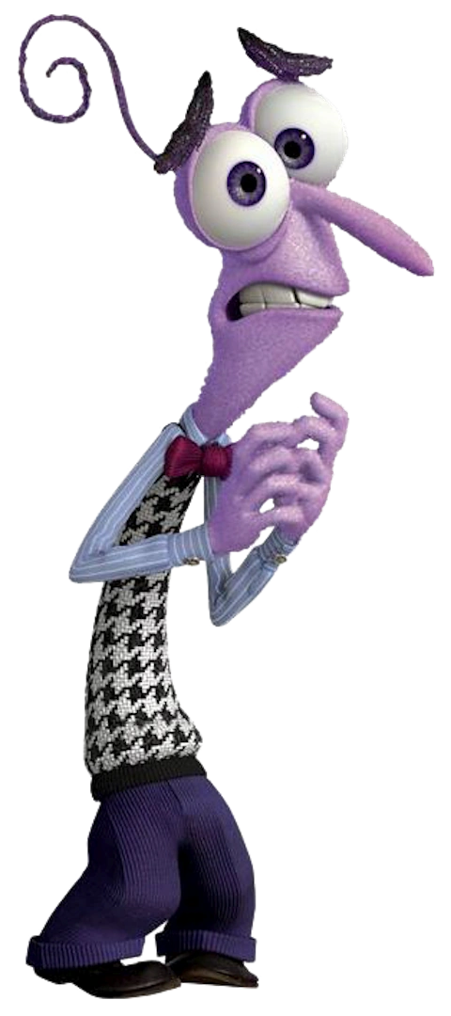

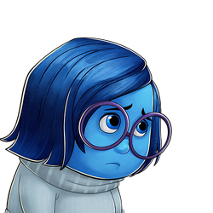
When we don’t communicate with empathy…
Notes:
People become defensive, angry, scared, sad or they shut down.
When you’re in these states it’s not easy to think clearly, and it’s also not easy to have empathy for others.

Slide 31
ANSWER IN THE CHAT
EMPATHY BLOCKERS
What behaviours send the message “I don’t care.”

Slide 32
Empathy Blockers
Labelling:
you’re an idiot, that was stupid, etc.
Blaming/Accusing: it’s your fault
Shaming:
you should have
Generalizing:
you always/never
Dismissing and minimizing:
it’s not a big deal, get over it, don’t worry
Interrupting:
finishing sentences, not giving people time to get their ideas out
One-upping / hijacking the conversation:
so back to me…
Poor body language:
lack of eye contact, looking away, arms crossed
Notes:
When you’re under stress it’s easy to resort to default behaviours.
Note: lack of eye contact, body language can also be a challenge for neurodivergent people as can one-upping the conversation.
Differences can also be cultural – eye contact is okay in some cultures between all people, in others it isn’t. It’s important to be aware of these.
What word starts a lot of these sentences?
YOU
Some of you are very good at expressing empathy. For others, it may be more of a challenge.

Slide 33
The D.E.A.R. Model
E
Empathize
Acknowledge the human challenge.
“I imagine things might have been overwhelming…”
PUT YOURSELF IN
THEIR SHOES
EXPRESS EMPATHY
I understand things are very busy…
I can see the situation has been frustrating…
I know there have been lots of changes lately and I understand this can be difficult…
I know it can be challenging when…
Notes:
A good empathy statement acknowledges that the conversation may be difficult, shows respect for the other person's perspective, and signals that you're approaching the discussion collaboratively rather than judgmentally.

Slide 34
The D.E.A.R. Model
D
Describe
Why you are meeting.
The behaviour or situation
as observed.
“I noticed you missed two deadlines…”
E
Empathize
Acknowledge the human challenge.
“I imagine things might have been overwhelming…”
A
Ask
Get their perspective
“Can you walk me through what’s been going on?”
R
Respond
Explain the impact and explore
“Here’s how this impacts things. What can we do moving forward?”
Notes:
The third step is to Ask. Why are things happening the way they are.
Now is your time to learn more

Slide 35

Most people act the way they do because:
They don’t know any better.
They don’t realize their behaviour is impacting others to the extent it is.
They are responding from a place of fear, hurt or unmet needs.
Notes:
Very few people do things maliciously.
When you ask you may find that what you think is happening isn’t actually happening at all.
June’s story
I was once a new hire on a team where everybody on the team was giving me the cold shoulder. I’d try to be friendly and they’d just grumble back. Whenever the manager praised me in front of them, I could feel them shuddering. I couldn’t understand what was going on. So I asked one of the team members, I’m getting the feeling people don’t like me here. No one makes small talk and when I ask questions they are terse with the answers. What’s going on? It turned out, I’d just been hired into this position permanently where all of my teammates were on contract and had been so for six years or more! Some of them had applied for my job. Furthermore, the manager, who was later removed from her position, was bullying some of the staff while treating me like her golden child.

Slide 36
The D.E.A.R. Model
A
Ask
Get their perspective
“Can you walk me through what’s been going on?”
Be curious. Seek first to understand.
What’s going on?
Walk me through your thinking.
Help me understand what’s happening?
What’s your perspective?
Notes:
Seek to understand the issue from the other person’s point of view before explaining yours.
Ask them to share their perspective/story/point of view, and step back.
Do not jump in with your own opinion or version of the “truth.”
Step is to let the employee speak and make them feel heard.
Here is where you really want to use those active listening skills. .

Slide 37

The D.E.A.R. Model
A
Ask
Get their perspective
“Can you walk me through what’s been going on?”
Active Listening
Give your full attention
Avoid interrupting
Listen for feelings
Pay attention to body language and tone
Paraphrase
Ask powerful questions
Notes:
Many of us listen to reply rather than to understand.
The key behaviors of active listening are:
Providing your undivided attention
no looking at your phone or checking incoming emails even if the other person is in a remote location.
truly listening, instead of thinking of what you’re going to say next or jutting in with your thoughts
Listen for feelings
Paying attention to both their spoken words and body language. Body language can give you more context than words sometimes. Are they stressed? Scared? Regretful? etc.
Especially in the remote world we live in where a lot of conversations take place virtually, you need to make a conscious effort to attempt to read the other person’s body language
Listening to the employee’s message, and then paraphrasing back to them what you heard.
Paraphrasing
Confirming that you’ve understood the meaning behind their words
allows you to keep the conversation constructive if the other party is framing their ideas negatively.
Asking questions that promote discovery and Insight

Slide 38
ACTIVELY LISTENING
Sarah, who is normally very dependable, has missed three deadlines in the past two weeks.
What facts did you hear?
What emotions did you hear?
What important detail could be missed if you focused only on the missed deadlines?
If you were Sarah's manager, what would be a good active listening response?
Notes:
Get a volunteer to play the manager.
Sarah who is normally very dependable has missed three deadlines in the past two weeks. You ask her what’s going on? Here’s how she responds.
Sarah,
“This is so embarrassing. I’m just like overwhelmed. For the past month, I've been working late covering for Jamie’s while she’s on leave. I've tried to keep everything moving, but there just haven't been enough hours in the day. And I know you said, “Don’t work overtime, come to me if things are hard” but I don’t want to bother you – I know you’re overworked too. And a part of me says I can do this. I’m so sorry. I’ll try harder. If you want, I can take on more work to make it up to you."
Now Sarah reacted rather calmly but what if the person isn’t calm or doesn’t give you information?

Slide 39
TRUE OR FALSE?
If the person goes silent, I should talk more to reduce the awkwardness.
False
Notes:
Be silent as well and wait.
Some people need to time to think things through.
Some people shut down when emotionally overwhelmed.
If it’s been a few minutes and they still haven’t spoken. You can observe that. I notice that you are very quiet right now. What’s going on?
Or you can offer to come back to the conversation once they’ve had some time to think about it.

Slide 40
TRUE OR FALSE?
If the person starts crying, I should compliment them to try to make them feel better.
False
Notes:
False.
Pause and give them a moment.
Stay calm and don't rush to fill the silence.
Offer tissues if appropriate.
Acknowledge the emotion.
"I can see this is upsetting."
"I know this is difficult to hear.“
Check what they need.
"Would you like a few minutes?"
"Would it help to take a short break and continue?“
Refocus on support and next steps.
"Let's talk about what success looks like and how I can help you get there."

Slide 41
TRUE OR FALSE?
If the person gets angry, I should match their tone to bridge our emotions.
False
Notes:
False.
Stay calm and don't match their emotion.
Keep your voice steady and professional.
Avoid arguing or becoming defensive.
Listen before responding.
Let them explain their perspective.
Sometimes anger comes from feeling surprised, misunderstood, or unheard.
Acknowledge without necessarily agreeing.
"I can see you're frustrated."
"I understand you see the situation differently.“
Bring the discussion back to facts and examples.
Use specific behaviors, outcomes, and observations.
Set boundaries if needed.
"I'm happy to continue discussing this, but we need to speak respectfully to each other."
If the conversation becomes abusive or threatening, end it and reconvene later with HR support if appropriate.

Slide 42
When dealing with strong emotions
The biggest mistake managers make is either:
Becoming so uncomfortable that they abandon the feedback, or
Becoming so focused on the feedback that they ignore the person's emotional reaction.
The best approach is to do acknowledge the emotion and continue the conversation respectfully.
A useful phrase is:
"I can see this is difficult, and I appreciate you staying in the conversation. The reason I'm raising this is because it's important, and I'd like us to focus together on what happens next."
Notes:
To sum up

Slide 43
The D.E.A.R. Model
D
Describe
Why you are meeting.
The behaviour or situation
as observed.
“I noticed you missed two deadlines…”
E
Empathize
Acknowledge the human challenge.
“I imagine things might have been overwhelming…”
A
Ask
Get their perspective
“Can you walk me through what’s been going on?”
R
Respond
Explain the impact and explore
“Here’s how this impacts things. What can we do moving forward?”
Notes:
The final step of the DEAR model is to respond.
Notice all the things that go before this
describing objectively why you hare having this conversation,
putting yourself in the other person’s shoes and
acknowledging what might be going on for them,
asking for their perspective first.
Only then, do you share your side of things.
At this point, hopefully the other person hopefully is feeling heard and respected in their situation, is going to be more open to exploring a way forward.

Slide 44
The D.E.A.R. Model
R
Respond
Explain the impact and explore
“Here’s how this impacts things. What can we do moving forward?”
1. Explain the impact
How does the behaviour, situation affect your work, the team, your team’s goals, etc.
Keep this simple (don’t lay on the blame)
2. Explore solutions
Ask for help in finding a solution
  What steps might you take moving forward?
  How can we better support each other to wrap things up?
  How might we meet both of our needs in this situation?
  What would help you remember…?
Notes:
Let’s say, for example, you are dealing with a tardiness issue. At the beginning of the conversation you tell the employee that you have noticed you have been arriving late to their shifts a few times over the past two weeks.
You acknowledge that sometimes life can make it challenging to get to work on time. Then you ask them what’s going on?
The employee profusely apologizes for being late and explains their parent’s caregiver has quit and they are juggling caregiving responsibilities with their siblings while they hire a new caregiver and that they feel terrible for keeping their colleagues waiting but it has been just been so challenging on a personal and a professional level, etc.
Empathise with their situation. Yes, that can be challenging. Then you want to explain the impact. The challenge here is it keeps colleagues you are replacing late waiting for them to take over, which is not fair to them and also disrupts the work with patients.
Notice it’s very factual and again we’ve shown empathy. Then you can then direct the conversation to what can be done to address the situation and help them find solutions.
This is where you might ask for their help in finding a solution. What might you be able to do while you find a new caregiver?
In other situations you might ask questions such as:
How can we better support each other to wrap things up?
How might we meet both of our needs in this situation?
What would help you remember…?

Slide 45
The D.E.A.R. Model
R
Respond
Summarize &
book follow-up
3. Wrap up the conversation
If the conversation is with an employee, ask them to summarize the discussion and agreed-upon actions in their own words to ensure they understand
If the conversation is with a colleague or higher-level leader, summarize the discussion and agreed-upon actions and ensure you have them right
Ask “Is there anything further I can do to support you?”
Book follow-up meetings after the conversation if needed to check-in
Notes:
A lot of times, the conversation is a starting point to require further action or behavior change so you need to conclude the conversation with a wrap-up or a later follow-up.

Slide 46
One person plays:
One person plays Emily.
  If you are playing Emily, come up with a backstory for why you are behaving the way you are
One person plays the manager.
  Use the DEAR framework:
    D Describe the purpose.
    E Show empathy for Emily's experience.
    A Ask for her perspective on what's happening.
    R Respond and work together on solutions.
One person play the observer.
After the role play share:
  Did the manager clearly state the purpose?
  Did they demonstrate empathy before problem-solving?
  Did they ask open-ended questions?
  Was the final solution collaborative?
  What was one thing done well?
  What was one improvement opportunity?
One person plays:
Emily
One person acts as:
Observer
BREAKOUTS
Emily is an experienced nurse, 5 years from retirement, who has recently become withdrawn and short with colleagues. Several coworkers have expressed concerns about her communication style.
You are her manager.
You need to have a conversation regarding the concerns while maintaining the relationship.
Notes:
In groups of three 10 minutes
Emily
Manager's Goal
Use the DEAR framework:
D Describe the purpose.
E Show empathy for Emily's experience.
A Ask for her perspective on what's happening.
R Respond and work together on solutions.
Observer Questions
Did the manager clearly state the purpose?
Did they demonstrate empathy before problem-solving?
Did they ask open-ended questions?
Was the final solution collaborative?
What was one thing done well?
What was one improvement opportunity?

Slide 47
OBJECTIVES
Learn how to approach difficult conversations with more confidence.
How to prepare for the conversation
Behaviours that can create barriers in difficult conversations
The DEAR model: a practical four-step model to navigate difficult conversations more effectively
Notes:
Where we’ve been

Slide 48
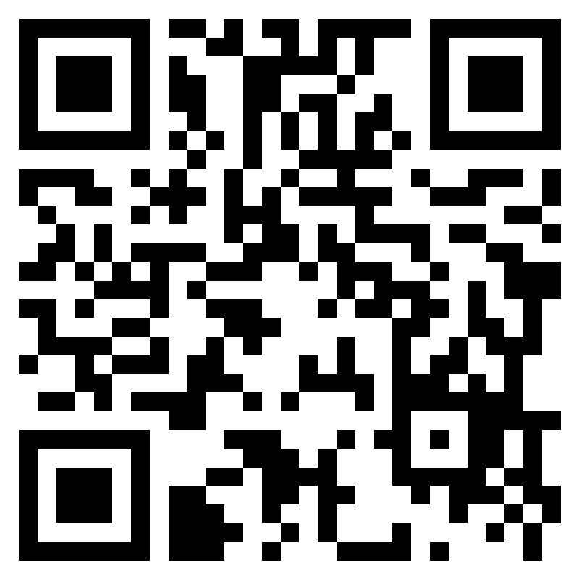

Give us your feedback
Fill out the evaluation form online on your phone using the QR code or the link in the chat
Notes:
https://forms.office.com/r/PAFP6G8Vky
One more thing to share before we conclude.
Fill out this form and then we’ll wrap up.

Slide 49
The quality of our relationships is often determined by the quality of the conversations we're willing to have.
Identify one conversation you've been putting off and commit to taking the next step this week.
Notes:
As we wrap up today, remember that difficult conversations are rarely easy, but avoiding them often makes things harder. Active listening, empathy, and clarity won't eliminate discomfort, but they will help you navigate it with confidence.
Before you leave, identify one conversation you've been putting off and commit to taking the next step this week. The measure of today's workshop won't be what we discussed here—it's the conversation you choose to have afterward."

Slide 50

Join us for our next Harvard ManageMentor webinar
TEAM MANAGEMENT
Tuesday, Aug. 4 from 10:30-noon
Notes:
Sign up for Team Management:
https://events.teams.microsoft.com/event/b6afea20-c130-4a60-8ad6-c23d0d6f25f4@c86b09eb-7ad7-4aa2-9d82-98a45bd8ec19

