Slide 1
Welcome!
As you wait for the webinar to begin, please answer in the chat…
How do you feel about receiving performance reviews?
Ugh! Can we skip it?
Okay, but I’d rather not have one.
Meh. It’s part of being employed.
I could warm up to it with the right manager.
Excited. I can’t wait to hear about where I’m doing well and discuss training plans to improve!

Slide 2
How to Conduct Performance Reviews
Notes:
Materials come from HMM Course – Performance Appraisals, as well as materials from MacLean & Company, previous research done at Health PEI, sources.

Slide 3
Answer in the chat
How do you feel about receiving performance reviews?
Ugh! Can we skip it?
Okay, but let’s get this over fast.
Meh. It’s part of being employed… just another box to tick.
I could warm up to it with the right manager.
Excited. I can’t wait to hear about where I’m doing well and discuss how I can improve!
Notes:
Many people look at performance reviews as something that is more punishment than partnership.
As a manager you have an opportunity to change this. Performance reviews can be instrumental not just for your team, but in a person’s career and in their life.

Slide 4
Common Challenges with Performance Reviews
Give a
if you relate.
Lack of time for meaningful reviews
Keeping ongoing documentation of performance
Measuring performance objectively
Providing feedback across multiple disciplines and shifts
Balancing empathy with accountability
Addressing poor performance
Keeping high performers and average performers motivated
Lack of time for meaningful coaching and feedback throughout the year
Notes:
Managers and supervisors in health care often face unique challenges when conducting performance reviews because they operate in high-pressure environments where patient care, staffing shortages, regulatory requirements, and team dynamics all intersect.
Give a thumbs up if you can relate to any of these.
Here are some of the most common challenges:
1. Lack of Time for Meaningful Reviews
Health care leaders are often managing patient care issues, staffing concerns, scheduling, and administrative responsibilities. As a result:
Performance reviews may be delayed or rushed.
Managers may have little time to gather examples and feedback.
Conversations can become a "check-the-box" exercise rather than a meaningful development discussion.
The policy says “Supervisors will implement the policy within their area of responsibility.”
2. Limited Ongoing Documentation
Many supervisors struggle to keep detailed records of staff performance throughout the year.
This can lead to:
Reliance on recent events rather than the full review period ("recency bias").
Difficulty providing specific examples of performance.
Employees questioning the fairness or accuracy of ratings.
3. Measuring Performance Objectively
Health care performance is often complex and not easily captured by metrics alone.
Managers may struggle with:
Evaluating teamwork and collaboration.
Assessing patient-centred care behaviours.
Balancing quantitative metrics with qualitative contributions.
Accounting for factors outside the employee's control.
4. Managing Unionized Environments
In unionized settings, supervisors may need to ensure:
Reviews are consistent with collective agreements.
Documentation is objective and defensible.
Performance concerns are addressed appropriately.
Processes are applied consistently across employees.
This can make managers cautious about providing candid feedback.
5. Providing Feedback Across Multiple Disciplines and Shifts
Health care managers often supervise employees whom they do not observe regularly.
Examples include:
Staff working evenings, nights, or weekends.
Multiple clinical disciplines with different roles.
Large teams spread across departments.
Managers may rely heavily on feedback from charge nurses, team leads, physicians, or peers, which can create challenges around consistency and accuracy.
6. Balancing empathy with accountability
Many health care employees continue to experience high workloads and emotional strain.
Managers may find it difficult to:
Separate performance concerns from burnout symptoms.
Discuss attendance or productivity issues sensitively.
Balance empathy with accountability.
Support employee well-being while maintaining service standards.
7. Addressing Performance Issues with Clinical Staff
Providing constructive feedback can be particularly challenging when:
The employee is highly experienced or clinically skilled.
Poor performance involves behaviours rather than technical competence.
Managers worry about damaging relationships or morale.
There are concerns about patient safety implications.
There is a shortage of that skill.
Difficult conversations are often avoided until review time, making the discussion more challenging.
May disagree with feedback.
Often require clear improvement plans and ongoing coaching.
Can trigger difficult conversations and conflict.
8. Dealing with High Performers and average performers
Both ends of the performance spectrum can present challenges:
High performers
Expect meaningful recognition and growth opportunities.
May become disengaged if reviews feel generic.
9. Creating Meaningful Development Plans
Managers may struggle with:
Identifying realistic growth opportunities.
Finding time for coaching and follow-up.
Aligning employee goals with organizational priorities.
Supporting career development when staffing shortages limit opportunities.

Slide 5
Where we’re going
The benefits of performance review
The performance review process
  Tracking performance
  Preparing for the review
  Conducting the review

Slide 6
Answer in the chat or raise your hand
What are the benefits of doing performance reviews?

Slide 7
Benefits
Employee
Manager
Organization
Clarity of expectations
Recognition of strengths
and achievements
Ask for/receive support
Identify strengths and gaps
Career advancement
Preserve a record of impact
Improved relationships
Build engagement
Clarify goals and roles
Increase productivity
Improve team moral
Spot issues before they escalate
Become better leaders
Reveal training needs
Help with succession planning
Protect against legal action
Preserve record for transferring information
Accreditation

Slide 8
Policies and Collective Agreements
Policy
Employee Performance & Development Policy
Employees should complete a Performance & Development Plan with their supervisor at least once a year (PDP or PIDP)
Collective Agreements
Probationary Period Review
When employee gets their first permanent position with Health PEI
Trial Period Review
When an employee moves from one position in Health PEI to another
All forms are available on the Performance Development Toolkit
on the Staff Resource Centre (SRC).
Notes:
Performance Development Plan for Employee form and related resources available in the Performance Development Toolkit on the SRC:
https://src.healthpei.ca/performance-development-toolkit
Excluded leaders should use the PIDP

Slide 9

Performance reviews are more than a meeting.

Slide 10
Performance Review Process
Set expectations
Review key responsibilities (tasks & goals)
Discuss required competencies
Determine developmental needs
Planning
Ongoing feedback and documentation
Formal performance appraisal
Ongoing feedback and documentation
Check-ins and meetings
Coaching
Recognition
Document performance
Determine developmental needs
Formal Performance Appraisal
Measure goals and evaluate performance
Coaching & recognition
Notes:
Initial planning meeting.
At the start of the cycle, managers meet with each of their direct reports to set goals and review key job responsibilities. They discuss what behaviors and competencies are important for getting the job done, how performance will be measured, and what constitutes success.
Ongoing feedback and coaching. Throughout the time frame, managers help their direct reports improve their performance by providing feedback and coaching. Employees should always know what their managers think of their performance and should not be caught off guard by a negative review.
Formal performance appraisal. At the end of the cycle, managers evaluate how well their direct reports have performed. They complete performance appraisal forms and meet with each team member to review the assessment. Once this discussion is over, the process begins again, with another planning meeting to discuss the goals and expectations for the following year.

Slide 11
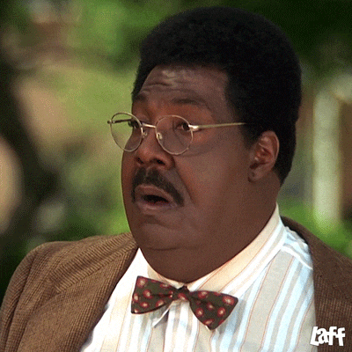
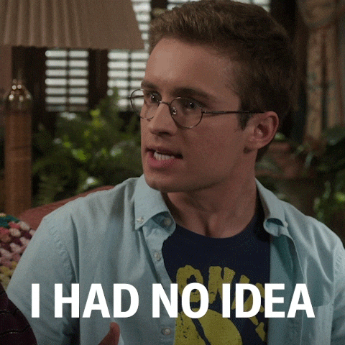

What you don’t want…

Slide 12
Which stage has the biggest impact on performance?
Planning
Ongoing feedback and coaching
Formal performance reviews
B
Research shows that continuous feedback, regular coaching conversations, performance development and forward-looking conversations have a more significant impact on performance that performance reviews.
Notes:
During the 2010s, many organizations shifted from traditional annual performance appraisals toward:
Continuous feedback
Regular coaching conversations
Performance development
Frequent check-ins instead of annual reviews
This trend was supported by research from Brandon Hall Group, Deloitte, CEB/Gartner, and others.

Slide 13
True or False
High performers don’t need that much attention in the planning and feedback stages of the cycle.
False
All employees, regardless of their level of performance, need attention at all phases of the cycle.
Notes:
Stars – if not appreciated will look elsewhere or stop performing
Acceptable employees – need to know if you are investing time in them, you are investing it in everyone
Employees needing growth – benefit from encouragement and support

Slide 14
When it comes to performance reviews, ABP stands for…
Ask Boss Permission
Always Be Preparing
Abductor Pollicis Brevis
Another Boring Process
All Points Bulletin
B
Always Be Preparing

Slide 15
ABP: Set Clear Expectations

Slide 16
Planning Meeting
Purpose
Ensure that the employee understands the tasks, goals and capabilities required of them
Tools
Job description
Strategic plan, departmental plan, operational needs, policies, etc.
The appropriate review form
Notes:
Performance Development Plan for Employees
Performance Impact and Development Form for Leaders (includes Leaders Learning & Development Plan)
Probationary Employee Assessment Form
Trial Period Assessment Form

Slide 17
You will be evaluating goals, competencies and tasks.
Goal:
The outcome you want to achieve
Ex. Reduce hospital infections by 20% this year.
Competency:
The knowledge and skills required to perform effectively.
Ex. Infection prevention and control
Task:
The specific activities performed to achieve the goal.
Ex. Perform hand hygiene, use PPE, follow sterilization protocols
Notes:
Need to be clear about what’s required.
Competencies for excluded people leaders are LEADS: leads self, engages other, achieves results, develops coalitions and shapes systems.
Competencies for staff include
Communication
Working relationships
Adaptability
Work habits
These are all spelled out on the forms.

Slide 18
ABP: Check-ins
Throughout the Year

Slide 19
Answer in the chat
How frequently do you have one-on-one check-ins with your staff?
Weekly or biweekly
Monthly
Quarterly
Only when there is an issue
I don’t have staff
Notes:
How frequently you meet with your team depends a lot on the type of work you do and availability, but best practice is to meet one-on-one at least quarterly – more if they are new to the job.
This means you need to schedule this meetings.

Slide 20
Goal (G), Competency (C) or Task (T)?
Improve patient comfort
Patient-centred care
Maintain a clean and safe environment
Clinical judgement
Check medication orders
Prevent patient falls
Notes:
Improve patient comfort (goal)
Patient-centred care (competency)
Maintain a clean and safe environment (task)
Clinical judgement (competency)
Check medication orders (task)
Prevent patient falls (goal)

Slide 21
High-Quality Conversations
Tie to Health PEI’s mission, vision, values and strategic priorities.
Recognize achievements and strengths
Allow room for discussing challenges and solutions.
Provide clarity and accountability.
Anchor feedback in observable results and behaviours.
Have ample opportunity for the employee to speak.
Mix feedback with coaching.

Slide 22
Coaching (C) or Feedback (F)
I noticed you’ve been late four times in the past two weeks.
What’s been contributing to that?
This is impacting patient coverage.
Our expectations are that you arrive on time.
What might you do to get to work on time?
Notes:
Effective managers use both approaches together.

Slide 23
Combine feedback with coaching
Feedback
Focused on past performance.
A statement delivered by an observer.
One-time.
Coaching
Focused on future performance
Uses questions to help the individual gain insight and find solutions.
Ongoing or over a period of time.

Slide 24
ABP:
Document, Document, Document
Notes:
You’ll want to take notes after each check in.

Slide 25

Document
Answer in the chat or raise your hand
What are some ways to
document staff performance?

Slide 26

ABP: Documentation
Notes from one-on-one and team meetings
Trackers
Reports
Metrics, KPI
Compliments, complaints, testimonials
Emails
Regular updates in review forms
Others?

Slide 27
The Performance Review

Slide 28
Prepare for the meeting
Gather your forms and tools.
The appropriate review form
Employee Performance Self-Reflection Form
Development Discussion Checklist
PIDP Guide (on PIDP SRC page)
Available on SRC Performance Development Toolkit

Slide 29
Prepare for the meeting
Schedule the formal performance conversation.
  Book 45 to 60 minutes without interruption.
  Choose a quiet , neutral location.
  Schedule more challenging meetings after easier ones.
  Put the most challenging meeting at the end of the day.
  Stick to the date (avoid pushing it off).

Slide 30
Prepare for the meeting
Ask the employee to do a self appraisal and come prepared to discuss their achievements, challenges and developmental needs.
  Share:
  Employee Performance Self-Reflection Form
  The relevant form
  Make clear that the purpose is to gain information from their point of view and these are one source you will use to prepare the final performance appraisal
Notes:
Ensure you have enough time to review these

Slide 31
Prepare for the meeting
Review your performance documentation
  Look for performance trends
  Review your employee’s self-assessments and comments
  Consider factors that may have impacted performance

Slide 32
Prepare for the meeting
Evaluate the performance
  Write your appraisal
  Assign ratings

Slide 33
PDP Employee Ratings
Mastering | Skills and behaviors at this level demonstrate the highest level of performance and contribution to the organization’s future success.
Succeeding | Skills and behaviors at this level indicate competent performance. This level of performance should be demonstrated by most employees on a regular basis.
Developing | Skills and behaviors at this level are those that are considered to be in need of enhancement. Performance is below that expected after training and experience. It is important to identify and focus on areas of development.
Notes:
These descriptions are in the forms

Slide 34
PIDP Employee Ratings
Exceptional | Demonstrates consistently outstanding performance with a level of quality, impact, or contribution well beyond what is expected.
Exceeds | Demonstrates strong, reliable performance that is above expected standards.
Delivers | Demonstrates consistent, dependable performance that meets expected standards.
Developing | Demonstrates partial or inconsistent performance relative to expected standards.
Did Not Deliver | Performance does not meet expected standards.
Notes:
These descriptions are in the forms

Slide 35
Break out Groups
Performance Review Calibration
Introduce yourself to your group.
Read the employee profile. We will send this to your group’s chat.
As a group, give the person an overall performance rating of either:
  Mastering
  Succeeding
  Developing
Notes:
Divide into groups of six.
Give each group one of three scenarios. A, B, or C.
10 minutes.

Slide 36
Break out Groups
Performance Review Calibration
Debrief
Three Jordan Smiths.
3-year nurse
10-year nurse with a Masters of Science in Nursing (Dr. Smith)
20-year nurse
Performances listed were identical but listed in a different order.
Notes:
Call on each group (around 10 groups) to put group #and over overall rating in the chat.
Call on spokesperson from three different groups to explain rating.
10 minutes
Instructions: https://www.youtube.com/watch?v=IDrMzEZsbX4&t=88s

Slide 37
Check for Biases
Halo Effect: Letting one strength influence all ratings
Horns Effect: Letting one weakness lower all ratings
Leniency effect: Giving consistently high ratings
Severity bias: Giving consistently low ratings
Notes:
The goal is to be as objective as possible: respond the same way, supported by facts and observations, regardless of who demonstrates the behaviour

Slide 38
Check for Biases
Central Tendency effect: rating most employees average despite actual performance
Recency effect: Allowing recent events or performance to have a greater influence on the appraisal than performance over the entire review period.
Confirmation bias: Looking for or emphasizing information that supports an existing opinion about an employee while overlooking contradictory evidence.
Notes:
The goal is to be as objective as possible: respond the same way, supported by facts and observations, regardless of who demonstrates the behaviour

Slide 39
Name the bias
Everyone on my team is getting a 4 out of 5. They're all doing great!
Answer: Leniency bias
Halo
Horns
Leniency
Severity
Central Tendency
Recency
Confirmation

Slide 40
To be fair, I gave everyone a 3. After all it’s a team effort.
Answer: Central tendency bias
Name
the bias
Halo
Horns
Leniency
Severity
Central Tendency
Recency
Confirmation

Slide 41
I’ve always thought Taylor wasn’t a strong performer and the examples I found confirmed it.
Answer: Confirmation bias
Name
the bias
Halo
Horns
Leniency
Severity
Central Tendency
Recency
Confirmation

Slide 42
Jordan did well until March when she missed an important deadline that impacted a key project. My director is still upset about that so I gave her lower ratings in every category.
Answer: Recency effect
Name
the bias
Halo
Horns
Leniency
Severity
Central Tendency
Recency
Confirmation

Slide 43
Priya consistently exceeds expectations with clients and I think she is a good fit for a future leadership position, so I rated her highly in every category.
Answer: Halo effect
Name
the bias
Halo
Horns
Leniency
Severity
Central Tendency
Recency
Confirmation

Slide 44
Prepare for the meeting
Prioritize your feedback
What are the most important things you want the employee to take from the conversation?
  Think about what you would like them to continue, start and stop
  Distill into one sentence each
Gather the facts – be descriptive about the performance.
Notes:
Focus on the issues that really matter (avoid firehosing with long list of everything wrong)
People are limited in the amount of information they can remember, particularly from an hour-long meeting that may include sensitive content.
Distill down to a sentence the key idea you want the employee to be able to recall after your performance appraisal meeting; for example “Be open-minded to solutions suggested by coworkers and customers.”
Share the worksheet

Slide 45

Conduct the Performance Review
It’s a two-way conversation.
Notes:
It’s a two-way conversation. You are directing.

Slide 46
Conduct the Performance Review
Set the tone
Practice active listening.
Use a positive, collaborative and forward-looking tone.
Keep it solution-focused. Work together to solve problems.
Notes:
Practice Active Listening
Listen carefully and paraphrase key points to confirm understanding.
Pay attention to emotions, concerns, and workplace dynamics that may be influencing performance.
Set a Positive, Collaborative Tone
Frame the discussion as a partnership focused on growth and success.
Use inclusive language such as we and us.
Sit beside the employee, if possible, to encourage collaboration.

Slide 47
Answer in the chat
Which of the following demonstrates active listening?
Interrupting to offer solutions
Taking notes without responding
Paraphrasing what the employee has said to confirm understanding
Having a conversation while walking
Answer C
Checking in on your understanding, helps employees feel heard and respected while helping you be more objective.

Slide 48
Which statement best reflects the intended tone of a performance appraisal?
I'm going to explain where you've gone wrong.
HR says we need to do this meeting so here we are.
Please listen while I explain your rating.
Let's review your accomplishments, discuss any challenges, and identify how I can support your success.
Answer in the chat
Answer D.
It sets it up as a collaboration.

Slide 49
Which question best supports problem-solving?
Why didn't you do better?
Whose fault was it?
What might you do to overcome this challenge?
Do you think this matters?
Answer in the chat
Answer C
This coaching approach respects the employee’s abilities.

Slide 50
Conduct the Performance Review
Explain the purpose of the meeting and agenda.
We’re going to review your accomplishments over the past year, discuss any challenges you encountered, and look at how I can support your continued success.
We’re going to review your accomplishments over the past year, discuss any challenges you encountered, and look at how I can support your continued success.”
Notes:
Explain the Purpose and Agenda
Open by restating the purpose of the meeting.
Outline how the discussion will flow and emphasize two-way communication.
For example: “We’re going to review your accomplishments over the past year, discuss any challenges you encountered, and look at how I can support your continued success.”

Slide 51
Conduct the Performance Review
Explain the purpose of the meeting and agenda.
Ask the employee to share their self assessment.
We’re going to review your accomplishments over the past year, discuss any challenges you encountered, and look at how I can support your continued success.”
Thanks for sharing your assessment.
I’ve read it and I’d like to hear from you – how are things going?
Notes:
Invite the Employee's Self-Assessment
Ask the employee to share their self-appraisal.
Encourage them to discuss how things have been going from their perspective.
Avoid the tempatation to jump in or defend or immediately get into problem solving.

Slide 52
Conduct the Performance Review
Review progress, accomplishments, goals and competencies
  Go through the form together. For each section:
    Recognize successes and strengths
Notes:
Review Accomplishments, Goals, and Competencies
Discuss progress toward goals.
Review competencies, strengths, and key achievements.
Recognize successes and contributions throughout the year.

Slide 53
TRUE OR FALSE
When recognizing strengths and successes you should use broad adjectives rather than specific examples to build the employee’s self esteem.
Answer in the chat
FALSE
Specific examples are more memorable, meaningful, and encourage repeat behaviour.
Notes:
Use facts and concrete examples to recognize strengths and successes
The more specific the feedback, the more likely the employee will be able to repeat—and even improve on—those behaviors.

Slide 54
Conduct the Performance Review
Review progress, accomplishments, goals and competencies
  Go through the form together. For each section:
    Recognize successes and strengths
    Discuss challenges and barriers
Notes:
Review Accomplishments, Goals, and Competencies
Discuss progress toward goals.
Review competencies, strengths, and key achievements.
Recognize successes and contributions throughout the year.

Slide 55
TRUE OR FALSE
When an employee shares a challenge that is affecting their performance, the manager should explore the barrier, listen actively, and work with the employee to identify possible solutions and supports.
Answer in the chat
TRUE
What might you do to address this challenge?
Notes:
Encourage the employee to share concerns or obstacles affecting their performance.
Identify factors that may be preventing success.
Work together to identify solutions and improvement opportunities.
Ask action-oriented questions such as, “What might you do to address this challenge?”
Co-create strategies to improve outcomes, workflows, and behaviours.
Discuss what support, adjustments, or resources may be needed.

Slide 56
What is an important responsibility of the manager when barriers to success are identified?
Assign blame.
Discuss supports, resources, and adjustments that may help.
Change the employee's job immediately.
Look for another job yourself.
Answer in the chat
Answer B
Discuss supports, resources and adjustments that might help
I’ll have a discussion with
my director to see what might be changed.
Notes:
Share specific ways you can help the employee overcome barriers and succeed.

Slide 57
Conduct the Performance Review
Review progress, accomplishments, goals and competencies
  Go through the form together. For each section:
    Recognize successes and strengths
    Discuss challenges and barriers
    Be clear on areas that need improvement
Notes:
This is where the DEAR Method of difficult feedback can be helpful

Slide 58
Answer in the chat
When giving difficult feedback,
the acronym DEAR stands for:
Discuss, Explain, Agree, Reflect
Describe, Empathize, Ask, Respond
Define, Evaluate, Act, Review
Decide, Engage, Analyze, Report
ANSWER: B

Slide 59
The D.E.A.R. Model
D
Describe
The behaviour as observed.
“I noticed you missed two deadlines…”
E
Empathize
Acknowledge the human challenge.
“I imagine things might have been overwhelming…”
A
Ask
Get their perspective
“Can you walk me through what’s been going on?”
R
Respond
Explain the impact and explore
“Here’s how this impacts things. What can we do moving forward?”

Slide 60
The D.E.A.R. Model
D
Describe
The behaviour as observed.
“I noticed you missed two deadlines…”
Be very specific.
Go back to your documentation.
Keep it about the performance not the person.
“I noticed…”

Slide 61
For Subpar Performance
E
Empathize
Acknowledge the human challenge.
“I imagine things might have been overwhelming…”
Did the employee:
Misunderstand expectations or priorities, putting time and effort into the wrong tasks?
Lack training or the required knowledge or skills to carry out the job?
Did I:
Articulate your expectations or provide clear direction
Provide adequate assistance, resources, or training
Motivate the person to excel and build their self confidence —for example, by praising good performance
Notes:
For subpar performance, try to identify the factors that prevented the employee from being successful.
Ask yourself:
Did the employee misunderstand expectations or instructions?
Did they lack the required knowledge or skills to carry out the job?
Was the person confused about priorities, putting time and effort into the wrong tasks?
Consider how you may have contributed to or interfered with your employee’s performance.
Did you:
Articulate your expectations or provide clear direction
Provide adequate assistance, resources, or training
Motivate the person to excel
Build the employee’s self-confidence—for example, by neglecting to praise good performance or by delivering overly harsh criticism

Slide 62
For Subpar Performance
A
Ask
Get their perspective
“Can you walk me through what’s been going on?”
Check your assumptions.
Practice active listening.
Notes:
For subpar performance, try to identify the factors that prevented the employee from being successful.
Ask yourself:
Did the employee misunderstand expectations or instructions?
Did they lack the required knowledge or skills to carry out the job?
Was the person confused about priorities, putting time and effort into the wrong tasks?
Consider how you may have contributed to or interfered with your employee’s performance.
Did you:
Articulate your expectations or provide clear direction
Provide adequate assistance, resources, or training
Motivate the person to excel
Build the employee’s self-confidence—for example, by neglecting to praise good performance or by delivering overly harsh criticism

Slide 63
For Subpar Performance
R
Respond
Explain the impact and explore
“Here’s how this impacts things. What can we do moving forward?”
When an employee is not meeting expectations,
they need to know:
The expectations
That they aren’t meeting them
That they will need to meet them soon
What supports are available

Slide 64
But what if their performance is really, really bad… in multiple areas?
Contact your HR Manager to discuss a Performance Improvement Plan.
Notes:
a formal document and structured process used to help a struggling worker meet job expectations within a set time. It lists specific performance problems, clear goals, support resources, and consequences if goals are missed.
The form is on the SRC Performance Development Toolkit but again, reach out to your HR Manager.

Slide 65
Conduct the Performance Review
Confirm expectations and next steps. Reiterate your availability for coaching and support.
Ask the employee to write their final comments (if required) and sign the form.
Sign the form and send to your Employee Services Assistant (ESA) for filing on People Soft.
Document the conversation.
Schedule follow-up discussions/check-ins.
Notes:
Confirm Expectations and Next Steps
Summarize the key discussion points.
Ensure mutual understanding of expectations, action items, and development goals.
Address and document any areas of disagreement.

Slide 66
Next Steps
Review the appropriate forms for your staff.
Set up meetings to discuss expectations/plans.
  PIDP annual plans due Sept. 30
Set up processes to document performance.
Time block
in your calendar

Slide 67
Management Essentials
LEAD with Impact
Thursday, August 20, 9-10:30
Online (link in chat)
Notes:
Management Essentials - Lead with Impact

Slide 68
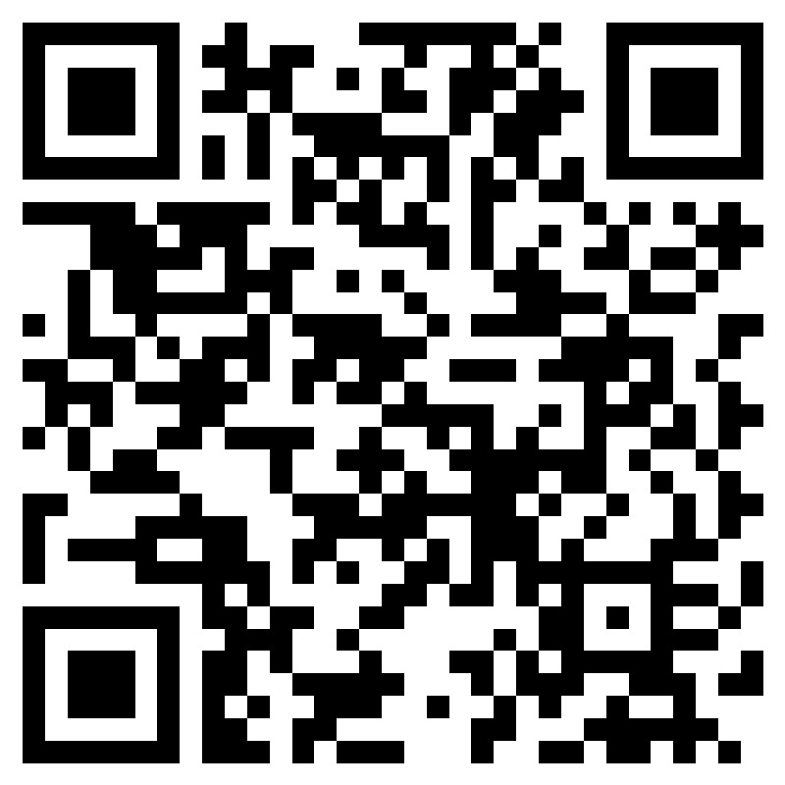
Evaluation
Please help us document our performance by taking a quick moment to fill out the evaluation form. (Link is in the chat.)
Notes:
https://forms.cloud.microsoft/r/Ezx4XuwfAT

Slide 69
Questions

