Slide 1


Documentation
Client Identification
Updated Dec 2024

Slide 2
What is Documentation?
Documentation means to give written information that is proof or support of something that has been done or observed.
  A medical record is the record of all care that is provided. If it is not recorded, it did not happen.
  If it is recorded incorrectly, it happened incorrectly.
Documentation provides a clear picture of the status of the resident, the actions of the nursing staff, and the patient outcomes.
Ensure you are documenting on the correct resident, using Health PEI Client Identification process.

Slide 3
Health PEI Policy:
Client Identification
All health care providers, in partnership with the client and their family/partner in care are required to confirm a client’s identity using two client identifiers during their first encounter.
The RN verifies the identity using the MRN and date of birth on health card with the CIS printed label and the InterRai-HC assessment with the Resident and/or Substitute Decision maker.
Once verified visual recognition/photo can be used as an identifier

Slide 4
Ongoing Client Identifiers in LTC – Photos
  Photo identifiers must include the date it was taken and be labeled with the client’s name, date of birth and MRN
  Photo identifiers must be retaken every year, or when a client’s appearance has changed
  The photo identifiers must be attached to Care Plans, Medication profile and/or their room if appropriate.
  Evacuation Tags must be prepared in advance and placed on the resident during evacuation.

Slide 5
Client with the same names
Client health records must be flagged with a Same Name Alert when clients are admitted to a care area with the same first and last names.
  In Long-Term Care: use the client’s middle name to differentiate the people who have the same name
  For same or similar name – the Chart must have a sticker indicating name alert

Slide 6

PSMS – Reporting Errors
If an error in client identification does occur then it must be reported as per HPEI Patient Safety Incident Reporting and Management Policy.

Slide 7
What is focus charting?
Focus charting:
  reflects nursing care that is provided to a resident based on observations, concerns and strengths, which have been identified by staff, in collaboration with resident and family
  provides a framework for promoting holistic and person-centered care
  Improves the quality of documentation

Slide 8
Focus Charting - Advantages
Provides a clear overview picture of resident’s condition
Reduces charting time
Reflects the nursing process
Identifies focus of priority care
Reduces duplication
Promotes nursing assessment and care planning
Simplifies the auditing process

Slide 9
The chart must be:
Legal
Concise and factual
Organized
Provide information that is easily accessible
Accurate
Current
Include all nursing observations, interventions
Include response to interventions
Audited on regular intervals

Slide 10
Charting – 4 parts, all required
Date
Time
Focus
Facts
NOTE: All chart forms require a resident label to be placed on it. The resident label includes the following information: Name, Date of Birth and MRN
DATE | TIME | FOCUS | FACTS
Notes:
All disciplines should be adapting Focus Charting

Slide 11
Focus
A statement that describes what a resident is experiencing
  Actual problem – pain
  Potential problem – risk for altered skin integrity
  Strength – Social interaction
Avoid vague focus
  Shift summary
  Status

Slide 12
Examples of Focus
Activity
Abdominal Pain
Appetite
Appointment
Behavior
Care Plan
Constipation
Elimination
Fall
Fatigue
Fear
Respirations
Family concern
Comfort
Fever
Medication
Mental status
Mobility
Nutrition
Skin integrity
Sleep
Bloodwork/Venipuncture

Slide 13
Subjective Data
This is the nursing part of the health assessment that involves collecting information through communication.
This is the information the resident is telling you and it often describes physical symptoms about how they feel. It can also pertain to certain beliefs, attitudes and perceptions that they may have.

Slide 14
Objective Data
This data is collected through the health professional's observations by seeing, hearing, smelling and touching.
This can include behaviors, actions and information gathered from test measurements or from a physical exam.

Slide 15
Facts – recording in D.A.R.P
Data - subjective and objective assessment
  Describes what you see, hear, and/or what the resident is telling you
Action- interventions
  Describes what you did related to the focus
Response – outcome of your action
  Did intervention work or not work?
Plan –
  What happens next? Update care plan as needed
Notes:
Example pain

Slide 16
General Guidelines for Documentation
Use Person Centered Care language
Select the correct chart and verify the resident’s name
Completed documentation in black or blue ink only. Use red ink for documenting allergies only.
Write the date as Month/Day/Year.
Document using the 24-hour clock
Document clearly, concisely, and legibly with correct spelling. Print if needed.
Chart in an organized, chronological order.
Chart as soon a reasonably possibly and indicate the resident concern, nursing assessment, nursing interventions and resident response.

Slide 17
General Guidelines for Documentation
NOTE: Charting in advance is not permitted
Do not use abbreviations
Be factual and concise
  Describe the event
  Chart facts only
  Document using concise phrases. Complete sentences are not required. Begin each phrase with a capital letter
  Use objective, un-biased, non-judgmental words
  Do not use generalities (i.e. appears, seems or apparently)
  Place quotation marks around subjective descriptions, as quoted by the resident.

Slide 18
Example of DARP focus charting
Date | Time | Focus | Facts
Dec 23/23 | 1600 | Pain | D) Resident complaining of pain to left leg with a rating of
 |  |  | 6/10 and requesting something for pain. A) Resident’s left
 |  |  | leg assessed for Range of Motion and skin condition, both
 |  |  | unremarkable and resident’s stated ‘Oh it is just my arthritis
 |  |  | acting up again.’ Tylenol 650mg po given as per PRN order
 |  |  | R) Resident satisfied with same P) will ressess in one hour
 |  |  | during 4P rounding.---------------------------------- HGoode LPN
Dec 23/23 | 1700 | PRN | D) Resident is resting comfortablely in bed and is now rating
 |  | Response | pain as 3/10. Notified the RN that Tylenol was given and was
 |  |  | effective-----------------------------------------------HGoode LPN

Slide 19
General Guidelines for Documentation
Use Focus Charting Method (Data, Action, Response, & Plan)
Sign all documentation with first initial, full last name and status or professional designation. Ensure your name and designation is legible.
Make alterations/corrections appropriately
  Do not erase, apply correction fluid or correction ribbon to cover an error
  Draw a single line through the error, above it write ME and initial – ME (mistaken entry) is the only acceptable abbreviation
  Write the date/time/correct entry and initial

Slide 20
General Guidelines for Documentation
Ensure each line in the resident’s record is filled
Empty lines left at the bottom of the page should be crossed out with a straight line and there should not be a space left between the end of a chart entry
Sign the last line of each page
If an entry flows to the next page, sign the bottom of the page and continue to the next page. Write date/time/focus and ‘continued’ on the top of the next page in the integrated record. Continue Documentation.
Chart late entries up to 48 hours past the actual event to be charted. Indicate late entries by charting the date/time of entry and include “Late Entry” for date/time of original care observations, then document focus, facts, and sign.

Slide 21
Example of DARP focus charting
Date | Time | Focus | Facts
March 5/24 | 0800 | cough | D) Resident coughing this am and bringing up green sputum
 |  |  | A)LPN HGoode notified.---------------------AMacDonald RCW
March 5/24 | 0900 | respiratory | D) Resident complaining of cough and feeling chilled A) NP
 |  |  | notified of cough, sputum, fever, and chest assessment.
 |  |  | Resident placed on isolation precautions R) Orders received
 |  |  | to obtain a Fluvid swab. -------------------------------BBrown RN
March 5/24 | 0905 | respiratory | Late entry for 0830 D) Writer notified at 0815 regarding
 |  |  | resident’s cough and sputum. A) Vitals taken Temp 38 Resp
 |  |  | 24 Pulse 68 BP 142/84 O2 sat 94% and chest auscultated
 |  |  | for decreased air entry throughout with an expiratory
 |  |  | wheeze in the mid to lower lobe bilat and fine crackles at the
 |  |  | bases bilat. R) RN BBrown notified----------------HGoode LPN
March 5/24 | 1000 | Fluid swab | D) Resident due for Fluvid swab A) Writer collected Fluvid
 |  |  | swab at 0920 as per policy R) Taxi arrived at 0945 to
 |  |  | transport the specimen to the lab P) Will check--BBrown RN

Slide 22
Example of Continued and late DARP –focus charting
Date | Time | Focus | Facts
March 5/24 | 1000 | Fluid swab | Continued - swab results on Cerner in 1 hour ---BBrown RN
March 5/24 | 1130 | Swab result | D) Swab results reveal resident is positive for Covid. A) NP
 |  |  | updated of swab results. R) Orders received QID vitals and
 |  |  | Oxygen via nasal prongs to keep O2 sat greater than 94%.
 |  |  | -------------------------------------------------------------BBrown RN
March 5/24 | 1200 | Family | D) Writer contacted resident’s family to provide an update
 |  | notification | regarding symptoms, positive swab results, and the plan
 |  |  | for care. Family appreciative of phone call and will be in to
 |  |  | visit later today.-----------------------------------------BBrown RN
March 6/24 | 0730 | Family | Late note for March 5/24 at 1700 D) Resident’s family in to
 |  | Isolation | visit and questioning writer about isolation precautions and
 |  | questions | length of time to remain in isolation. A) Explained to family
 |  |  | that resident is to remain in isolation until symptom free
 |  |  | and ok’d by infection control to remove precautions.
 |  |  | Explained that isolation precautions means that all staff and
 |  |  | Visitors are to gown, glove, mask, and use goggles when
 |  |  | entering the room. R) Family satisfied with explanation and
 |  |  | grateful for the care their loved one is receiving -BBrown RN

Slide 23
Care Plan
Review a Resident’s Care Plan
The care plan should be reflective of the actual care needed.

Slide 24
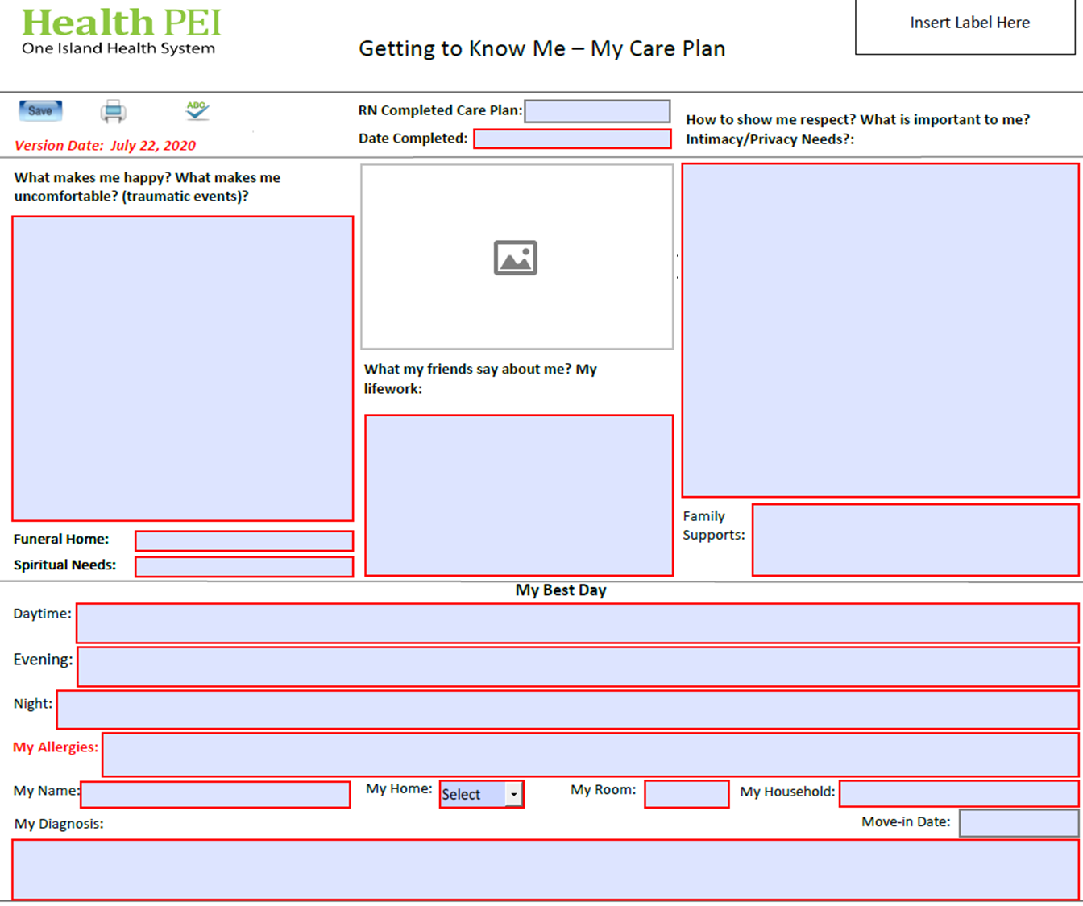

Slide 25
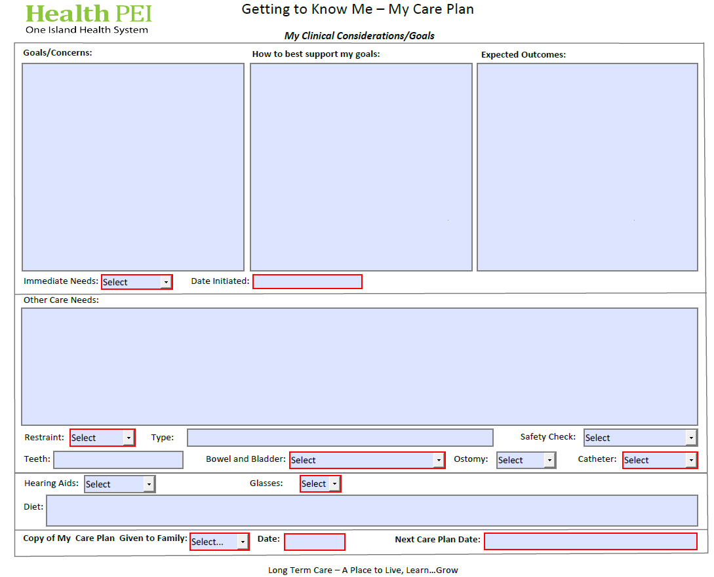
Notes:
The most relevant concerns for the resident should be recorded first in the care plan concerns.

Slide 26
Example of DARP focus charting
Date | Time | Focus | Facts
Nov 26/24 | 0900 | Emotional | D) Resident stating “I think people are looking at me through
 |  | distress | my window” A) Some reassurance provided to the resident
 |  |  | and reported to the RN BBrown. -------------------JRowe RCW
Nov 26/24 | 0905 | Emotional | D) Writer in to assess resident. Resident still stating that
 |  | distress | people are looking at her through the window. A) Writer
 |  |  | checked around the window and looked outside the window
 |  |  | and it was noted that no one was present. Reassurance
 |  |  | provided to resident that there was no one outside the
 |  |  | window and writer closed the blind and the curtains.
 |  |  | R) Resident more at ease at this time. P) Will up date the care
 |  |  | plan ---------------------------------------------------- BBrown RN
Nov 26/24 | 0930 | Care plan | D) Resident’s care plan updated to include information about
 |  | update | closing the blinds and curtains in the resident’s room when
 |  |  | the resident thinks people are outside her window BBrown RN
RN documents that the care plan was updated.

Slide 27

When to Chart – Accreditation Standards
A change in resident’s health status
A safety incident has occurred
A change in the care plan
A change in resident’s medications
When a resident is transitioning to another level of care
All documentation should include service provided, any interventions and/or conversations with resident or family

Slide 28
When and Where to Document – Nursing Notes
Document each time the Physician or Nurse Practitioner is contacted
Document any communications with the resident and/or family
Complete documentation each time the resident leaves and returns to the nursing home and with whom
Document all assessments/interventions as the resident’s status changes
Document any infection control measures, including q-shift assessments while on isolation precautions.
All new move ins require 1 nursing note per shift for the first 48 hours.
RN/LPN may change the frequency of documentation based on resident’s condition and the complexity of his/her health status and should be documented in the Care Plan

Slide 29
When and Where to Document – Flow Sheets
Use the resident care flow sheet for daily routine cares:
  The care provider completes and signs the flow sheet (with initials) during their shift, which is the responsibility of the RCW but can be delegated to nursing designations as needed.
  Signing the flow sheet is confirming that all information in the flow sheet is accurate
  Document Medication Administration in the Medication Administration Record (MAR) is the responsibility of the LPN/RN.
    RCW is responsible to document any treatments they provide (suppositories, or fleets etc) on the MAR - Second hand charting is not acceptible. LPN cannot document "given by RCW"
Notes:
Properly identify all forms in the health record with the resident’s name, Medical Record Number, and Date of Birth
ensure it is somewhere above.

Slide 30
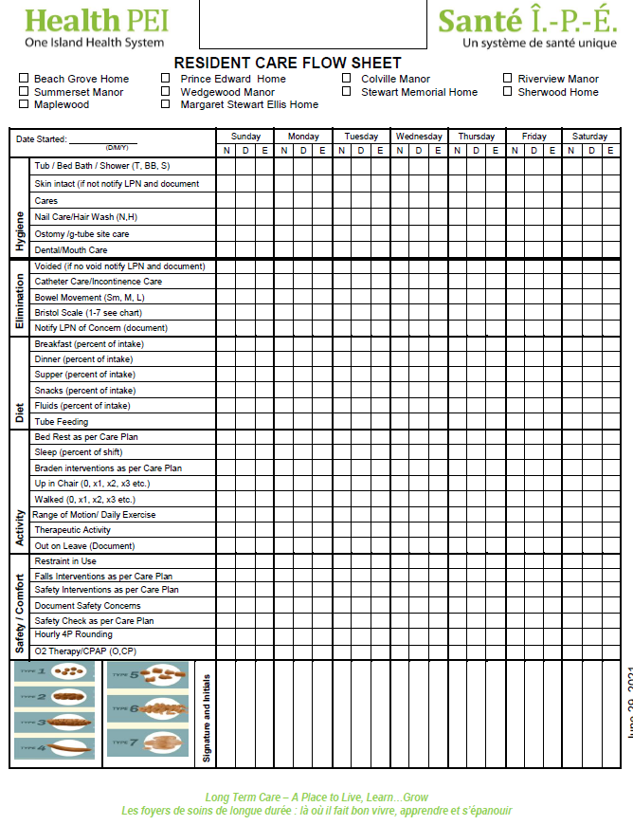

Slide 31
Monthly Charting
Charting requirements should be identified in the clinical goals and considerations of the care plan
Every Care Plan should be individualized for the resident
Interventions could include a timeframe for charting (ie, resident is a high falls risk and is on safety checks, one intervention could be document safety concerns weekly)

Slide 32
Monthly Charting
Monthly Charting Requirements:
    Vital signs – on graphic record
    Braden Scale – on Braden flow sheet
    Weight – on graphic record
    Any other documentation based on immediate needs or concerns as outlined in the care plan.
Notes:
Check to see what homes do the last 3 things -

Slide 33
Monthly Charting requirements – Nursing Notes
There must be one nursing note entry per month for each resident.
Near the end of each month the charts will need to be checked to ensure there is already a nursing note
If the chart does not have a nursing note then one must be written pertaining to the resident’s care plan
If the chart has a nursing note but it only about going out on a pass then this is not sufficient and a nursing note will need to be written pertaining to the resident’s care plan
Notes:
Check on a provincial process

Slide 34
Monitoring Safety Risks
4 P Hourly Rounding will be standard process for all residents to assess and identify safety risks.
It is the RN’s responsibility to ensure all safety concerns are updated in the care plan including all interventions.
All restraints and safety checks need to be documented in the care plan.

Slide 35
Documenting Treatments
All treatments are to be documented on the treatment sheets located in the resident's chart.
  It is the responsibility of the RCW to Initial each section when the treatment has been administered.
  If there are any changes to the area receiving the treatment, then a nursing note must be completed and and must be reported to the Team Leader – RN/LPN
  It is the responsibility of the LPN/RN to follow up on any concern, an assessment is required including documenting the assessment.
If the treatment ordered can only be performed by a LPN/RN then this treatment sheet will be located with the MAR. It is the responsibility of the LPN to ensure all treatments in the MAR are completed.
It is the responsibly of the RN that all treatment sheets are recopied each month, the first recopy may be delegated to LPN. RN must do the second check.

Slide 36
Documenting PRN Treatments
All treatments are to be documented on the treatment sheets located in the resident's chart.
If a treatment is ordered as PRN then a time needs to be included with the staff initials
When administering a PRN treatment then a nursing note should be written as well

Slide 38
RIM Guidelines
All information about the resident must be located in the resident's chart and thinned as per the chart guidelines in the front of the chart.
No other binders should contain resident's information with the exception of the MARS.
The thinned charts must be located at the home in a secure storage area and accessible as needed.
Once the resident has passed away, the chart can be transferred to a central storage are off site and maintained based on RIM guidelines.
https://src.healthpei.ca/records-and-information-management-rim

Slide 39
References
Health PEI (2016) . Long Term Care – Resident Management and Documentation Policy.
Health PEI (2015) . Chart Documentation Standard
Accreditation Canada (2023). Standards for Long Term Care Services - HSO
Accreditation Canada (2023) . Required Organizational Practices Handbook
College & Association of Registered Nurses of Alberta (2023). Documentation Standards For Regulated Members
College of Registered Nurses of Manitoba.(2022) Documentation Guidelines for Registered Nurses.
Nurses Association of New Brunswick (2022). Standards for Documentation.
College of Registered Nurses Prince Edward Island. (2020) Documentation Standards.
Health PEI (2022) Client Identification Policy (next review Aug 2025)

Slide 40

Questions

