Slide 1
Therapeutic Nurse-client relationships
Created by: Jessica Howard RN

Slide 2
This Presentation and case study has been created using the Practice directive titled "Therapeutic Nurse-Client Relationships" created by CRNMPEI & CLPNPEI in June of 2024.
CRNMPEI & CLPNPEI. June 2024. Practice directive Therapeutic Nurse-Client Relationship.

Slide 3
Learning Goals
Understand the therapeutic Nurse-Client relationship
Understand and create professional boundaries
Identify when boundary crossing or boundary violation has occurred
Manage relationships with current and former clients
CRNMPEI & CLPNPEI. June 2024. Practice directive Therapeutic Nurse-Client Relationship.

Slide 4


What is a Therapeutic Nurse-client relationship?
A relationship between a nurse and a resident that is purposeful, and goal directed and based on meeting the client's needs.
This relationship protects client's dignity, autonomy, and privacy and allows the development of trust and respect.
Begins when the client receives care from the nurse and completes when all care is ended.
CRNMPEI & CLPNPEI. June 2024. Practice directive Therapeutic Nurse-Client Relationship.

Slide 5
Five Common CHARACTERISTICS of a therapeutic nurse client relationship
Trust: Nurses are trusted to act in the best interest of their clients to provide them with safe, competent, compassionate and ethical care. Clients trust nurses to maintain confidentiality and provide care in the best interests of the client.
Respect: Nurses value and recognize each clients worth and treat them with respect. Nurses demonstrate respect through non-judgmental and culturally sensitive behaviours.
Professional Intimacy: The nature of the nursing practice creates an environment that naturally increases the vulnerability of clients. In therapeutic nurse-client relationships professional intimacy is therapeutic, time limited and client-focused.
CRNMPEI & CLPNPEI. June 2024. Practice directive Therapeutic Nurse-Client Relationship.

Slide 6
Five Common CHARACTERISTICS of a therapeutic nurse client relationship
Fiduciary Duty: Nurses are required to put aside their own needs, act in the best interest of their clients and avoid conflicts of interests. Nurses must separate their own needs and values from those of the clients. Embedded in this definition is the notion that no harm will come to a person by engaging in a relationship with the nurse.
Power: The nurse-client relationship is one of unequal power. The client depends on the nurse's knowledge and authority of the healthcare system. Nurses are responsible to recognize the imbalance of power and be aware of the potential for clients to feel intimidated or dependent. Some particularly vulnerable populations are those with mental illness, elders and children.
CRNMPEI & CLPNPEI. June 2024. Practice directive Therapeutic Nurse-Client Relationship.
Notes:
Elders and those with mental health diagnosis' are populations that we see often in LTC so it is important to remember that we are often dealing with vulnerable clients.

Slide 7
Therapeutic nurse client relationships vs. Personal relationships
Characteristics | Therapeutic Nurse-Client Relationships | Personal Relationships
Behaviour | Regulated by a code of ethics and professional standards | Guided by personal values and beliefs
Remuneration | Nurses paid to provide care | No payment involved
Location of Relationship | Defined and limited to where nursing care is provided | Unlimited and undefined
Purpose of Relationship | Goal-directed, providing care to clients | Spontaneous, unstructured, pleasure and interest directed
Power Balance | Unequal, nurse has authority, knowledge, influence, and access to privileged information about clients | Relatively equal
Responsibility for Relationship | Nurse to establish and maintain | Equal (to establish and maintain)
Preparation for Relationship | Nurse requires formal knowledge, preparation, and orientation | No formal knowledge, preparation or orientation required
Amount of Time Spent in Contact | Limited by clients need of nursing care and an employment agreement for the number of hours worked | Personal choice for the amount of time spent in contact
CRNMPEI & CLPNPEI. June 2024. Practice directive Therapeutic Nurse-Client Relationship.

Slide 8


Boundary Crossing
Boundary crossing is a deviation from normal therapeutic behaviour that crosses professional lines while attempting to meet a client's needs.
Some examples of actions or behaviours with the potential to cross the boundary of therapeutic nurse client relationship include:
Establishing a personal relationship with clients
Use of social media with current or former clients
Self-disclosure to clients
Accepting gifts from clients
Giving gifts to clients
Providing care beyond one's 'job'
Providing care to family and friends
CRNMPEI & CLPNPEI. June 2024. Practice directive Therapeutic Nurse-Client Relationship.

Slide 9

Boundary Violation
Boundary violation is an act of abuse in the nurse-client relationship. Can result when the needs of the nurse and client are confused.
Some examples of boundary violations include:
Engaging in a romantic or sexual relationship with current or former clients
Excessive self-disclosure to the point where a client is upset about the nurse's personal situation
Borrowing or attempting to borrow money from a client
Accepting a gift of money from a client
Giving a gift to a client and expecting a favour in return
Influencing a client to write or change their will or power of attorney so the nurse will benefit
Becoming emotionally involved in a client's personal relationships
Selling products to promote the nurse's personal business
CRNMPEI & CLPNPEI. June 2024. Practice directive Therapeutic Nurse-Client Relationship.

Slide 10
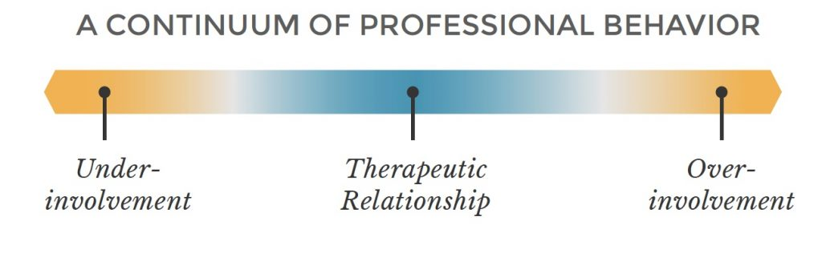
Boundaries & Practice
Abuse and Neglect are examples of extreme boundary crossing.
Over-involvement or under-involvement can become boundary crossing and violation.
Over-Involvement
Refers to unnecessary attention. Paying special attention to a client. Can include gift giving and creating personal relationships.
Under-Involvement
Avoiding client interactions. This often happens when a client exhibits behaviours that make a nurse feel uncomfortable and results in the nurse only providing minimal care.
This continuum provides a reference to assist the nurse in evaluating their own nurse-client relationships and those of their colleagues.
CRNMPEI & CLPNPEI. June 2024. Practice directive Therapeutic Nurse-Client Relationship.

Slide 11
Large headline
Whether the boundary violation is initiated by the client or nurse, it is the nurse's responsibility to identify and address the professional boundary issue in a manner that is professional and therapeutic.

Slide 12
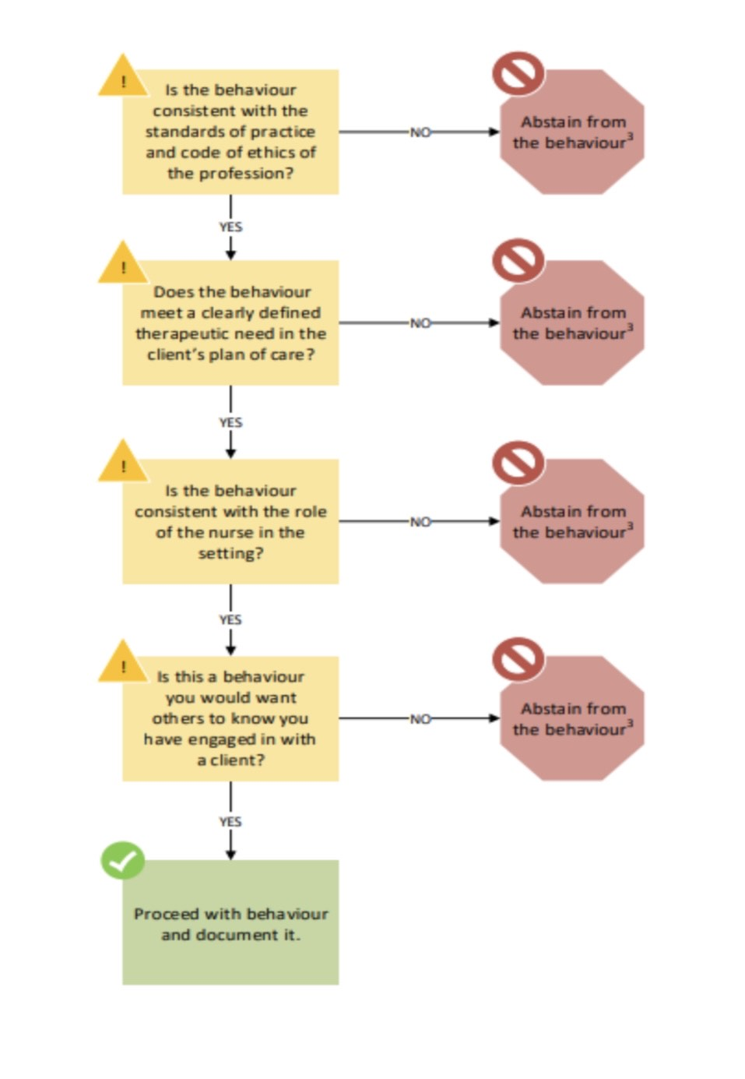
Decision making framework
The lines of boundaries may not always be clear. This framework can provide support to the nurse and help determine if they should engage or abstain from a behaviour.
CRNMPEI & CLPNPEI. June 2024. Practice directive Therapeutic Nurse-Client Relationship.

Slide 13

Personal Relationships
Nurses must never engage in a personal relationship or any form of sexual behaviour with a client.
An individual is considered a current client when a nurse-client relationship has been formed and is ongoing.
Establishing a personal relationship with a former client can be complex. It can be difficult to determine if the relationship began while the client was receiving care from the nurse.
CRNMPEI & CLPNPEI. June 2024. Practice directive Therapeutic Nurse-Client Relationship.

Slide 14

How to determine if a nurse-Client relationship has been formed
Consider the following factors. Where one or more of the below factors are met, a nurse-client relationship exist.
Has the nurse provided a nursing service for the client?
Has the nurse contributed to or viewed/accessed a health record or file of the client?
Has the client consented to a nursing service provided by the nurse?
Other factors relevant to the circumstances of the individual and the nurse.
CRNMPEI & CLPNPEI. June 2024. Practice directive Therapeutic Nurse-Client Relationship.

Slide 15
Case study
How can we apply this information to our day to day care we provide?

Slide 16
Background...
Name: Mr George Thompson
Age: 82 years
Gender Identity: Male
Diagnoses: Parkinson's Disease, Early-Stage Dementia, post-fall hip surgery
Timeline: Recently moved to Long Term Care following a long hospital stay.
Family: Widowed, has 2 kids and 3 grandchildren. His family visits once a week.
He is quiet, values privacy, and is hesitant to ask for help.
Nurse Jessie has recently been assigned to George's care team.

Slide 17
How does Jessie establish trust with Mr. Thompson in their early interactions?
Be honest, consistent and dependable
Explain what she is doing and why
Follow through on promises (Example: 'I will come back at 11:00 for your walk" - and doing so)
Protecting his privacy
CRNMPEI & CLPNPEI. June 2024. Practice directive Therapeutic Nurse-Client Relationship.

Slide 18
Mr. Thompson expresses discomfort with bathing assistance. How does Jessie demonstrate respect in this scenario?
Asking his preferences about who assists with bathing
Giving him choices such as "Would you like to wash your upper body yourself and I can help you with your back?"
Ensuring privacy and using a calm, non-rushed tone
CRNMPEI & CLPNPEI. June 2024. Practice directive Therapeutic Nurse-Client Relationship.

Slide 19
Jessie connects with Mr. Thompson through shared stories and gentle emotional supports. How does this reflect professional intimacy?
Professional Intimacy is the closeness that naturally arises when providing personal care and emotional support
Asking meaningful, respectful questions about life "I noticed in your chart you loved gardening. What did you grow?"
These moments keep the emotional focus on his experience and not her own.
CRNMPEI & CLPNPEI. June 2024. Practice directive Therapeutic Nurse-Client Relationship.

Slide 20
How does power play a role in Jessie's interactions with Mr. Thompson, and how does Jessie manage this ethically?
Jessie holds more power due to her and knowledge in the profession
She uses this power to advocate for him
Never pressuring him to agree make or agree with decisions.
Ensuring he understands his choices and is encouraged to participate
This supports Mr. Thompsons sense of control and dignity.
CRNMPEI & CLPNPEI. June 2024. Practice directive Therapeutic Nurse-Client Relationship.

Slide 21
What is Jessie's fiduciary duty, and how does it guide her care?
Fiduciary Duty means always acting in Mr. Thompsons best interest
Reporting safety concerns
Putting his needs before convenience or routine
Avoid any action that would serve her needs over Mr. Thompsons
This is also an ethical responsibility, especially with the population of vulnerable clients in LTC.
CRNMPEI & CLPNPEI. June 2024. Practice directive Therapeutic Nurse-Client Relationship.

Slide 22
Mr. Thompson starts asking Jessie personal questions and gives her a small gift for "being so kind." How should she maintain healthy boundaries?
Gently decline the gift and explain that it is very thoughtful, but she cannot accept gifts
Redirecting personal questions with warmth while staying firm
Avoiding sharing personal details or becoming overly emotionally involved.
CRNMPEI & CLPNPEI. June 2024. Practice directive Therapeutic Nurse-Client Relationship.

Slide 23
References
CRNMPEI & CLPNPEI. June 2024. Practice directive Therapeutic Nurse-Client Relationship.

