Slide 1
MyHealthPEI Provider Portal Privacy and Security Training
For Community Providers

Slide 2

Vision
To empower patients and families through providing digital access to their personal health information as well as important health resources, tools, and information.
To enhance patient health care by providing Community Partners with access to health information required to support their scope of practice.

Slide 3
Training Objectives
Ensure all Community Providers accessing MyHeathPEI Provider Portal
Are aware of privacy and security principles and best practices, and
Understand their obligations under the Health Information Act (HIA) and their role in protecting electronic personal health information (PHI).

Slide 4
Privacy vs Security vs Confidentiality
Privacy
Privacy is the right of an individual to determine when, how and to what extent they share information about themselves with others. Individuals’ privacy rights are protected under privacy laws, including the Health Information Act (HIA)
Security
Security refers to the measures taken to protect the confidentiality, integrity and availability of information (including PHI) from unauthorized access, use, disclosure, modification or destruction.
Confidentiality is the moral, ethical, legal and professional to protect the information entrusted to us.
This includes anything you learn about the patient, including any information shared verbally and any PHI obtained from the health portal or other means.
Confidentiality
It is the right of the patient to control the collection, use and disclosure of their personal health information (PHI)

Slide 5
Privacy vs Security vs Confidentiality
Personal Health Information (PHI)
Confidentiality
Privacy
Security
Every Community Health Care Provider has an obligation to protect the privacy, security, and confidentiality of personal health information (PHI) in which they are entrusted.

Slide 6
Overview of PHI
Personal Health Information (PHI) is governed by the Heath Information Act (HIA), which defines PHI to include identifying information about an individual in oral or recorded form that relates to:
ones physical or mental health, family health history or health care history,
the provision of health care to the individual,
information collected for the purpose of registering for the provision of health care,
a drug, a health care aid, device, product, equipment or other item provided to an individual under a prescription or other authorization issued by a health care provider, and
other information as defined under the HIA

Slide 7

Overview of PHI
Examples of PHI which may be accessed by Community health care providers in the MyHeathPEI provider portal could include
Patient name, date of birth, provincial health card number
Patient address,
Patient immunization history,
Patient laboratory test results, or
Other PHI with the consent of the patient

Slide 8
Health Information Act (HIA)
The HIA governs how PHI must be managed and protected.
Community Health care providers accessing PHI in the MyHealthPEI Provider Portal are considered custodians under the Act, which:
Establishes rules regarding the collection, use, disclosure, retention and secure destruction of PHI,
Enables PHI to be shared and accessed, where appropriate, for the better provision of health services and the planning and management of the health care system, and
Establishes mechanisms to ensure the accountability of custodians and to safeguard the security and integrity of PHI in their custody or control.

Slide 9
Health Information Act (HIA)
When community health care providers collect, use, or disclose PHI in MyHealthPEI, this must be done in compliance with the HIA. For example,
Collection: When requesting a patient’s name, date of birth, and provincial health card number to search for their file in MyHealthPEI
Use: When reviewing a patient’s immunization history prior to administering a vaccine
Disclosure: When sharing a patient’s recent lab test result with another pharmacist in order to seek another clinical opinion on medication advice

Slide 10
Health Information Act (HIA)
Consent: Under the HIA, knowledgeable consent of the individual is required prior to collecting, using, or disclosing PHI via MyHealthPEI (with limited exceptions).
To ensure consent is knowledgeable, Community Health Care Providers must make readily available to, or provide patients with, a notice describing the purpose of the collection, use or disclosure of the individual’s PHI.
Protection: refers to safeguards that work to prevent PHI from:
•Unauthorized use, disclosure, copying, modification, destruction,
•Inappropriate access, or
•Loss or theft

Slide 11
Trust and Confidentiality
Trust: Being debatably the most important determinant of the level of control patients want with their medical records, trust is crucial to foster and maintain patient privacy. This can be achieved by collecting, using and sharing information only for the purpose of the care of that patient.
Confidentiality: Confidentiality and trust go hand in hand. Patients expect and have a right to confidentiality of their medical records. This means that health care providers can only share PHI on a need-to-know basis, unless authorized to do so by the individual.

Slide 12
Need to Know Principle
Consider the minimum amount of information needed
Only collect PHI that is relevant to the purpose for which you are collecting it
Do I need to capture this information to provide patient care?
Only access and use PHI that is required in that moment
Do I need to access this information right now?
Only disclose PHI required or permitted to serve the purpose
Does another custodian need to know this information to support the patient's care?

Slide 13
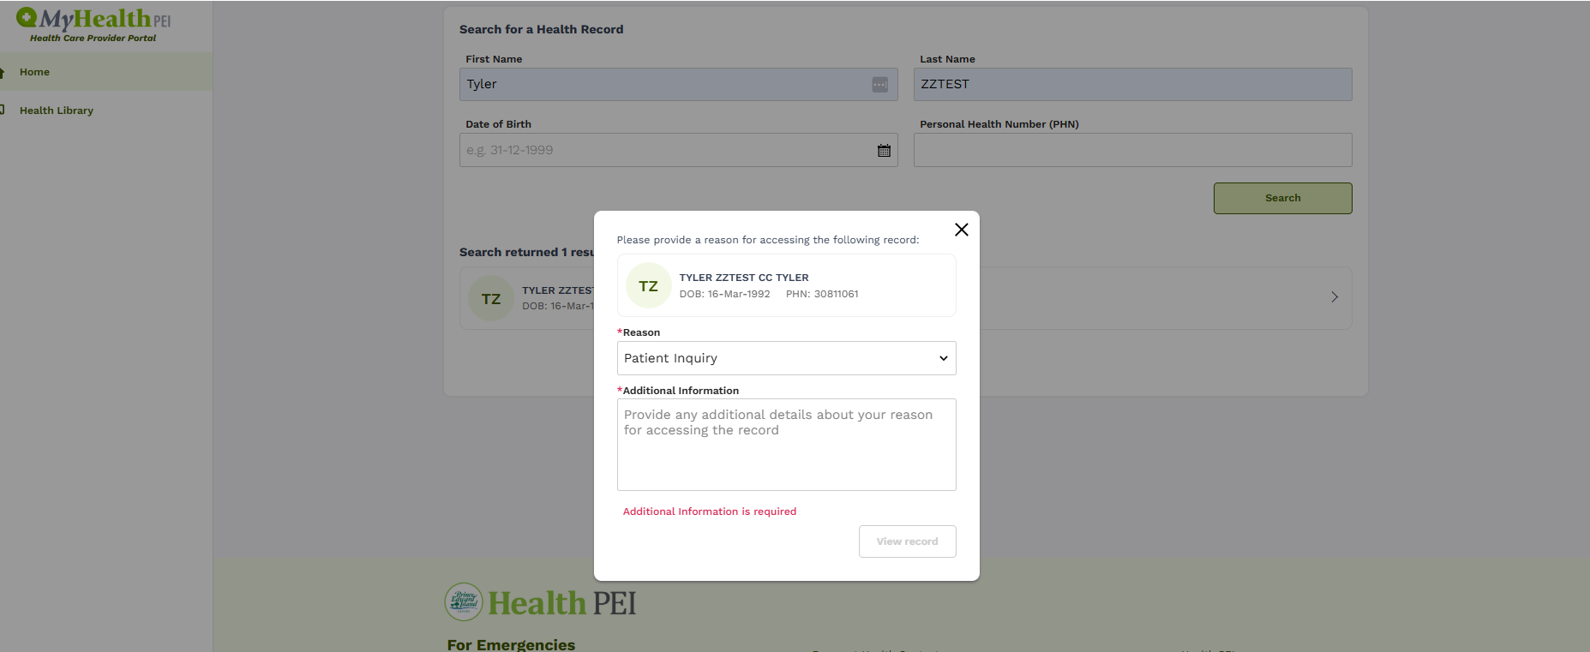
Need to Know Principle
Being part of the patient’s “Circle of Care” at some point in time DOES NOT mean that access to their PHI is permitted at any time for any reason.
To support the “Need to Know” Principle, Provider Participants must select a reason for accessing a patient’s file in MyHealthPEI.
If the Need-to-Know principle is not followed, then a privacy breach may result.

Slide 14

Privacy Breaches
What is a privacy breach?
A breach occurs when a patient’s PHI is collected, used, disclosed or destroyed without authorization, or is lost or stolen
Examples could include
Accessing the PHI of patient in MyHealthPEI for whom you are not providing or supporting the provision of health care,
Using PHI from MyHealthPEI for a purpose other than providing or supporting health care,
Sharing PHI from MyHealthPEI with other staff without a need to know,
Printing PHI from MyHealthPEI and leaving in an area accessible to individuals not authorized to access it
A confirmed privacy breach will be subject to termination of access to the Provider Portal and possible disciplinary action.

Slide 15
Privacy Breaches
How to determine if a breach has occurred?
Was PHI involved?
Was there a need to know or share the information?
Was more PHI than necessary accessed or disclosed?
Was the access/disclosure unauthorized?
All suspected or confirmed breaches should be reported to the
Support Desk (myhealthpeisupport@gov.pe.ca) upon detection.
Be sure to follow any internal notification requirements based on your organization’s privacy breach protocol.

Slide 16
Privacy Breaches
Containment Actions
Once the Health Portal Manager has been notified, there are several actions you can take to help contain and prevent a further breach, including
Gathering and documenting initial details of what happened
Determining exactly what information may have or has been breached
Recovering, retrieving or confirming destruction of any PHI
Documenting facts in an incident report

Slide 17
Privacy Breaches
Prevention
Use the “Need to Know” Principle
Maintain Confidentiality and Privacy by using these best practices:
Avoid discussing PHI from MyHeathPEI in public areas
Never leave computers or other devices containing PHI from MyHealthPEI unattended or in a clear view of others.
Do NOT share your MyHealthPEI Provider Portal login information and always log out of the system when not in use. You are responsible for activity under your credentials.
Do NOT engage in conversations about PHI from MyHealthPEI with family, friends, neighbors etc.
Practice the 10 Key Privacy Principles as outlined by the CSA

Slide 18
Privacy Breaches
CSA Model Code for 10 Principles for Protection of Personal Information
#1 | Accountability | An organization is responsible for personal information under its control. It must appoint someone to be accountable for its compliance with these fair information principles.
#2 | Identifying Purposes | The purposes for which the personal information is being collected must be identified by the organization before or at the time of collection.
#3 | Consent | The knowledge and consent of the individual are required for the collection, use, or disclosure of personal information, except where inappropriate.
#4 | Limiting Collection | The collection of personal information must be limited to that which is needed for the purposes identified by the organization. Information must be collected by fair and lawful means.
#5 | Limiting Use, Disclosure and Retention | Unless the individual consents otherwise or it is required by law, personal information can only be used or disclosed for the purposes for which it was collected. Personal information must only be kept as long as required to serve those purposes.
#6 | Accuracy | Personal information must be as accurate, complete, and up-to-date as possible in order to properly satisfy the purposes for which it is to be used.

Slide 19
Privacy Breaches
CSA Model Code for 10 Principles for Protection of Personal Information
#7 | Safeguards | Personal information must be protected by appropriate security relative to the sensitivity of the information.
#8 | Openness | An organization must make detailed information about its policies and practices relating to the management of personal information publicly and readily available.
#9 | Individual Access | Upon request, an individual must be informed of the existence, use, and disclosure of their personal information and be given access to that information. An individual shall be able to challenge the accuracy and completeness of the information and have it amended as appropriate.
#10 | Challenging Compliance | An individual shall be able to challenge an organization’s compliance with the above principles. Their challenge should be addressed to the person accountable for the organization’s compliance with privacy legislation, usually their Chief Privacy Officer.

Slide 20
Privacy Breaches
Health PEI’s response
In the event of a suspected or confirmed privacy breach, Provider participants must co-operate with the breach investigation, initiated by the Health Portal Manager in consultation with Privacy team and others as appropriate.
You may be required to
Gather further information from additional sources if needed
Confirm facts, identify failed safeguards, identify if breach was intentional vs accidental etc
Determine exactly what information has been breached
Assist in assessing potential risks to the affected individual
In response to the investigation Health PEI may:
Notify and report to the affected individuals, if applicable
Notify the Information and Privacy Commissioner, if necessary
Determine whether new or enhanced safeguards are required
Revoke Participant Access to the Provider Portal if needed
Provide and disciplinary recommendations to the applicable College
Consult your participation agreement for more information on actions taken when a privacy breach has occurred.

Slide 21
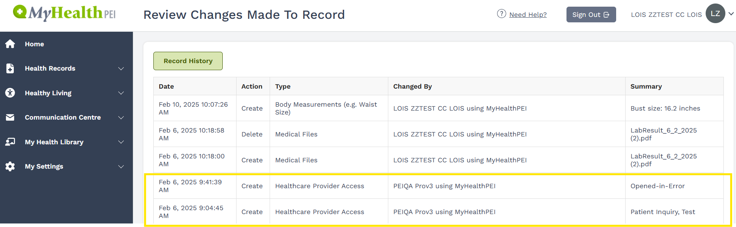
Audit Log
All citizen users can view an audit log that displays all record history, including when PHI was accessed and by whom. The Community health care provider and date and time of access will appear in the log.

Slide 22
Privacy Complaints
Individuals have a right to submit a privacy complaint.
A member of the public may have a privacy concern related to the Provider Portal and may contact the Provider, the organization or College, or HealthPEI to file a complaint.
An established MyHealthPEI privacy breach protocol will be executed to investigate. All Provider participants are obligated to co-operate with the complaint investigation.
The investigation may result in suspension or termination of the Provider’s portal access, and the applicable College may be contacted and consulted with if necessary.

Slide 23
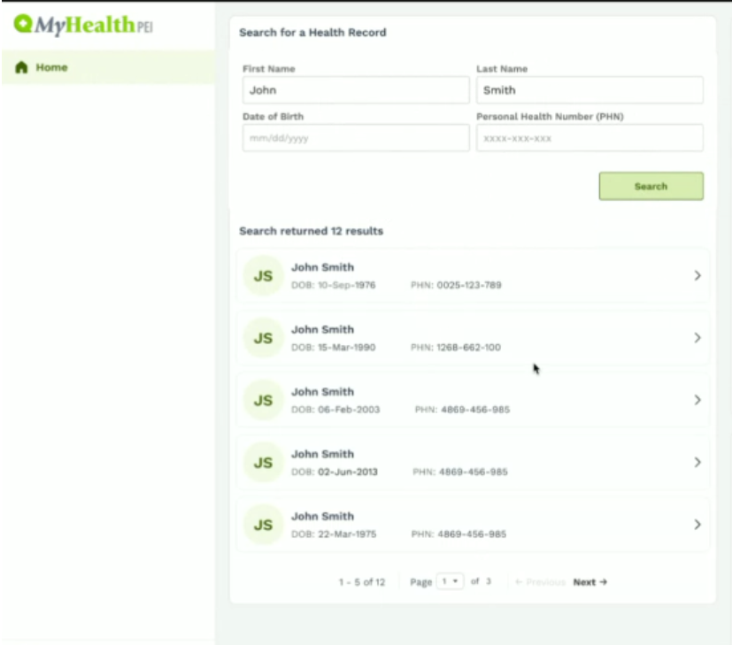
Searching for a Patient
When searching for a patient in the MyHealthPEI Provider Portal, search results will display any patient with matching name credentials.
To mitigate occurrences of unauthorized access to PHI, ALWAYS confirm Patient Health Number (PHN) prior to opening a patient’s record.

Slide 24
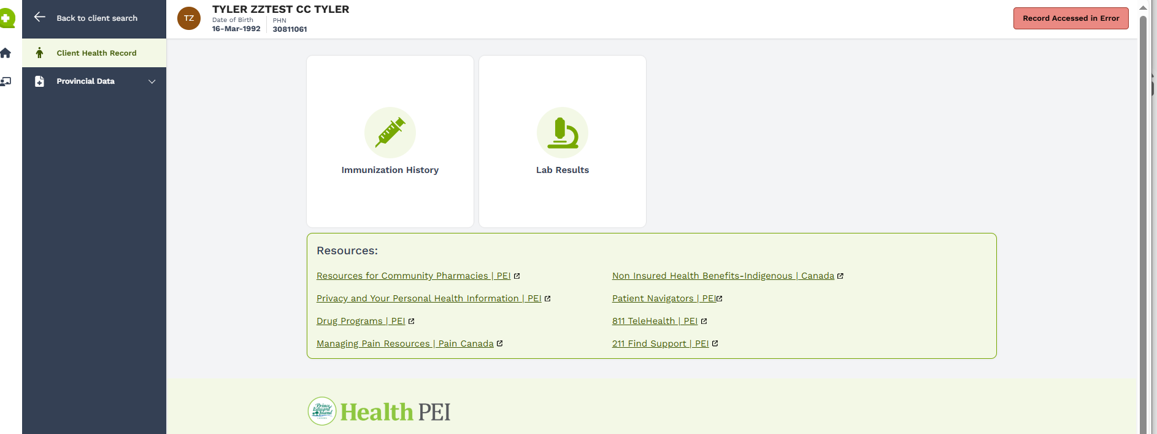
Accessing a Patient Record in Error
If a patient record is viewed by mistake, hit the “viewed in Error” button.
View from Patient’s portal:

Slide 25
Security
Implementation of electronic health records and regular use of mobile devices has increased opportunities for data, including PHI, to be hacked, manipulated or destroyed.
Security breaches may cause patients to lose their trust in the clinician or the health portal, resulting in the patient not being forthright with their care provider, or withdrawing from MyHealthPEI.

Slide 26
Security Best Practices
Do not let anyone other than yourself use your MyHealthPEI login
Do not leave devices unlocked with patient PHI visible.
If using a shared workstation, log out of MyHealthPEI prior to walking away from the workstation.
Do not share your password with anyone; don’t write your password down or save it to your internet browser
Safeguard PHI in oral form by taking reasonable steps to prevent overhearing of conversations with patients or other members of the patient care team.
Do not use email communication to share PHI. Discourage patients from using email and instead encourage the data to remain on MyHealthPEI.

Slide 27
Security – IT Recommendations
Use a strong password. Incorporate both upper and lower letters, at least one number, at least one special character and at least 8 characters long. Don’t use a birth date, or family names. It’s recommended to change your password periodically.
Ensure all devices have antivirus and firewall protection.
Use secure wireless networks and the strongest form of encryption (WPA2 where possible).
Set devices to automatically lock after 5 minutes of inactivity.

Slide 28
Security - Suspension of Access to MyHealthPEI
To protect PHI in the system, Health PEI may suspend a Provider’s access in the following situations:
Following a period of inactivity for six months
User becomes no longer eligible as per the Participation Agreement
Participant is being investigated for a suspected Privacy breach
User is being investigated for a suspected breach of the Participation Agreement

Slide 29
Conclusion
MyHealthPEI Provider Portal aims to enhance patient health care by providing Community Partners with access to health information required to support their scope of practice
This objective can only be made possible through adherence to applicable privacy laws and best practices, and by maintaining a high-security mindset when performing any action in the provider portal.
For any questions on this material, please contact myhealthpei@gov.pe.ca
Additional resources can be found as an appendix

Slide 30

Thank You!
Thank you for completing this training.
A competency quiz is necessary prior to gaining access to MyHealthPEI. It can be found here
On the Provider Portal Access Application form, record the date the competency quiz was completed and acknowledge that you’ve read and understand the material.
Please submit the completed Access Application form to myhealthpei@gov.pe.ca to gain access to MyHealthPEI.

Slide 31
Appendix: Additional Resources
CMA Principles for the Protection of Patient Privacy
Health Information Act (HIA)
Freedom of Information and Protection of Privacy Act (FOIPP)
Office of the Privacy Commissioner of Canada - PIPEDA Fair Information Principles

