Slide 1
PEDIATRIC AND YOUNG ADULT FERTILITY PRESERVATION IN ATLANTIC CANADA
Project

Slide 2
Presentation Objectives
  Project Background
  Project Deliverables
  Benefit to HPEI
  Guideline Principles & Development
  Current State- Chart Audit
  Implementation
  Important Links
  Provider Flow
  Prompt
  Evaluation
  Interest Holder Engagement

Slide 3
Project Background
  Funder: Canadian Partnership Against Cancer (CPAC)
  Project Lead: Atlantic Provinces Pediatric Hematology/Oncology Network (APPHON)
  Multi-Provincial: pediatric and young adult
  Project-Level Outcomes:
    Patients: Increased awareness of potential impacts of treatment on fertility and improved access to timely fertility information, fertility-related supports.
    Health Care Providers: Increased awareness and supports (e.g., evidence-informed best practice guideline) to help facilitate fertility conversations. Provide patients with timely information and referral for fertility consultation, fertility-related supports, and fertility preservation (if desired).
    Inclusion and Equity: Fertility pathways and education resources are created with an equity lens of local relevance to meet the needs of equity-denied, First Nations, Inuit and Métis and out of province patients. The value of reciprocity guides all engagement work with First Nations, Inuit and Métis organizations or patients.
* Has be developed with patient and family partners through every step!*

Slide 4



Project Deliverables
  Working Groups and Steering Committee
  Develop and Adapt Fertility Preservation Guideline
  Equitable and Sustainable Fertility Referral Pathway
  Education/Information/Awareness Plan
  Validated Oncofertility Screening Prompt
  Performance Measurement Planning and Knowledge Sharing
  Sustainability Plan

Slide 5

HOW WILL THIS PROJECT BENEFIT US IN PEI?
  - Resource Accessibility (for patients and providers!)
  Patients: resources (e.g., education handouts) re: fertility preservation education, funding, etc.
  Providers: oncofertility guidelines, clinical care pathways, embedded screening prompt.
  Developing sustainable key quality indicators (KQIs) and patient reported outcomes (PROs) to ensure providers and patients are supported.
  Will assist our facilities in meeting Accreditation Canada standards.

Slide 6

GUIDING PRINCIPALS OF THE GUIDELINE
All patients undergoing cancer-directed therapy or cancer-like therapy have a right to:
  Know the risks of potential fertility impairment from their therapy.
  Knowledge and choice regarding fertility preservation options, if available and clinically appropriate.
  Understand the feasibility and potential outcome of the different fertility preservation options.
  Discuss this information prior to exposure to therapy.

Slide 7
GUIDELINE DEVELOPMENT
  Began as an update of the IWK oncofertility evidence-based
  guideline(2020).
  Developed using a literature review of new evidence/research since the IWK guidelines were published.
    For example, some experimental treatments have been revised to standard of care(ovarian tissue cryopreservation).
  Diverged into separate pediatric and adult guidelines to ensure differences are appreciated.
  Contains best practice recommendations, regardless of the services currently available in each province.

Slide 8

GUIDELINE DEVELOPMENT
  Presentations to providers and distribution for feedback in December 2024
  Updates incorporated 2025
  Re-Distribution along with usability survey to professionals in Atlantic Canada July/August 2025
  Guideline is finalized and is posted on the APPHON website.
    https://www.apphon-rohppa.com/en/oncofertility/guidelines

Slide 9
Implementation
  Introduction and Provision of Finalized Education Materials
    At diagnosis educational materials AMAB and AFAB (Adult and Pediatric & a 1- page Adolescent)
    Post treatment educational materials AFAB and AMAB (Adult and Pediatric)
    Funding brochure

Slide 10

Implementation
  Embed the guidelines, patient validated prompt, and pathways into practice and documentation systems.
    Use it as a tool to help you and your patients.
    Included in the guideline are a clinical care pathways to assist providers
    Information and Education sessions

Slide 11
Important Links
  Oncofertility guideline https://www.apphon-rohppa.com/en/oncofertility/guidelines
  Education resources
    At Diagnosis https://www.apphon-rohppa.com/en/oncofertility/at-diagnosis
    Post Treatment https://www.apphon-rohppa.com/en/oncofertility/post-treatment
    Funding https://www.apphon-rohppa.com/en/oncofertility/funding

Slide 12
Atlantic Canada Fertility Clinics
Conceptia (NB) only does Embryo freezing not Egg freezing so females can go to Atlantic Fertility (Halifax) for egg freezing
https://www.conceptia.ca/referring-physicians
https://atlanticfertility.ca/referral
Males can go to either fertility clinic for sperm freezing.
Conceptia blood work required:
For males, it would be the “Preconception Panel”(partner) so that they can freeze the sperm.
Atlantic Fertility blood work required for males and females:
ID screens (Hep C, HIV, Hep B, AG and Syph) and a referral. Atlantic Fertility does not have a printable referral form; they have the template to do the online referral.

Slide 13
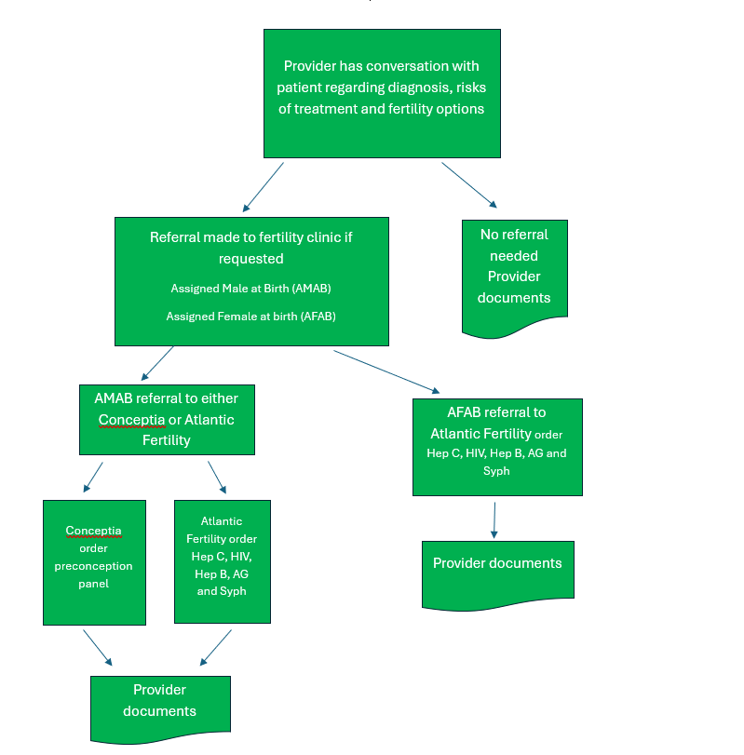
Provider Flow

Slide 14
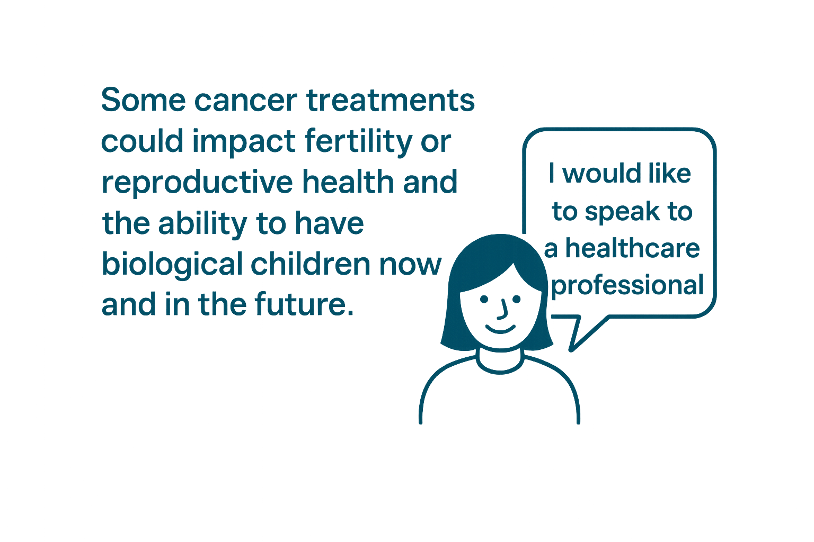
Patient & Family Advisor Validated Prompt

Slide 15

Evaluation
  KQIs to determine success and satisfaction from the guidelines, prompt and resources.
    Patients who were screened using the prompt on the SFD
Number of patients who answered yes
Number of patients who answered no
Number of patients screened
Number of new cancer pts referred to a cancer centre
    Patients who requested a fertility referral
      Number of patients referred to a fertility clinic for a consult
    Reasons for not requesting a referral

Slide 16
Evaluation
  Additional chart audits to measure success of implementation.
  Sustainability Plan
    APPHON responsible to review and update resources
      Guideline
      Educational materials
  Provincial Cancer Organization/ PEICTC
    Ongoing monitoring to ensure Oncofertility processes are embedded in practice.

Slide 17

Interest Holder Engagement
  Educate providers and interested parties on the Oncofertility Project
    Other specialty providers (e.g. Gyne/Obs/ Urology/SHORS)
    Health PEI Navigators
    Primary Care/Medical Homes
    Medical Affairs Office Newsletter –January 2026
    Community Engagement
      Canadian Cancer Society

Slide 18
Food for Thought
“….only half of patients discussed fertility with their medical team, and only 13 per cent went through any type of fertility preserving procedure..”
Young Adult Cancer Canada Prime Study 2020

Slide 19

Thank you!
Questions?

Slide 20

Contact
Carol Digout, Executive Director APPHON
Carol.digout@iwk.nshealth.ca
Marla Delaney, Program Development Lead
mdelaney@ihis.org

