Slide 1
Organ and Tissue Donation Coordinating Program
Nursing Orientation
Angela Carpenter
OTDT Manager
Notes:
Welcome to the presentation on the PEI Organ and Tissue Donation Coordinating Program. I am Angela Carpenter, the program manager.

Slide 2
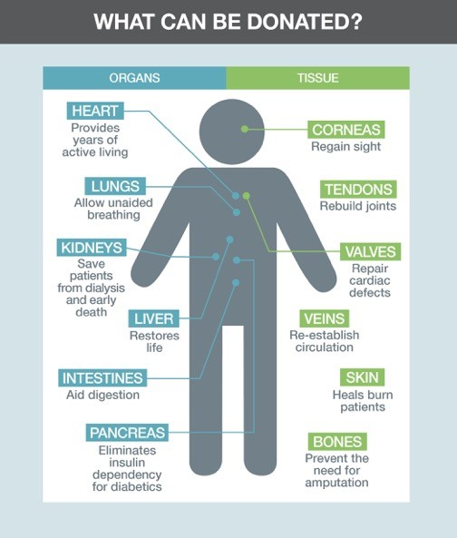
Organs and Tissues for Transplant
Notes:
I’d like to start by talking about which organs and tissues can be donated for transplant. The organs that can be transplanted include the heart, two lungs, two kidneys, liver, intestines, and pancreas. The tissues that can be donated include the corneas, tendons, heart valves, skin, and bones. Islanders can also donate their body to science or their brain for research, but those are different programs. This program only deals with organs and tissues that can be transplanted into other people.

Slide 3
Why is Organ and Tissue Donation Important?
Organ transplantation is the most effective treatment for end stage organ failure, and for some people, it is the only treatment.
Tissue transplantation can improve or save the lives of people with blindness, mobility issues, burns, and other injuries.
Notes:
Organ and tissue transplantation are important because organ transplantation is the most effective treatment for end stage organ failure, and for some people, it is the only treatment. Tissue transplantation can improve the lives of people with blindness, mobility issues, and can even save the lives of people with severe burns, and other injuries.

Slide 4
Why is Organ and Tissue Donation Important?
2782 transplant procedures performed in Canada
4351 people on transplant waitlist
223 people died while waiting for a transplant
Stats from CORR 2019
Notes:
Organ and Tissue Donation is important because the number of donated organs is less than what is required to meet the demand for organ transplants. In 2018, there were 1317 living and deceased organ donors who contributed to the 2782 transplant procedures that were performed. The vast majority of those transplants were kidney transplants, followed by liver transplants, lung transplants, heart transplants and pancreas transplants. There were also a small number of small bowel transplants.
Unfortunately, there were still 4351 people on the transplant list at the end of 2018, and over 200 people died while waiting for a transplant that never happened.
Canada’s deceased donation rate is 21.8 dpmp (in 2008, rate was 14.4 dpmp, so we have increased 52% in 10 years!)
29 small bowel transplants

Slide 5
Why is Organ and Tissue Donation Important?
Notes:
One donor can provide up to 8 organs and up to 75 tissue grafts that save and improve the lives of many. Donation can also be beneficial to the families of donors because it is something good that can come out of a tragedy.

Slide 6
Why is Organ and Tissue Donation Important?
MANY DON’T HAVE THE OPPORTUNITY…
Donation is a rare opportunity. Less than 2% of all deaths occur under circumstances allowing for organ donation.
Less than 10% of people who die in hospital on PEI are able to donate tissues.
Notes:
The opportunity to donate organs and tissues is very rare. A person has to die under very specific circumstances to become an organ donor, and only about 2% of deaths occur under those circumstances. Tissue donation is also quite rare, with less than 10% of people who die in hospital meeting the criteria for tissue donation.

Slide 7
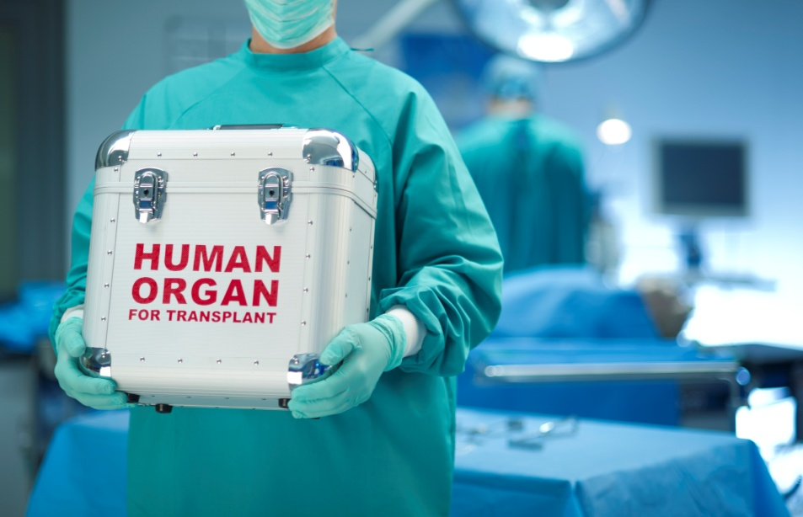
Organ Donation
Only a small proportion of all people who die are clinically suitable candidates for organ donation.
A deceased organ donor:
Severe brain damage
Otherwise healthy organs
Organ function temporarily
maintained with ventilator (must be in ICU or ED)
No severe/systemic infection
No cancer
Notes:
PEI does not have an organ procurement organization- we refer our organ donors to Halifax or Moncton. Organ donors usually have a severe brain injury with otherwise healthy organs. Their organs must be perfused so the potential donors have to be in ICU or ED. Transplant recipients are more susceptible to infection and cancer because of the antirejection medications they must take for the rest of their lives so we don’t want to increase their risk even more by exposing them to infections or cancer cells that might be transplanted with the organ.

Slide 8
Tissue Donation
Higher potential on PEI
Donors can come from any unit, and even out of hospital
One tissue donor can donate up to 75 tissue grafts
Notes:
Tissue donors can come from any unit in the hospital, or even deaths that occur outside of the hospital, which means the potential for tissue donation is higher than the potential for organ donation, and is why the rest of this presentation focuses on tissue donation. This illustration shows the many tissue grafts that can be recovered from a tissue donor.

Slide 9
Tissue Donation Process
Identify potential donor
Refer to Regional Tissue Bank
Approach family
Check Intent to Donate Registry
Documentation/Coordinate recovery
Notes:
The Tissue Donation Process has four main steps:
Identify the potential donor, to do this, we should be screening all patients who die for their potential to be tissue donors
Referral to the Regional Tissue Bank- PEI doesn’t have a tissue bank, so we refer all of our potential tissue donors to Halifax
Approach the family- ask them to support their loved ones decision or let us know if they think their loved one changed their mind.
The last step is to document the process and coordinate the recovery if applicable.

Slide 10
1. Identify Potential Donor Does the patient meet the basic suitability criteria?
Age greater than 70
Weight over 136 kgs (300 lbs)
Weight less than 2.7 kgs (6 lbs)
Tests positive for HIV, HEP B/C, HTLVI/II
Antibiotic Resistant Organisms
Test positive for active TB
Neurological diseases
Unknown time of death (within 12 hours)
Severe sepsis (criteria must be met)
Cancer (able to donate corneas)
Notes:
The first step is to determine whether your patient meets the basic suitability criteria to be a tissue donor. Age is the most common contraindication on PEI, followed by cancer and sepsis. People with cancer can still be referred for cornea donation as long as they don’t have any other contraindications. There are some things you might not know about your patients such as their HIV status. If you don’t know, you can assume they are negative and make the referral. The tissue bank will test the tissues and quarantine them until the test results come back. If the patient has been ARO+ in the past, they could still be a donor as long as they are negative now. Patients who die in hospital should have a known time of death, so the unknown time of death only applies to donors from out of the hospital (for example someone who comes to ED who is DOA). If your patient has even one contraindication (other than cancer), they cannot be a tissue donor.

Slide 11
2. Refer to Regional Tissue Bank
902- 473-2222
Someone on call 24-7
Referral Information for Organ and Tissue Donation form
Call them before you talk to the family
Notes:
If your patient has no contraindications, you should refer them to the Regional Tissue Bank in Halifax for further assessment. There could be other reasons why the tissue bank would not accept a potential donors so this referral should be made BEFORE speaking to the family. The number, 902-473-2222 is the number for the switchboard at the QEII. This number is on your donor assessment cards, the ACT and GIVE posters on the units, on the paper screening form and the electronic screening form. There is always someone at that number. Tell them you would like to speak to the Tissue Bank Specialist on call and leave the number you want them to call you at. It can take a few minutes for the tissue bank specialist to return the call, so you can use that time to complete the Referral Information for Organ and Tissue Donation form. You can also call the tissue bank specialist to ask a question about a potential donor, if you aren’t sure that you should make a referral, it is better to ask them and let them decide.

Slide 12
2. Refer to Regional Tissue Bank
Notes:
This form is not required, but some staff had asked to have a list of questions the tissue bank specialist might ask. Not all questions will apply to all patients, and again, this is not a required form.

Slide 13
3. Approach Family
Usually the step that causes the most anxiety
Easier if you know what the patient wants
Check the Intent to Donate registry
Call 902-438-4200
Need patient MRN
If patient said no- let family know
If patient said yes- let family know
If patient is not on registry- family has to decide
Notes:
If the tissue bank specialist thinks the patient could be a potential donor, the next step is to approach the family. This is usually the step that causes the most anxiety for staff. It is much easier to approach the family if you know what the patient wants because then you are asking them to support their loved one’s decision rather than make the decision themselves. That is why we have been asking Islanders to register their intentions for donation on the Intent to Donate Registry.
So, if the tissue bank specialist thinks the patient could be a potential donor, you should call 902-438-4200 to see if the patient is on the registry. This number is on green stickers at every nurses station. There is always someone at that number. They will ask for the patient’s health card number and confirm their identity with their name and birthdate. They will tell you if the person has said yes, no, or has not registered. If the person has registered their decision, you can let the family know and ask them to support their loved one’s decision unless they have some reason to believe their loved one might have changed their mind. If the patient has not registered their intentions, it will be up to the family to make the decision on behalf of their loved one.

Slide 14
3. Approach Family
If the RTB accepts the patient after initial screening, determine patient’s wishes
Intent to Donate Registry (902-438-4200)
Offer donation option to family
Let family know patient’s wishes
Approach family after they have accepted the death (or impending death) of their loved one
Use a sensitive, caring, compassionate approach
Notes:
When you are talking to the family of the potential donor, please use a sensitive, caring, and compassionate approach. If the family has not accepted the death or impending death of their loved one, they are not ready to talk about donation. In most cases the family has accepted the death or impending death and they are going to be grieving the loss of their loved one, and staff may be hesitant to talk about donation at such a sensitive time. Remember that the opportunity to donate should be part of quality end of life care. If you do not approach the family, you are taking that opportunity away from them.

Slide 15
4. Documentation and Coordination of Recovery
Call RTB when donor dies
Preserve corneas
Take to morgue as soon as possible
Documentation- Tissue Donation Screening Tool and Record of Discussion are on electronic health record under ad hoc charting (admission, discharge, and transfer)
Notes:
The last step is to coordinate the recovery. Sometimes the identification and referral of a potential donor can take place before the patient actually dies. If that is the case, please remember to call the Regional Tissue Bank when the patient dies. The tissue bank specialist will make arrangements to transfer the body to Halifax for tissue retrieval. When caring for the body after death, the only special actions to take for tissue donors is to preserve the corneas. The corneas are very fragile so the eyes should be treated with polysporin eye drops or natural tears. Every unit should have these on hand for potential donors. After the drops are applied, the eyes can be taped shut. If for some reason there are no eye drops on the unit, taping the eyes shut will help preserve the corneas.
The body should be taken to the morgue as soon as possible, but please do not rush the family out of the room. Give them the time they need to say good-bye.
Finally, the process should be documented on the patient’s chart. It is preferable that this is done on the electronic chart, but there should be paper forms available to be used during downtimes.

Slide 16
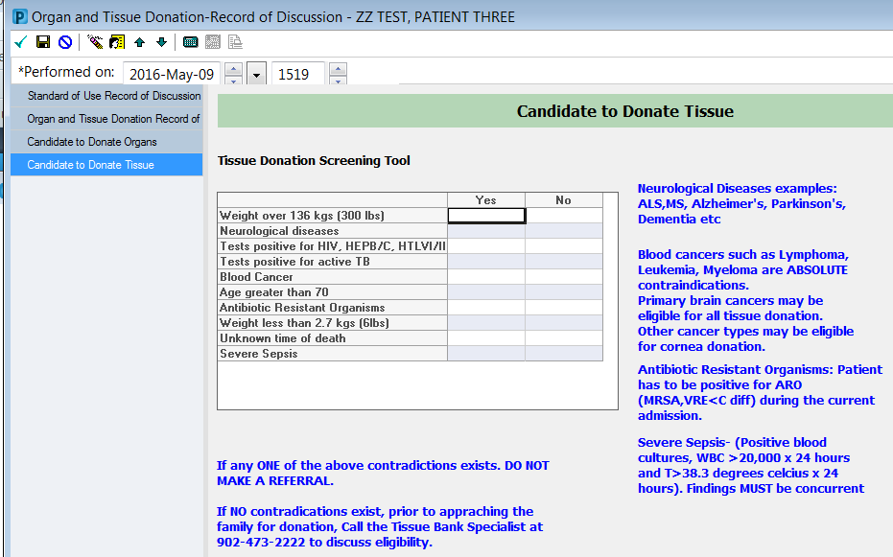
Tissue Donation Screening Tool
Notes:
On the electronic health record, click on the ad hoc charting tab and then on the admission, transfer, discharge tab. The expiration record is also on this tab so you can complete both forms at the same time.
The organ and tissue donation discussion tab contains the candidate to donate tissues form and the record of discussion form. Both of these are required forms and must be completed for every in hospital death.
The candidate to donate tissues form has the same list of contraindications that are on the donor assessment card. If your patient has one of the contraindications, you can click yes in that box.

Slide 17
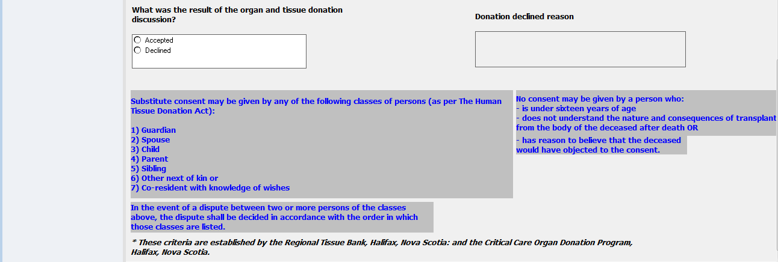
Record of Discussion
Notes:
The record of discussion should be completed for every death as well. Completion of this form is required by the Human Tissue Donation Act of PEI.
The first section asks if the person is suitable to be a donor, if they are not, you can click no and fill in the reason why not. You don’t have to complete the rest of the form.
If the answer is yes, you will have to answer the second section. Did you make a referral? If you did not make a referral, you can enter the reason why, and stop there. If you did make a referral you would record the result- was the patient accepted as a potential donor or deferred? If the patient was deferred by the tissue bank, please record the reason why, and you can stop there.
The third section is about approaching the family. The first question in that section refers to the patient. In some cases, the patient may be conscious and competent enough to tell you themselves if they would like to donate or not. Or they may have recorded their intention on the registry which would also count. If the family was not approached, please indicate why not and you can stop there. If the family was approached, please indicate which family member you spoke to. The hierarchy of substitute consenters is listed on the form and the person highest on the list should be asked to make the decision. Lastly, please record the result of the discussion with the family. If they give you a reason why they do not want to donate their loved one’s tissues, please record that in the space provided.

Slide 18
Remember…
Front line staff make donation possible by
identifying and referring potential donors.
Notes:
Donor identification and referral is the first and most essential step in the deceased donation process. If a potential donor is not identified and referred, organ donation cannot happen. Deceased donation rates in Canada lag behind leading countries. It is vital that health care professionals are able to identify and refer potential organ donors. If they do not, patients on transplant waiting lists are left waiting and the wishes of potential donors and their families remain unfulfilled.

Slide 19
PEI Donation and Transplantation Statistics 2009- 2018
PEI also had 18 Living Organ Donors from 2009-2018
There were 31 Tissue Donors from PEI in the years 2009- 2018
Notes:
I thought I would include a few statistics because I often get asked about these things. There have been 13 deceased organ donors from PEI in the past 10 years, and 18 living organ donors. There have also been 31 tissue donors in the same 10 year period. Islanders have received a total of 93 organ transplants in the past ten years, 59 kidney transplants, 19 liver transplants, 9 lung transplants, 4 heart transplants, and 2 people have received a kidney and a pancreas in the same operation.
I also get asked about the Intent to Donate Registry. We introduced the registry in the fall of 2015, and at the end of 2019 we have over 48,000 people on the registry. People can register their decision online at makeitzero.ca, on paper at AccessPEI locations, and when they apply for or renew their health cards. As of December 5, 2019 there are no more red hearts on driver’s licenses. If people have said yes on the registry, they will have a red heart on the back of their health card. With the recent talk of presumed consent, it is important to note that on PEI people are able to opt out if they wish. We have a combined registry so people can say YES or NO.

Slide 20
For more information…
Health PEI Staff Resource Center:
www.healthpei.ca/src/organandtissuedonation
Canadian Blood Services:
https://profedu.blood.ca/en/organs-and-tissues
PEI Organ and Tissue Donation Website:
Makeitzero.ca
Phone:
(902) 368-5920
Email:
organandtissue@gov.pe.ca
Notes:
For more information, you can access these resources. Please don’t hesitate to call or email me with any questions.

