Slide 1

The Edmonton Symptom
Assessment System Revised
(ESAS-r)
Quick Guide
PEI Provincial Integrated Palliative Care Program
November 2020

Slide 2
What is ESAS-r?
The ESAS-r helps to assess nine common symptoms in palliative care patients.
Key assessment tool that is used in the Provincial Integrated Palliative Care Program
Provides a clinical profile of symptom severity over time. It provides a context within which symptoms can begin to be understood

Slide 3
Nine Common Symptoms
Pain
Tiredness
Drowsiness
Nausea
Lack of Appetite
Shortness of breath
Depression
Anxiety
Well-being
Other (e.g.; sleep, constipation, cough)

Slide 4
Why is ESAS-r used?
The goal of this tool is to obtain the patients perspective of their symptoms.
It helps to direct treatment and to assess for treatment effects.

Slide 5
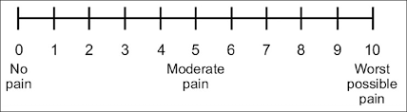
How to use ESAS-r tool?
The patient should be instructed to rate the severity of each symptom on a 0 to 10 scale, where 0 represents absence of the symptom and 10 represents the worst possible severity.
The number should be circled on the scale.
The patient should be instructed to rate each symptom according to how she/he feels at that moment in time.

Slide 6
When to complete ESAS-r?
In the palliative Home Care setting, an ESAS-r shall be completed on admission to P-IPCP.
If symptoms stable and well controlled, shall be done weekly either electronically, by telephone or on paper
If symptoms not well controlled, shall be completed daily either electronically, by telephone or by personal contact

Slide 7
When to complete ESAS-r?
In Acute/hospital setting - completed daily
In Ambulatory Care setting - at each visit
In Palliative Care Unit - completed daily
In LTC facility - if symptoms are well controlled, completed weekly
ESAS-r should be completed whenever there is any change
in symptoms or patient status

Slide 8
Who completes the ESAS-r?
Ideally, it is the patients opinion of their symptom
If patient is mildly cognitively impaired or too sick to do so – it can be completed with assistance of family, caregiver, health care provider
Patients and family should be given direction on how to complete form
Notes:
For best results, ideally it is the patients opinion of their symptom. Studies have shown that family members over estimate their loved ones symptom severity and that Health professionals tend to underestimate.
Its important to note that if the patient is cognitively impaired

Slide 9
Who completes the ESAS-r
If patient cannot participate at all, or refuses to do so – can be completed as objectively as possible by family, caregiver or health care provider alone
Whomever completed form, should be documented

Slide 10
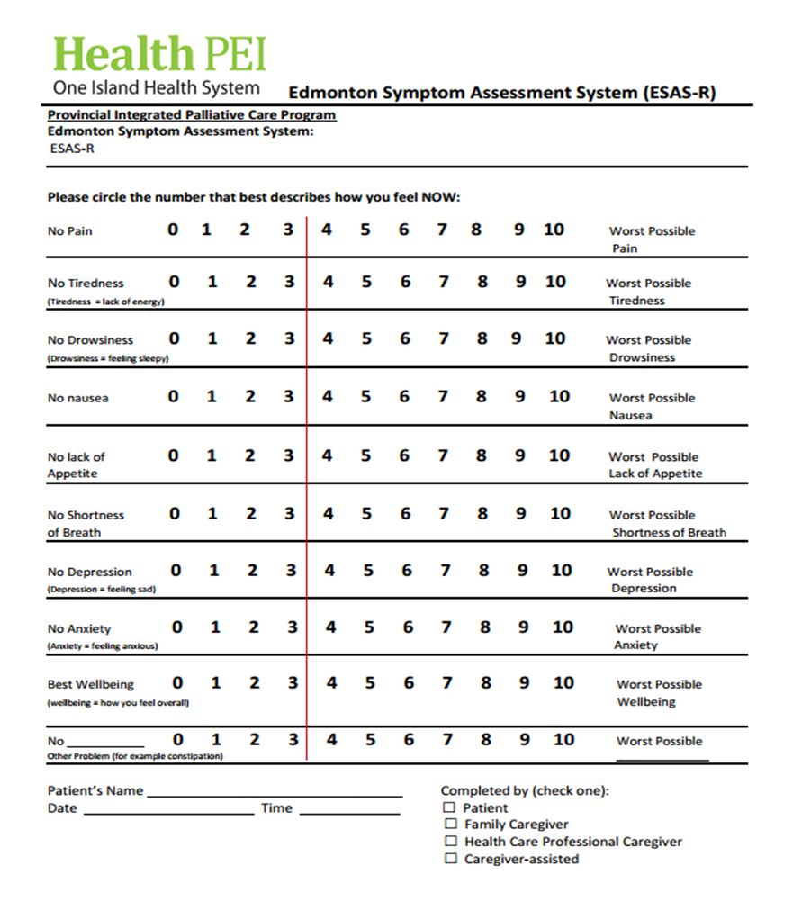
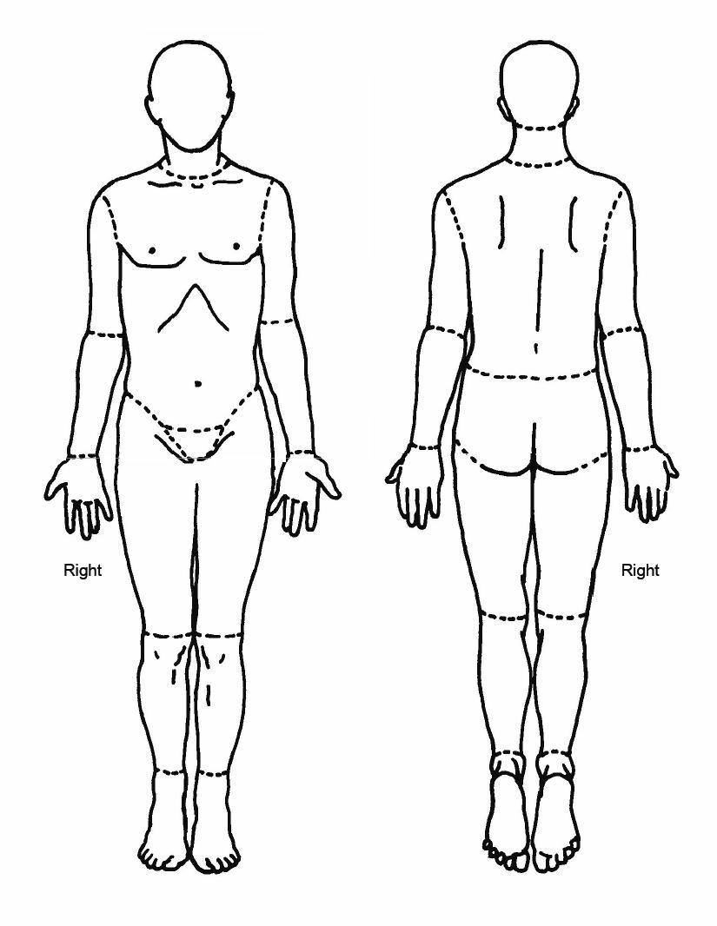
ESAS-r Paper tool - Front & Back

Slide 11

Where to Document ESAS-r
Paper
CIS
ISM
Online
Notes:
ff

Slide 12
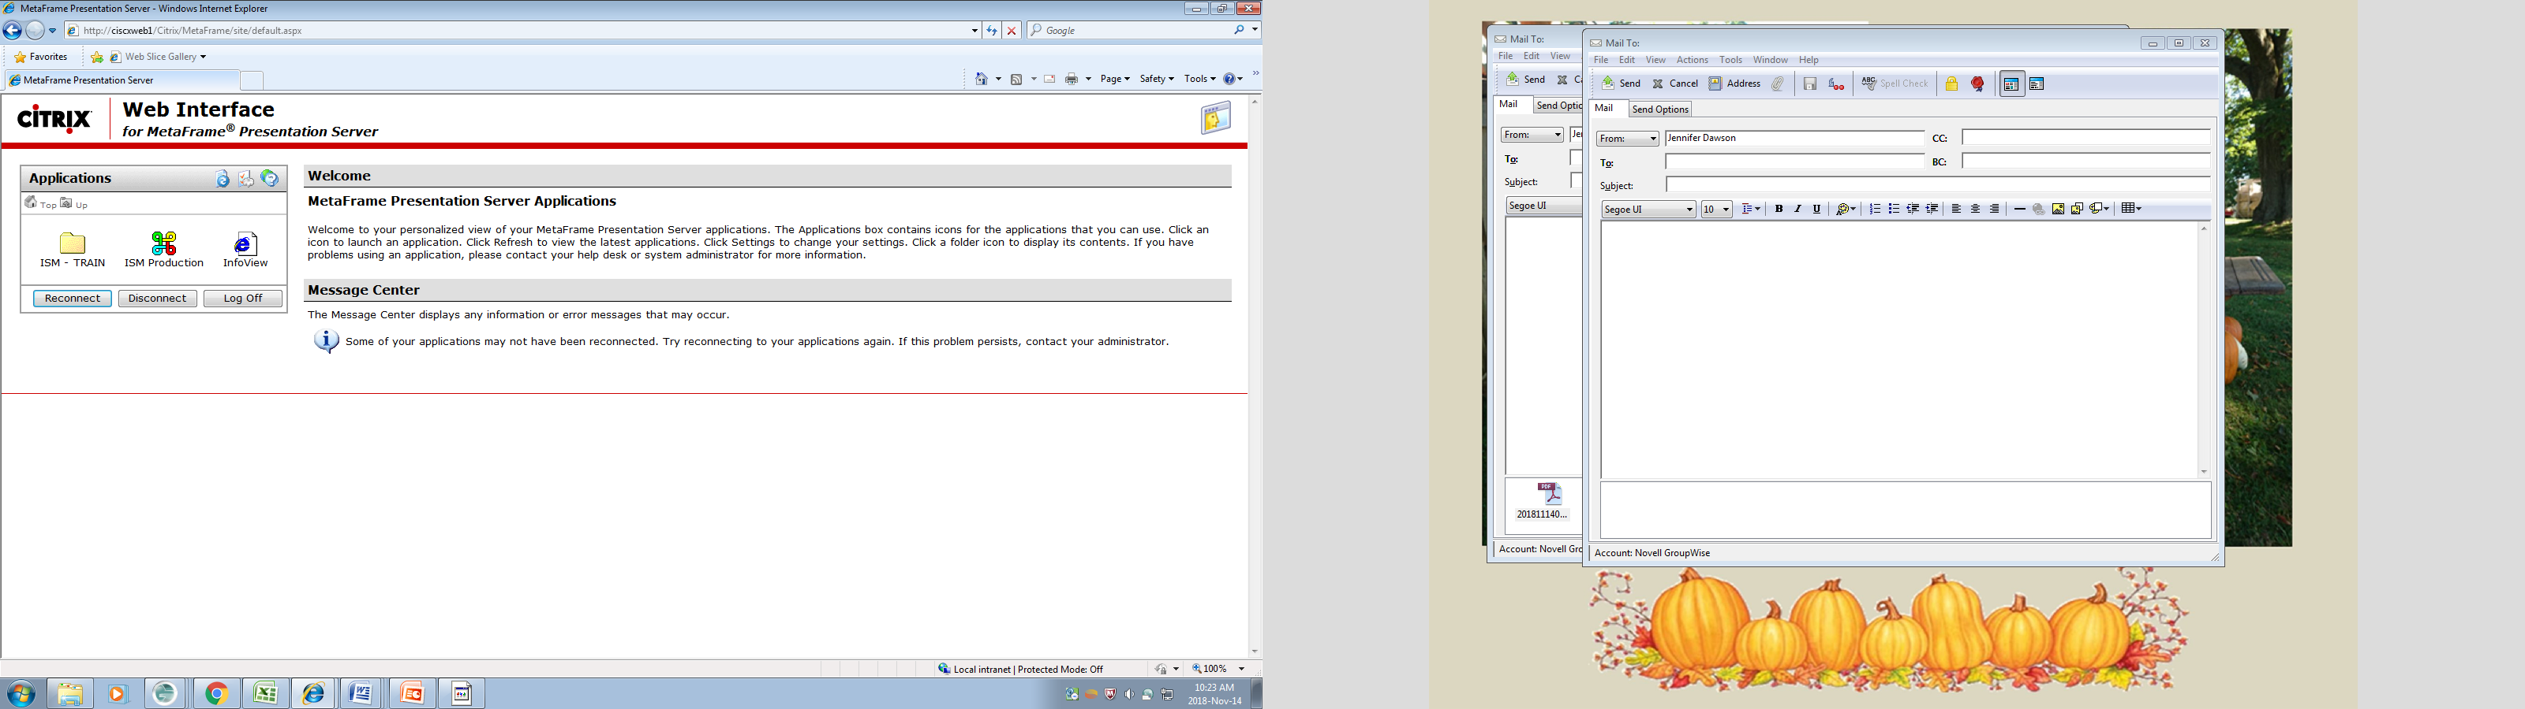
Steps to Document in ISM
Find patient/client chart
Click assessment tab
Double Click ESAS-r
Click apply
Click on ? Icon
Chart results/comments
Complete ESAS-r Graph

Slide 13
ESAS-r Graph

Slide 14
Steps To Chart ESAS-r on Cerner
Go to ADHOC charting
Click on Assessments or Palliative Care
Click on Edmonton Symptom Assessment System
Note each score 0-10
Right click to add comment/details
Click green checkmark to save

Slide 15
To View ESAS Results on Cerner
Found under assessment tab
Last assessment on list
You can also view previous results and track trends

Slide 16

Online ESAS-r
Any patient registered to the Provincial Integrated Palliative Care (P-IPCP) Program can now complete an ESAS-r via an online patient portal at www.healthpei.ca/ESAS

Slide 17
Patients Symptoms Matter
One of the most critical aspects of symptom management is routine symptom assessment and re-assessment
Allows symptoms to be recognized, diagnosed, treated & tracked over time.

