Slide 1
PEI Smoking Cessation Program (SCP):
Overview
Provincial Tobacco Control Coordinator
Health Promotion Unit
Chief Public Health Office
Department of Health and Wellness
Notes:
Created Nov 25, 2025

Slide 2

Introduction
SCP Overview
Program Forms
SCP Enrollment
Education/Resources
Chief Public Health Office 2024

Slide 3
PEI Smoking Cessation Program
The PEI Smoking Cessation Program helps PEI residents who wish to stop smoking, vaping, using other tobacco products by covering 100% of the cost of nicotine replacement therapy (NRT) or specific smoking cessation prescription medications.
Access via healthcare services (acute care, community based) and community pharmacies
Once per year, eligible PEI residents can receive a single continuous course (minimum 6 weeks to maximum 18 weeks in a row) of treatment.
Notes:
The PEI Smoking Cessation Program helps PEI residents who wish to stop smoking, vaping, using other tobacco products by: covering 100% of the cost of nicotine replacement therapy (NRT) or specific smoking cessation prescription medications.
Access via healthcare services, community pharmacies
Once per year, eligible PEI residents can receive a single continuous course (minimum 12 weeks in a row; maximum 18 weeks in a row) of treatment.
Available treatments:
Option 1: Non-Prescription Nicotine Replacement Therapy (NRT) Products (patches, gum, lozenges, inhaler, spray/mist)
Option 2: Prescription smoking cessation medications (Zyban® or Champix®).

Slide 4
Ottawa Model for Smoking Cessation
ASK
ADVISE
ASSESS
ASSIST
ARRANGE
Ask and document tobacco use status for all clients.
Use a standard message to reinforce the benefits of quitting – can be tailored for maximum impact.
Readiness to quit, confidence, behavioural patterns, and level of addiction.
Provide:
Pharmacotherapy
(NRT, Meds)
Counselling
Self-help materials
Follow-up support to monitor effectiveness, provide support and modify treatment plan.
An evidence-based approach that can be used in all healthcare settings.
Notes:
Best practice evidence: Based on OMSC (5A’s) - Ask, Advise, Assess, Assist, Arrange

Slide 5
Readiness To Quit:
Using Scaling as an Assessment Tool:
Importance and Confidence
1
2
3
4
5
Not
Very
-Level 4 or 5 indicates readiness to quit
-Readiness completed within 30 days of quit date
Notes:
A person’s motivation to quit and their confidence to quit can change from day to day, sometimes hour to hour.
Using scaling to assess an individual’s readiness to quit tobacco products is an important strategy used in helping people quit.
Scales are useful in addressing the extent to which a person is ready to change.
The OSCM uses two scales to identify how important quitting is at that moment, and how confident the person feels about quitting.
This is empowering information which can help an individual identify their motivators to quit and overcome barriers to making a quit attempt.
Patient’s must identify at least 4 or 5 on each scale to be eligible for the smoking cessation program.

Slide 6
Cessation Support Works
  Two components
    Nicotine Replacement Therapy (NRT) or Prescription Medications (buproprion, varenicline)
    Counselling
NRT or Meds
+ Counselling
Triple the odds of quitting (~30%)
PEI Chief Public Health Office
Notes:
There are two primary components to evidence-based smoking cessation treatment:
First, we have pharmacotherapy, which includes Nicotine Replacement Therapy (NRT)—such as patches, gum, lozenges,inhalers, spray/mist—and prescription medications like bupropion or varenicline. These work by reducing withdrawal symptoms and cravings, helping individuals manage the physical dependence on nicotine.
Second, we have counselling, which supports the behavioural aspect of quitting. This can include one-on-one or group counselling, quitlines, and digital tools that provide coping strategies, accountability, and encouragement.
When these two components are used together, they are significantly more effective. Research shows that combining behavioural support with pharmacotherapy triples the odds of a successful quit attempt, compared to using either one alone or no support at all.
This integrated approach is the cornerstone of our Smoking Cessation Program and what we encourage for all individuals seeking to quit tobacco or vaping products.

Slide 7
Changes in Coverage
Patients may switch course of treatment or between one dosage strength to another within 30 days of starting their treatment.
  New Intake Form [action plan] must be completed. Send to pharmacare and patients' pharmacy
  Approval by provincial tobacco control coordinator is not required
Follow up: Offer 1-2 weeks after initial consultation (recommend 3 follow ups after program start)
If beyond 30 days, changes will not be accommodated.
Travel supply
Chief Public Health Office 2024
Notes:
During a course of treatment, patients may switch between one dosage strength to another only when picking up their fills covered for the course of treatment.
Patients are permitted to switch the course of treatment (e.g., switch from one type of nicotine replacement therapy to one of the prescription smoking cessation medications or vice versa) at the 14-day follow-up appointment or within 30 days of starting their initial treatment with an SCP provider.
After this initial period, changes to the treatment plan will not be accommodated under the program.
Travel supply

Slide 8
Special Circumstances:
  Early Re-enrollment
  There may be exceptions to Islanders wanting to enroll more than once per calendar year, please reach out to the Tobacco Control Coordinator to review it on a case-by-case basis.
Age of consent:
  No minimum age to enroll.
  Consideration for prescribing NRT for youth under 18 - moderately or severely addicted to nicotine and motivated to quit.
  If NRT is prescribed and in the best interest of the patient—where the benefits outweigh the risks—the responsibility for the decision lies with the provider.
Chief Public Health Office 2024
Notes:
Eg. Someone enters hospital after only completing a couple weeks of the program and is looking to return to it 6-8 months later when health and readiness have improved

Slide 9
Roles and Responsibilities
Role | Responsibilities
Patient/Client | Express interest, consent to enroll, use NRT or prescription medication
Provider | Screen, assess readiness for quitting, complete consult form, educate, track progress, Submit forms, liaison with CPHO Follow-ups at 2, 6, 10 weeks (recommendation)
Pharmacare | Enroll eligible patients (ex. Ready to quit; PEI Health Card; not enrolled in the program within the past 12 months).
CPHO | Submit form to pharmacare and manually enter Consult Form into PHDMS (database)
Pharmacy | Dispense approved NRT or Rx
PEI Chief Public Health Office
Notes:
Expansion of Program:
1. Primary Care Networks: Complete consult forms, submit directing to pharmacare for approval

Slide 10
Consult Form: Paper
Eligibility:
Must answer 4 or 5 to questions #11 and # 12;
Must be interested in quitting in the next month;
Must be willing to set a quit date (within 30 days of consult date);
Valid PEI Health Card
PEI Chief Public Health Office
Notes:
Currently, paper forms are submitted by health care providers (ex. Primary care; acute care). Community Pharmacists enter information electronically into the PHDMS. Ongoing work to add consult forms to the EMR and CIS documentation programs. Updates will be provided when indicated.
Pharmacy enrollment follows same guidelines as PCN’s: product billing not available until confirmed eligible by Pharmacare (1-2 business days)
Require access to the Population Health Data Management System (PHDMS)
Prescription medication:
Patient enrolls with PCN – chooses prescription medication.
PCN can refer patient to pharmacy – Pharmacy will complete a *new* SCP assessment if patient requires a prescription.
Need to be explicit with patient that pharmacist will be completing a duplicate assessment (legally must perform an assessment to write prescription )
Acute Care: On admission, patients’ smoking status is identified. RT or RN will meet with the patient to determine eligibility for the smoking cessation program. Enrollment to the program starts once discharged. The patient is referred to a Primary care network; PCN completes the intake form.

Slide 11
Action Plan (Intake Form for Drug Cost Assistance): Paper
-To be completed at the same time as the consult form
-Sent to Pharmacare for program enrollment/eligibility
-Also completed for any product changes within 30 days of starting the program
PEI Chief Public Health Office
Notes:
Primary care/Community Providers (except Pharmacy): The form is called ‘Intake Form for Drug Cost Assistance’.
Pharmacy providers: Submit this form electronically on the PHDMS

Slide 12
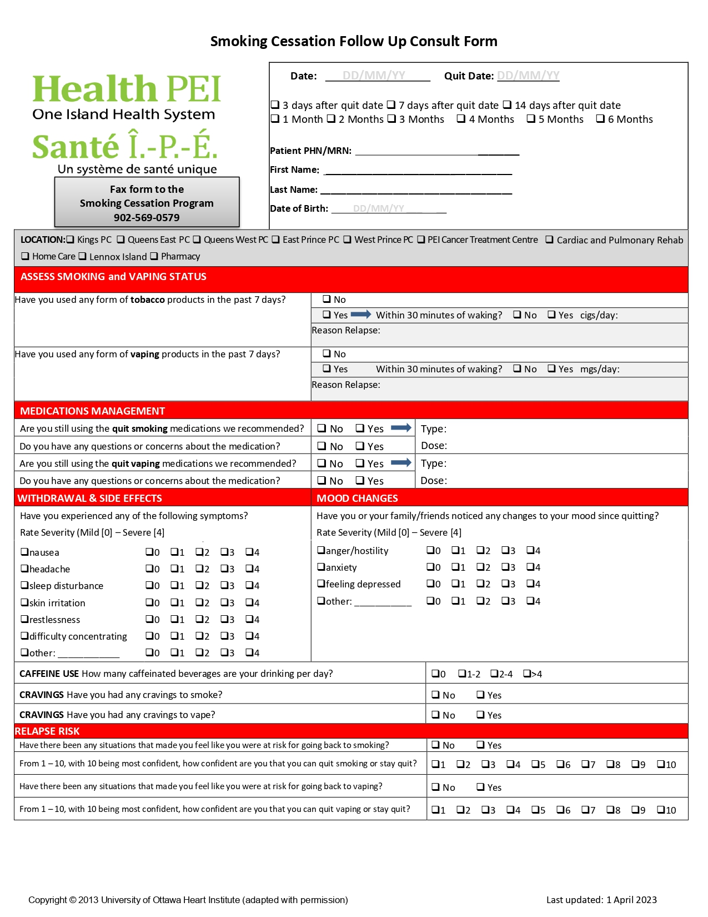
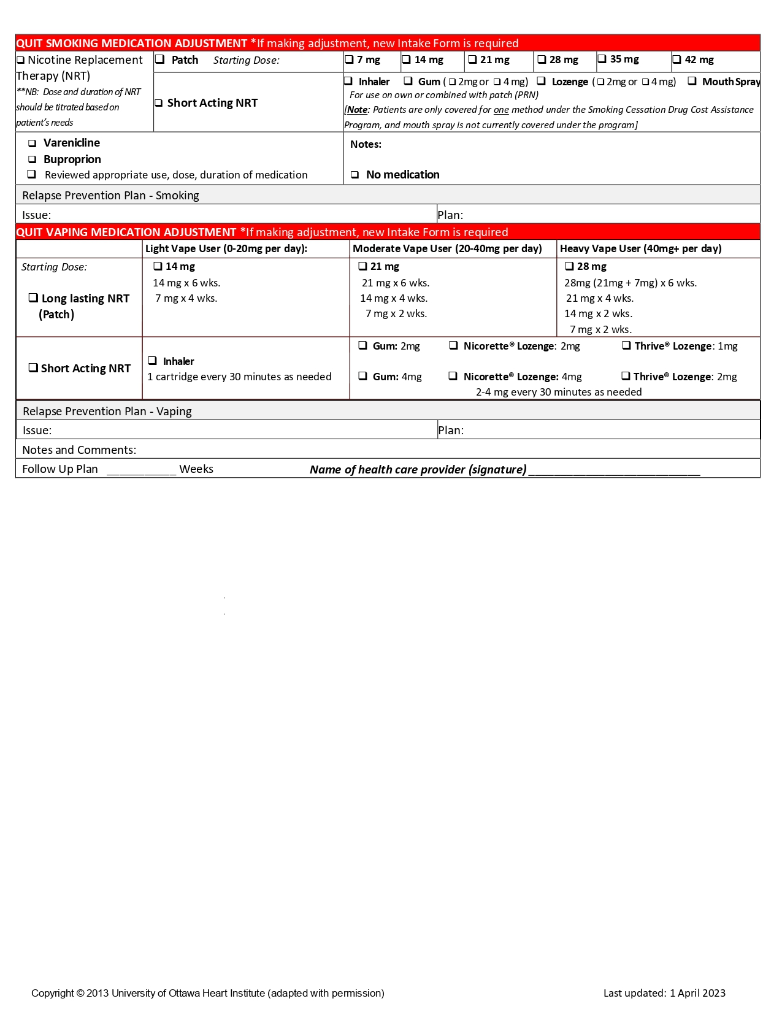
Program Form: Follow-up
-Monitor progress; change NRT product/method before initial 30 days if required
-Recommend follow up at three intervals:
  1-2 weeks;
  1-2 months;
  End of treatment
Notes:
Monitor progress, adjust treatment plans and provide ongoing tobacco cessation support
Consultation Forms have to be completed and sent prior to follow-up forms
Issue: follow-up forms have been received with no consultation received prior
Short-Term Follow-up: Scheduled 1-2 weeks after the initial consultation to allow for early assessment of progress and adjustment of the cessation plan.
Mid Term Follow-up: Scheduled 1-2 months after initial consultation to evaluate ongoing progress and address any challenges.
Long Term Follow-up: Scheduled for end of treatment plan for maintaining cessation success and preventing relapse.

Slide 13
PEI Chief Public Health Office

Slide 14
Education/Training:
https://www.youtube.com/watch?v=gZtZ20xr8M8
Disclaimer: Not all comments made by the presenter represent current practice in PEI. Providers are expected to follow direction by the Smoking Cessation Program. In PEI, only one NRT method is covered 100% in the PEI Smoking Cessation Program.
PEI Chief Public Health Office
Notes:
Note: At time 1:35-Discussion of special populations; review of counselling strategies; case studies

Slide 15
Frequently Asked Questions
What NRT products are covered by the Smoking Cessation Program?
Can a patient/client receive more than one type of NRT while enrolled in the Smoking Cessation Program?
What if a patient/client relapses?
What if a program is interrupted and they don’t complete it, are they able to enroll again?
What if the patient/client wants to change NRT product during the program?
What are common resources that patients/clients can access to support their smoking cessation journey?
PEI Chief Public Health Office
Notes:
Q: What NRT products are covered by the Smoking Cessation Program?
NRT patch; short acting NRT (inhaler, gum, lozenge, mouth spray/mist) and prescription medication (Varenicline or Buproprion)
Q: Can a patient/client receive more than one type of NRT while enrolled in the Smoking Cessation Program?
Patient/clients are eligible for one method under the Smoking Cessation Program (ex. NRT or Medication). Patient/Clients may choose to use a combination of NRT methods to assist with smoking cessation. Only one method under the Smoking Cessation Program is covered.
Q: What if a patient/client relapses?
Relapse is a normal part of the quitting journey. Patient/Clients are always welcome to re-enroll in the program once per calendar year (12 months)
Q: What if a program is interrupted and they don’t complete it, are they able to enroll again?
Special circumstances such as illness/hospitalization are considered; providers should contact the Provincial Tobacco Control Coordinator for approval. If approved, a new consult and action plan will be required.
Q: What if the patient/client wants to change NRT product during the program?
Patients/Clients may change NRT product within 30 days of starting the Smoking Cessation Program. No approval by the Provincial Tobacco Control Coordinator is required. Providers must submit a new Action Plan form.
Q: What are common resources that patients/clients can access to support their smoking cessation journey?
There are several free resources/programming to offer patient/clients: Smoker’s Helpline, Community Mental Health and Addiction and Live Well PEI program.

Slide 16

Smoking Cessation Resources
Smoker’s Helpline: Support to anyone looking to quit smoking/vaping/other tobacco products
  Call: 1-866-366-3667;
  Visit: https://smokershelpline.ca
Livewell PEI - Resources
  Visit: www.livewellpei.ca
Chief Public Health Office 2024

Slide 17

Questions?
Contact Information for the Provincial Tobacco Control Coordinator:
Phone: 902-368-4319
Email: quitsmoking@ihis.org
Web: www.princeedwardisland.ca/quitsmoking

