Slide 1


Chest Tubes
Transition to Practice

Slide 2

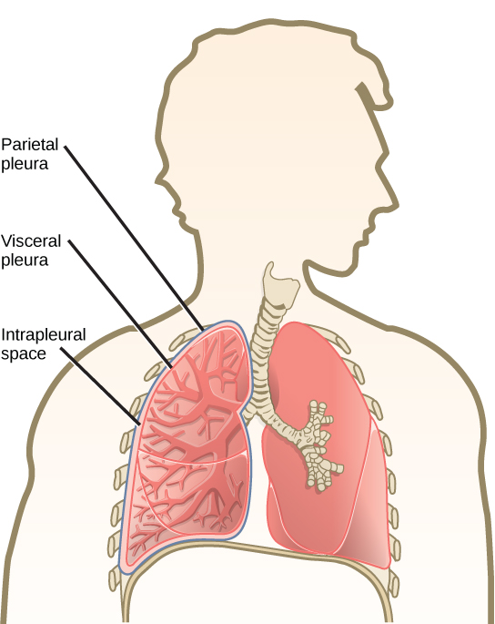
What do Chest Tubes do?
Chest Tubes are inserted to remove air and fluid from the pleural space, prevent air or fluid from re-entering the pleural space, and re-establish normal intrapleural and intrapulmonic pressures.
(Potter & Perry, 2010)
Notes:
The blood, air of fluid within the pleural cavity cause the lung to collapse. We insert chest tubes to re expand the collapsed lung.

Slide 3
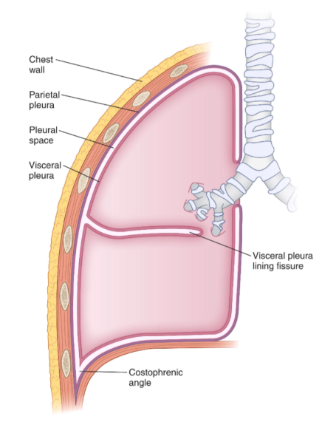
What is the Pleural Space?
The pleural cavity is a very thin potential space located between the parietal and the visceral pleura.
The visceral and parietal pleura are bound by connective tissue to the surface of the lung and inner surface of the chest wall.
The pleural cavity (space) contains a small amount of fluid and some free cells that reduce friction between these layers to aid in effective respirations.
Bekele & Alayande, 2022)
Notes:
The lung does not lie in the pleural cavity; rather it is enveloped by the pleural cavity.
The amount of fluid between these pleural layers is so small that it cannot be visualized by ultrasound. It is a lubricant that aids in effective inspiration and expiration.

Slide 4
Reasons for Chest Tube Insertion
Blood, air or fluid in the intrapleural space disrupts the normal negative pressure and causes the lung to collapse.
Pneumothorax: Air within the pleural space
Hemothorax: Blood within the pleural space
Pleural effusion: Fluid within the pleural space
Empyema: Collection of pus within the pleural cavity
(Potter & Perry, 2010)​
Notes:
Pneumothorax: Accumulation of air in the pleural space, which results in a rise in intrathoracic pressure and reduced vital capacity.
Hemothorax: Most common cause is blunt or penetrating injury to the intra or extrathoracic structures.
Pleural effusion: Any condition that interferes with secretion or drainage of fluid will lead to pleural effusion. Eg. Pneumonia, cancer, heart, liver or kidney disease.
Empyema: Fluid is thick, opaque, and foul smelling. The most common cause is pulmonary infection and lung abscess caused by thoracic surgery or chest trauma, in which bacteria are introduced directly into the pleural space. Treatment is aimed at treating the infection, emptying the empyema cavity, reexpanding the lung, and controlling the infection. Thoracentesis or chest tube may be used to help resolve the empyema.

Slide 5
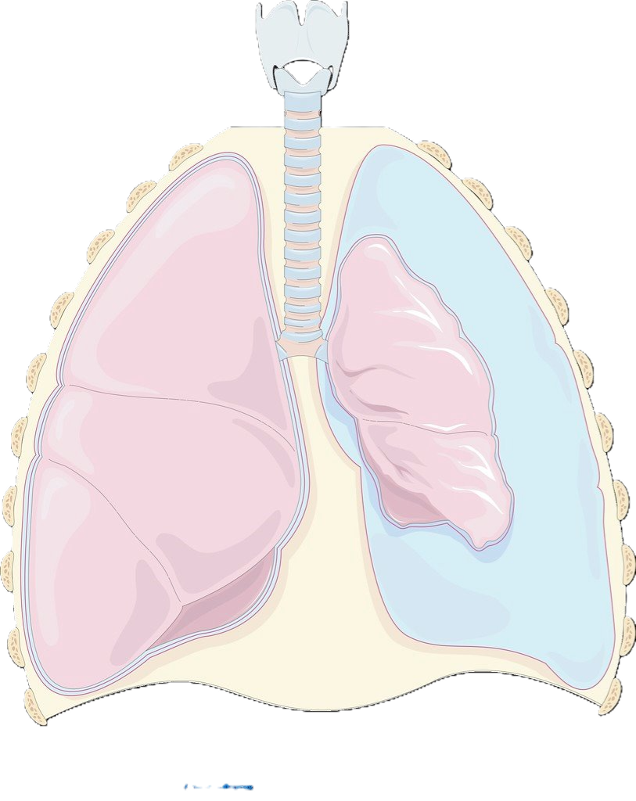
Notes:
Example of a Pneumothorax

Slide 6
What Chest Tube Do We Need?
Options you might see:
Wide-bore Chest Tube (Trochar chest tube)
Pigtail Chest Tube (Wayne Pneumothorax)
Pleur-X tube

Slide 7
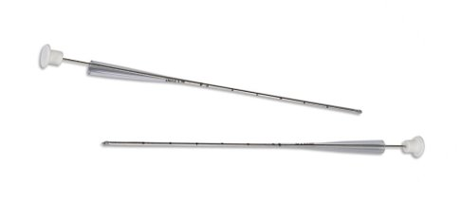
Trocar Chest Tube
The Wide-bore chest tube you will see most often is the Trochar Chest Tube. Trocar Catheters consist of a surgically sharp aluminum trocar and a clear PVC thoracic catheter. This tube is larger and is less likely to become blocked/clogged, used to remove thicker fluid or when suspicious of larger clots.
(Cardinal Health, n.d.)
Notes:
PVC = polyvinyl chloride
https://www.cardinalhealth.com/en/product-solutions/medical/surgical/cardiothoracic/thoracic-catheters/argyle-trocar-catheters.html

Slide 8
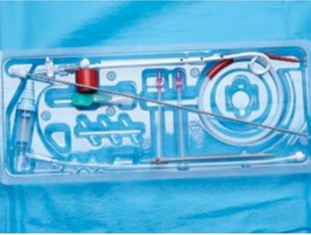
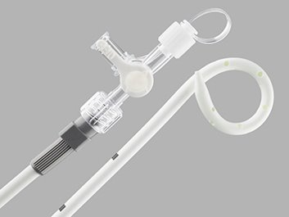
Wayne Pneumothorax
The pigtail chest tube you will see most often is the Wane Pneumothorax Chest Tube. It is used for the relief of simple, spontaneous, iatrogenic, and tension pneumothorax.
(Cook Medical, n.d.)
Notes:
The Wayne Pneumothorax is a type of Pig tail chest tube
Physicians may ask you to open the Wayne pneumothorax kit to access the Heimlich valve (one way valve), this is not something we should be doing , instead use the P-eggy drain.
The Heimlich valve is a rubber flutter one-way valve within a rigid plastic tube which connects to standard chest drain. It does not need to be kept upright like the underwater sealed drain and therefore is suitable for outpatient use. However, the efferent portal of the Heimlich valve must be kept open to the atmosphere making control of the fluid effluent difficult. The device is bulky under clothing and staining is a constant problem. To avoid this problem, the valve should be attached to a perforated plastic bag, or a specifically designed one-way valve including a small reservoir can be used
Iatrogenic means relating to illness caused by medical examination or treatment.
https://www.cookmedical.eu/products/ac405881-4bb9-42c0-bd4d-70b4dee22bd4/

Slide 9
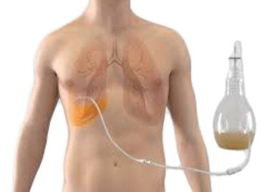
Pleur-X tube
The PleurX Pleural Catheter System is indicated for intermittent, long term drainage of symptomatic, recurrent, pleural effusion, including malignant pleural effusions and other recurrent effusions that do not respond to medical management of the underlying disease.
(BD, n.d.)​

Slide 10
Placement
The physician will locate the 4th/5th intercostal space mid or anterior axillary line
landmarks = “triangle of safety”: anterior to mid axillary line, posterior to pectoral groove, 5th intercostal space
Following insertion the Chest tube will be Xray’d
(Nickson, 2020)
Notes:
https://litfl.com/intercostal-catheter-chest-drain/

Slide 11
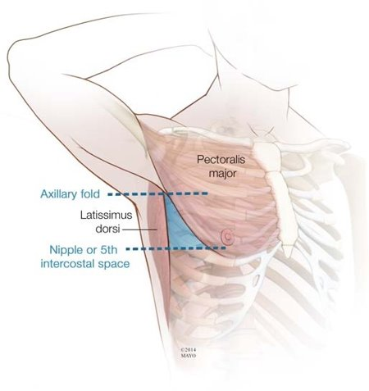
Notes:
Triangle of safety: This is the area in which we attempt placement of thoracic catheters for pneumo’s.
We use this landmark to avoid thoracic nerves, muscle, breast tissue and axillary structures (nodes).
The MD will insert the chest tube above the rib to avoid the nerves below the rib.
Needle decompression is 2nd intercostal space MCL

Slide 12
*Make sure the Chest tube is well secured at the insertion site before the chest tube is dressed and the physician leaves*
Notes:
If you work in an area where a physician might insert a chest tube this is very important

Slide 13
Now That my Patient has a Chest Tube Inserted, What do I Dress it With?
Supplies needed
Oil emulsion non-adhering dressing (Shur-Conform)
Y cut 4x4 Gauze
Mepore tape
Orange waterproof tape
Notes:
This information was received from the QEII Thoracic Unit.

Slide 14
Dressing the Site
Place the petroleum gauze around the insertion site (make sure it is around the base not on top of the tube. You can wrap this around the tube or make a Y cut to in the dressing to encircle the tube at the base).
Next place one Y cut 4x4 gauze over the oil emulsion gauze around the insertion site of the tube.
Lay one full gauze over the site (Tubing included so the tape does not stick to the tube close to the insertion site).
Secure dressing with Mepore tape to patients skin. Orange waterproof tape is very hard on the skin.
*When cutting dressing supplies remember to use sterile scissors*
Make sure to tape each connection site with orange waterproof tape to ensure maintenance of solid connection.
Notes:
This information was received from the QEII Thoracic Unit. Staff note that there is talk of changing the top layer of the dressing from mepore tape to a mepilex dressing.

Slide 15
Now That I’ve Dressed it What do I Attach it to?
Frequently used Drainage Systems:
Pleur-evac drainage system
P-Eggy Drain
PleurX Drainage System
Notes:
The drainage system will be ordered by the doctor.
Heimlich valve was used in the past and this choice should be replaced by the P-Eggy drain.

Slide 16
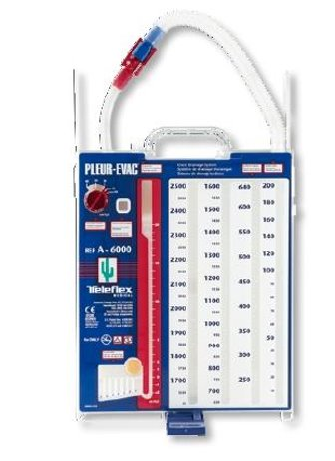
Pleur-Evac Drainage System
Follow the link provided for a refresher and instruction on setup of the Pleur-Evac Drainage System.
https://www.youtube.com/watch?v=_OlzXZck3iw
Notes:
16 min video. Stop Video at 9:40. Before 2 suction/1 device

Slide 17
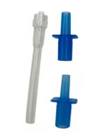
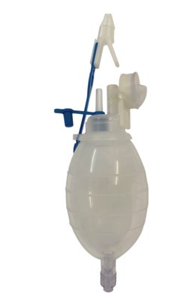
P-Eggy
The P-Eggy drain can be connected to any chest catheter as it comes with a few different options for connection.
It is a one way valve that removes air and fluid (if the fluid is thin and believed to be a small amount)
They look very similar to the JP drains we use at Health PEI and are very similar in that we squeeze the bulb to create a negative pressure atmosphere to draw drainage into.
Video below for set up instructions:
https://www.youtube.com/watch?v=VbK5nrBbkNY
Notes:
The bottom has a port that leur locks to our syringes allowing us to pull samples off the collection bulb.
The side has a one way valve allowing air out but not back in.
2 min video

Slide 18
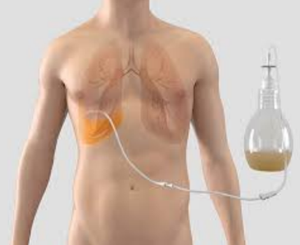
PleurX Drainage System
You may have a patient who has an existing or who is being discharged with a PleurX Pleural Catheter System.
PleurX™ Pleural Catheter System
(BD, n.d.)
Notes:
The device is indicated for the palliation of dyspnea due to pleural effusion and providing pleurodesis (resolution of the pleural effusion).
Provides steps for patients to take at home. Great video to know about to direct patients to as well as how to care for this drain.
12 min video

Slide 19
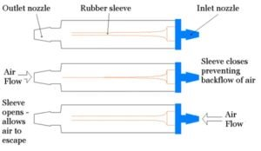
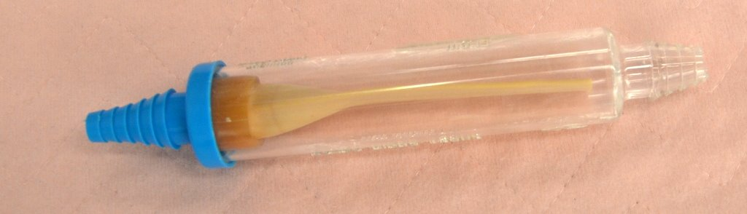
Heimlich Valve
Notes:
You may hear a physician talking about the heimlich valve. This was used more in the past, now we have the P-Eggy drain and is a great alternative.

Slide 20
*Remember we need a physician's order to have a suction device attached to the patient*

Slide 21
References
BD. (n.d.). PleurXTM pleural Catheter System. PleurXTM Pleural Catheter System.
  https://www.bd.com/en-ca/products-and-solutions/products/product-families/pleurx-
  pleural-catheter-system
Cardinal Health. (n.d.). ArgyleTM trocar catheters - cardinal health. ArgyleTM trocar catheters.
https://www.cardinalhealth.co.uk/en_gb/medical-products/operating-room/cardiothoracic/thoracic-catheters-and-trocars/argyle-trocar-catheters.html
Cook Medical. (n.d.). Wayne Pneumothorax Catheter Set.
  https://www.cookmedical.eu/products/ac405881-4bb9-42c0-bd4d-70b4dee22bd4/
Nickson, C. (2020). Intercostal Catheter (Chest Drain). https://litfl.com/intercostal-catheter-chest-drain/
Potter, P. A., & Perry, A. G. (2010). Fundamentals of Nursing (4th ed.). Elsevier.
Urden, L.D., Stacy, K.M., & Lough, M.E. (2018). Critical care nursing: diagnosis and management (8th ed.). ISBN:
978-0-323-44752-2
Zisis C, Tsirgogianni K, Lazaridis G, Lampaki S, Baka S, Mpoukovinas I, Karavasilis V, Kioumis I, Pitsiou G,
Katsikogiannis N, Tsakiridis K, Rapti A, Trakada G, Karapantzos I, Karapantzou C, Zissimopoulos A,
Zarogoulidis K, Zarogoulidis P. Chest drainage systems in use. Ann Transl Med. 2015 Mar;3(3):43. doi: 10.3978/j.issn.2305-5839.2015.02.09. PMID: 25815304; PMCID: PMC4356865.

Slide 22
You can find this presentation on the Staff Resource Center under Transition to Practice

Slide 23
Questions?

