Slide 1

Drawing Blood Cultures
TRANSITION TO PRACTICE
PROFESSIONAL PRACTICE OFFICE

Slide 2
Objectives
By the end of this session Participants will be able to:
Identify why blood cultures would be ordered
Identify who can draw blood cultures from a CVAD
Indicate when it would not be appropriate to draw blood cultures
Preform appropriate blood culture collection technique
Identify the difference between Aerobic and Anaerobic
Identify the appropriate order of blood draws

Slide 3
Policy
Currently there is one policy on the Health PEI Policy Website
QEH Nursing - Blood Cultures Policy
This policy ensures that blood cultures are obtained using aseptic technique, appropriate blood volumes, and correct timing in relation to antibiotic therapy.
Notes:
PCH Educators indicate that they follow this policy as well as Potter and Perry.

Slide 4
Blood Cultures
Collection of blood cultures is a critical diagnostic procedure used to detect blood infections including bacteremia and septicemia.
By using standardized practices for obtaining blood cultures, we enhance patient safety, diagnostic accuracy and reduce incidents of contaminated specimens.
(Health PEI Policy and Procedures Manual, 2026)

Slide 5
Indications for Blood Cultures
Suspected bacteremia, septicemia or sepsis; Fever, hypothermia, chills or rigors of unknown origin
Suspected endocarditis
Clinical deterioration of hemodynamic instability without a clear source of infection
Suspected bloodstream infection in immunocompromised patients
As ordered by the Most Responsible Provider (MRP) prior to the initiation of antimicrobial therapy
(Health PEI Policy and Procedures Manual, 2026)
Notes:
Reasons you may see blood cultures ordered.
Bacteremia is the presence of bacteria in the bloodstream

Slide 6
Contraindications
Blood Cultures should not be collected in the following circumstances unless specifically ordered:
Routine or repeated collection without clinical indication or provider order
Collection from a vein with an active intravenous infusion
Collection from a peripheral venous catheter
Repeated collections less than 24 hours apart without critical changes in patient condition
When collection would significantly delay the initiation of time sensitive antibiotic therapy beyond 1 hour unless directed otherwise
(Health PEI Policy and Procedures Manual, 2026)
Notes:
Blood culture sampling must not be repeated more frequently than daily, unless under critical conditions and/or changes in patient symptoms as ordered by the MRP.

Slide 7

All Nurses Can Draw Blood Cultures
Notes:
All nurses RN/LPN can draw blood cultures with a butterfly.
Only specially trained RN's can access CVAD devices for blood cultures. *This is not that training*
*Policy stated to never draw from a peripheral IV* CVAA indicated that this causes hemolysis but may be an option of there are no others.

Slide 8
Antiseptic technique and routine practices are essential to prevent contamination and ensure accurate blood culture results.
Timely and appropriate blood collection supports early diagnosis and effective treatment of bloodstream infections
(Health PEI Policy and Procedures Manual, 2026)

Slide 9
Blood cultures must be obtained before starting antibiotic therapy whenever possible.
** Antibiotic administration must not be delayed by more than one hour from when it was ordered.**
(Health PEI Policy and Procedures Manual, 2026)

Slide 10
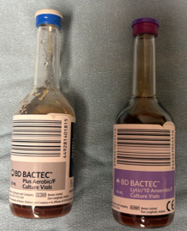
Blood Culture Bottles
Blood Cultures consist of two bottles, one aerobic (blue top) and the other anaerobic (purple top).
This determines what type of bacteria is growing in the bloodstream.
  Aerobic bottles grow bacteria that thrive in oxygen
  Anerobic bottles grow bacteria that cannot survive in the presence of oxygen
(Potter & Perry, 2010)
Notes:
Aerobic bottles grow bacteria that thrive in oxygen (Staohylococcus aureus or Pseudomonas and fungi (e.g Candida)
Anerobic bottles grow bacteria that cannot survive in the presence of oxygen (anaerobes such as Bacteroides fragilis or Clostridium species).

Slide 11
Aerobic vs. Anaerobic
Aerobic
Require the presence of air or free oxygen for life
Bottle has a blue top and a silver label
Drawn 1st
Anaerobic
Live in the absence of air or free oxygen
Bottle has a purple top and a purple label
Drawn 2nd
Notes:
WHY Aerobic first?
Because when using a butterfly there is air in the tubing and aerobic require the presence of air and anaerobic need absence of air and O2.

Slide 12
Drawing Blood Cultures
2 sites are drawn as close to same time as possible
  2 Peripheral sites
  OR
  Peripheral and CVAD
  If multi-lumen CVAD is used, draw aerobic/anaerobic bottles from the distal lumen and an aerobic bottle only from the remaining lumens.
Order of Draw
  Aerobic Bottle (blue top) First then Anaerobic Bottle (purple top)
  Blood cultures are drawn before any other labs
(Health PEI Policy and Procedures Manual, 2026)
Notes:
When trying to remember what bottle comes first think of your ABCs… Blue before Purple
~20mL required – Goal is 10 ml in each bottle

Slide 13
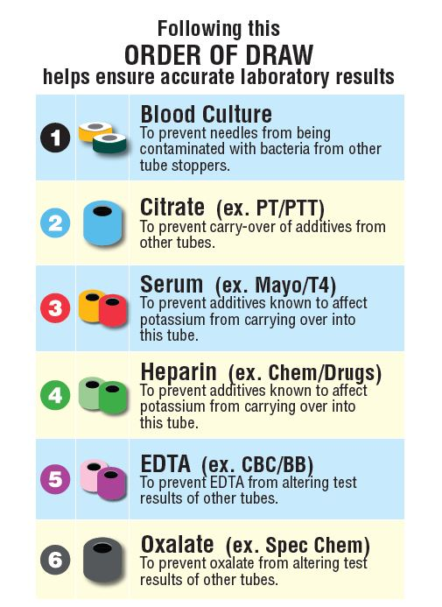

Slide 14

Anaerobic bottles must only be collected for pediatric patients when ordered by the MRP.
(Health PEI Policy and Procedures Manual, 2026)
Notes:
For pediatric patients, we use the BD Bactec Peds Plus/F Vials which automatically include testing for both aerobic and anaerobic.

Slide 15
Blood Cultures Must Not be Drawn From:
A vein in which an intravenous solution is running.
A peripheral venous catheter.
(Health PEI Policy and Procedures Manual, 2026)
Notes:
Hemolysis is a major factor when blood is drawn through a peripheral IV

Slide 16
Wait time is routinely not required between blood culture collections from separate sites.
(Health PEI Policy and Procedures Manual, 2026)

Slide 17
If Your Patient Has One or More Access Points:
(exceptions may apply for the pediatric population)
Draw first set from a peripheral site.
Draw a second set from a central venous access device lumen.
If the CVAD is suspected to be the source of infection, draw an aerobic culture from all lumens and an anaerobic from one CVAD lumen.
For patients with suspected endocarditis, a third set of cultures may be collected. If “blood cultures x 3” are requested, the last draw should preferably be performed at least 30 minutes after the previous collections (if antibiotic therapy is not pending)
(Health PEI Policy and Procedures Manual, 2026)
Notes:
When drawing a set of cultures this means you draw both the aerobic and Anaerobic bottles.
In specific circumstances a physician may request an additional aerobic culture from each remaining lumen of the CVAD and any additional access points, i.e. Arterial lines, dialysis lines, etc.

Slide 18

Drawing Blood From a CVAD
The RN must complete the following competency requirements:
The RN must have taken the CVAD course with Vascular Access Coordinator
Successfully completed blood sampling requirements.
Have been deemed competent by the Provincial Access Coordinator or Clinical Nurse Educator.
(Health PEI Policy and Procedures Manual, 2026)
Notes:
Obtaining blood culture sample from CVAD must only be performed by an RN trained in CVAD blood withdrawal.

Slide 19
Gather Your Equipment
Appropriate blood vial
Blood Culture vials (Please check for expiry date):
  Anaerobic (purple top, purple label) 8-10 mL per draw, preferably 10 mL.
  Aerobic (blue top, silver label) 8-10 mL per draw, preferably 10 mL.
Pediatric (silver top, pink label) 1-3 mL per bottle. (Used for infants and children up to age 17).
(Health PEI Policy and Procedures Manual, 2026)
Notes:
Make sure you are marking the 10 ml mark on the side of the bottle before you begin the draw.
Fungal (histoplasmosis)/mycobacterium (red top, red label) (5 mL per draw) (Obtained from Microbiology Laboratory - extremely rare use).

Slide 20
Peripheral vs. CVAD Equipment
For Peripheral Draws:
Venipuncture supplies
70% alcohol swab (2)
Untinted 2% Chlorhexidine Gluconate with 70% alcohol swab
For CVAD Draws :
70% alcohol swab (3)
Blood transfer device
Empty 10 mL sterile syringes
0.9% Normal Saline pre-filled 10 mL flush (2 per lumen)
Sterile 4x4 gauze (one per lumen)
(Health PEI Policy and Procedures Manual, 2026)

Slide 21
For Both Techniques You Will:
Verify provider order and obtain labels.
Introduce self and explain procedure to the patient.
Identify patient and compare identifiers with specimen labels.
Perform hand hygiene.
Mark desired blood levels on bottles before initiating draw (8-10 mL adult, 1-3 mL pediatric).
Aerobic and/or anaerobic cultures deficient by more than 1 mL of the minimum required volume will have a comment added in the report and the event will be entered in PSMS.
Take each set of blood cultures from a separate site.
(Health PEI Policy and Procedures Manual, 2026)
Notes:
***Accurate blood to medium ratio is crucial to ensuring accurate results*** Make sure to mark your line and draw 8-10 ml
Maximum blood culture withdrawal from an adult (regardless of draws/bottles) is to be no more than 80 mL per collection.

Slide 22
Obtaining a Sample via Venipuncture
Perform hand hygiene.
Perform proper skin antiseptic prior to collection.
Open an untinted 2% Chlorhexidine Gluconate and 70% alcohol swab and prep the site.
Allow complete drying for a minimum three (3) minutes.
Remove plastic flip top from blood culture bottle and vigorously wipe septum with 70% alcohol and allow for complete drying for 30-60 seconds.
Proceed with venipuncture as per Potter & Perry “Collecting Blood Specimen and Culture by Venipuncture”.
(Health PEI Policy and Procedures Manual, 2026)

Slide 23
Venipuncture Sample Continued
When drawing blood cultures peripherally, use a butterfly collection device, as direct connection could allow for the medium to reflux into the vein.
Ensure blood culture bottle does not get inverted during collection until removed from collection device.
Add/collect blood into the blood culture vial up to the indicated line
Draw paired samples from 2 separate sites. If unable to obtain second site, then allow 30 minutes between samples from same site.
Obtain aerobic culture then anaerobic culture (when required), prior to other venipuncture specimens, as per order of draw.
(Health PEI Policy and Procedures Manual, 2026)

Slide 24
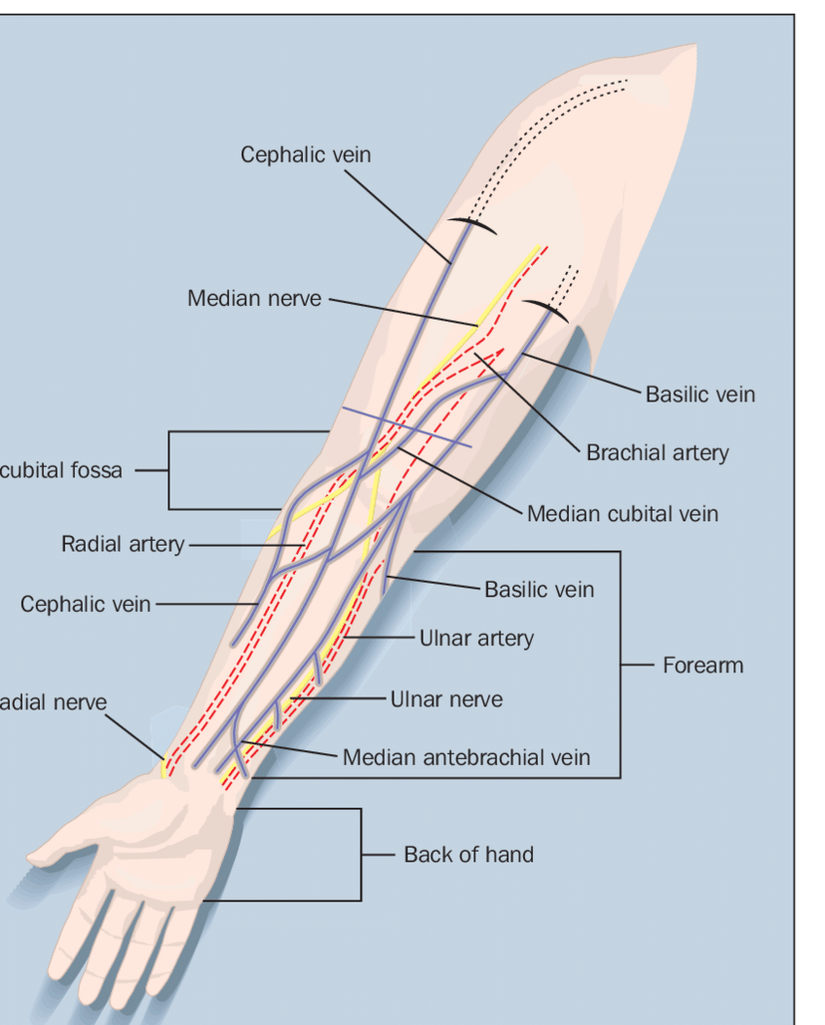

Slide 25
Obtaining a sample from a CVAD
Turn off all infusions and clamp lumens for 1 – 2 minutes.
Wearing a mask and sterile gloves, remove and replace needle free connector before blood sampling or draw directly from the CVAD hub.
Cleanse with 70% alcohol and allow complete dry of 30-60 seconds.
Place sterile 4x4 under lumen.
Remove plastic flip top from blood culture bottle and vigorously wipe septum with 70% alcohol and allow for complete dry of 30-60 seconds.
Perform hand hygiene.
Do not flush (if possible) or discard prior to blood culture sample.
(Health PEI Policy and Procedures Manual, 2026)
Notes:
***Only to be performed by an RN trained in CVAD blood withdrawal***
Do not flush (whenever possible) or draw discard prior to blood culture sample

Slide 26
CVAD Sample Continued
Do not directly connect blood culture bottle to CVAD using holder, due to risk of reflux of culture medium into line.
Use a 10mL syringe to collect all blood cultures from CVAD’s.
Add/collect blood into the blood culture vial up to the indicated lined
Flush CVAD with 20 mL of sterile 0.9% sodium chloride until needle free connector is clear using the push pause technique.
(Health PEI Policy and Procedures Manual, 2026)
Notes:
Connect syringe to needle-free connector and withdraw 8-10 mL.
Use blood transfer device to transfer sample into blood culture bottle.
*****Above is in the Policy but CVAA guidelines state do not draw through needle free connector** potential colonization in the needle free connector.
Do not draw blood through existing needle-free connector to reduce risk of contamination from device colonization. Remove and replace needle-free connector adhering
To policy before blood sampling or draw directly from hub (Guidelines Development Group on behalf of Canadian Vascular Access Association, 2024).

Slide 27
**Do not draw blood for cultures through the existing needle free connector**
To reduce the risk of contamination from device colonization, remove and replace the needle free connector as per policy before sampling. Otherwise, draw directly from the hub.
(Guidelines Development Group on behalf of Canadian Vascular Access Association, 2024)

Slide 28
Immediately After Collection
Invert blood culture bottle 8 to 10 times. This mixes the blood and medium together and prevents the blood from clotting.
Label the blood collection bottle using specimen collection label.
When entering the order electronically, include the time of draw and the site the specimen was obtained from.
Sign label with your first initial and last name.
If site is not documented electronically, hand write the site location on the label.
If drawing from a CVAD, ensure to label from which lumen the sample came from either the color of the lumen or distal, medial, proximal.
(Health PEI Policy and Procedures Manual, 2026)

Slide 29
After Collection Continued
Place collection label in the same orientation as the bottle, do not cover bottle barcode or wrap label around bottle or neck of bottle.
Place in biohazard bag for transport.
Remove gloves; perform hand hygiene.
Arrange transport to the Lab as soon as possible.
Document the procedure in the patient health record as per HPEI Nursing Documentation Standard Policy
(Health PEI Policy and Procedures Manual, 2026)

Slide 30
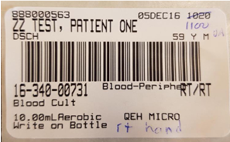


Slide 31
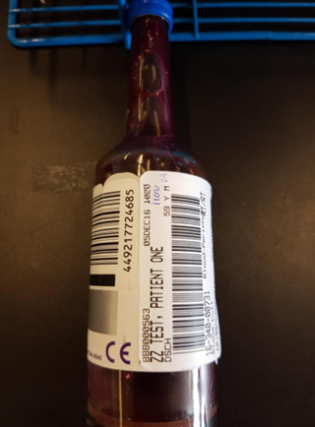

Slide 32
Frequently Asked Questions Revisited
Draw first set of cultures from a peripheral site first then draw a second set from a central venous access device lumen if available.
If the CVAD is suspected to be the source of infection, draw an aerobic culture from all lumens and an anaerobic from one CVAD lumen.
  Identify on the label which lumen each sample is from.
Accurate blood to medium ratio is crucial to ensuring accurate results. Make sure to get a sample of at least 8mL (goal 10mL)
If you are unable to obtain a sample from a second site, then allow 30 minutes between samples from the same site.
(Health PEI Policy and Procedures Manual, 2026)
Notes:
Reviewing the FAQ’s from the Policy that we have already reviewed but they are good take home points.

Slide 33
FAQ's Continued
Draw Aerobic cultures first and Anaerobic cultures second.
Draw blood cultures prior to other venipuncture specimens, as per order of draw.
Do not flush (if possible) or discard prior to blood culture sample.
Do not directly connect blood culture bottle to CVAD using holder, due to risk of reflux of culture medium into the line. Connect syringe to needle-free connector and withdraw 8-10 mL.
If collecting a sample through a needle free connector, make sure you have changed the connector as per policy prior to sample collection. Otherwise remove the connector and draw directly from the hub.
(Health PEI Policy and Procedures Manual, 2026)
Notes:
Cultures, Blue, Red, Green, Lavendar, Grey

Slide 34

If you are ever looking for additional resources, CVAA Guidelines have been added to the staff resource center for ease of access by all staff.
Username: HealthPEIguidelineuser
Password: 2024PEIGuidelines
Notes:
Username and passwords are case sensitive

Slide 35
Questions?

Slide 36
References
Guidelines Development Group on behalf of Canadian Vascular Access Association. (2024). Canadian Vascular Access and Infusion Therapy Guidelines, 2nd Edition. Pappin Communications.
Health PEI Policy and Procedures Manual. (2026).Blood Cultures. Health PEI.
Potter, P. A., & Perry, A. G. (2010). Fundamentals of Nursing (4th ed.). Elsevier.
Developed in collaboration with ​Jaimee Lee Surins – Clinical Nursing Educator​ Medical/Palliative at Prince County Hospital​

