Slide 1

Head-to-toe Assessment
Transition to Practice Program
Professional Practice Office

Slide 2
Learning Objectives
By the end of the session participants will:​
Perform a systematic head-to-toe assessment.​
Recognize abnormal findings and early signs of deterioration.​
Prioritize nursing concerns.​
Increase confidence in clinical decision-making.​
Notes:
The information included in this slide show may highlight aspects of your assessment that come second nature and you may not realize you are already doing.

Slide 3
General Survey
Notes:
Your Assessments will always be tailored to your patient's treatment area and purpose of the exam. Ex: Initial assessment is more thorough, follow up assessments are more focused.

Slide 4
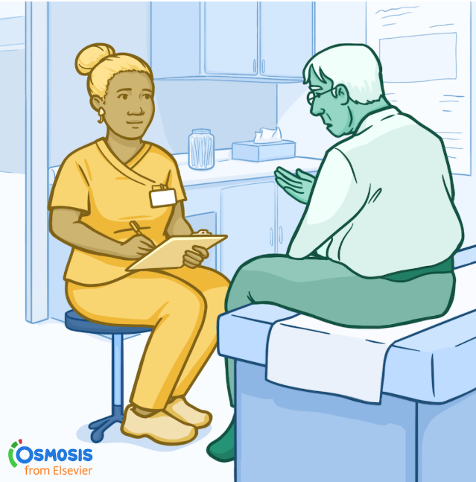
What is a General Survey?
Assessed throughout interaction with the patient
Assessment of
  Behavior
  Appearance
  Mobility
Provides information about illness characteristics, hygiene, body image, emotional state, recent changes in weight, and developmental status
(Astle et al., 2024)

Slide 5
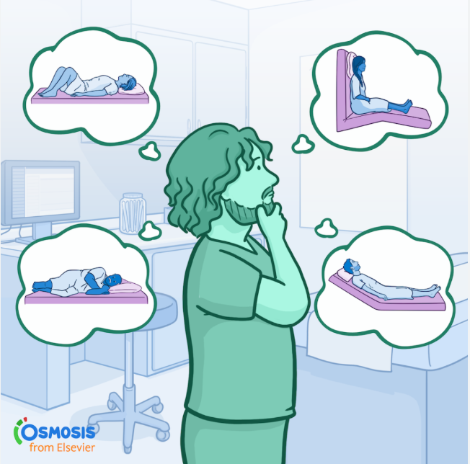
Appearance and Behavior
Age, gender, body type
Height and weight
Signs of distress
Posture and position
Gait and body movements
Hygiene and grooming
Dress
Affect and mood
Speech
Victims of violence
(Astle et al., 2024)
Notes:
Age and gender: affects the manner in which the entire assessment is performed.
Body type: Observe if pt is muscular, obese, or excessively thin. Can reflect the levels of health, age, and lifestyle
Signs of distress: There are sometimes obvious signs of distress that can indicate pain, difficulty breathing, and anxiety
Posture/position: Is the patient slumped, erect, or bent? Are they leaning to one side? Are they laying, are they able to sit or stand? Posture and position can indicate mood or pain
Gait: Observe patient walking if they are ambulatory. Are movements coordinated or uncoordinated? They should be walking with arms swinging freely at sides, with head and face leading the body
Body movements: should be purposeful. Note any tremors and if any body parts are immobile
Hygiene and grooming: Note pt's level of cleanliness by observing hair, skin, and fingernails. Note if patient's clothes are clean
Dress: different factors affect dress, such as culture and socioeconomic status. Is the clothing appropriate for weather and temperature? Older adults may wear more layers due to sensitivity to cold
Body odor: Unpleasant odor can be the result of physical exertion (sweating), poor hygiene, or certain disease states.
Affect and mood: Affect is a persons feelings as they appear to others. Patients can express mood and emotions verbally or non-verbally. Note if verbal and non-verbal cues match. Observe if mood is appropriate for situation. Observe facial expressions while asking questions.
Speech: should be understandable and moderately paced. Note pace, tone, and clarity of words
Victims of violence: obvious physical injury or neglect are signs of possible physical intimidation and violence. Assess for patient's fear of fear of the spouse, partner, parent, caregiver, or adult child. Note if partner or caregiver has a hx of violence, alcoholism, or drug abuse. Is the person unemployed, ill, or frustrated with caring for pt? If abuse/neglect is suspected, interview pt in private and proceed accordingly.
Height and weight: Important to monitor trends. There is typically variation throughout the day, but weight gain of 2.3kg (5lb) or more in a day indicates fluid retention. If Pt has lost >/=5% of body weight in a month or >/= 10% in 6 months, the loss is considered significant. BMI and waist circumference are used together to measure the health risk associated with obesiety. Patients should be weighed at the same time every day.

Slide 6
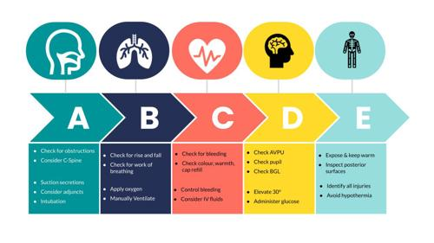
Notes:
As we complete out general Survey we assess for A-B-C-D-E. For inpatients is often done as an “at the doorway assessment”. The first assessment when you see your patient.
Airway
Breathing
Circulation
Disability (AVPU is a rapid assessment tool used to measure a patient’s level of consciousness, standing for Alert, Verbal, Pain, Unresponsive.)
Exposure

Slide 7
Vital Signs

Slide 8
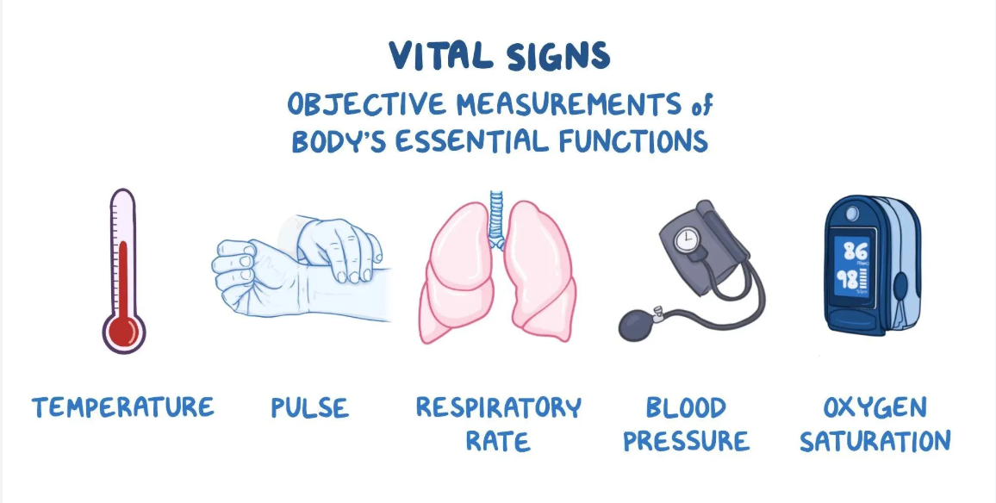
Notes:
T-P-R-BP-O2

Slide 9
What are we Assessing?
Includes temperature, pulse, blood pressure, respiratory rate, and oxygen saturation
  Pain is sometimes referred to as the 5th vital sign because of its influence on the standard vital signs
Gives a picture into the function of the circulatory, respiratory, neural, and endocrine systems
A change in vitals indicates a change in physiological function, therefore intervention may be required
(Astle et al., 2024)
Notes:
Vitals signs are the most frequent measurements obtained by healthcare providers.

Slide 10
Expected Values for Adults
Temperature
36° C to 38° C
Pulse
60 – 100 bpm
Respirations
12 – 20 per minute
Blood Pressure
Systolic: 120 – 139 mm Hg
Diastolic: 80 – 89 mm Hg
Oxygen Saturation
95 – 100%
(Astle et al.,2024)
Notes:
Typically see temperatures between 36.5 – 37.5. Astle et al. note normal findings as above.

Slide 11
When Should V/S be Assessed?
Upon admission
According to healthcare provider's order/per facility protocols
Before, during, and after surgical/invasive diagnostic procedures, administration of blood products, administration of medications that affect cardiovascular, respiratory, and temperature control function
Condition changes
Before and after nursing interventions that affect a vital sign (i.e. before a patient previously on bed rest ambulates)
When a patient reports "feeling funny" or "feeling different"
Before a patient leaves for pass and upon their return
Remember, the HCP's order is the minimum number of times vitals should be assessed.
(Astle et al.,2024)

Slide 12
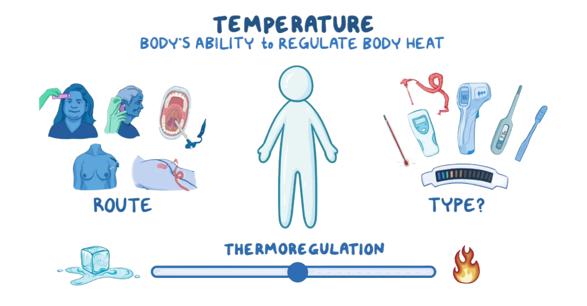
Temperature
Body cells and tissues function best between 36 – 38 ° C
Knowledge of thermoregulation is important to be able to regulate patient temperatures
Hypothalamus detects change in body temperature and can engage mechanisms to adjust as needed
Heat is lost through radiation, conduction, convection, and evaporation
Factors affecting temperature include age, exercise, hormones, circadian rhythm, stress, environment, and temperature alterations (i.e. fever, hyperthermia, or hypothermia)
(Astle et al.,2024)
Notes:
Factors affecting temperature:
Age: newborns have an immature temperature regulation system that does not stabilize until puberty. Normal temperature range drops through adulthood. Older adults are sensitive to temperature extremes because of deterioration in control mechanisms - poor vasomotor control, decreased subcutaneous tissue, reduced sweat gland activity, and reduced metabolism.
Exercise: As we exercise our body requires more energy therefore more metabolism occurs which creates heat as a byproduct
Hormones: Progesterone during the menstrual cycle causes fluctuations. Low progesterone = lower body temp. Menopause causes times of intense body heat and sweating, skin temp may increase up to 4 degrees Celsius – due to instability of vasomotor controls.
Circadian rhythm: Body temp is lowest during sleep and highest in the evening.
Stress: Physiological changes caused by stress increase metabolism, therefore heat production
Environment: Hot = you are hot, cold = you are cold
Temperature alterations: Fever – pyrogens trigger immune response. Temp raises, reducing concentration of iron therefore inhibits growth of bacteria. Heat loss mechanisms can't keep up. Hyperthermia: overload of body's thermoregulatory system - body can't cool down. Hypothermia: overload of body's thermoregulatory system – body can't heat up.

Slide 13
How to Assess
Pick your route.
Common routes in HPEI are:
  Oral
  Tympanic
  Temporal
  Axillary
Each site has advantages and disadvantages.
If measuring orally, wait 2 minutes after patient has smoked, 5 minutes after the patient has chewed gum, and 20 minutes after patient has ingested hot or cold liquids.
(Astle et al.,2024)
Notes:
Sites representing core temp best:
Rectum
Tympanic membrane
Temporal artery
Esophagus
Pulmonary artery
Urinary bladder
Nasopharynx (more accurate to body's actual temperature, however not always practical)
Sites that represent surface temp best: skin, mouth, axillae
Although we see many sites listed above that are best at representing core temperature best they are very invasive and may be seen used more often in critical care areas.
For unexpected outcomes:
Temp too high: Assess possible sites for localized infection (i.e. catheter) and for related data suggestive of systemic infection
Temp too low: remove any drafts, wet clothing, or damp linens and apply extra blankets, and unless contraindicated, offer warm liquids.

Slide 14
Pulse
Regulated by the sympathetic and parasympathetic nervous system
Radial pulse is commonly assessed because it is easily palpable
When radial pulse cannot be felt due to a cast, dressing, or if it is abnormal, assess apical pulse (5th intercostal space midclavicular line)
If the patient's condition deteriorates, carotid artery pulse is assessed
Characteristics of a pulse:
Rate: Palpate for 30 seconds if regular and multiply by 2. Palpate for 60 seconds if irregular.
Rhythm: regular, irregular, regularly irregular, irregularly irregular
Strength: 0, +1, +2, +3, +4
Equality: Is it equal bilaterally?
(Astle et al.,2024)
Notes:
Pulse is regulated by two branches of the autonomic nervous system: the sympathetic nervous system and the parasympathetic nervous system. Stimulation of the sympathetic nervous system releases epinephrine and norepinephrine, leading to an increase in HR, whereas stimulation of the parasympathetic nervous system releases acetylcholine which leads to decrease in HR.
Carotid pulse is assessed when patient condition deteriorates because the carotid artery supplies blood to the brain for as long as possible. Vital organs are prioritized and peripheral arteries receive less blood supply, making them very difficult to palpate
Rhythm: Normally, a regular interval occurs between each pulse or heartbeat. An interval interrupted by an early or late beat or a missed beat indicates a dysrhythmia. Dysrhythmias threatens the hearts ability to provide adequate cardiac output. If dysrhythmia is present, the nurse should assess the regularity of its occurrence and auscultate the apical rate for one full minute Can be regularly irregular (the next pulse can be predicted) or irregularly irregular (the next pulse cannot be predicted).
Strength: Bounding = +4, strong= +3, weak = +2, thready = +1, or absent = 0.

Slide 15
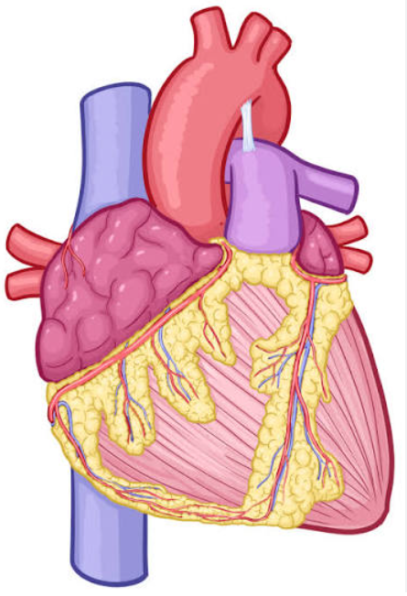
Unexpected Outcomes:
Radial pulse is weak/thready
Apical pulse greater than 100 bpm
Apical pulse less than 60 bpm
(Astle et al., 2024)
Notes:
Radial pulse is weak/thready:
Observe for symptoms of decreased tissue perfusion distal to weak pulse (i.e. pallor, cyanosis,cool skin temp)
Assess both radial pulses and compare findings
Measure apical and radial pulses simultaneously to assess for pulse deficit
Apical pulse greater than 100 bpm:
assess for presence of fever, anxiety, pain, recent exercise, hypotension, decreased oxygenation, or dehydration
Measure all vital signs
Assess for factors associated with decreased cardiac output such as chest pain, dizziness, cyanosis, fatigue, and orthopnea
Apical pulse less than 60 bpm
Assess for the presence of factors that may alter heart rate, such as digoxin or other cardiac medications. It may be necessary to withhold prescribed medications until the prescribing health care provider can evaluate the need to adjust dosage
Assess for factors associated with decreased cardiac output
What do you do if your patients HR is low and they are ordered cardiac medications?

Slide 16
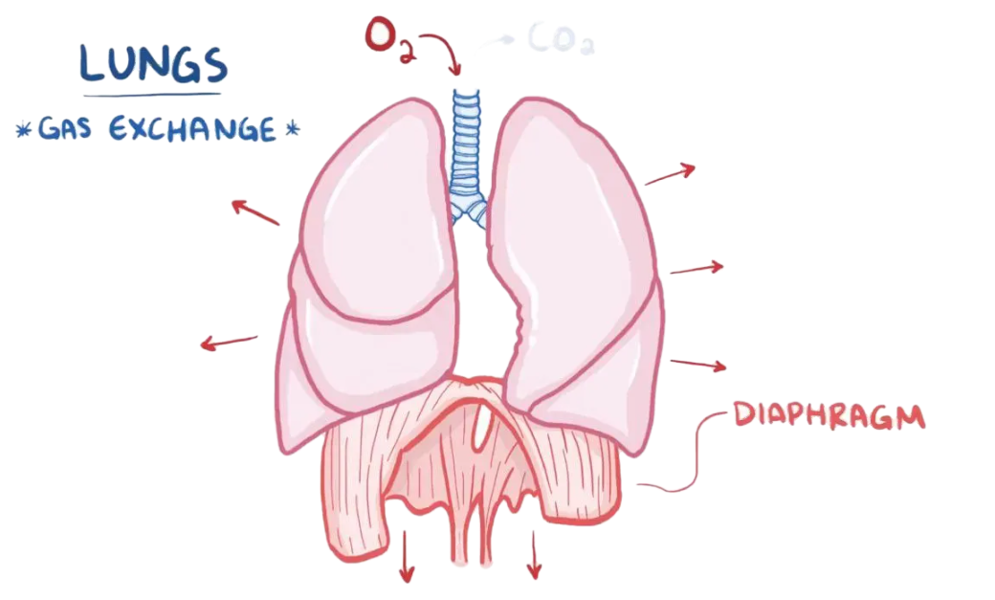
Respirations
Respiration is the mechanism that the body uses to exchange gases between the atmosphere and the blood and between the blood and the cells
Involves ventilation, diffusion, and perfusion
Respiratory center in brainstem regulates the involuntary control of respirations
Elevated CO2 level causes the respiratory control system in the brain to increase the rate and depth of breathing
Factors affecting respiration include exercise, acute pain, anxiety, smoking, body position, medications, neurological injury, and hemoglobin function
(Astle et al., 2024)
Notes:
Respiration is the mechanism that the body uses to exchange gases between the atmosphere and the blood and between the blood and the cells. Respiration involves ventilation (the movement of gases in and out of the lungs), diffusion (the movement of oxygen and carbon dioxide between the alveoli and the RBC’s) and perfusion (the distribution of RBC’s to and from the pulmonary capillaries). Ventilation is assessed by determining respiratory rate, depth, and rhythm. Diffusion and perfusion are assessed with oxygen saturation.
Elevated CO2 level causes the respiratory control system in the brain to increase the rate and depth of breathing. Increased ventilation expels excess CO2 by increasing exhalation. However, those with chronic lung disease have ongoing hypercarbia. For them, chemoreceptors in the carotid artery and aorta become sensitive to low oxygen levels. If arterial O2 levels fall, these receptors signal the brain to increase the rate and depth of ventilation. Because low levels of arterial O2 provide the stimulus for respiration in these patients, administration of high O2 levels can be dangerous to these patients.
Factors affecting respirations:
exercise (increases respiratory rate to meet the body's need for additional O2 and to rid the body of excess CO2),
acute pain (breathing becomes shallow, patient may inhibit chest wall movement when pain is in the area of the chest or abdomen),
anxiety (anxiety increases resp rate and depth as a result of sympathetic stimulation),
smoking (changes pulmonary airways, resulting in increased rate of respirations at rest when the person is not smoking),
body position (a straight, erect posture promotes full chest expansion),
medications (opioids, general anesthetics, and sedative hypnotics depress respiratory rate and depth, amphetamines and cocaine may increase respiratory rate and depth, bronchodilators slow respiratory rate by causing airway dilation),
neurological injury
hemoglobin function

Slide 17
Blood Pressure
Blood pressure (BP) is the force exerted on the walls of an artery by the pulsing blood under pressure from the heart
  Systolic BP = peak of maximum pressure when ejection of blood from the heart into the aorta occurs
  Diastolic BP = the minimal pressure exerted by the blood remaining in the arteries when the ventricles relax
BP involves the interrelationships of cardiac output, peripheral vascular resistance, blood volume, blood viscosity, and artery elasticity
(Astle et al., 2024)
Notes:
BP involves the interrelationships of
Cardiac output: Increase in cardiac output occurs when HR increases, greater heart muscle contractility, or an increase in blood volume. A rapid or significant increase in HR decreases the hearts ability to fill, resulting in blood pressure decreasing. CO=HRxSV
Peripheral Vascular Resistance: The smaller the blood vessel, the greater the resistance, therefore the greater the pressure.
Blood volume: If the volume of blood increases, more pressure is exerted against arterial walls.
Viscosity – The thickness or viscosity of blood effects the ease with which blood flows through the small vessels.
Elasticity – Normally, the walls of an artery are elastic and easily distensible. As pressure within the arteries increases, the diameter of the vessel walls increases to accommodate the rising pressure change. In certain diseases, such as arteriosclerosis, vessel walls lose their elasticity and are replaced by fibrous tissue that cannot stretch as well. Reduced elasticity means resistance to blood flow is greater. When the left ventricle ejects its stroke volume, the vessels no longer adjust to pressure, and the blood is forced through the rigid artery and systemic pressure rises. Systolic pressure is more significantly elevated than diastolic pressure.

Slide 18
Factors Affecting BP
Age
Stress
Sex
Daily variation
Medications
Activity
Weight
Smoking
(Astle et al., 2024)

Slide 19
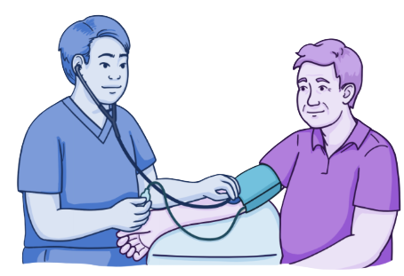
Assessing Blood Pressure
Choose the location – avoid arms with IV fluids infusing, AV shunts/fistulas, the side where breast/axillary surgery has been performed, or diseased/traumatized extremities
Ensure the cuff fits - bladder length should cover 80 to 100% of arm, width should be close to 40% of arm circumference
Placement - The lower edge of the cuff should be 2.5 - 3cm above where the brachial pulse is palpable
If doing blood pressures bilaterally, take the higher reading
(Astle et al., 2024)
Notes:
Show me where the brachial artery is on your arm.

Slide 20
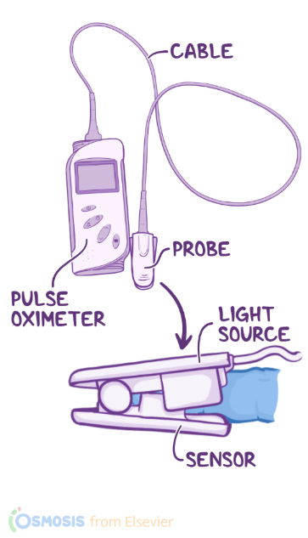
Oxygen Saturation
Oxygen saturation of the blood evaluates diffusion and perfusion
Percentage of hemoglobin attached to O2 in the arteries = the percentage of saturation of hemoglobin (SaO2)
Device contains a probe with an LED and photo detector - LED emits light wavelengths that are absorbed differently by oxygenated and deoxygenated hemoglobin molecules
Different routes:
To determine most appropriate site, assess capillary refill and skin condition at the site – site needs to have adequate circulation
Site must be free of nail polish/acrylic/gel nails
If tremors are present, use earlobe as site
Fingers, toes, earlobe, bridge of nose
(Astle et al., 2024)
Notes:
The percentage of hemoglobin that is attached to oxygen in the arteries is the percentage of saturation of hemoglobin (SaO2). This value is usually between 95 and 100%
As always, if you get an abnormal reading, assess for signs and symptoms of hypoxemia. Do nursing interventions such as position changes (raising head of bed) and breathing exercises, then reassess.

Slide 21
Vital Signs Summary
Recognizing trends is critical
Knowing the factors that influence vital signs can help to evaluate abnormal values
Always use equipment that is functional and appropriate for the size/age of the patient to ensure findings are accurate
Minimize environmental factors that may influence vital signs
Be aware that your manner of approach can affect vital signs
Analyze results of vital signs by considering the patient’s usual baseline values, medical history, therapies, and prescribed medications
(Astle et al., 2024)
Notes:
Recognizing trends in vital signs is critical. If you have a significantly increased HR your filling time is decreased in the heart which can result in a lower blood pressure as an example.
Manner of approach - If you are going quickly and not explaining the procedure to the patient they may get nervous and their HR may increase for example
Remember the importance of taking vital signs before administering medications they may affect HR, BP or RR.

Slide 22
Head and Neck

Slide 23
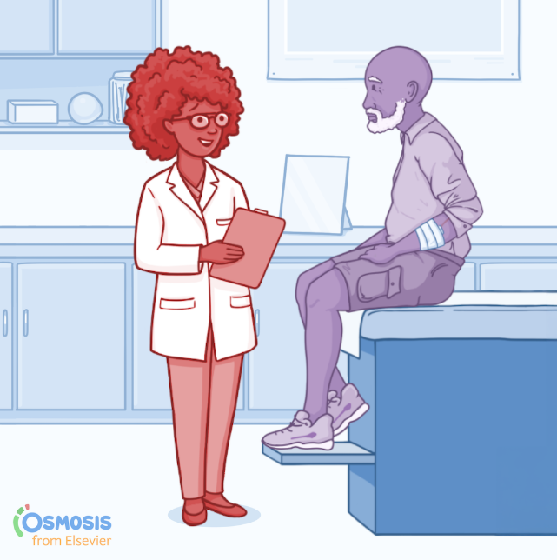
Subjective Data
Ask patient about the following:
  Any headache
  Head injury
  Dizziness
  Neck pain/limitation of motion
  Lumps or swelling
  History of head or neck surgery
(Jarvis et al., 2024)​
Notes:
Ask the patient about:
Headache: unusual frequency, unusual severity. Onset – when did this kind of headache start? Location, localization, character, pain scale, time of day, duration, precipitating factors, other associated symptoms, any illness, medications, family hx, relieving factors (if any), relation to menstral periods if applicable, coping strategies
Head Injury: Any head injury or recent blow to your head or neck? Onset, what happened, setting, events leading up to (i.e. was it a fall due to dizziness?), did you lose consciousness and then fall (which came first), did you go unconscious immediately? Hx of illness, location, duration (how long were you unconscious?), any other symptoms, change in LOC, pattern (have symptoms become worse or better), effort to treat (emergency department, hospitalization or medications?)
Dizziness: describe the dizziness, onset (abrupt or gradual? After a change in position?), associated factors/symptoms (i.e. nausea/vomitting, pallor, immobility, decreased hearing acuity, tinnitis, palpitations? Shortness of breath?)
Neck pain, limitation of motion: onset (how did the pain start? Injury, car accident, lifting, following a fall, with a fever, gradual), location, associated symptoms (i.e. numbness/tingling in shoulders, arms or hands), limitations to ROM, precipitating factors, triggers (stress), coping
Lumps and swelling: any lumps or swelling in the neck? Any recent infection? If lump persists, how long have you had it, has size changed? Hx of irradiation of head, neck, upper chest? Difficulty swallowing? Hx of smoking/chewing tobacco/alcohol? Hx of thyroid problem?
Hx of head and neck surgery: Ever had a surgery of the head or neck? For what condition? When? How did you feel about the results?

Slide 24

Objective Data
Inspect and palpate the skull
Inspect the face
  Note symmetry of eyebrows, fissures, nasolabial folds, sides of mouth
Inspect and palpate the neck
  Note any enlargements
  Trachea should be midline
(Jarvis et al., 2024)​
Notes:
When preforming a focused assessment on the head and neck:
Inspect and palpate the skull: note size and shape, palpate shape
Inspect the face: inspect symmetry of face by looking at eyebrows, palpebral fissures, nasolabial folds, and sides of mouth. Note facial expressions. Note any abnormal facial structures (coarse facial features, exophthalmos, changes in skin pigmentation), note any abnormal swelling. Note involuntary tics in the facial muscles.
Inspect and palpate the neck: Head should be midline, neck muscles should be symmetrical. Head should be erect and still. Note any limitation in movement during active motion (range of motion). Patient should be able to push shoulders up against your hands and push their head against your hands when turning their head to the side. Note any enlargement of lymph nodes, lymph glands, salivary glands, thyroid, or parotid gland. Note any obvious pulsations.

Slide 25
Ears, Nose, Mouth, and Throat
Ears:
Subjective – ask about earache, infections, discharge, hearing loss, tinnitus, vertigo
Objective – Observe for any excessive discharge, note any redness, swelling, lesions or foreign bodies
Nose:
Subjective – discharge, frequent colds, sinus pain, trauma, epistaxis, allergies, altered smell
Objective – inspect for deformity, discharge, asymmetry, inflammation, or lesions
Mouth and Throat:
Subjective – sores or lesions, sore throat, bleeding, dental issues, dysphagia, altered taste, alcohol and tobacco consumption
Objective – inspect tongue, buccal mucosa, tonsils, throat, and teeth
(Jarvis et al., 2024)​​
Notes:
Typically this is a very quick assessment completed with our general survey, UNLESS the patient has a complaint then there should be a focused assessment completed.

Slide 26
Neurological System

Slide 27
Subjective Data
Examiner asks about:
Headache
Head injury
Dizziness or vertigo
Seizures
Tremors
Weakness
Coordination
Numbness or tingling sensation
Difficulty swallowing or speaking
Significant past history
Environmental/occupational hazards (i.e. insecticides, lead, medications, mood-altering drug use such as marijuana, cocaine, tranquilizers)
(Jarvis et al., 2024)​​
(Jarvis et. Al, 2024)
Notes:
If your patient is alert and orientated, you can ask them the following questions.

Slide 28
Components of Neuro Assessment
Inspect
Orientation
Alertness
Pupils
Palpate / Motor Function
Pronator Drift
Hand Grips
Foot Pressors

Slide 29
Neuro Assessment
The first thing we should take note of with our neuro assessment is the patient’s level of consciousness
Notes:
NEURO ASSESSMENT
Level of Consciousness is defined as a general awareness of oneself and the surrounding environment
** LOC is the first indicator that will demonstrate deterioration if there is a change in cerebral oxygen supply
Level of Consciousness
Arousal
Lowest level of consciousness & Indicates wakefulness
Arousal does not have very much to do with the thinking parts of the brain
If the patient can open their eyes to voice or painful stimulation than the arousal center in the brain is functioning
Awareness
Is higher level function
The content of consciousness
Ex seeing a red apple, feeling sad, have a toothache in my left molar
When a patient is aware, it means that the cerebral cortex is working and that the patient can interpret and interact with his environment
Description of LOC
Awake and alert
Confused –to person, place or time
Somnolent- sleepy but arousable (ok if known that they were up all night, ex q1h neuros, just came to ed , etc)
Lethargic- marked drowsiness, can wake and respond easily but when assessment done they go back to sleep easily
Obtunded- difficult to arouse, verbal response mumbled
Stuporous- difficult to arouse, not responsive to environment, when stimulation stopped immediately unresponsive again
Comatose- no response
Vital Signs
Indicator of deterioration of neuro status due to brain and brainstem influences on cardiac, respiratory and body temp functions
Normal regulation of temperature occurs in the hypothalamus
Inadequate supply of O2 to this area can result in alteration in temperature
Fevers can be high and resistant to antipyretics
Hypothermia can mean death is imminent.

Slide 30
Orientation
Person
Place
Time
Notes:
When assessing orientation, we assess the patient's knowledge of their name, where they are and what the date is.

Slide 31
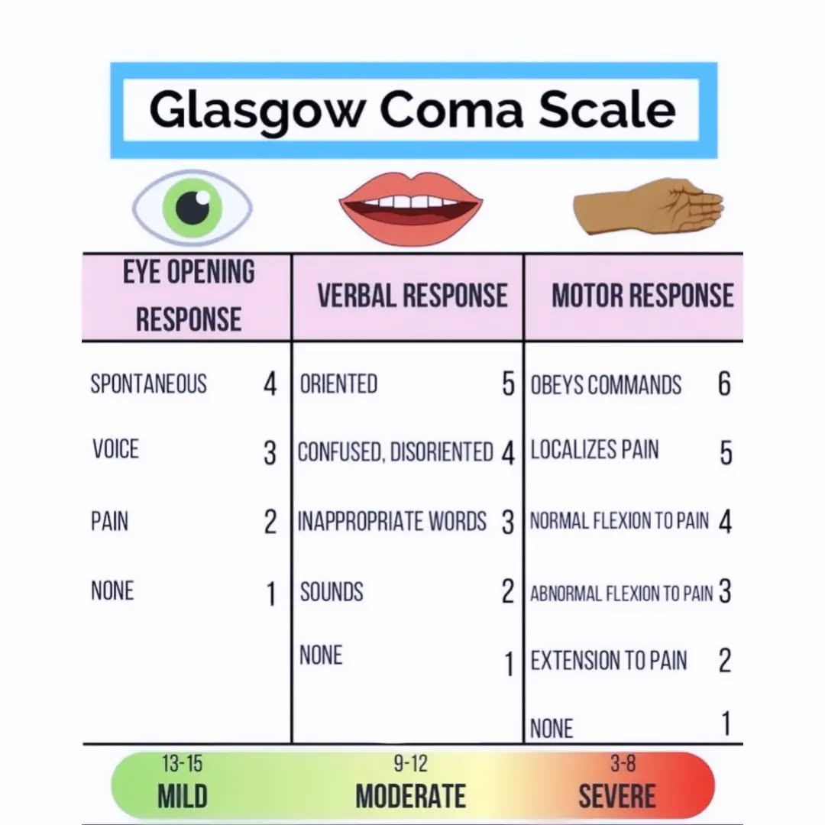
Alertness
Assessing Level of Consciousness using GCS
Most used tool to assess LOC
Score /15
Notes:
GCS: Most basic Neurological assessment . Scoring tool that looks at how appropriately the pt responds to you in 3 key areas
Eye Opening
Verbal Response
Motor Response
Eye Opening
Shows that the arousal mechanism in the brainstem is functioning properly
Voice, shake, then pain
Apply one at a time (don’t shout and shake at the same time)
When assessing pain, apply a central stimulus- trap squeeze and apply for a full 30 seconds before stating there is no response to pain
Verbal Response
Assesses consciousness by determining whether the patient is aware of themselves and the environment
Comprehension of what has been said and expression of thoughts into words
Assesses verbal response as oriented, confused, inappropriate, incomprehensible sounds, or no response.
Orientation- ask time, place, person (usually becomes abnormal in this order)
Best Motor Response
Assess best motor response as
Obeys commands, And you can go through assessment of motor function at this time to keep your neuro exam flowing nicely
Localizing to pain (trying to stop pain)
Flexion to withdraw from pain
Abnormal flexion (decorticate posturing -pts body is still, arms bent in with fists clenched, legs straight feet turned inward. Thinks decorticate-turned to core)
Abnormal extension (decerebrate posturing- pt holds arms and legs out straight, head and neck may be arched, toes point downward, hands bent toward at wrists arms straight. Usually have a GCS of <3 no neuro response at all.)
Severe= GCS <8
Moderate= GCS 9-12
Minor= GCS >13
*Any change in focal signs indicates neurological deterioration and is an urgent assessment finding

Slide 32
      Upper and Lower Extremity Motor Test
      Assesses strength in arms by flexing client’s arms and asking the client to:
        Resist or pull against flexion
        Resist against extension
      Assesses pronator drift by asking client to hold arms out in front with palms facing upwards and close eyes tightly.
      Assesses leg strength by asking the client to: a) raise knee against resistance; b) straighten knee against resistance.
      Asks the client to dorsi flex and plantar flex foot against resistance.
      Assesses presence or absence of spasticity and flaccidity by attempting to straighten the client’s arm.
Notes:
Fit this assessment in with the instructions you are asking your patient to follow when assessing their ability to follow instruction.

Slide 33
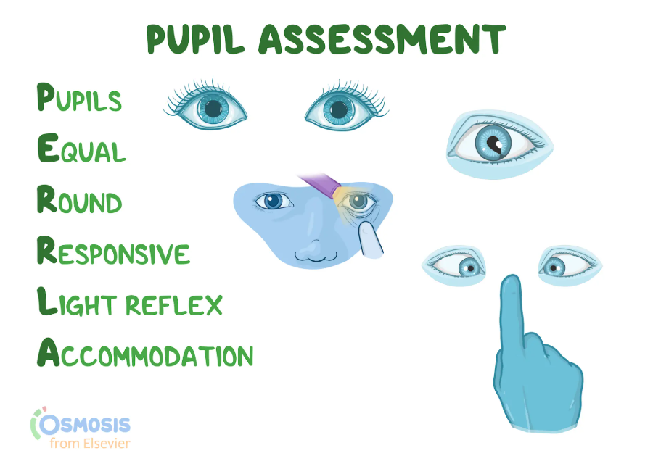
Notes:
Subjective
Ask about any blurred vision, decreased acuity, or blind spots
Ask about eye pain, redness, or swelling
Ask about any excessive watering or discharge
Any history of eye injury/surgery?
Glaucoma?
Use of glasses or contact lenses? Vision loss? Vision changes?
Objective
Using a pen light, make sure pupils are equal in size, reactive to light, and round. Check for accommodation.
Observe for discoloration (i.e., jaundice)
Record the size of the pupils using the chart on the side of the pen light. Do this before and after shining the light in the eyes. Make sure pupils are equal in size. Size should be 3-5mm and decrease in response to light. Advance light in from the side and note response. Have patient look into the distance. This should dilate the pupils.
Ask them to focus on your finger/an object, held in front of their face about 7-8cm from their nose. Pupils should constrict and converge of the axes of the eyes.
(Jarvis et al., 2024)​

Slide 34
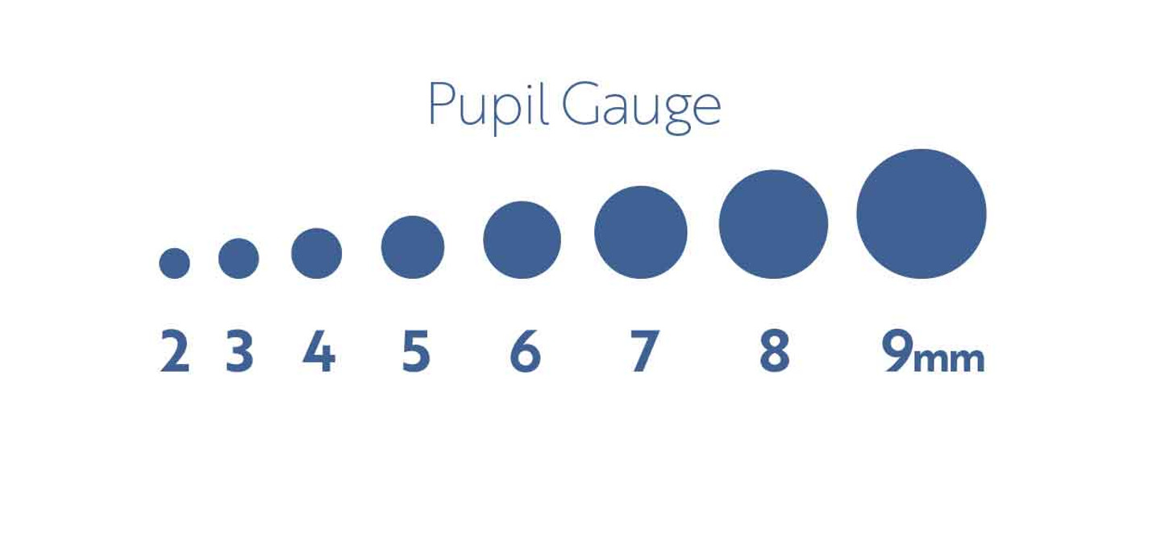
Notes:
Normal PERRLA results indicate that the eyes, nerves, and brain regions controlling the pupils are functioning well. Abnormal results may require further testing to identify potential issues.
This scale can be found on the side of a pen light. (Obviously not to scale in slide show)

Slide 35
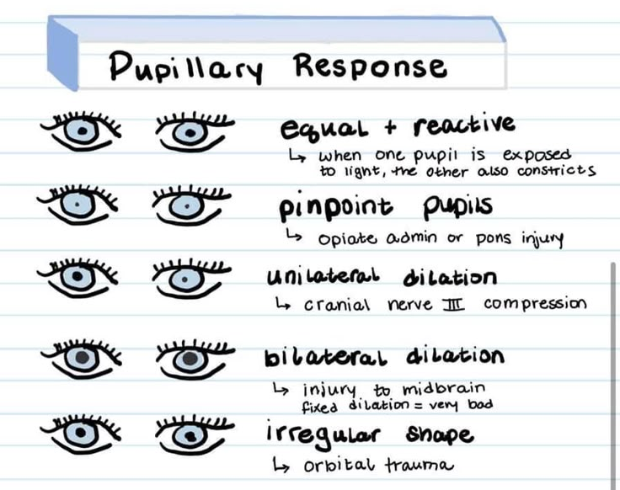
Notes:
Cranial nerve 3 – Oculomotor nerve
Controls most eye movements, lifts the upper eye lids and manages pupil size and focus.

Slide 36
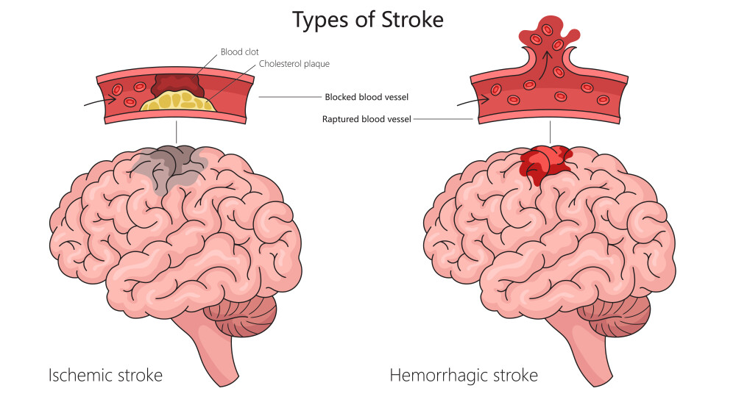
Stroke Assessment
LOC
  Alert
  Oriented
  Response to stimuli
  GCS score
Facial Droop
  Smile
Speech and Language
  Slurred, appropriate- able to repeat words or follow commands
Arm Drift
Motor function
  Hand grips and Foot presses
Record and Report
Notes:
Explain the risks associated with Stroke & treatments for each.
FAST – Facial drooping, Arm drift, speech slurring, time to treatment.

Slide 37
Thorax and Lungs

Slide 38
Subjective Data
Health History Questions:
Any cough?
Shortness of breath?
Chest pain with breathing?
History of respiratory infections?
Smoking history/exposure?
Environmental exposure (i.e. conditions that may affect breathing such as workplace)?
Any recent/present illness?
(Jarvis et. Al, 2024)

Slide 39
Components of the Respiratory Assessment
Inspect
Auscultate
Palpate

Slide 40
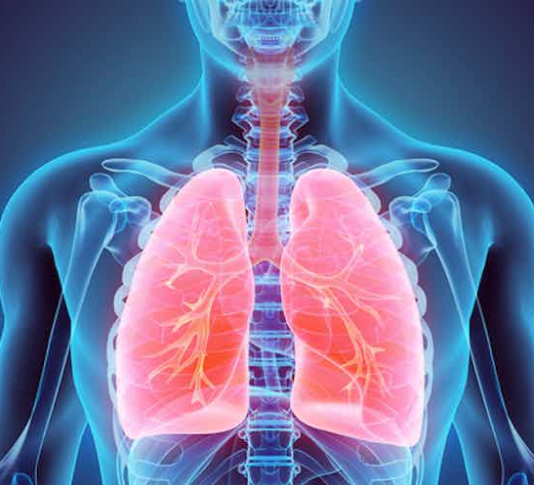
Inspect
Rate
Effort
Pattern
Color
Positioning
(Jarvis et. Al, 2024)​
Notes:
Inspection- A quick look can tell you a lot
Observing- does the pt look like they are having any Respiratory distress or compromise.
Increased WOB ,Pursed lip breathing, tachypneic, air hungry, accessory muscles use, not breathing,
What is their LOC? Restless or agitated may hypoxic / Somnolent or obtunded may have elevated C02 levels
What does their color look like? Cyanotic lips, nail beds, etc
What position are they sitting in? Tripod? Aids use in muscle recruitment to breath. Retractions.
Chest rise and fall, is it equal on both sides? Will tell you that the mechanics of Respiration are intact
Chest expansion should be symmetrical – this can be assessed by placing your hands on the patient's back with your thumbs at the level of T9 or T10. Slide hands medially to pinch up a small fold of skin between your thumbs. Ask the patient to take a deep breath. Your thumbs should move apart symmetrically.
Are they moving air? Feel with hand or let it fog up glasses. Mechanics are working but no air movement. Occluding their airway.
Clubbing – chronic (COPD, interstitial lung disease)
Can they talk short sentences without becoming SOB
Inspects anterior and posterior chest walls for shape (A – P diameter, slope of ribs), symmetry of chest expansion, accessory muscle use, and breathing patterns.
Symmetry of Chest expansion- thumbs at T9-T10
Muscles tire and pts been working really hard to compensate they will then decompensate. The sooner we can intervene the better
Note position that patient takes to breath, tripod = aids use of muscle recruitment to breath
Note color- cyanotic, pale etc.

Slide 41
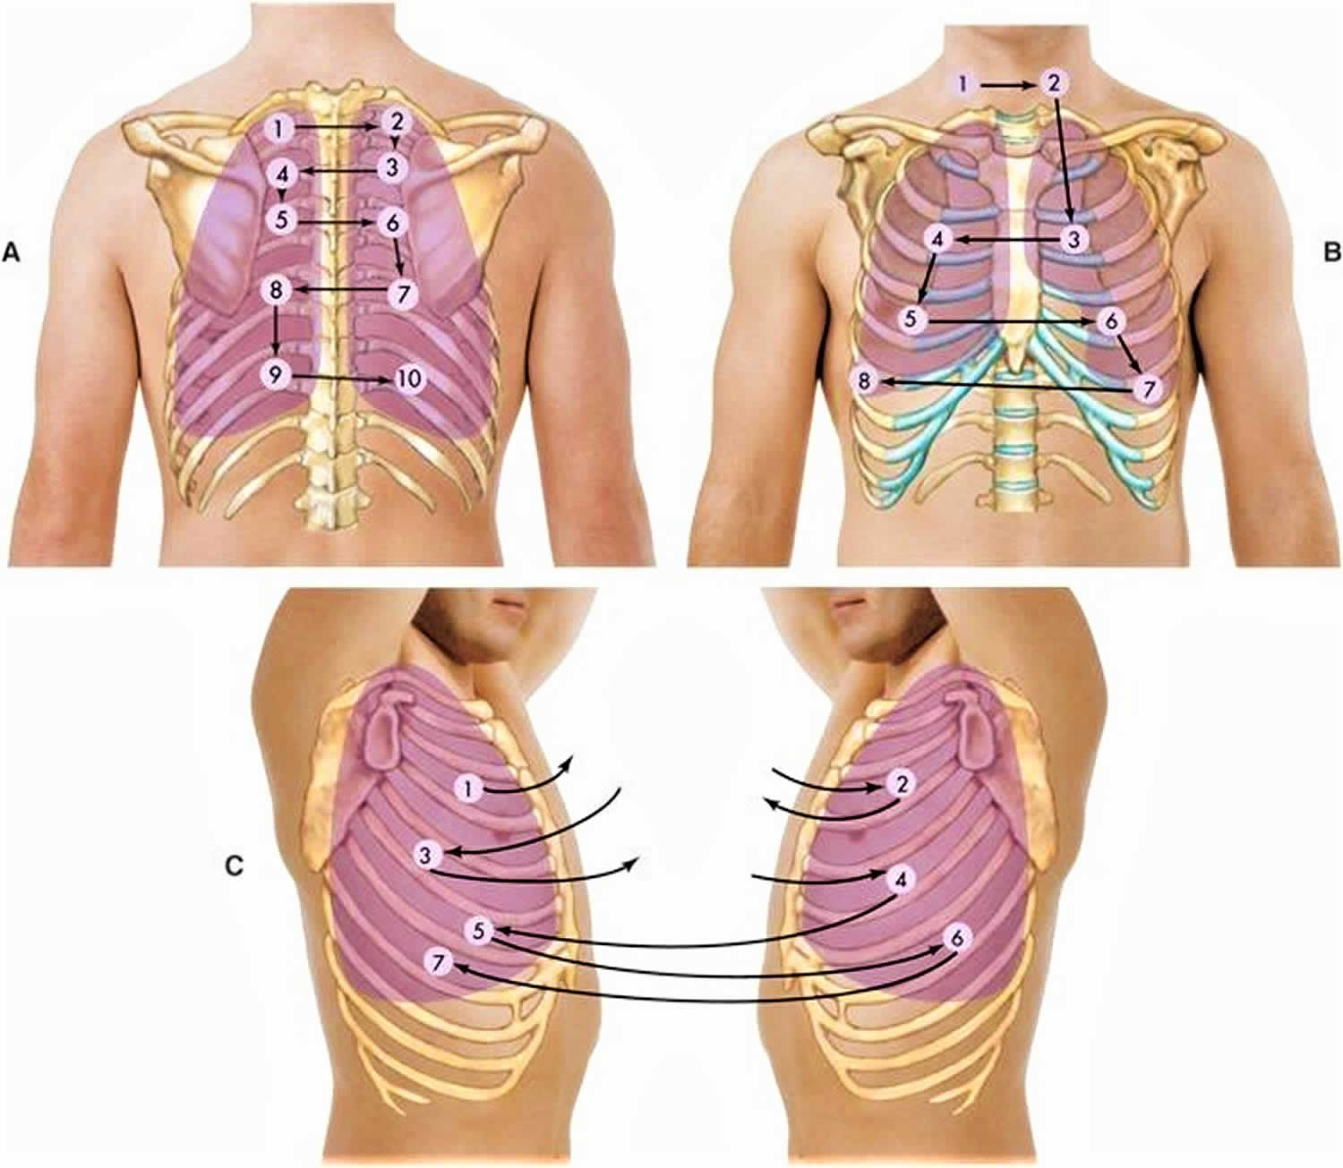
Auscultation
Systematic approach to auscultation
Notes:
Make sure you are listening through a full cycle before moving to the next site. Full inspiration and expiration.
Z pattern so you can compare Rt side to Lt side.

Slide 42
Objective Data - Auscultation
Posterior: Patient should be sitting, leaning forward slightly. Instruct them to take slightly deeper breaths than normal, but stop if they feel dizzy. Listen to at least one full respiration at each location, under clothing
  Side to side comparison is important
  Listen from the apices, moving laterally down to the 7th or 8th rib
Anterior: Auscultate from the apices (supraclavicular areas) down to the 6th rib, moving side-to-side
Lateral: Auscultate the lateral chest wall – especially the right to ensure the right middle lobe is heard
  The vesicular lung fields wrap around the sides of the patient
(Jarvis et. Al, 2024)​​

Slide 43
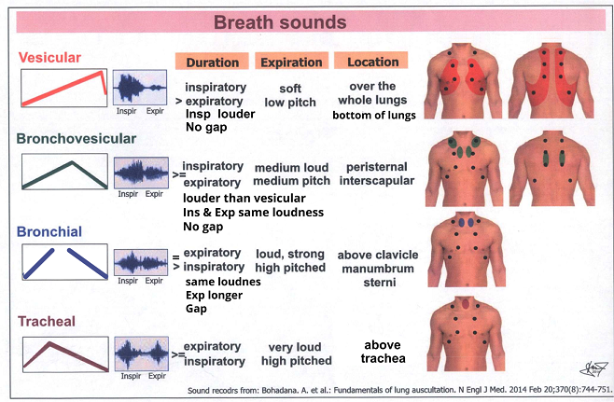
Notes:
3 types of lung sounds: Bronchial, bronchovesicular, vesicular
Bronchial - high pitched and loud (over trachea and larynx)
Vesicular - auscultated in peripheral lung fields and make up the majority of the lung sounds you are listening for. Soft and Low in pitch
Bronchovesicular sounds - mid sternum and posteriorly between scapula. Medium loud and medium pitched.
If you hear these sounds in an area you are not supposed to hear them, it is a sign that there is something abnormal going on
Diminished and absent bs are going to be associated with decreased air flow, decreased lung expansion or absent airflow and lung expansion.

Slide 44

Adventitious Lung Sounds
Fine crackles: discontinuous, high-pitched, short popping sounds heard during inspiration that are not cleared by cough.
Course crackles: discontinuous, loud, low pitched, bubbling and gurgling sounds that start in early inspiration and may be present in expiration; may decrease after coughing/suctioning but will reappear shortly.
Pleural friction rub: a superficial sound that is course and low pitched; sounds louder if you push the stethoscope harder onto the chest wall.
Wheeze – high-pitched: continuous, high-pitched, musical squeaking sounds that has multiple notes like a music chord.
Wheeze – low-pitched: continuous, low pitched, single note, musical snoring, moaning sounds. May clear somewhat after coughing. Often described as Rhonchi.
Stridor: continuous, high-pitched, single note, inspiratory, crowing sound, louder in neck than chest wall.
(Jarvis et. Al, 2024)​​
Notes:
Examples:
Fine crackles:
This can be simulated by moistening your thumb and index finger and separating them by your ear
Course crackles:
Sounds like Velcro
Atelectatic crackles: discontinuous; sound like fine crackles but do not last and are not indications of disease.
sound like fine crackles but do not last and are not indications of disease
Pleural friction rub:
Has a grating quality; sounds like two pieces of leather being rubbed together
Wheeze – high-pitched:
high-pitched, musical squeaking sounds that has multiple notes like a music chord
Wheeze – low-pitched:
low pitched, single note, musical snoring, moaning sounds. May clear somewhat after coughing
Stridor:
high-pitched, single note, inspiratory, crowing sound, louder in neck than chest wall

Slide 45
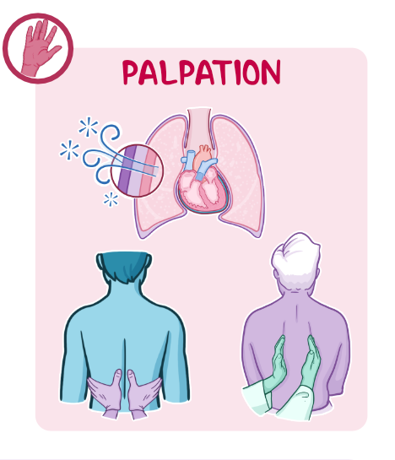
Palpate
Tenderness
Masses or abnormalities
  crepitus
Tracheal deviation
Notes:
Palpation
Palpates (using fingers and palms) the anterior, lateral, and posterior chest wall for tender areas, crepitus, tactile fremitus, abnormal retraction or bulges, pulsations or depressions.
Crepitus- subcutaneous emphysema
Fremitus= palpable vibration (use ball of fingers and trace down chest following areas that you would auscultate)
Normal= Should feel the same on corresponding areas of each chest

Slide 46
Cardiac System
Notes:
CARDIOVASCULAR ASSESSMENT
Looking at how well the cardiovascular system performs its physiological function - delivery of blood and O2 throughout the body, and also assessing the indications of oxygen supply and demand balance on the cardiovascular system itself.

Slide 47
Subjective
Chest pain or tightness
Dyspnea
Orthopnea
Cough
Fatigue
Cyanosis or pallor
Edema
Nocturia
Cardiac history and family cardiac history
Personal habits/cardiac risk factors
Notes:
Subjective, Ask the patient about :
Chest pain or tightness
Dyspnea
Orthopnea
Cough
Fatigue
Cyanosis or pallor
Edema
Nocturia
Cardiac history and family cardiac history
Personal habits/cardiac risk factors (i.e. nutrition, smoking, alcohol, exercise, medications, stress)

Slide 48
Objective Data
Vital signs
Inspection
Auscultation
Palpation
(Jarvis et al., 2024)​
Notes:
Inspect / General Survey
Level of consciousness and orientation
Skin color (pallor, cyanosis, flushing) if increasingly pale, blood is being shunted to vital organs.
Respiratory effort
Signs of distress
Presence of edema
Activity tolerance
Distended jugular veins & pulsatile carotid artery
(Jarvis et al., 2024)​

Slide 49
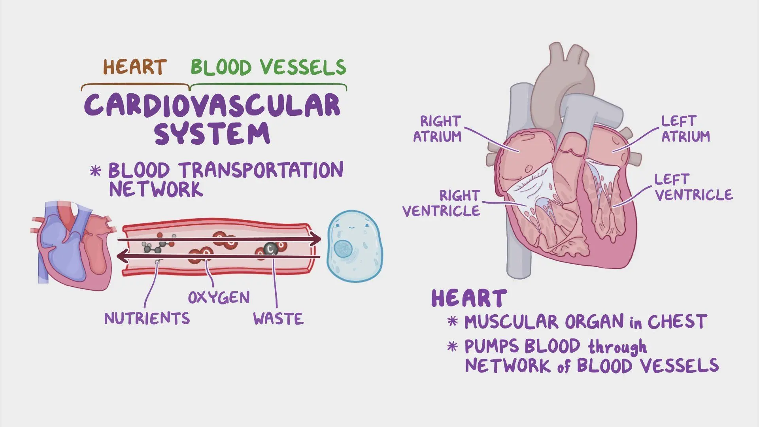
Notes:
The cardiovascular system transports blood and oxygen to all parts of the body.
Heart, blood vessels and blood.

Slide 50
Cardiac Output= Heart Rate X Stroke Volume
Notes:
When assessing the heart you should be thinking about the patient's cardiac output.
Heart Rate
The body uses heart rate to increase Cardiac Output when needed (running) or to compensate for a drop in stroke volume
Directly tells you about the patient’s oxygen supply
Stroke Volume (preload, afterload, contractility)
Preload (looking at volume status)
Jugular veins: distended neck veins indicate increased preload
Increased blood returing to the heart causes blood to back up into the venous system, distending the veins
Flat neck veins can indicate inadequate circulating volume
Edema
Accumulation of fluid in the extravascular spaces of the body
Increased circulating volume exerts a high pressure in the venous system causing capillary leaks into the tissues
Not always reliable, can be intravascularly depleted and have edema
Mucus membranes
If well hydrated, mucous membranes and lips should be moist
Afterload - resistance or load against which the ventricles must pump blood during systole.
Diastolic BP
Pulse Pressure
narrowed= increased afterload
wide= decreased afterload
Vasoconstriction and Vasodilation
Any indicator of vasoconstriction: skin temperature, skin color, peripheral pulses
Contractility
Pts past medical history, ECG changes, cardiac biomarkers

Slide 51
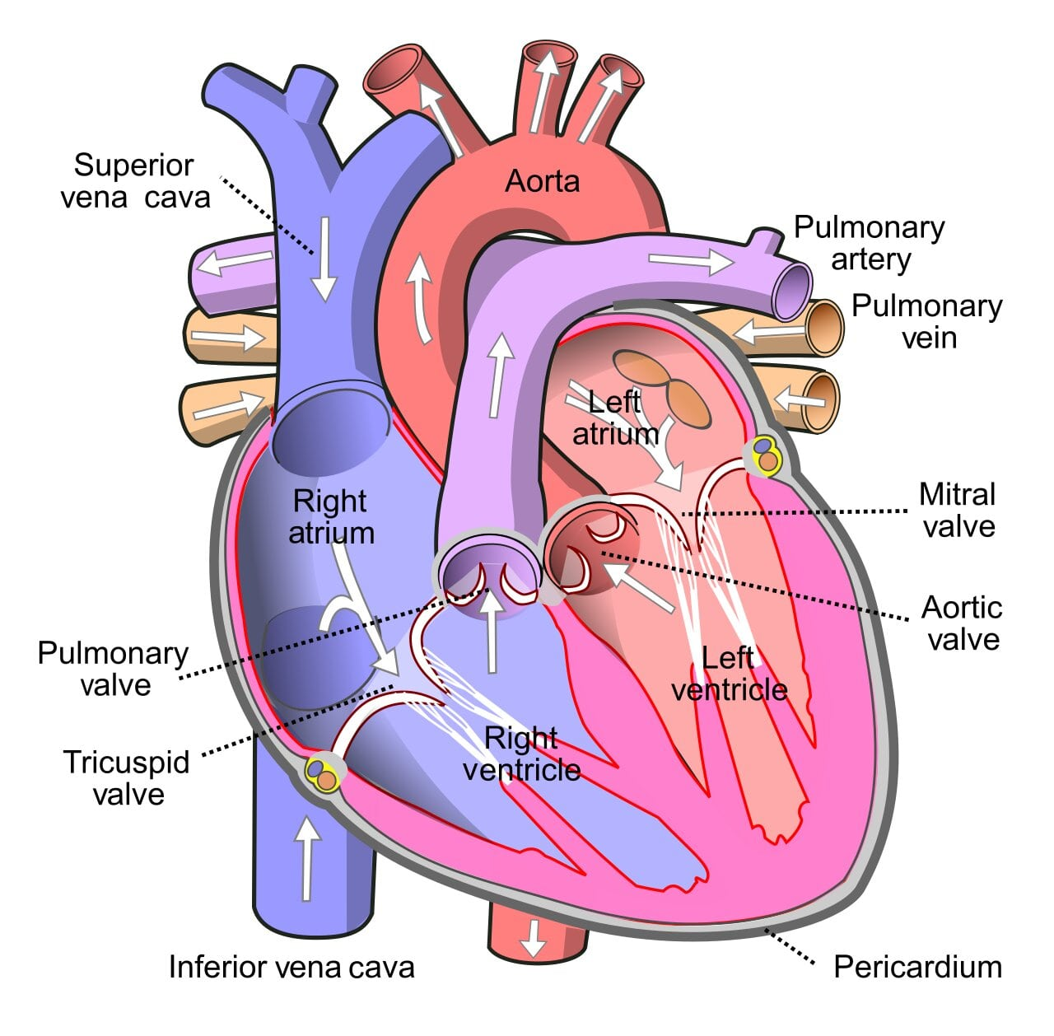
Notes:
This picture illustrates the path of blood flow through the heart.

Slide 52
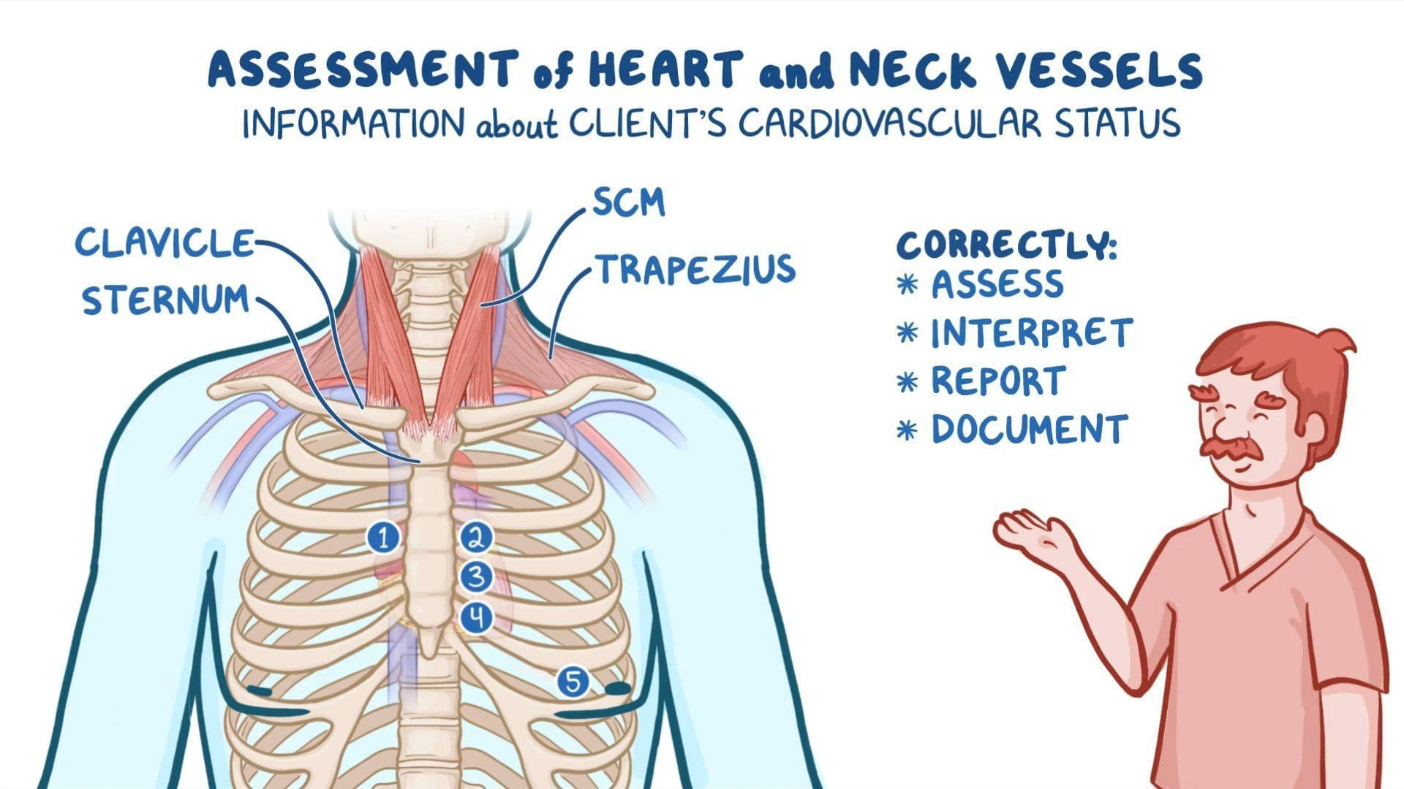
Notes:
APETM
Aortic 2nd ICS Rt Sternal border
Pulmonic 2nd ICS Lt Sternal border
Erbs pt (not tested) 3rd ICS Lt sternal border
Tri 4th ICS Lt Sternal Border
Mitral 5th ICS Left MCL
Assess:
Rate
Rhythm
S1 and S2
Extra heart sounds (S3, S4)
Murmurs
Clicks or rubs
Abnormal Findings
Irregular rhythm
Murmurs
Pericardial friction rub
Gallops (S3 or S4)

Slide 53
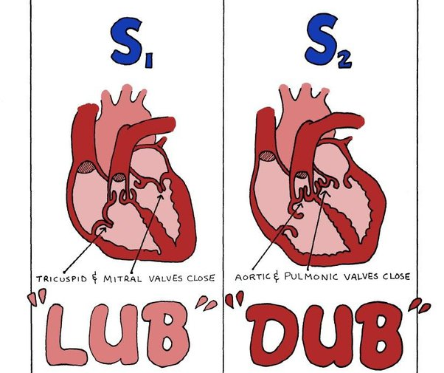
Notes:
Heart Sounds
Abnormal
S3= ventricle are resisting to fill and the rapid filling causes a vibration sounds= 1st rush of blood, right after S2. Lub-Dub-Shh
S4= occurs at the end of diastole when ventricle are resistant to filling, atria contracts and pushes blood into a non compliant ventricle. Shh-Lub-Dub.
Both s3 and 4 are low pitch. Best heard at the apex, left laying, using BELL of stethoscope- 5th ICS MCL
S4 S1 S2 s3 s4 S1 S2 s3
Murmur= turbulence in blood flow= increased velocity of blood flow, decreased viscosity of blood or structural defects
Nurses do not diagnose murmurs or extra heart sounds but it is very important for you to document your findings and notify the MD if you have any abnormal assessment findings for them to further investigate.

Slide 54
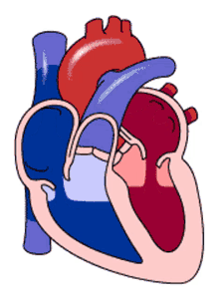
From Lungs
Left Atrium
Mitral Valve
Left ventricle
Aortic valve
image Retrieved from mage Retrieved from https://www.lumoslearning.com/llwp/minid-maps/192/circulatory-system.html
Notes:
This picture illustrates the routes at which blood enters and exits the heart. You can note the valves shutting and when we would hear our S1 & S2.
S1 (Lub): The closing of the mitral and tricuspid valves.
S2 (Dub): The closing of the aortic and pulmonary valves.

Slide 55
Palpate
Peripheral Pulses
Cap Refill
Temperature
Skin Colour
Skin Turgor
Edema
(Jarvis et al., 2024; Urden et al., 2018)​
Notes:
Palpation - Peripheral Perfusion Assessment
Assess:
Peripheral pulses (radial, brachial, femoral, popliteal, posterior tibial, dorsalis pedis) bilaterally for rate, rhythm, and force (strength). Equality. Scale of 0 (absent- doppler) to 4+ bounding (warm sepsis)
Capillary refill - Normal is < 2 seconds. Anything greater than 5 seconds has been associated with more severe organ failure (Urden et al., 2018).
Skin temperature - Cold and pale- afterload increased, blood is being shunted from peripheries to vital organs
Warm/hot - septic/febrile.
Skin color
Presence of edema. Scale 1+ - 4+ (1+ (about 2mm, slight, rapidly returns to normal) to 4+(very swollen, distorted, 2-5mins to return to normal)
Normal Findings
Pulses 2+ and equal bilaterally
Capillary refill <2 sec
Extremities warm
No edema

Slide 56
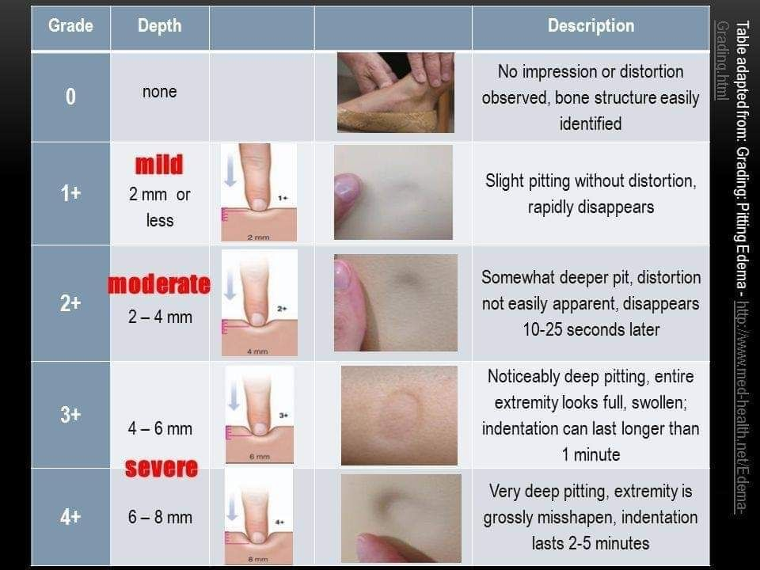

Slide 57
Gastro-Intestinal System

Slide 58
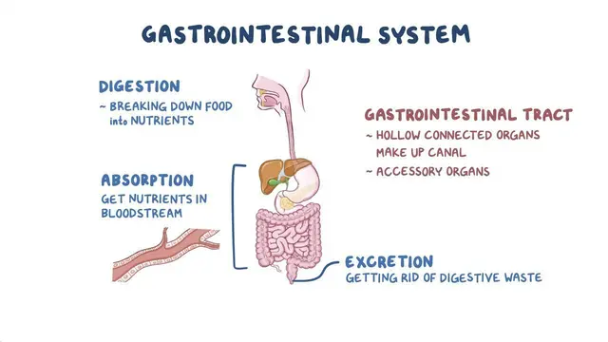

Slide 59
Objective Data
1. Inspection
2. Auscultation
3. Percussion
4. Palpation
(Urden et al., 2018)
Notes:
Palpate Last- in case of aneurysm, pain, disrupts bowel sounds !!!

Slide 60
Inquire
Skin
Shape
Movement
Oral cavity
INSPECT
(Jarvis et al., 2024)​
Notes:
Inquire- last bm, frequency, consistency, colour
Appetite, weight changes, difficulty swallowing
Do you have abdominal pain? Location, onset, anything make it better? Worse?
Nausea vomiting?
Past abdominal history
Oral Cavity- for gingivitis, lesions, and ability to swallow. (already assessed in the ENT section but is also tied to the GI assessment
Observe the abdomen for:
Contour (flat, rounded, protuberant, scaphoid)
Symmetry
Distention (ascities)
Skin color and condition
Scars
Striae
Lesions
Dilated veins
Umbilicus characteristics
Visible peristalsis
Visible pulsations
Presence of hernias or masses
Normal Findings
Abdomen symmetrical
Rounded or flat contour
Skin intact and uniform in color
Umbilicus midline and inverted
No masses, lesions, or distention
No visible peristaltic waves
Aortic pulsation may be visible in thin individuals
Abnormal Findings
Distention
Bulging or masses
Hernias
Visible peristalsis
Prominent veins
Everted umbilicus
Skin discoloration or lesions

Slide 61
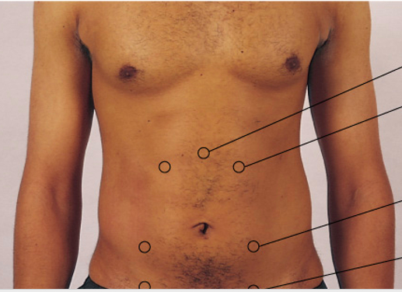
Auscultate
Bowel Sounds
Vascular Sounds
Friction Rubs
(Jarvis et al., 2024)​
Notes:
1. Assess for bowel motility, using the diaphragm of the stethoscope. Listens in all four quadrants.
5 minutes in the right lower quadrant before deciding that bowel sounds are absent (Urden et al., 2018).
2. Auscultation
Auscultate before percussion and palpation.
Bowel Sounds
Listen in all four quadrants for:
Frequency
Pitch
Character
Normal Findings
Bowel sounds present in all quadrants
Irregular gurgling or clicking sounds occurring every 5 to 15 seconds
Abnormal Findings
Hypoactive bowel sounds
Hyperactive bowel sounds
Absent bowel sounds (after prolonged auscultation)
Vascular Sounds
Auscultate for bruits over:
Aorta - Places bell of stethoscope in mid-epigastric region (thoracic aortic bruit). Bruit – whooshing, blowing, swishing noise
Renal Arteries - over right and left mid-hypochondriac region (renal artery bruit).
Iliac arteries - over right and left mid-lumbar region (iliac artery bruits).
Femoral arteries - over right and left femoral arteries (femoral artery bruits).
Over epigastric region and umbilicus (venous hum).
Normal Findings
No bruits present
Abnormal Findings
Bruits suggesting turbulent blood flow or vascular disease
Systolic Bruit= pulsatile blowing sound and occurs with stenosis or occlusion of an artery
Aortic Bruit is not a good sign- don’t palpate may rupture aortic aneurism.

Slide 62
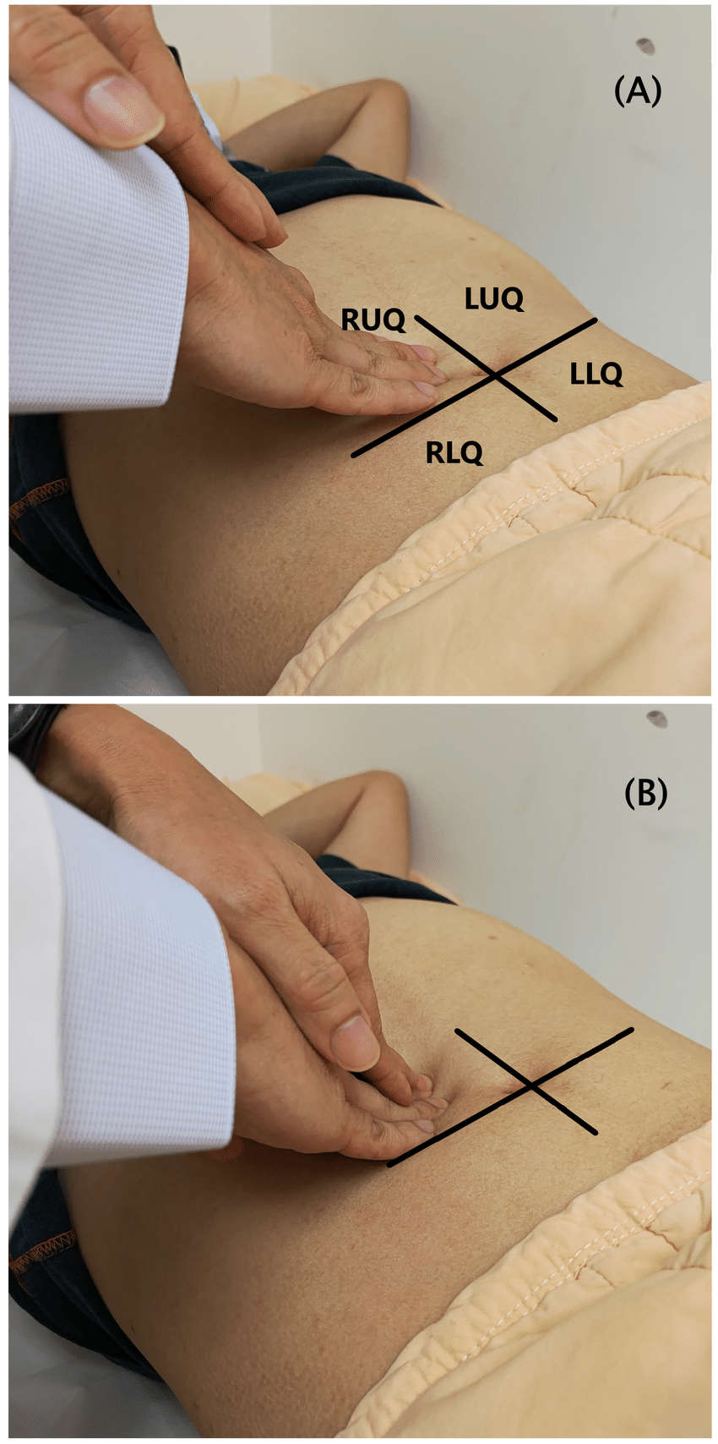
Palpate
Light
Deep
Tenderness
Masses
Abnormalities
(Jarvis et al., 2024)​
Notes:
Palpate Last- in case of aneurysm, discomfort, disruption of bowel sounds
1. Lay supine
2. Bends the client’s knees by placing on a pillow.
3. Percussion
Percuss all four abdominal quadrants.
Assess for:
Tympany
Dullness
Organ size
Abdominal distention
Normal Findings
Predominantly tympany throughout the abdomen due to air in the intestines
Scattered areas of dullness over solid organs such as the liver and spleen
4. Palpation
Palpation should be performed gently and systematically. Using the palmar surface of the hand, lightly palpates the entire abdomen
Light Palpation
Assess:
Tenderness
Muscle guarding
Surface masses
Muscle tone
Normal Findings
Abdomen soft and non-tender
No guarding or rigidity
No palpable masses
Deep Palpation
Assess:
Deeper masses
Organ enlargement
Areas of tenderness
Normal Findings
No masses
No organ enlargement
Minimal discomfort
Liver Palpation
Assess:
Liver edge
Tenderness
Consistency
Normal Findings
Liver edge may be palpable at the right costal margin in some healthy adults
Smooth, firm, non-tender edge
Spleen Palpation
Normal Findings
Spleen generally not palpable in adults
Abnormal Findings
Palpable spleen suggesting splenomegaly
Kidney Palpation
Assess for enlargement or tenderness.
Normal Findings
Kidneys usually not palpable in adults
No costovertebral angle tenderness

Slide 63
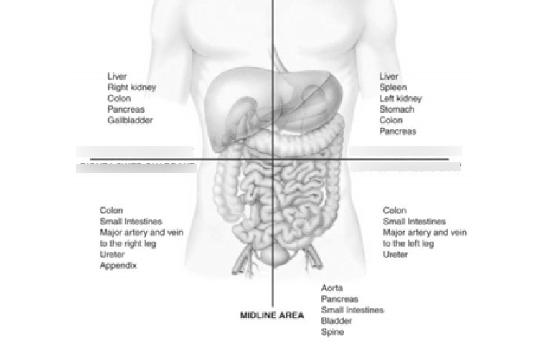
Notes:
Major red flags in an abdominal assessment:
Cholecystitis (RUQ), Pancreatitis (RUQ/midline), AAA (midline)
Appendicitis(RLQ), Diverticulitis, Bowel Obstruction, Bowel Perforation, Kidney Stones, Gastritis, Gastroenteritis,

Slide 64
Subjective Data
1. Appetite
2. Difficulty Swallowing (Dysphagia)
3. Food Intolerance
4. Abdominal Pain
5. Nausea and Vomiting
6. Bowel Habits
7. Past Gastrointestinal History
8. Medications
9. Nutritional Assessment (24-Hour Diet Recall)
(Jarvis et al., 2024)
Notes:
1. Appetite
Ask:
Have you noticed any change in your appetite?
Do you experience a loss of appetite (anorexia)?
Have you noticed increased hunger?
Assess for:
Decreased appetite
Early satiety
Unintentional weight loss or gain
Clinical significance: Changes in appetite may be associated with gastrointestinal disorders, infections, malignancy, depression, or metabolic diseases. [quizlet.com], [studylib.net]
2. Difficulty Swallowing (Dysphagia)
Ask:
Do you have difficulty swallowing?
Is swallowing painful?
Do you have trouble with solids, liquids, or both?
Have you experienced choking episodes?
Assess for:
Dysphagia
Odynophagia (painful swallowing)
Clinical significance: Difficulty swallowing may be associated with neurological disorders, esophageal disease, strictures, or gastroesophageal reflux disease (GERD).
3. Food Intolerance
Ask:
Are there any foods you cannot tolerate?
Do certain foods cause diarrhea, bloating, nausea, gas, or pain?
Do you have any food allergies?
Assess for:
Lactose intolerance
Gluten sensitivity
Food allergies
Fatty food intolerance
Clinical significance: Food intolerance may indicate digestive disorders, enzyme deficiencies, gallbladder disease, or inflammatory bowel disorders.
4. Abdominal Pain
Ask:
Are you experiencing abdominal pain?
Where is the pain located?
When did it begin?
What does it feel like (sharp, dull, cramping, burning)?
What makes it better or worse?
Does the pain radiate anywhere?
Assess using:
Provocation/Palliation
Quality
Region/Radiation
Severity
Timing
Clinical significance: Abdominal pain may be related to gastrointestinal, hepatobiliary, urinary, reproductive, or cardiac conditions.
5. Nausea and Vomiting
Ask:
Do you experience nausea?
Have you been vomiting?
How frequently?
What does the vomit look like?
Is it associated with meals?
Assess for:
Frequency
Duration
Triggers
Presence of blood or bile
Clinical significance: Nausea and vomiting may indicate infection, obstruction, medication effects, pregnancy, or gastrointestinal disease.
6. Bowel Habits
Ask:
How often do you have a bowel movement?
Has there been a recent change in bowel habits?
Do you experience constipation or diarrhea?
Have you noticed blood, mucus, or black stools?
Do you have problems controlling bowel movements?
Assess for:
Frequency
Consistency
Color
Presence of blood
Rectal bleeding
Incontinence
Clinical significance: Changes may indicate infection, inflammatory bowel disease, irritable bowel syndrome, colorectal disease, or gastrointestinal bleeding.
7. Past Gastrointestinal History
Ask about:
Previous GI disorders
Peptic ulcer disease
GERD
Inflammatory bowel disease (Crohn's disease, ulcerative colitis)
Hepatitis
Gallbladder disease
Liver disease
Gastrointestinal surgery
GI bleeding
Clinical significance: Previous gastrointestinal conditions often influence current symptoms and risk factors.
8. Medications
Ask:
What prescription medications do you take?
What over-the-counter medications do you use?
Do you take laxatives, antacids, or herbal supplements?
Clinical significance: Many medications can affect gastrointestinal function, including NSAIDs, antibiotics, opioids, iron supplements, and antacids.
9. Nutritional Assessment (24-Hour Diet Recall)
Ask:
What did you eat and drink in the last 24 hours?
How much fluid do you typically drink each day?
Have you had recent weight changes?
Do you follow any special diet?
Assess for:
Nutritional intake
Hydration
Weight loss or gain
Dietary restrictions
Clinical significance: Helps to identify their nutritional status

Slide 65
Genito-Urinary System

Slide 66
GU Assessment
Output
Skin
Symptoms
(Jarvis et al., 2024)​
Notes:
Objective Assessment
Inspect and palpate the abdomen for bladder distention
Assess for tenderness
Observe urine characteristics if available (color, clarity, amount, odor) (should be 0.5ml/kg/hr min)
Monitor intake and output
Assess for edema. Fluid accumulation ? Renal involvement
Evaluate continence status
Review relevant laboratory findings:
Urinalysis
Urine culture
Serum creatinine
Blood urea nitrogen (BUN)
Estimated glomerular filtration rate (eGFR)
Oral Cavity- for lesions, and ability to swallow. Will affect the amount of fluid they are taking in.
Skin- perineum. Excoriation present?

Slide 67
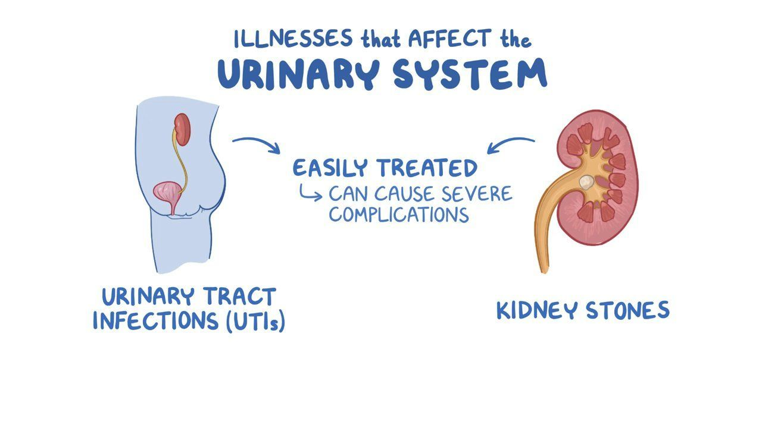
Notes:
These are just two of the common illnesses that we encounter with the urinary system.
Can anyone tell me what symptoms patients may exhibit with each? What are we assessing?

Slide 68
Subjective Assessment
Urinary frequency, urgency, nocturia, or changes in urinary patterns
Pain or burning with urination
Hesitancy or incontinence
Hematuria
Flank, pelvic, or suprapubic pain
Changes in urine color, odor, or volume
History of urinary tract infections, kidney disease, renal calculi, or sexually transmitted infections
Medications that may affect urinary function
Fluid intake and hydration status
(Jarvis et al., 2024)​
Notes:
If your patient is independent, they may or may not have an indwelling urinary catheter and you will need to use a measurement device (hat) to assess their urine output or ask them the following questions.

Slide 69
Musculo Skeletal System

Slide 70
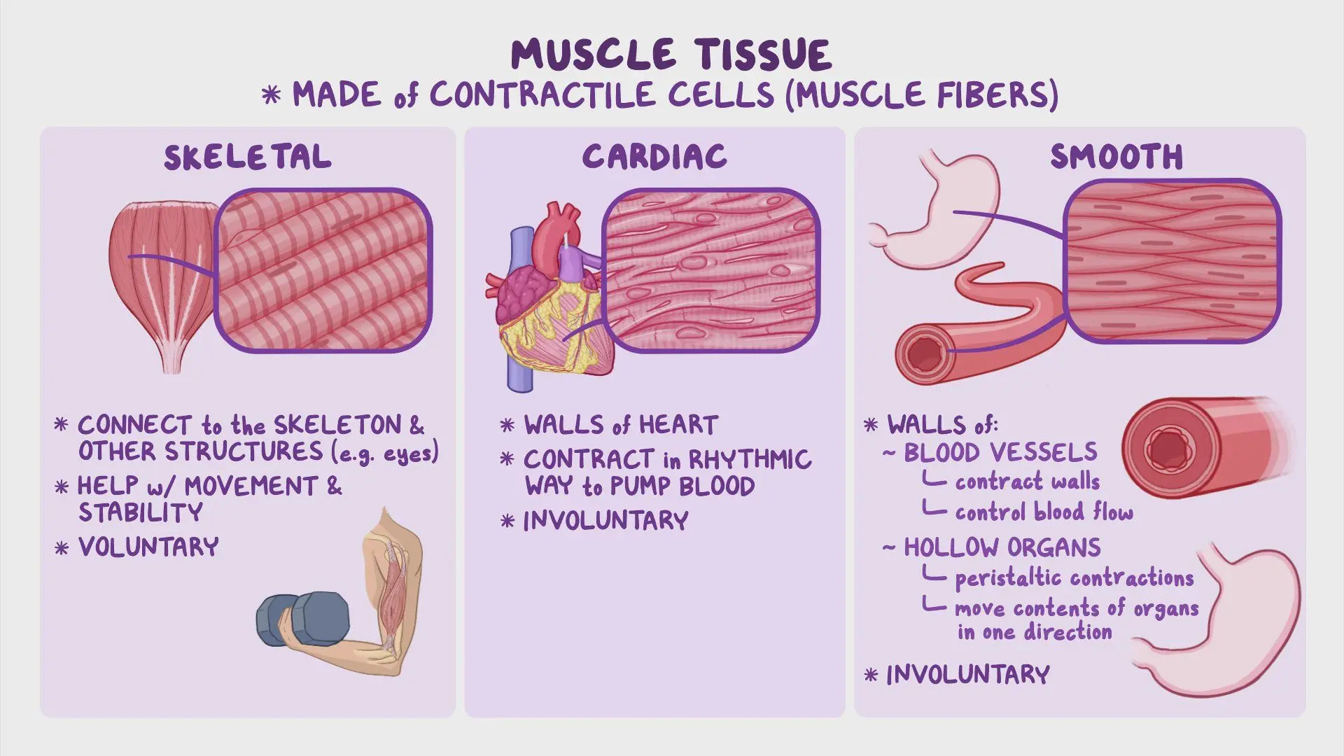
Notes:
These are the different types of cells that make up our muscles.

Slide 71
Objective Data
Inspection
Palpation
Range of Motion (ROM)
Muscle Strength Testing
Functional Assessment
(Jarvis et al., 2024)​
Notes:
Objective Assessment
The objective examination follows the sequence of:
Inspection
Palpation
Range of Motion (ROM)
Muscle Strength Testing
Functional Assessment

Slide 72
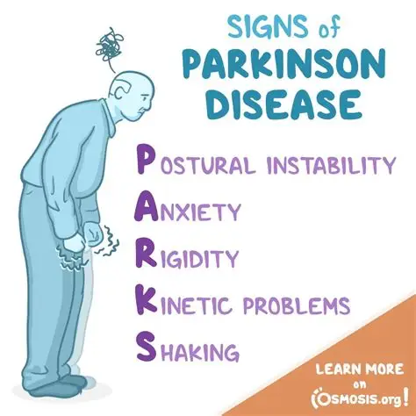
Inspection
Symmetry
Alignment
Deformities
Swelling
Redness
Muscle size
Muscle atrophy
Posture
Gait
(Jarvis et al., 2024)​
Notes:
1. Inspection
Inspect all major joints, muscles, and bones for:
Symmetry
Alignment
Deformities
Swelling
Redness
Muscle size
Muscle atrophy
Posture
Gait
Normal Findings
Symmetrical joints
No swelling or deformity
Upright posture
Smooth, coordinated gait
Equal muscle development bilaterally

Slide 73
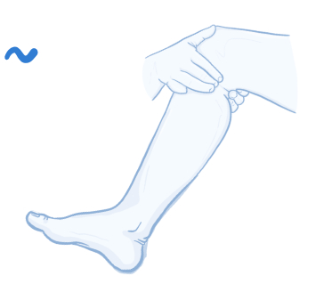
Palpation
Tenderness
Warmth
Swelling
Crepitus
Muscle tone
Masses
(Jarvis et al., 2024)​
Notes:
2. Palpation
Palpate joints and muscles assessing for:
Tenderness
Warmth
Swelling
Crepitus
Muscle tone
Masses
Normal Findings
No tenderness
No heat or swelling
Firm muscle tone
No crepitation during joint movement

Slide 74
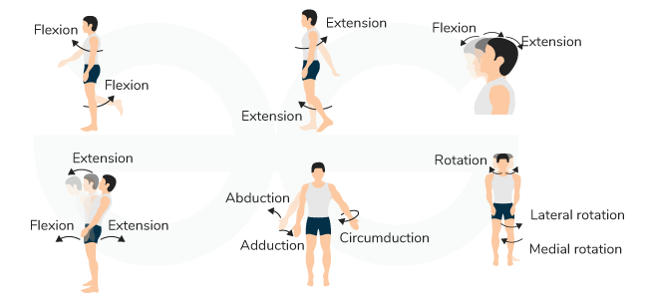
Range of Motion
Cervical spine
Shoulders
Elbows
Wrists
Fingers
Hips
Knees
Ankles
Toes
(Jarvis et al., 2024)​
Notes:
Unless your patient has an issue with ROM/a joint specifically we would not necessarily complete a full ROM assessment. This is specific to patient.
3. Range of Motion (ROM)
Assess active ROM of:
Cervical spine
Shoulders
Elbows
Wrists
Fingers
Hips
Knees
Ankles
Toes
Evaluate:
Flexion
Extension
Hyperextension
Abduction
Adduction
Rotation
Normal Findings
Smooth, coordinated movement
Full ROM without pain
Equal bilaterally

Slide 75
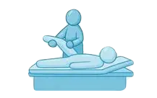
Muscle Strength Testing
Assess muscle strength against resistance
(Jarvis et al., 2024)​
Notes:
4. Muscle Strength Testing
Assess muscle strength against resistance:
Normal Findings
Muscle strength 5/5 bilaterally
Equal muscle strength throughout

Slide 76
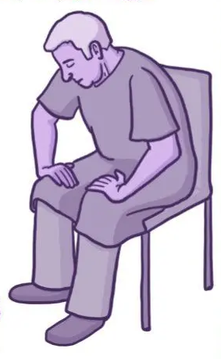
Functional Assessment
Walking
Rising from a chair
Climbing onto an examination table
Fine motor activities
Balance and coordination
(Jarvis et al., 2024)​
Notes:
5. Functional Assessment
Observe:
Walking
Rising from a chair
Climbing onto an examination table
Fine motor activities
Balance and coordination
Normal Findings
Independent mobility
Stable gait
Good balance
Ability to perform ADLs without assistance

Slide 77
Subjective Data
1. Joint Assessment
2. Muscle Assessment
3. Bone Assessment
4. Functional Assessment
(Jarvis et al., 2024)​
Notes:
Often your subjective assessments are complete as you preform an objective assessment.
1. Joint Assessment
Ask about:
Pain
Stiffness
Swelling
Heat or redness
Limitation of movement
Location and duration of symptoms
Precipitating events or injury
Impact on daily activities
Examples of questions:
Do you have pain in any joints?
Are your joints stiff, especially in the morning?
Have you noticed swelling, warmth, or redness?
Does movement improve or worsen the pain?
Do your joints limit your activities? [quizlet.com], [quizlet.com]
2. Muscle Assessment
Ask about:
Muscle pain (myalgia)
Cramping
Weakness
Fatigue
Loss of muscle function
Examples of questions:
Do you experience muscle aches or cramps?
Do your muscles feel weak?
Have you had difficulty climbing stairs, lifting objects, or rising from a chair? [quizlet.com], [pressbooks...rontomu.ca]
3. Bone Assessment
Ask about:
Bone pain
Previous fractures
Trauma
Sprains
Dislocations
Deformities
Examples of questions:
Have you ever fractured a bone?
Have you recently experienced trauma or injury?
Have you noticed changes in bone shape or alignment? [quizlet.com], [quizlet.com]
4. Functional Assessment
Assess the patient's ability to perform:
Activities of daily living (ADLs)
Mobility
Self-care activities
Work-related activities
Recreational activities
Examples of questions:
Are you able to bathe, dress, and groom yourself independently?
Do you have difficulty walking, climbing stairs, or carrying groceries?
Have musculoskeletal problems affected your work or leisure activities? [quizlet.com], [quizlet.com]

Slide 78
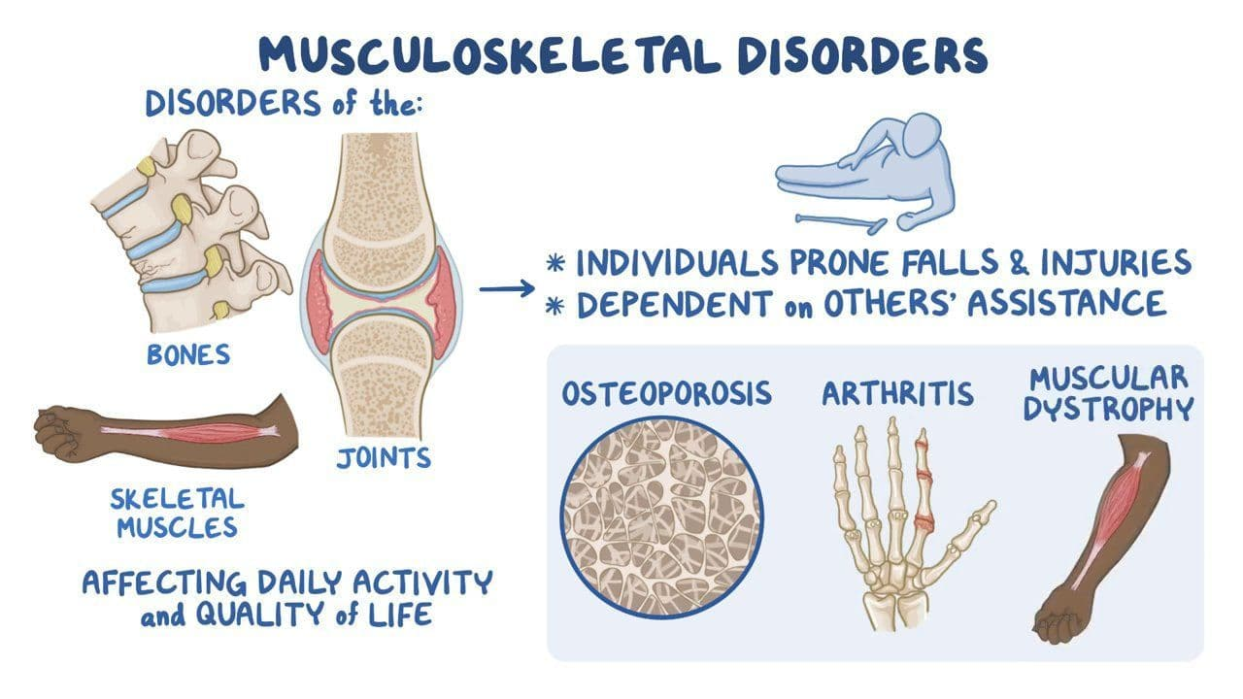
Notes:
Some disorders you may come across can include:

Slide 79
Integumentary System

Slide 80
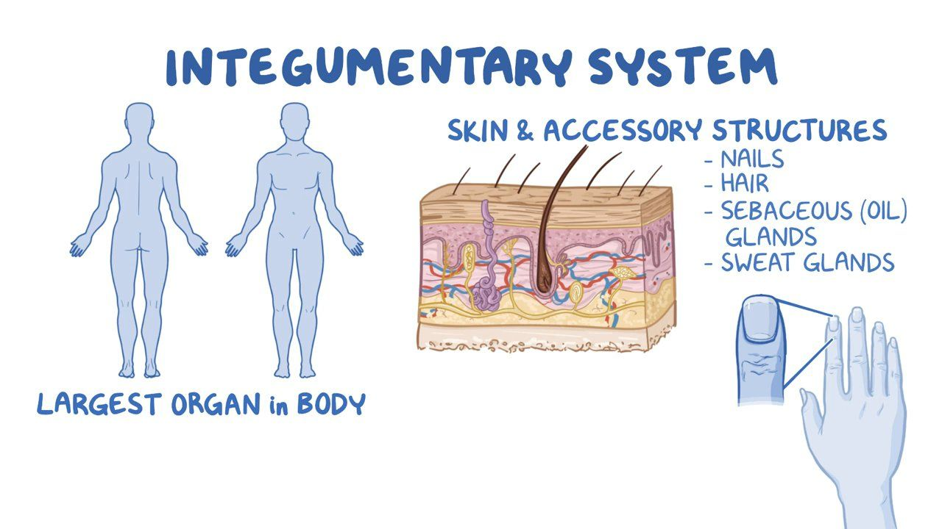
Notes:
When we are assessing the integumentary system, we are assessing:
The skin
Hair
Nails
Sebaceous glands
Sweat glands

Slide 81

Components of a Skin Assessment
Inspection
Palpation

Slide 82
Color
Pigmentation
Lesions
Vascularity
Bruising
Scars
Moisture
Distribution of lesions
Inspect
(Jarvis et al., 2024)​
Notes:
Inspect
Assess:
Color
Pigmentation
Lesions
Vascularity
Bruising
Scars
Moisture
Distribution of lesions
Normal Findings
Skin color appropriate for ethnicity
Even pigmentation
No suspicious lesions
No unusual bruising
Skin intact without breakdown or ulceration

Slide 83
Palpate
Temperature
Moisture
Texture
Mobility
Turgor
Edema
(Jarvis et al., 2024)​
Notes:
Palpate
Assess:
Temperature
Moisture
Texture
Thickness
Mobility
Turgor
Edema
Normal Findings
Warm and dry skin
Smooth texture
Elastic turgor with prompt recoil
No edema
Mobile skin with underlying tissues intact

Slide 84
Lesion Assessment
Location
Size
Shape
Color
Distribution
Borders
Elevation
Drainage
(Jarvis et al., 2024)​
Notes:
When lesions are present assess:
Location
Size
Shape
Color
Distribution
Borders
Elevation
Drainage
ABCDE Assessment of Pigmented Lesions
Assess for:
Asymmetry
Border irregularity
Color variation
Diameter > 6 mm
Evolving changes
Abnormal findings may indicate melanoma or other skin cancers to be diagnosed by a primary care provider. Just remember this for your assessments.

Slide 85
Color
Distribution
Quantity
Texture
Presence of lesions or parasites
Hair Assessment
(Jarvis et al., 2024)​
Notes:
3. Hair Assessment
Inspect
Assess:
Color
Distribution
Quantity
Texture
Presence of lesions or parasites
Normal Findings
Hair evenly distributed
Appropriate texture for age and ethnicity
No scalp lesions
No excessive hair loss
Palpate
Assess:
Texture
Thickness
Normal Findings
Hair smooth and resilient
Scalp clean and intact

Slide 86
Shape and contour
Color
Surface characteristics
Thickness
Nail Assessment
(Jarvis et al., 2024)​
Notes:
4. Nail Assessment
Inspect
Assess:
Shape and contour
Color
Surface characteristics
Thickness
Normal Findings
Nails smooth and firm
Slightly curved nail angle
Pink nail beds
No clubbing or deformity
Palpate
Assess:
Nail consistency
Another opportunity to assess Capillary refill
Normal Findings
Firm nail
Capillary refill less than 2 seconds

Slide 87
Subjective Data
Ask about:
Current skin problems
Rashes or lesions
Itching (pruritus)
Dryness
Excessive sweating
Changes in skin color
Easy bruising
Delayed wound healing
Pressure injuries
Changes in their hair or nails
(Jarvis et al., 2024)​
Notes:
Skin History
Ask about:
Current skin problems
Rashes or lesions
Itching (pruritus)
Dryness
Excessive sweating
Changes in skin color
Easy bruising
Delayed wound healing
Pressure injuries
Previous skin disorders
Examples of Questions
Have you noticed any changes in your skin?
Do you have any rashes, sores, or lesions?
Have you experienced itching or dryness?
Do you bruise easily?
Have you noticed any changes in moles or birthmarks?
Do cuts or wounds heal normally?
Hair History
Ask about:
Hair loss (alopecia)
Changes in hair growth
Changes in hair texture
Scalp itching or lesions
Examples of Questions
Have you noticed increased hair loss?
Have you had any scalp irritation or dandruff?
Has the texture of your hair changed?
Nail History
Ask about:
Changes in nail shape
Changes in nail color
Brittle nails
Nail infections
Nail trauma
Examples of Questions
Have your nails changed in appearance?
Do your nails split, crack, or break easily?
Have you had nail infections?

Slide 88
Questions?

Slide 89
References
Astle, B. J., Duggleby, W., Potter, P. A., Perry, A. G., Stockert, P. A., & Hall, A. (2024). Potter and Perry’s Canadian fundamentals of nursing (7th ed.). Elsevier Health Sciences.
Jarvis, C., Eckhardt, A., Browne, A. J., MacDonald-Jenkins, J., & Luctkar-Flude, M. (2024). Physical examination and health assessment (Fourth Canadian Edition). Elsevier Inc.
Urden, L.D., Stacy, K.M., & Lough, M.E. (2018). Critical care nursing: diagnosis and
management (8th ed.). ISBN: 978-0-323-44752-2

