Slide 1


PICC Dressings
Transition to Practice Program
Professional Practice Office

Slide 2

Peripherally Inserted Central Catheter (PICC):
A thin, flexible catheter which is inserted into one of the larger veins of the upper arm and advanced in the venous system until the distal tip is positioned in the distal superior vena cava at the cavoatrial junction.
A PICC is a central venous access device.
Notes:
Insertion of the Peripherally Inserted Central Catheter (PICC) is considered to be an advanced nursing practice.

Slide 3
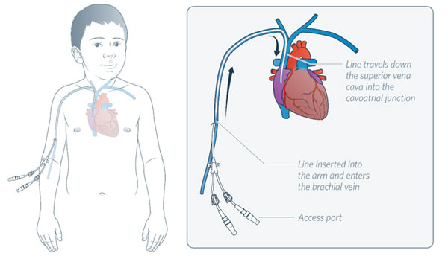
What/Where is the Cavoatrial Junction?
basilic vein or cephalic vein
Notes:
The Cavoatrial Junction is the junction of the superior vena cava and the right atrium.

Slide 4
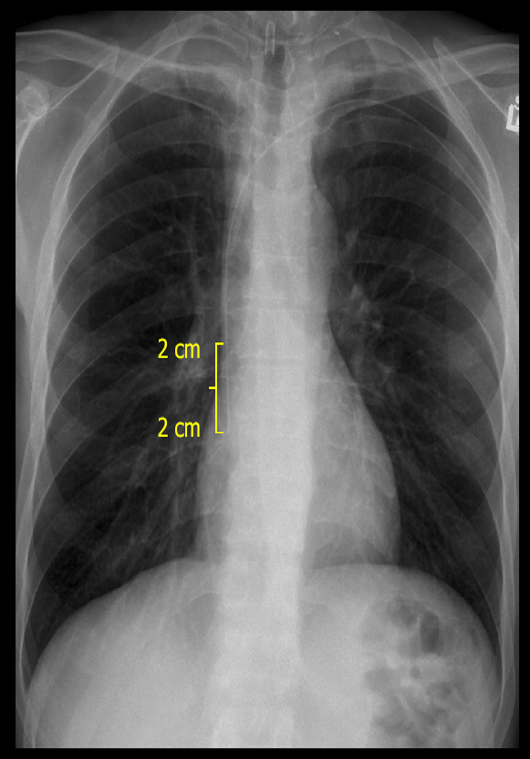
Notes:
This is a picture of what your patients Xray should look like with Proper placement of a PICC

Slide 5
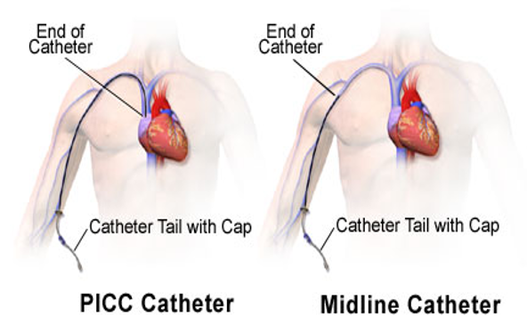
Notes:
Example of where a PICC ends vs. a midline catheter

Slide 6
Why Would my Patient Need a PICC
Treatment for at least seven (7) days.
Infusion of hyperosmolar solutions. (higher concentration of solutes.)
Infusion of vesicants, irritating antibiotics/drugs (alkaline or acidic ph levels), antineoplastic drugs.
Multi- access required.
Intermittent to long-term access (continuous or intermittent).
Lack of peripheral access and meets one of the above criteria.
Notes:
Contraindications for PICC insertion are:
Inadequate veins (too small).
Injury to the upper arm or potential for compromised skin integrity on upper arm.
Severe bleeding disorders (not absolute contraindication).
Non-compliance by patient (confusion that may result in accidental removal, intravenous [IV] drug users) - not absolute contraindication.
Chronic kidney disease that may require dialysis in the future (discuss with attending Nephrologist).
The tip of the PICC should reside in the cavoatrial junction for optimal positioning. The tip is confirmed using radiographically or with the Sherlock 3CG Tip confirmation system.
Antineoplastic drugs: are medications designed to prevent the growth and spread of cancer cells by interfering with cell division and survival.

Slide 7
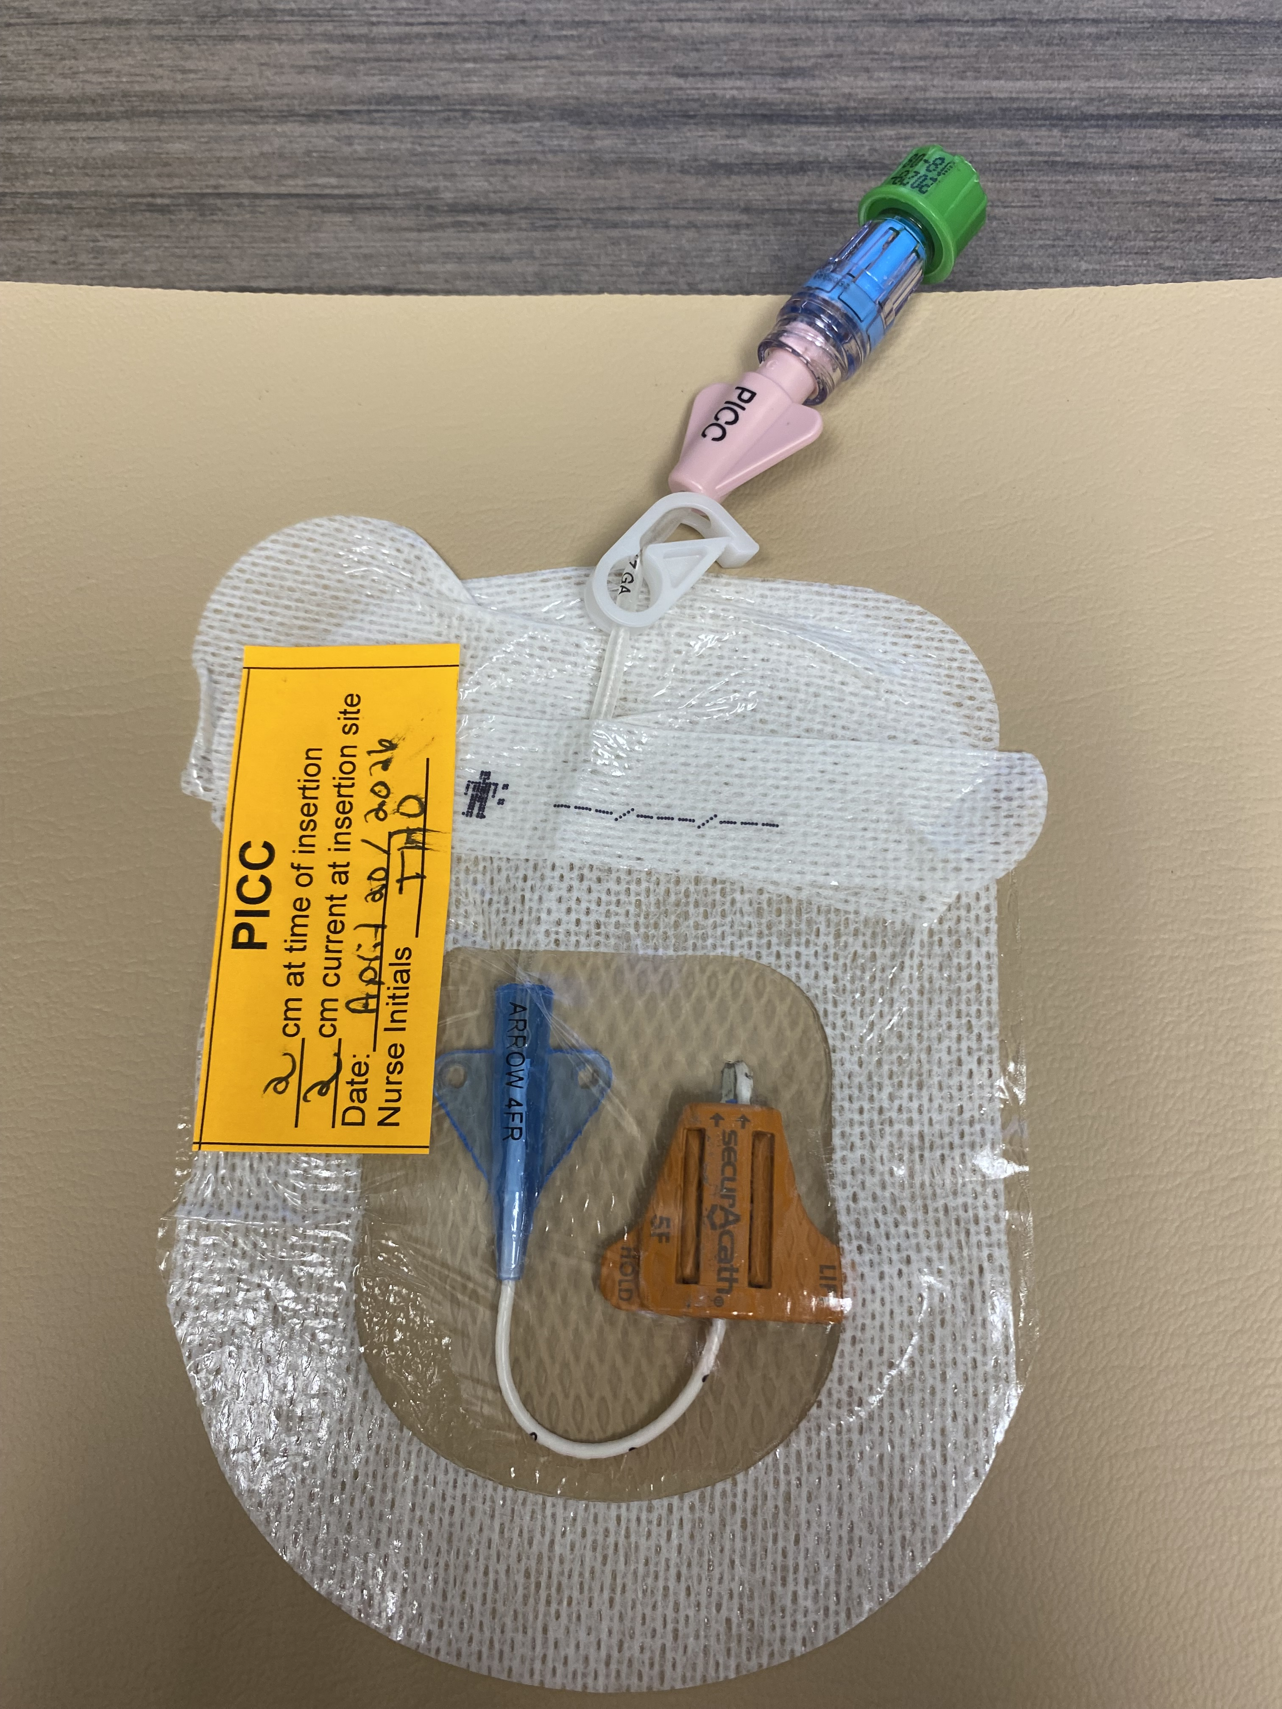
What does a proper PICC dressing look like?
Notes:
You can see in this photo that:
There is no drainage
The transparent dressing covers the Area 2 cm above the insertion site
The SecurAcath device on the PICC measures <= 3 cm from exit site.
The entire line is covered up to and including the butterfly wings
The sticker indicates the cm at the time of insertion and the current cm, date last changed, nurses initials who changed the dressing.

Slide 8
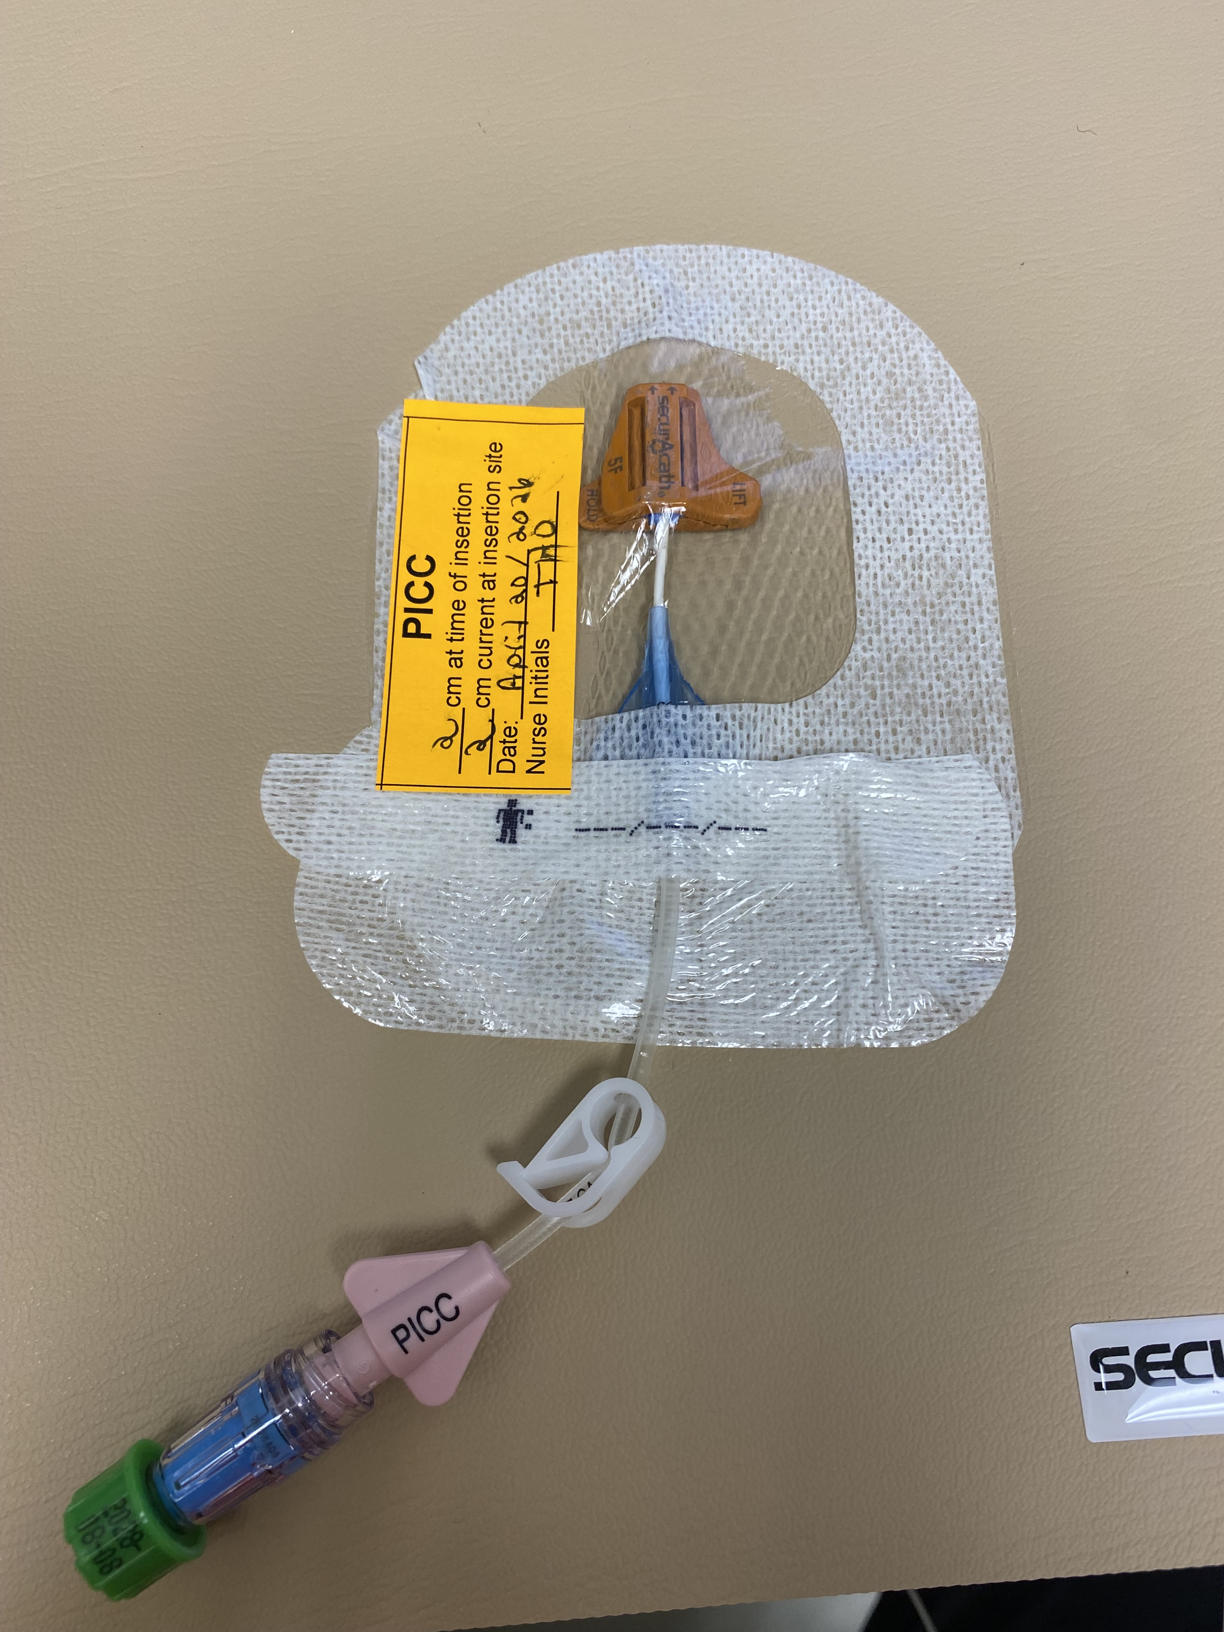
Notes:
Green Caps are placed on the end of your needleless connector after each use. This removes the need to swab the cap before accessing. Ensure you apply a new cap each time one is removed.

Slide 9
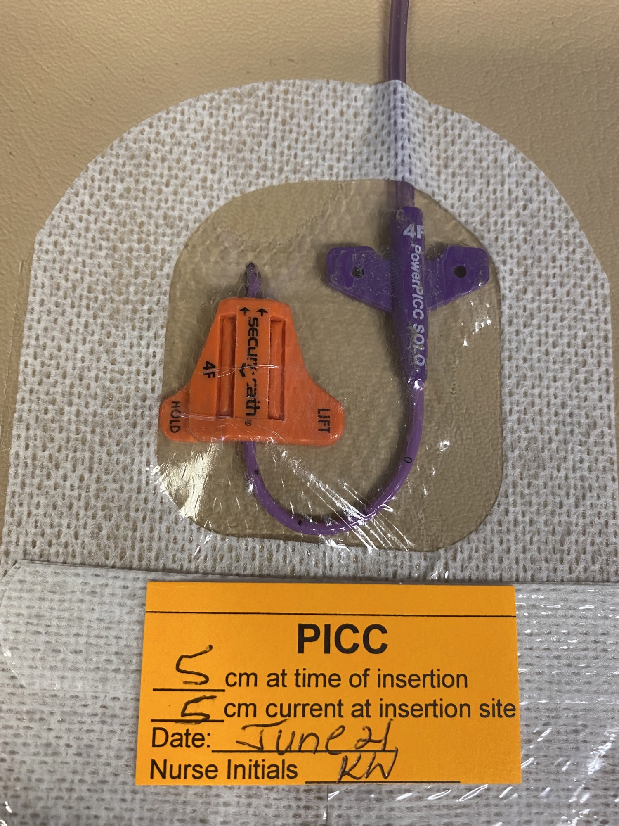
Notes:
Purple PICCs will be seen coming from other hospitals. You most likely will not see them come to you with a secureAcath and they require an adhesive securement device that will be changed weekly.

Slide 10
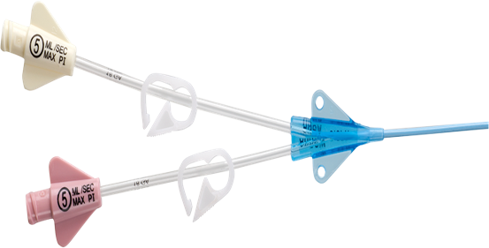
Notes:
The PICCs used at the QEH are dual lumen. Add positive needle free connectors.

Slide 11
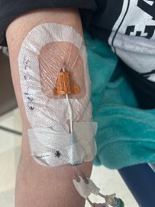
Examples of PICC Dressings Done Incorrectly
Notes:
Can anyone tell me why this dressing is not done properly?
-The line is exposed before the hub

Slide 12
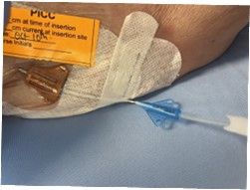
Notes:
Can anyone tell me why this dressing is not done properly?
-The wings are exposed. Once the wings are exposed, they can not be put back under sterile dressing.

Slide 13
When do you Change the Dressing?
The transparent dressing must be changed every 7 days or when the dressing is wet, soiled, or has any old or fresh blood at the insertion site or under the dressing.
QEH now applies an adhesive glue to seal the site upon insertion, and this aids in preventing infection.
If the site is bleeding QEH will apply stat seal, PCH applies stat seal to all PICC insertions.
Place a dated sticker on your dressing once it is complete and document , so all staff are aware when the next dressing is due.
Notes:
Previous practice was to change the PICC dressing 24 hours post insertion followed by every 7 days. In current practice PICC dressings are only changed at 24 hours if there is blood or drainage at the site or a gauze.

Slide 14
Before Completing a Dressing Change
Note the external centimeter markings or dots visible to insertion site.
For a PICC, this can be found under the Histories Tab > PICC Insertion > Documentation Comment on the electronic health record.
*Registered nurses must never attempt to re-insert a central venous catheter under any circumstances, including when catheters accidentally dislodge or migrate.

Slide 15
What Supplies do I Need?
1 - Mask
1 - Dressing tray
3 - 2% chlorhexidine – 70% alcohol (CHG) swab sticks (non-sterile)
1 - Pair of sterile gloves
1 - Transparent dressing
1 - Securement device (not required if a SecurAcath insitu or is sutured in place)
Positive needle free connector (if needed for each lumen)
2 or 3 - 10 mL pre-filled saline syringe (if needed for each lumen)
1 - PICC, mid-line or central line label
Non-sterile gloves
Cavilon Swabsticks (if required)
Swab for C&S (if needed)
Notes:
PCH Uses Kits put together by staff with sterile supplies and towel.

Slide 16
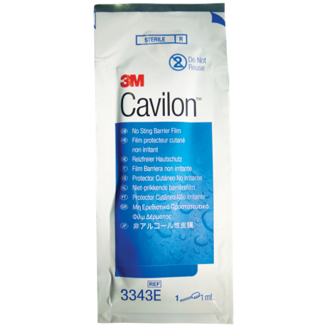
Notes:
This is what a cavilon swab stick package looks like.
They are used for skin protection by creating a barrier that prevents skin damage from friction , shear, and body fluids.
The swab sticks form a breathable, waterproof, and transparent film that lasts for up to 72 hours, providing protection against moisture associated skin damage and adhesive trauma.

Slide 17
How do I Change a PICC Dressing?
Don mask.
Perform hand hygiene as per HPEI Hand Hygiene Policy.
Identify patient using two identifiers as per HPEI Client Identification Policy.
Place patient in comfortable position and explain procedure.
Have patient wear mask or turn head away from the insertion site.
Prepare supplies.
Apply non-sterile gloves and remove transparent dressing. Be very careful not to dislodge catheter, especially if it does not have a SecurAcath device in place.
Apply new non-sterile gloves.
Notes:
Two RNs are required to perform non-implanted CVAD dressing changes for restless or pediatric patients.

Slide 18
Changing the PICC Dressing Continued
If there is no SecurAcath in place, remove the catheter from securement device
(a) Open the tape across the PICC.
(b) Gently lift the PICC out of the “post” on the device.
(c) Slide the catheter out of the device.
(d) Be very careful the PICC does not migrate out
externally.
To remove the old securement device (if used) from the skin easily:
(a) Apply CHG swab stick under edge of pad
(b) Gently lift edge
(c) Continue to stroke the under surface with swab
stick while lifting

Slide 19
Changing the PICC Dressing Continued
Examine catheter insertion site for:
  erythema, drainage, tenderness
  centimeter markings - number of dots visible to insertion site
  SecurAcath device on the PICC (if present) measures 3 cm from exit site.
If signs of infection are present
  (a) Send swab for C&S.
  (b) Report this to the physician, infection control nurse and PICC nurse.

Slide 20
Changing the PICC Dressing Continued
Cleanse entire insertion site area which will be covered by the dressing
  Using no-touch technique.
  With two (2) CHG swab sticks.
  Using a back and forth motion vertically and horizontally for at least 30 seconds.
  Allow to air dry for at least 3 minutes.

Slide 21
Changing the PICC Dressing Continued
Cleanse the entire length of the catheter.
  Hold the catheter with the connectors
  Use a third CHG swab stick
  If there is a SecurAcath, lift it up to clean it, but do not twist or turn it from its original position.
  Use sterile saline to remove blood (if present on SecurAcath or catheter) and then clean with 2%CHG. Allow to dry for at least 3 minutes. SecurAcath will take longer to dry.
Notes:
It is crucial they you do not rush the drying time and wait the entire three minutes. If you do not wait the three minutes this will lead to skin breakdown and burns under PICC dressings!
If it is humid you may need to wait longer than three minutes.

Slide 22
Changing the PICC Dressing Continued
Remove gloves.
Perform hand hygiene.
Open dressing tray, drape site and aseptically place needed supplies on the tray (including securement device (if used) and transparent occlusive dressing.
Apply sterile gloves.
Insert catheter into the securement device (if using) before adhering the device to the skin to avoid pressure on the skin and pulling of the catheter.
  (a) Slide the PICC catheter into the securement device
  (b) Place the PICC in the “post”
  (c) Remove paper backing, one side at a time
  (d) Place the securement device on the skin.

Slide 23
Changing the PICC Dressing Continued
Apply transparent dressing to cover the
  Area from 2 cm above the insertion site
  Securement device completely (if used)
  Butterfly portion of the PICC catheter.
Change the connector if needed.
Apply appropriate label (PICC, Midline). Date and initial dressing. Document external centimeter markings on the label.
Notes:
(Refer to the CentralVenous Access Device (CVAD) Neutral ConnectorChange procedure). * There was a policy that has since been rescinded*

Slide 24
Changing the PICC Dressing Continued
Dispose of soiled supplies.
Remove gloves and perform hand hygiene.
If centimeter marking has changed, notify the PICC Nurse.
This is charted on iView now under CVAD or midline form. If more detail is required, use progress notes. Use paper chart in areas when the electronic health record is not used.
Notes:
Policy states that you must notify the PICC nurse if the PICC centimeter markings have changed.

Slide 25

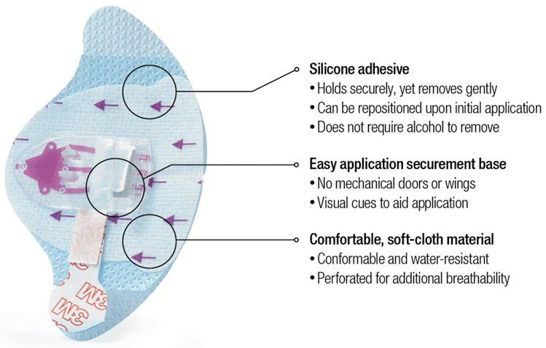
PICC Securement
As mentioned in the procedure, all Peripherally Inserted Central Catheters (PICCs) must be secured with a
securement device.
Notes:
Do not change SecureAcath devices when changing your PICC dressing. They are placed with the insertion of the PICC and are not intended to be removed until the PICC is discontinued.

Slide 26


Slide 27
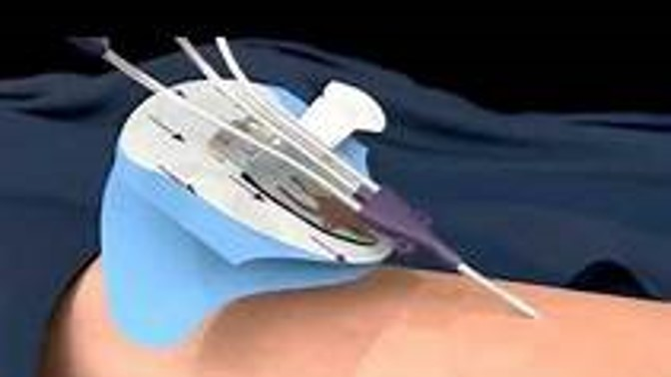

Slide 28
What do I do if the Site is Oozing?
If necessary, gauze is placed under the transparent dressing to absorb drainage or oozing at the CVAD insertion site. Gauze dressings must be changed every 48 hours to visualize the site as well as reduce risk of infection.

Slide 29
Do I Change the Connectors?
The positive needle – free connector must be changed every seven (7) days.
When checking for blood return:
Connect a prefilled Normal Saline Syringe.
Flush 1-2 ml.
Draw back on the syringe to check for blood return.
Once good blood return is noted you can either discard or flush back in.
Flush with 20ml of Normal Saline following this procedure.
Remove the syringe then clamp once removed.
Notes:
CVAA says you can flush blood back in once you have checked for blood return but you are also ok to remove the syringe and flush with 20ml of saline.
Remove the syringe then clamp because they are positive pressure connectors, when you remove the syringe there is a little push of the fluid left in the connector back into the line, completely emptying the connector.

Slide 30
What to do When Complications Arise
If you identify that there are indicators of inflammation or infection present at the CVAD insertion site notify the attending physician, PICC Nurse and the infection control nurse must be notified.
Culture and sensitivity (C&S) testing must be completed.
Should the short-term central line be accidentally dislodged or migrate, notify the physician and PICC Nurse.

Slide 31
Complications Continued
Should the PICC or Midline be accidentally dislodged/migrated three (3) or more centimeters from its original position, check the length in cm and compare it to the information in the histories tab in CIS. Then notify the designated PICC nurse or nursing supervisor if afterhours. If blood return is present and you are not infusing total parenteral nutrition (TPN) or a vesicant, you may continue to use the PICC until able to contact the PICC nurse or physician.
A chest x-ray will be required to ensure proper tip location if line has migrated.

Slide 32
Complications Continued
If you are unable to flush or get blood return from your PICC. Remember to check the line before administering CathFlo.
Notes:
Kinks happen and we do not want to administer any medications unnecessarily.

Slide 33
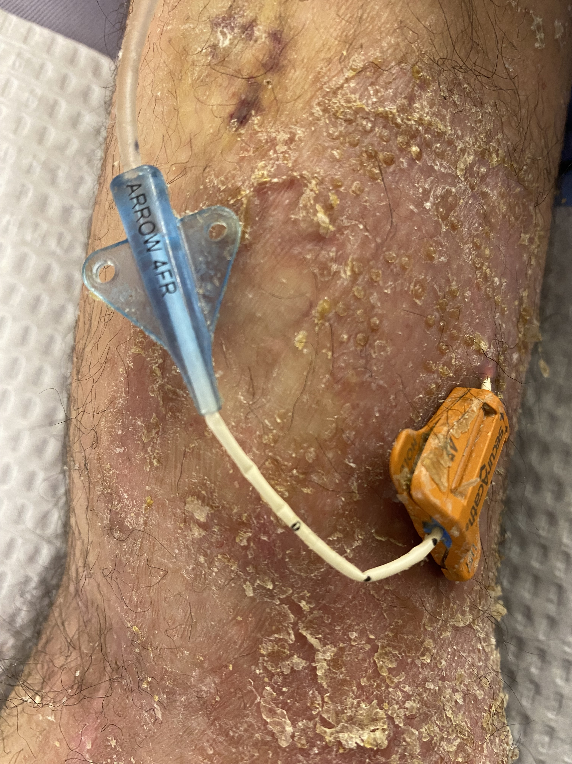
Notes:
Picture of a real QEH patient who suffered skin breakdown dure to PICC dressing changes.
You can see the PICC line is easily bent and may cause disruption in flushing and blood return. Always check for kinks!

Slide 34
If you are ever looking for additional resources, CVAA Guidelines have been added to the staff resource center for ease of access by all staff.
Username: HealthPEIguidelineuser
Password: 2024PEIGuidelines

Slide 35
This presentation is available on the Health PEI Staff Resource Center under the Transition to Practice Program

Slide 36
References
Harvard University. (n.d.). Radiographic findings with central venous catheters. https://hpn.hms.harvard.edu/central-line-location-tip-placement-issues
QEH Dressing Change for Non-Implanted Central Venous Access Device Policy
QEH Peripherally Inserted Central Catheter (PICC) Policy

Slide 37

Questions?

