Slide 1
TECH TIPS
101: Mobile Technology Basics

Slide 2
INTRODUCTIONS
Patricia Prosper
Dan Pettit

Slide 3
OVERVIEW
New Technology
Google Pixel smartphones have been purchased for all Home Care employees
By leveraging these devices, we will improve efficiency, communication and service to our Home Care clients
Today: Session 101
All about the basics!
We’ll learn how the phone works, and explore some useful apps to get you started
Google Pixel
Android 10 OS
10 GB data

Slide 4
AGENDA
The Basics
Using Apps
Security & Policies
What’s Next?

Slide 5
THE BASICS

Slide 6
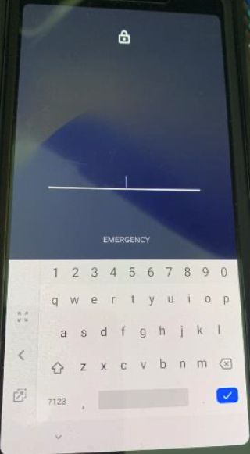
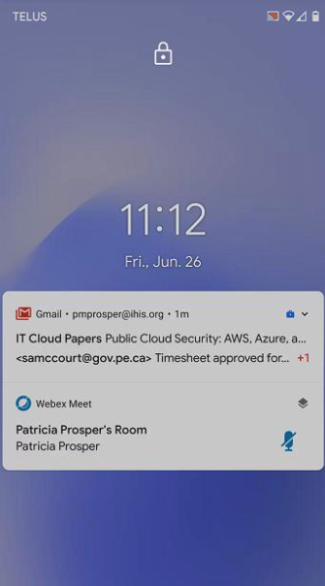
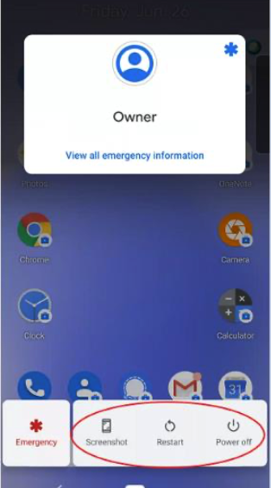
Power
When screen is dark, click on the power button for lock screen
Swipe up on lock screen to enter password manually
Hold down on power button:
Screenshot
Restart
Power Off

Slide 7
Emergency Call
Hold down power button to access the Emergency Call
Tap Emergency to call 911

Slide 8
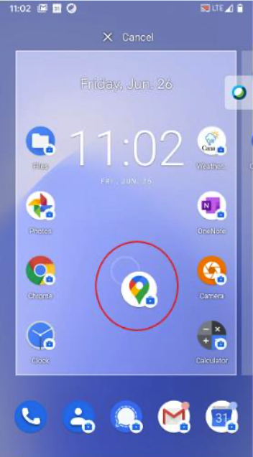
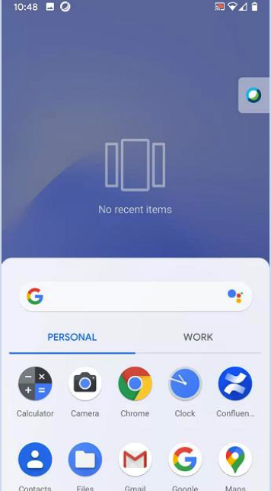
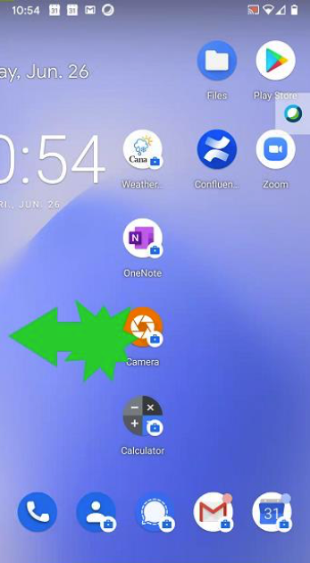
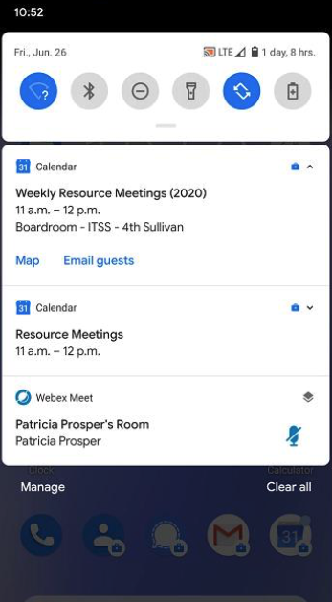
Navigation
Swipe up from the bottom for work & personal profiles
Swipe down from the top for notifications and quick settings
Swipe left to see more screens
Hold down and drag to move an app (drag the app off-screen to remove)

Slide 9
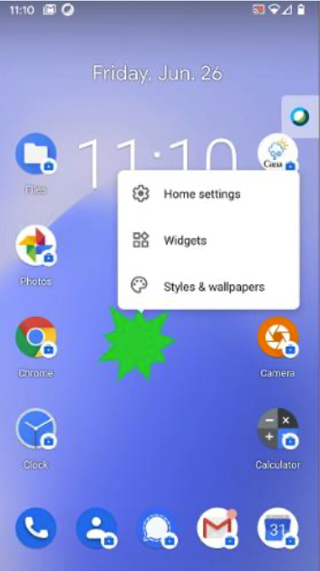
Settings
Swipe up from the bottom and choose Settings
Tap and hold on main screen for home settings and widgets

Slide 10
Volume
Use buttons on side of phone (below the power button) to:
Adjust volume
Switch to vibrate
Switch to silent mode
Use quick menu at the top by swiping down and clicking Do Not Disturb to silence the phone

Slide 11
Camera
Personal use:
Use Camera app under Personal Profile
Images store to Google Photos (Personal Profile)
Work use:
Use the orange Simple Camera under Work Profile
Images store to Google Photos (Work Profile)

Slide 12
WIFI
Swipe down to access the quick menu, tap and hold the WIFI symbol
Use WIFI at your own home, but not in a client’s home
WIFI is not currently available for smartphone use at the office – stay tuned!

Slide 13
USING APPS

Slide 14
PROFILES
Download apps for personal use from Play Store
WORK
Apps managed by IT Shared Services + have this icon:
Government Acceptable Use Policy applies to personal use
PERSONAL
Government Acceptable Use Policy and Home Care policies applies to work use
General Settings and Phone App can be found here
General Settings and Phone App are not stored here
Camera and photo storage apps have been pre-downloaded for personal use
Camera and photo storage apps have been pre-downloaded for work use
Pro Tip: Store shortcuts to all frequently used personal and work apps on separate screens
Don’t Panic! Some phones have both profiles, and some only have one – either way, it’s okay!

Slide 15
PERSONAL PROFILE
WORK PROFILE
Download apps from the Play Store
Restricted
Use Gmail for both profiles
Use Groupwise for work
Use this app as personal Camera
Use this one as work Camera
Photos are stored under each profile
Photos are stored under each profile
Use Messages for personal texting
Use Signal to text with co-workers
All Settings controlled from personal profile
Only one Phone app

Slide 16
GROUPWISE: EMAIL
Directly linked to your work email and calendar on your computer
Set email app to ‘blue E’ (top right-hand corner of app)
Use menu option to access folders and cabinet
Tap ‘compose’ to create an email - may appear as
Search email addresses by last name
Icons:
Reply
Reply All or Forward
Pro Tip: If you change your Groupwise password, it needs to also be changed on your phone

Slide 17
GROUPWISE: CALENDAR
It is directly linked to your work email calendar
Use the menu option to change the calendar view
Click on the plus sign to add an event (e.g. meeting)

Slide 18
SIGNAL
Allows for secure texting between Home Care staff
It is different than the Messaging app, which should not be used to share Personal Health Information (PHI)
Do not text PHI through Signal until the texting policies have been updated (date TBD)
Setup Signal: Open app, follow prompts and click ‘Allow’ when prompted
You will receive a text message on the Messaging app (personal profile) with a confirmation code during this process
To edit your profile, send a message, start a group, and more, visit:
https://support.signal.org/hc/en-us/sections/360001602712-Signal-Messenger-Basics
To learn more about the Health PEI physician Signal pilot and view the learning toolkit, visit:
https://src.healthpei.ca/signalc-learning-toolkit

Slide 19
PRIVATE NUMBER
We recommend turning your phone number ‘private’ or ‘unknown’
Open Phone app and follow these instructions:
Tap on the 3 dots on top right-hand corner
Tap Settings > Calls > Additional Settings > Caller ID
Click on Hide Number
Your number will now appear as ‘private’ or ‘unknown’ to those you are calling

Slide 20
ACCESSORIES
Ear Buds
Smartphone accessories are available through your office
Replacement Cases
Extra Cords & Other Items

Slide 21
SECURITY & POLICIES

Slide 22
SECURITY BASICS
Getting Started
Advanced Security
Responsible Use
Use the password supplied to you to log into the device
Unlock the phone with your fingerprint:
Open Settings app
Tap Security
Tap Pixel Imprint
Follow on-screen instructions
Make sure phone is locked if setting it down
If leaving phone in a car, ensure the car is locked
Do not share an unlocked phone with other individuals

Slide 23
ACCEPTABLE USE POLICIES
Smartphones are government-issued mobile devices
Staff must comply with all guidelines, standards and policies
Your assigned smartphone is for your use only (and no one else)
Appropriate use and confidentiality guidelines are being developed for Health PEI and will be tailored for use in Home Care. These guidelines will include:
Photography
Social media
Personal use
After-hours use
Care & maintenance
Secure texting
Auditing
Lost / stolen phones

Slide 24
QUESTIONS

Slide 25
SUPPORT
Self-Help Links
https://support.google.com/pixelphone#topic=7078250
https://www.android.com/intl/en_ca/android-10/
https://support.signal.org/hc/en-us/sections/360001602712-Signal-Messenger-Basics
In-Person Support
Check with the Scheduler in your office
Remote Assistance
Service Centre
(902) 620 - 3600
servicecentre@gov.pe.ca
Contact the Service Centre
To escalate any issues with phones, contact Patricia Prosper:
pmprosper@gov.pe.ca
(902) 213 - 1352

Slide 26
THANK YOU!

