Slide 1
TECH TIPS
Session 102

Slide 2
INTRODUCTIONS
Patricia Prosper

Slide 3
TODAY’S SESSION
Device Features
App Tours
Camera
& Photos
Workplace Rules
What’s Next?

Slide 4
DEVICE FEATURES

Slide 5
Notifications
Notifications show when you swipe down from the top of your screen
Some notifications also show on your lock screen and home screen
Open Settings > tap Apps & Notifications > Notifications
Pick the options you want as your phone’s default:
Notifications on lock screen
Sensitive notifications
Sensitive work profile notifications
Tap Advanced for:
Hide silent notifications in status bar
Allow notification snoozing
Do Not Disturb
Turning app notifications on and off
And lots more!
Notifications

Slide 6
TELEPHONE FEATURES
Check voicemail from notification on your phone:
You can check your message from the notification on your phone
Swipe down from the top of the screen
Tap Voicemail
Call your voicemail:
Open Phone app
Tap the keypad icon (bottom)
Tap and hold 1
Hold down power button to access the Emergency Call
Tap Emergency to call 911
Note: If you are in an area where your cell phone provider has limited service, the phone will use any network it can find to make the 911 call

Slide 7
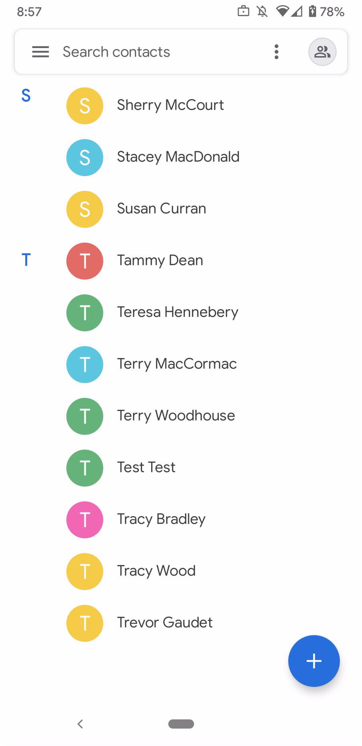
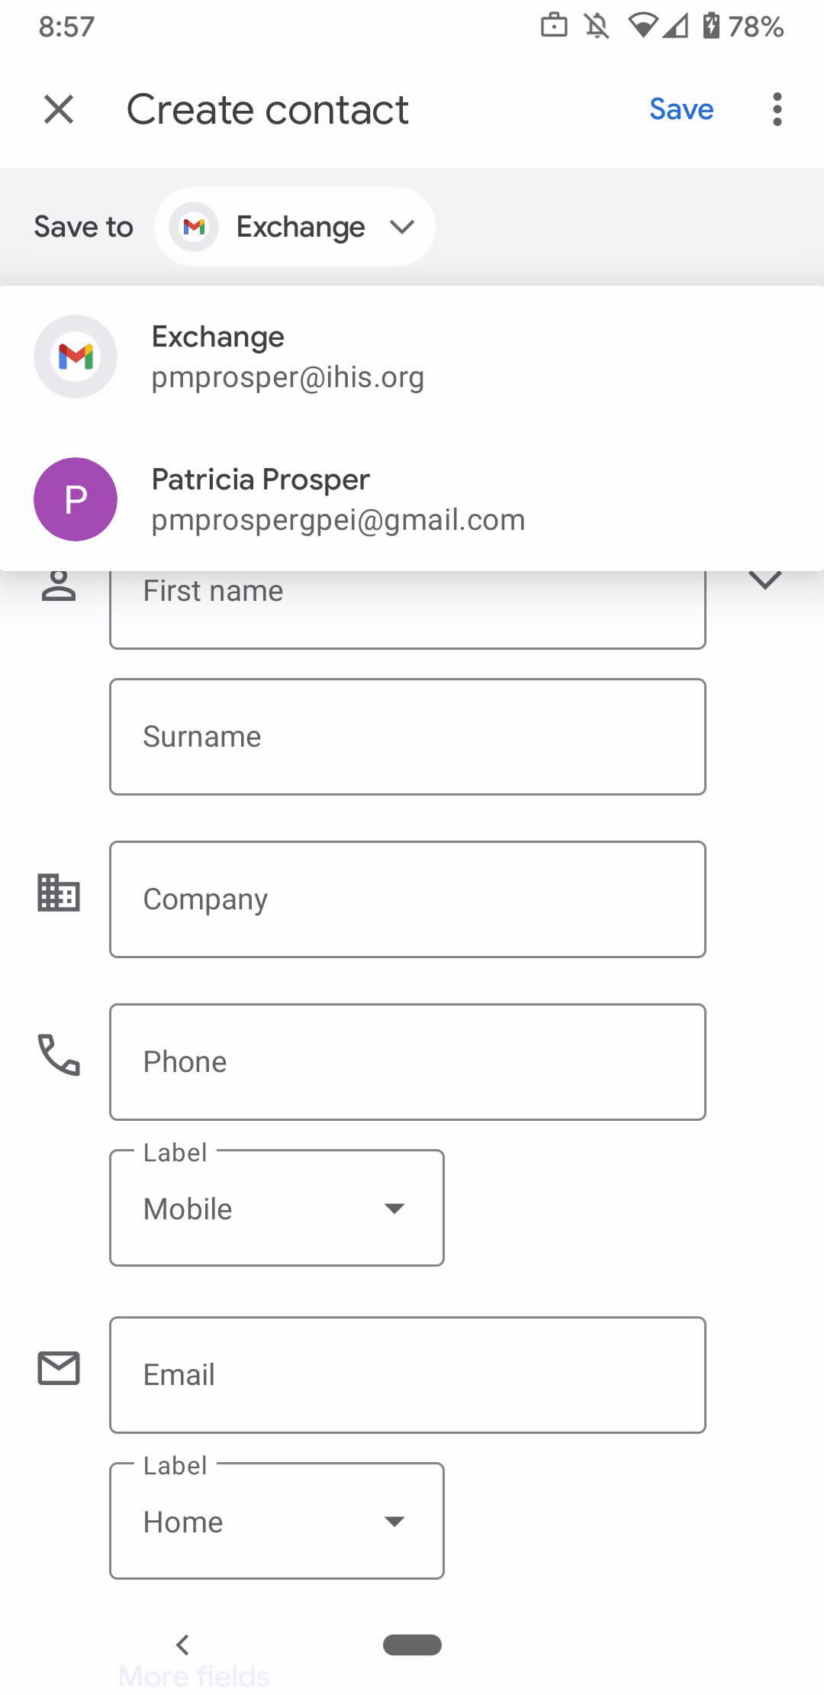
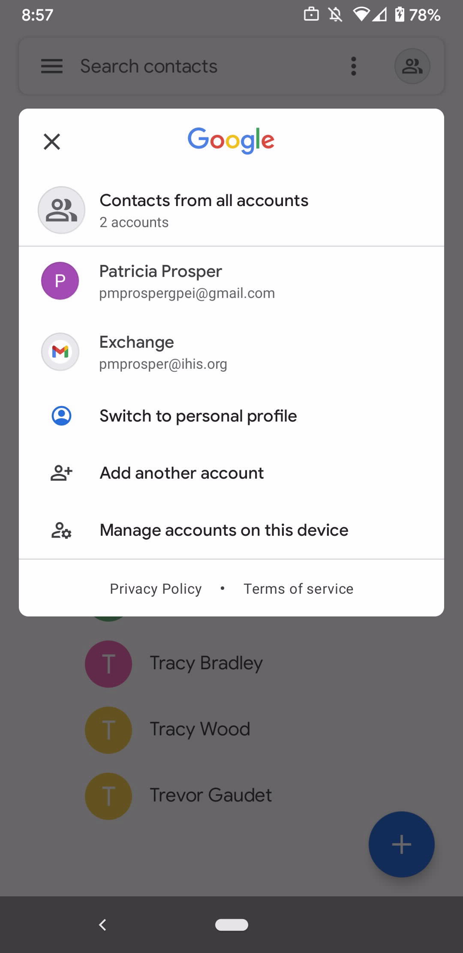
CONTACTS
Save the Contact to your:
ihis account (work)
or gmail account (personal)
Show ‘Contacts from all Accounts’ to search all contacts
To add a Contact, click

Slide 8
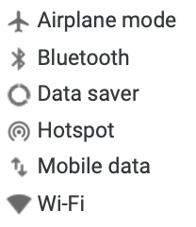
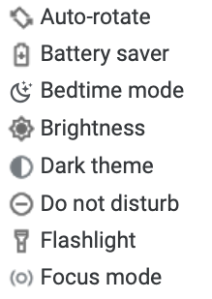
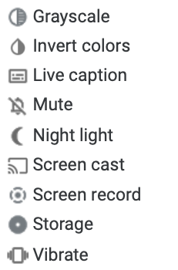
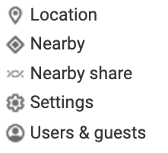
QUICK SETTINGS
Wifi, Bluetooth & Data
Device, Display & Sound
Swipe down to get to your first few Quick Settings
Swipe down again to get the full list
To turn a Setting on or off, tap it (dimmed settings are off)
To get more options for a Setting, touch and hold it
Location & Account

Slide 9
APP TOURS

Slide 10
GROUPWISE: EMAIL
Directly linked to your work email and calendar on your computer
Set email app to ‘blue E’ (top right-hand corner of app)
Use menu option to access folders and cabinet
Tap ‘compose’ to create an email - may appear as
Search email addresses by last name
Icons:
Reply
Reply All or Forward

Slide 11
GROUPWISE: EMAIL (continued)
Download an attachment:
Open Gmail
Open the email message
Tap Download
Download a photo from inside an email:
Open Gmail
Open the email message
Touch and hold the photo
Tap View Image
Tap the photo
In the top right, tape More
Tap Save
Pro Tip: If you receive a document or photo via email that contains Personal Health Information, don’t forget to delete it from your phone when you’re done with it!

Slide 12
SIGNAL
Allows for secure texting between Home Care staff
How to add Contacts in Signal:
Contact is a Signal User
Simply add them to your smartphone’s contacts app!
Contact does not have Signal Installed
Scroll to the bottom of your contact list on the Signal app
Click on ‘Invite to Signal’, ‘Share’, and use your email app to share the invitation to Signal
Then add the contact to your smartphone’s contact app and when they join Signal, their contact information will show up in your Signal app!
Send a Text
Click on the compose button, choose your contact, type your text in the ‘signal message’ box and click send
Pro Tip: Double check the lock on the send button: locked = secure, open = unsecure
Share a Photo or Document
Start by composing a text, click on the plus button, find the document or photo you want to share, ensure the lock on the send button is ‘locked’, and hit send

Slide 13
GOOGLE MAPS
Set your home and work locations:
Open Google Maps app > Tap Saved
Under Your Lists, tap Labeled
Choose Home or Work
Enter the address
Google Maps can help get you to your next appointment
Audible voice directions will play over your car speakers and guide you to your next appointment

Slide 14
CALCULATOR
To see a list of your past equations and results, swipe down from the middle of the calculator
Tap the past equation or result to use in a current calculation
To clear history, tap
To do advanced operations and functions, tap the bar on the right or hold your phone sideways
You’ll see buttons for:
Percentage
Pi
Exponents
Square root
To see more buttons, tap INV

Slide 15
CLOCK
Change timer settings:
From the Clock App, tap
Under Timers:
Tap Timer Sound to pick the ringtone that plays when the timer ends
Tap Timer Vibrate to make the timer vibrate
Change alarm settings:
From the Clock app, tap:
Under “Alarms”:
Tap Silence After to choose how long your alarm rings
Tap Snooze Length to choose how long “snoozing” delays an alarm
Use the Alarm Volume Slider to change your alarm’s volume
Tap Gradually Increase Volume to have an alarm become louder over time
Tap Start Week On to pick what day your week starts on

Slide 16
CAMERA & PHOTOS

Slide 17
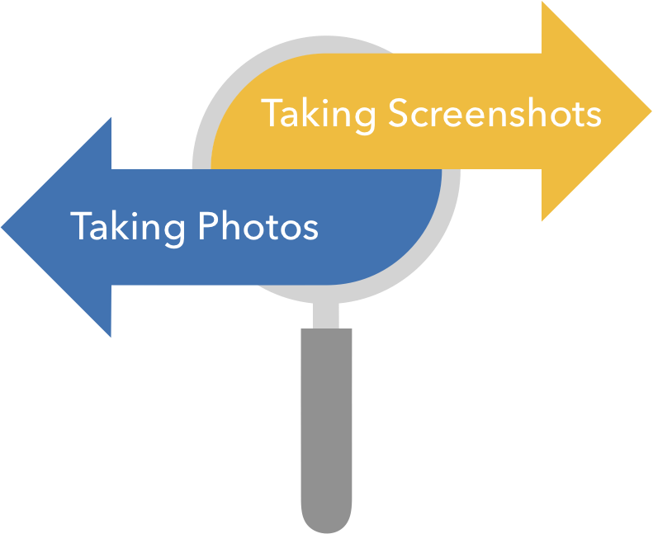
CAMERA
You can open your camera in several ways:
Tap the camera app
Double press the power button
From lock screen, swipe away from the camera
Say “OK Google, take a picture”
Take a screenshot:
Open the screen you want to capture
Press the Power and Volume Down buttons at the same time
Your phone will take a picture of the screen and save it
At the bottom left, you’ll find a preview of your screenshot
Take a photo:
Point camera toward object you want to photograph
Tap Capture in lower centre of the screen
Find all your screenshots:
Open your Photo app
Tap Library > Screenshots
Pro Tip: Follow Home Care’s photography guidelines for work photos
Remember to delete them from the smartphone
Tap Share to share
Tap Edit to edit

Slide 18
PHOTOS
Delete a Photo:
Open Photo app
Tap and hold the photo or video you want to move to trash (you can select multiple items)
At the top, tap Trash
Send by Email:
Tap Photos
Find and select the photo you want
Tap Share
Tap Gmail
Write email and tap send
Reminders:
If you delete a photo that’s backed up in Google Photos, it will stay in your Trash for 60 days
If you delete an item without it being backed up, it will stay in your trash for 60 days
Send by Signal:
Open the Signal app
Start a Signal Message
Tap Attach
Select photos > find and tap the file you want > Send

Slide 19
WORKPLACE RULES

Slide 20
REMINDER: RESPONSIBLE USE
Make sure phone is locked if setting it down
If leaving phone in a car, ensure the car is locked
Do not share an unlocked phone with other individuals

Slide 21
QUESTIONS

Slide 22
SUPPORT
Self-Help Links
https://support.google.com/pixelphone#topic=7078250
https://www.android.com/intl/en_ca/android-10/
https://support.signal.org/hc/en-us/sections/360001602712-Signal-Messenger-Basics
In-Person Support
Check with the Scheduler in your office
Remote Assistance
Service Centre
(902) 620 - 3600
servicecentre@gov.pe.ca
Contact the Service Centre
To escalate any issues with phones, contact Patricia Prosper:
pmprosper@gov.pe.ca
(902) 213 - 1352

Slide 23
THANK YOU!

