Slide 1
TLR BASIC TRAINING

Slide 2
HOUSEKEEPING
Bathroom locations
Cell phones
Evaluation forms

Slide 3
Please take a few minutes and fill in the smart Evaluation Form, “Prior to Session” section.

Slide 4
WHAT IS YOUR GOAL FOR TODAY’S TRAINING SESSION?
What would you like to learn?
What would you like to review?
What do you find most challenging about SMART?
Questions from the content on the online module?

Slide 5
INTRODUCTION TO TLR

Slide 6
TLR TRAINING
The MSIP Policy and PEI’s OH&S regulations require all employees to have injury prevention training
TLR requirements for nursing/caregiver staff:
7.5 hours of Basic TLR Training
1.5 hours of Refresher TLR Training every year
TLR is designed to eliminate/ manage the risks of musculoskeletal injuries during patient care

Slide 7
ACCOUNTABILITY
What does accountability mean to you?
At work:
Following policies
Using skills received in training
Being responsible for decisions/ actions you make at work and at home
Asking for help/ assistance if needed
Asking for additional training if needed

Slide 8
OH&S REGULATIONS
EMPLOYER’S RIGHTS
Provide a safe and healthy workplace
Provide equipment
Provide training
Provide competent supervision
EMPLOYEE’S RESPONSIBILITIES
Use the equipment/ PPR provided
Attend required training and use the skills taught
Report incidents
Protect themselves and their colleagues

Slide 9
OH&S– REFUSAL TO WORK
A worker may refuse to do an act where the worker has reasonable grounds for believing that the act will likely endanger his/ her or another workers’ health or safety
This needs to be communicated to your manager/ supervisor and proper paperwork needs to be filed

Slide 10
HEALTH PEI MSIP POLICY
Employee’s Responsibilities:
Apply principles of injury prevention training to daily work activities
Attend training
Follow safe work procedures
Use equipment provided
Identify and report hazardous tasks/ environments/ equipment or unsafe acts
Not using equipment NOT trained to use

Slide 11
MUSCULOSKELETAL INJURIES

Slide 12
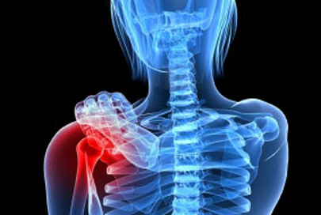
WHAT ARE MUSCULOSKELETAL INJURIES?
Soft tissue injuries
Muscles
Joints
Tendons
Ligaments
Nerves
Repetitive movements with insufficient rest and recovery
Most common areas:
Neck
Shoulder
Low back

Slide 13
CAUSES OF MSI
Repetitive Movements
Sustained & Awkward Postures
Excessive Forces

Slide 14
STEPS TO A MOVING TASK

Slide 15
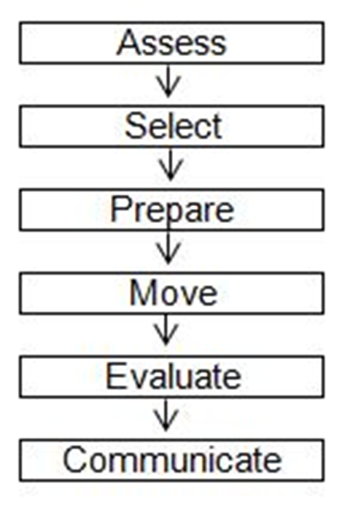
STEPS TO A MOVING TASK

Slide 16
STEP 1– ASSESS
Assessment is the most important part of TLR
Complete a risk assessment:
Self
Environment
Equipment
Object
Patient
Always assess “in the moment”

Slide 17
STEP 2– SELECT
Select the safest moving technique based on the risk assessment
TRANSFER
Patient bears their own weight through part(s) of their body with or without assistance
LIFT
No weight bearing
Unpredictable behavior
Mechanical equipment is used
REPOSITION
Moving on the same surface or two surfaces of equal height

Slide 18
STEP 3– PREPARE
If a moving technique is already identified, is it still current?
Eliminate or manage the identified risk:
Remove clutter
Clear a path
Call for assistance if needed
Have all equipment ready and close by

Slide 19
STEP 4– MOVE
Move object using the appropriate safe moving technique
If any new risk(s) arise, attend to them accordingly
DO NOT keep working with the risk(s)
Worker’s Duties:
Providing clear direction
Assistant’s Duties:
Managing the equipment

Slide 20
STEP 5– EVALUATE
What could have been done differently to make the task safer next time?
Ask yourself:
How did the move go?
Are there any ways to improve?

Slide 21
STEP 6– COMMUNICATE
Verbal and written communication
Important for the safety of everyone involved in the move

Slide 22
POSTURE & BODY MECHANICS

Slide 23
BODY MECHANICS

Slide 24
THINK & PLAN AHEAD
Know what the task is from start to finish
Ensure appropriate equipment is available
Seek assistance when needed
Plan a safe route
Listen to your body
Take your time

Slide 25
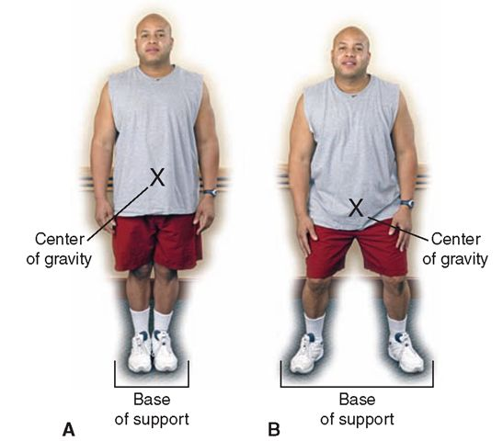
SAFE STANCE
Feet shoulder width apart
Knees slightly bent
Trunk aligned over your center of gravity
Avoid twisting or rotating
Shoulders in line with hips
Head and eyes facing forward

Slide 26
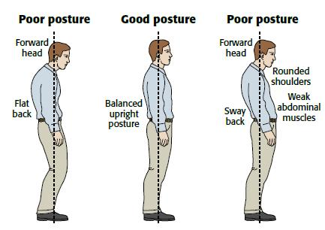
MAINTAIN 2 NATURAL CURVES OF THE SPINE
For the Top:
Ears over shoulders
Shoulders over hips
For the Bottom:
Bend at the knees
Bend at the hips
Tighten core
“Sit” into it

Slide 27
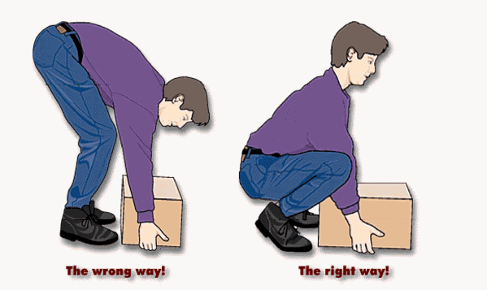
USE YOUR CORE
Core
Stabilize and support lumbar spine for safe dynamic movements
Butt, Thighs & Calves
Provides power and movement to move ensure weight of body
Lowering/ raising body
Standing
Walking
Pushing
Pulling

Slide 28
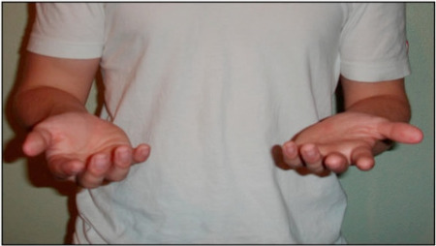
SAFE & EFFECTIVE GRIP
Wrists in a neutral position
Elbows tucked in, close to your side at a 90 degree angle
Thumbs up or out
Bicep= strongest muscle of the arm

Slide 29
WORK WITHIN YOUR COMFORT ZONE
Vertical Zone
Between your shoulder and where your fingertips touch your thighs
Horizontal Zone
Area in front of you when your elbows are at a 90 degree angle and are close to your sides
KEEP THE LOAD CLOSE

Slide 30
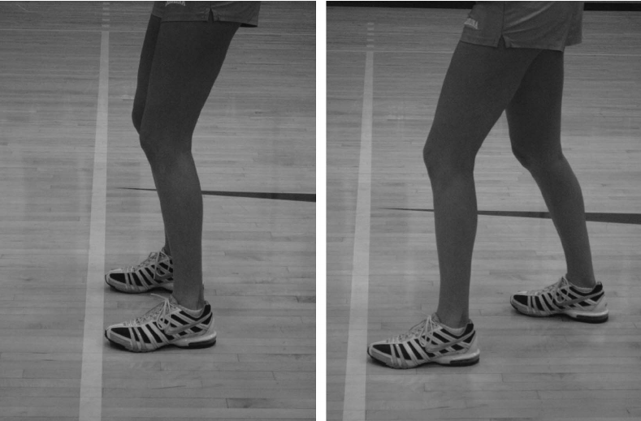
WEIGHT TRANSFER
Transfer weight from one leg to the other
(side-to-side or front-to-back)
Creates movement/momentum and help maintain balance.
Activity – centre of gravity with weight shifting

Slide 31
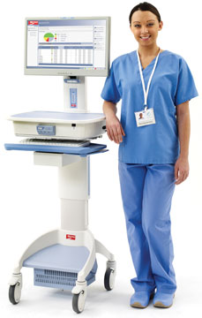
STANDING POSTURE
Tighten core
Bend knees
Work at an appropriate height for the task
Wear appropriate and supportive footwear
Use anti- fatigue mats for extended periods of standing
To relieve prolonged standing, place one foot up on an elevated ledge

Slide 32
SITTING POSTURE
Ears over shoulders, shoulders over hips
Avoid looking up or down for prolonged periods
Use a chair with good lumbar support
Feet flat on the floor
Thighs at a 90 degree angle with thigh slightly lower than hips
Use footrest if required
Take stretching breaks

Slide 33
Work in pairs.
Identify good body mechanics.
Identify areas of risk.

Slide 34
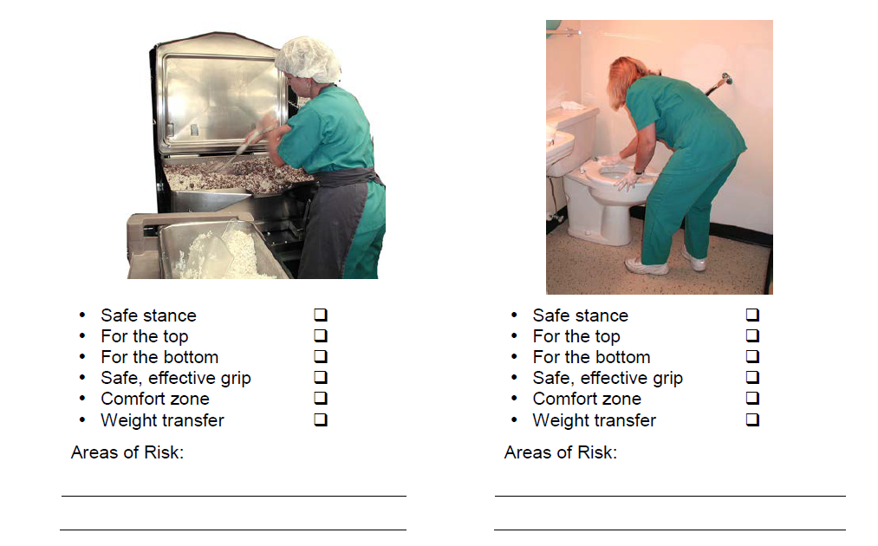

Slide 35
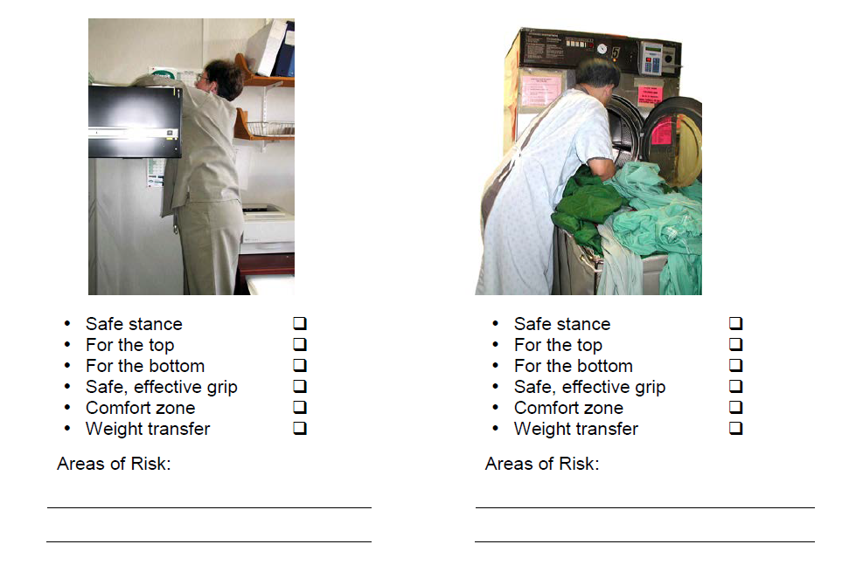

Slide 36
RISK ASSESSMENT

Slide 37
RISK ASSESSMENT
RISK
Any factor that has the potential to jeopardize the safety of the worker(s)
RISK ASSESSMENT
Process used to identify and eliminate or manage risks in order to select the safest moving technique

Slide 38
AREAS OF RISK ASSESSMENT
SELF
ENVIRONMENT
EQUIPMENT
OBJECT
PATIENT

Slide 39
PROCESS TO CONDUCT A RISK ASSESSMENT
Identify the risk(s) that would impact the safety of the move
Collect information about risk factors:
Written reports of previous injuries/ risks
Observation of co-workers
Speak with co-workers
Analyze information to determine appropriate course of action to eliminate or manage risk(s)

Slide 40
SELF RISK ASSESSMENT

Slide 41
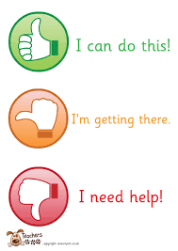
SELF RISK ASSESSMENT
About our own ability to work safe
Before, during and after the move
Risk factors that may impact the safety of the move:
Physical status
Emotional status
Training and experience
Communication skills
workload

Slide 42
SELF RISKS
Self-
Assessment
Physical
Status
Emotional
Status
Training
&
Experience
Communication
Skills
Workload

Slide 43
ENVIRONMENTAL RISK ASSESSMENT

Slide 44
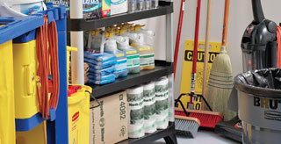
ENVIRONMENT RISK ASSESSMENT
Before, during and after performing the move
The environment may change at any point during the moving task
By making changes to the environment in advance, risks can be eliminated BEFORE the moving task
Problem solve for risks that can’t be eliminated or managed

Slide 45
ENVIRONMENT RISKS
Environment Risk
Assessment
Potential for Violence/
Aggression
Noise/
Distractions
Working
Surfaces
Colors/Lighting
Room/Area

Slide 46
EQUIPMENT RISK ASSESSMENT

Slide 47
EQUIPMENT RISKS
Environment Risk
Assessment
Quantity/
Accessible
Design/
Ergonomics
Manufacturer’s Intended Use
Quality
Capacity/
Ability

Slide 48
OBJECT RISK ASSESSMENT

Slide 49
OBJECT RISK ASSESSMENT
Assess risks before, during, and after moving an object
Risk factors may include:
Size/ shape
Weight
Texture
Contents
Handles
Balance
Temperature

Slide 50
GENERAL MOVING TECHNIQUES

Slide 51
REVIEW!

Slide 52
SAFE LIFTING PROCEDURE
Assess the load
Minimize the load as much as possible
Use equipment
Reduce the size of the load
Reduce the distance the load must be moved
Move the load in stages
Ask for assistance
Clear the lifting area and path
Use the Checkpoints of Safe Body Mechanics
Bend your hips and knees, not your back
Grasp the object with palms up or thumbs up when possible
Keep the object close to your body
Turn your feet, rather than twisting your trunk when you need to change direction

Slide 53
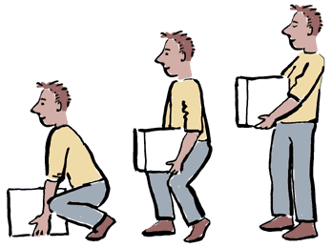
GENERAL MOVING TECHNIQUES
PUSHING/ PULLING
GOLFER’S LIFT
ONE HANDED PARTIAL SQUAT
TRIPOD LIFT
DIAGNOAL LIFT
POWER LIFT

Slide 54
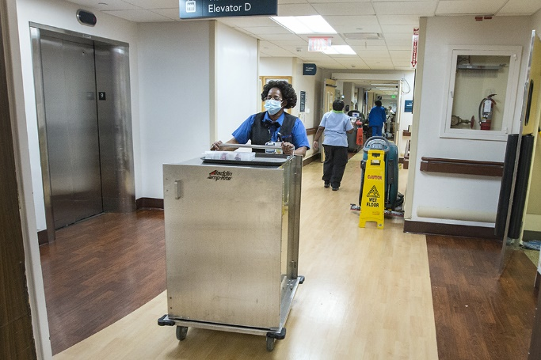
PUSHING & PULLING
Can use wheeled equipment to transport equipment that is too heavy or awkward to carry
Use safe body mechanics
Do not push one object while pulling another!
Adjust equipment if possible, if required
Maintain clear visibility
No twisting
Always ask for help when needed

Slide 55
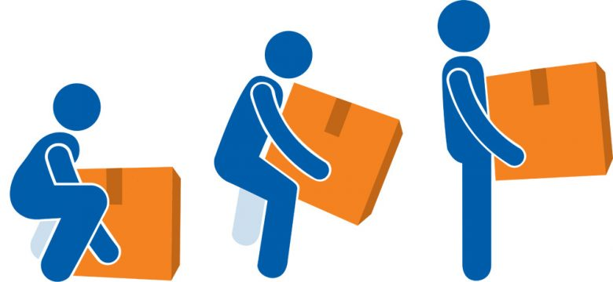
TECHNIQUE TIPS
If the object is on the floor:
Get it closer to you by using the DIAGNOAL LIFT OR TRIPOD LIFT
If the object is light:
Use the GOLFERS LIFT
If the object has a handle:
Use the ONE HANDED PARTIAL SQUAT LIFT
If the object is heavy:
Use the POWER LIFT
If the object is on the same surface:
Use REPOSITIONING

Slide 56
RISK ASSESSMENT – CLIENT MOBILITY

Slide 57
TLR ASSESSMENT
INITIAL ASSESSMENT
Patient arrival, prior to moving
RE-ASSESSMENT
Replaces previous assessment, upon return/ adjusted to agency
When 2 consecutive and documented changes occur
SPECIALIZED ASSESSMENT
Specific situations, tailor for a patient, conducted by a team
Utilization of PT/OT

Slide 58
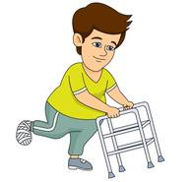
WHEN TO COMPLETE A TLR ASSESSMENT
On admission (within 24 hours)
Post- procedure
When a patient’s mobility has changed (improves or worse)

Slide 59
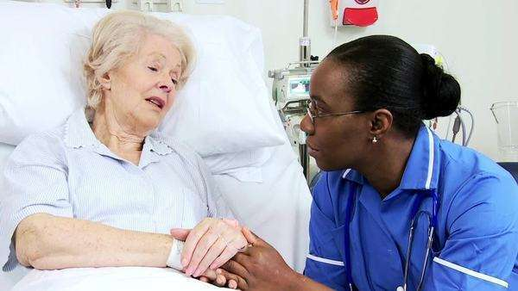
PART 1– RISK ASSESSMENT
Communication status
Cognitive status
Emotional status
Behavioral status
Medical status

Slide 60
CLIENT RISK ASSESSMENT
Patient Risk
Assessment
Communication Status
Cognitive Status
Emotional & Behavioural Status
Medical Status
Physical & Functional Status

Slide 61
PART 2– TESTING & OBSERVATION
Ensure any risks in Part 1 are managed or eliminated first
PRE-MOBILIZATION TESTING
Completed with the patient in lying or sitting
Provides information as to if the patient can do mobilization testing safely
MOBILIZATION TESTING
Patient is in sitting, unassisted, transfer from standing to walking

Slide 62
TLR ASSESSMENT POCKET CARD

Slide 63
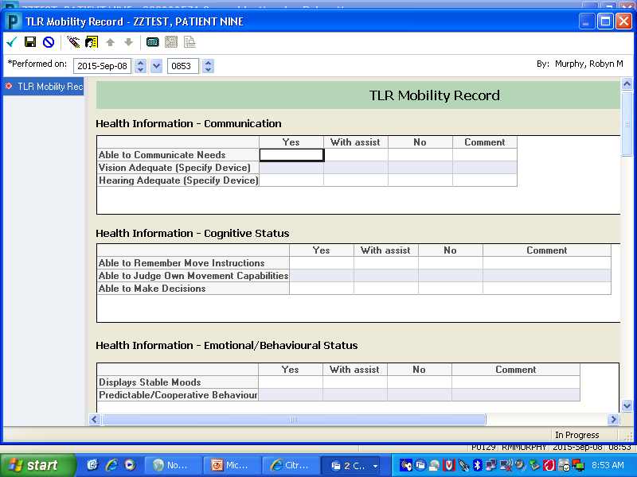
TLR MOBILITY RECORD (CERNER)

Slide 64
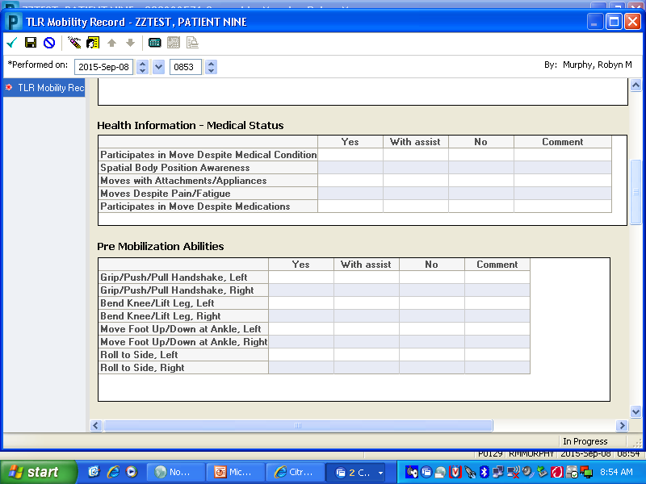
TLR MOBILITY RECORD (CERNER)

Slide 65
TLR MOBILITY RECORD (CERNER)

Slide 66
Practice performing the TLR assessment in groups.

Slide 67
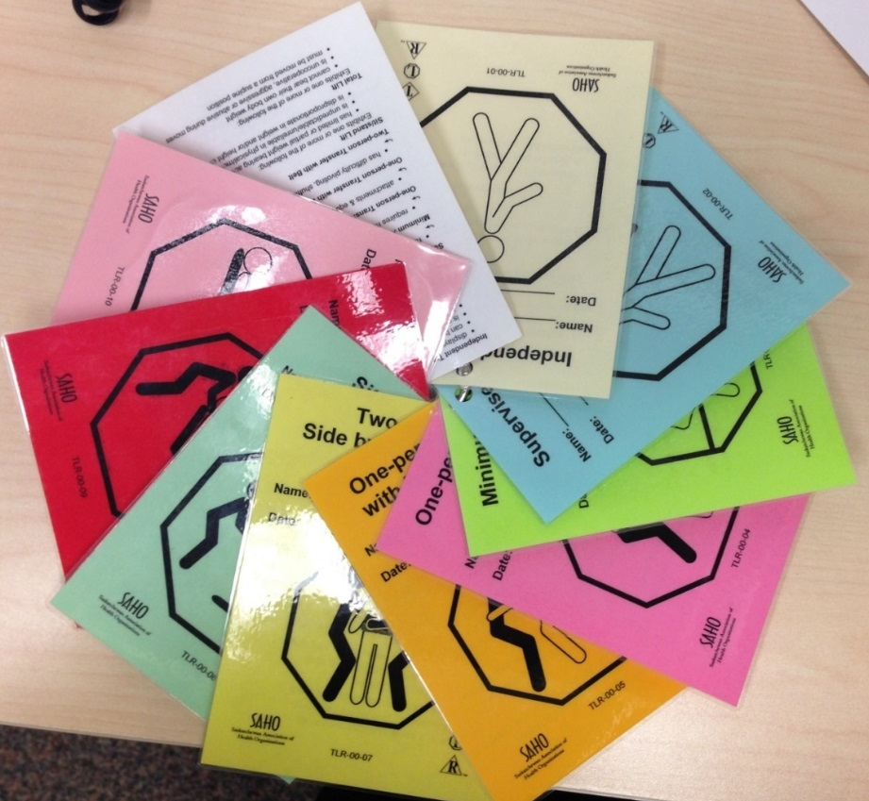
ASSIGNING TLR LOGO
Based on the TLR assessment results, determine the minimal level of assistance required to ensure a safe move
Assign a TLR logo
Bedside
Cerner
Kardex/ report sheet

Slide 68
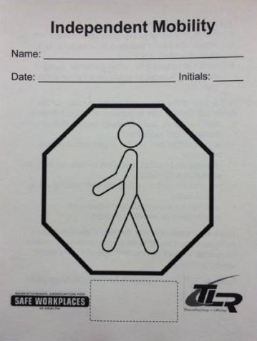
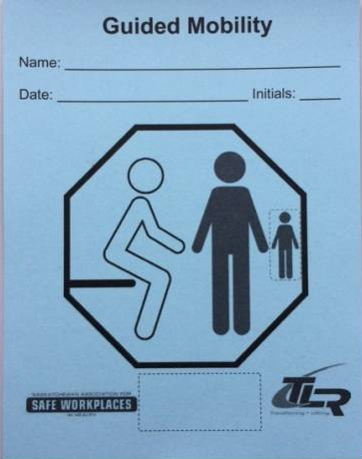
TLR LOGOS– MOBILE

Slide 69
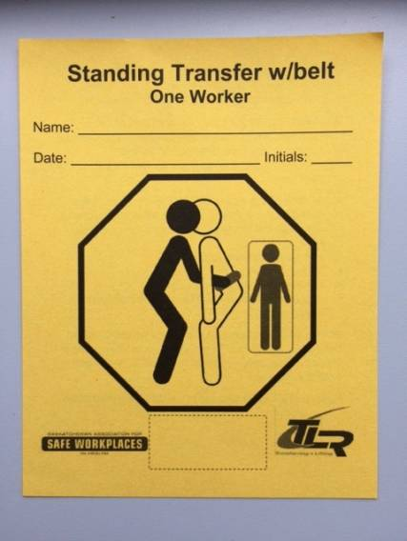
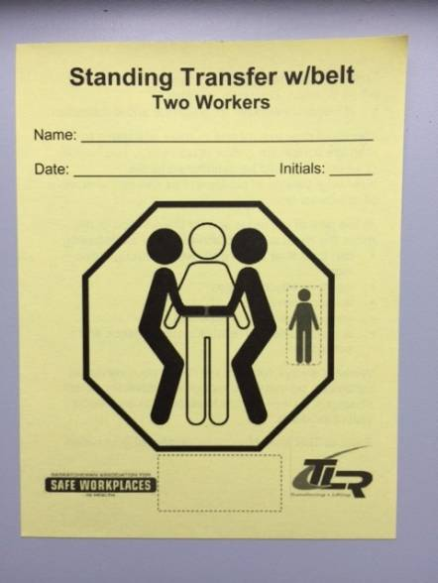
TLR LOGO– STANDING TRANSFERS

Slide 70
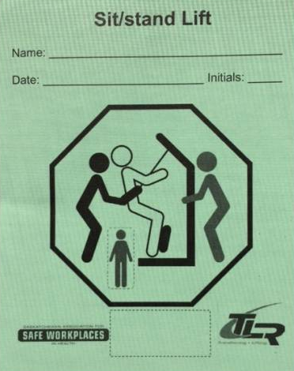
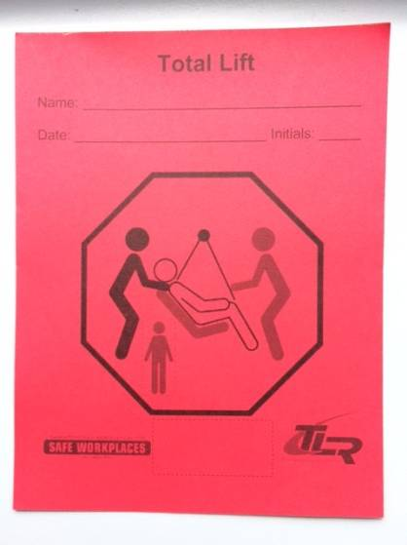
TLR LOGO– MECHANICAL LIFTS

Slide 71
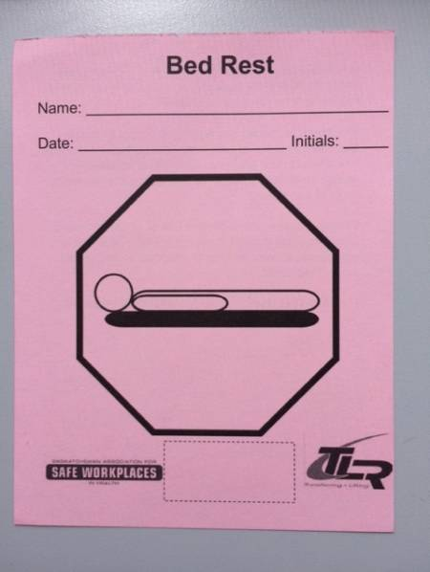
TLR LOGO– BED REST

Slide 72
CASE STUDIES

Slide 73
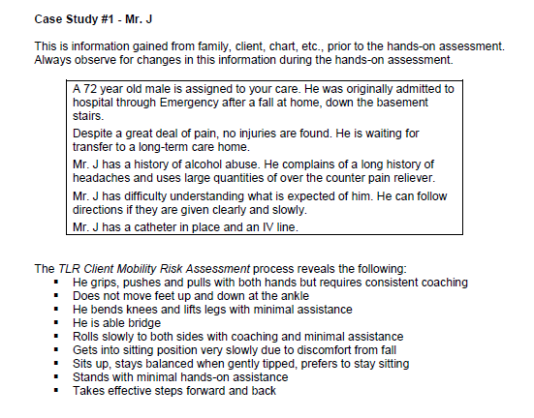
CASE STUDY 1

Slide 74
ANSWER
STANDING TRANSFER WITH BELT– ONE WORKER (WITH ASSISTANT)
Can bear his own body weight
Minimal hands on assistance required
Attachments (IV, catheter)

Slide 75
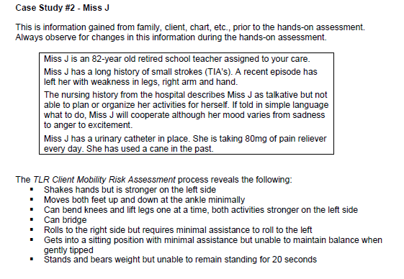
CASE STUDY 2

Slide 76
ANSWER
SIT- STAND LIFT
Bears weight for less than 20 seconds
Is unpredictable
Unable to remain balanced

Slide 77
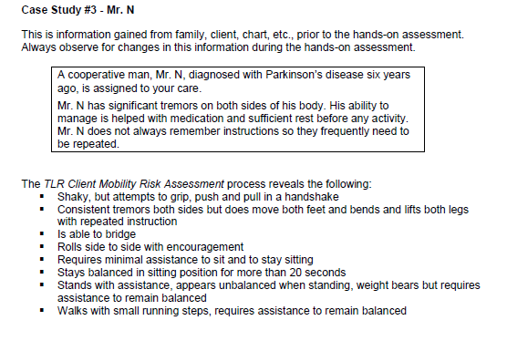
CASE STUDY 3

Slide 78
ANSWER
STANDING TRANSFER WITH BELT– TWO WORKERS
Can bear his own body weight
Requires assistance with balance

Slide 79
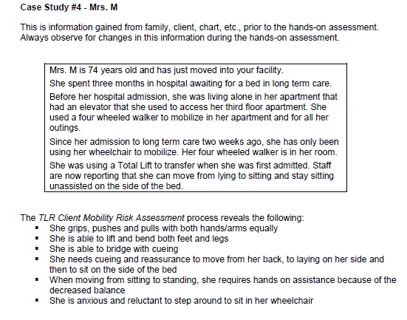
CASE STUDY 4

Slide 80
ANSWER
STANDING TRANSFER WITH BELT– TWO WORKERS
4 wheeled walker as an assistive device
Has the ability to stand but has decreased balance and is anxious

Slide 81
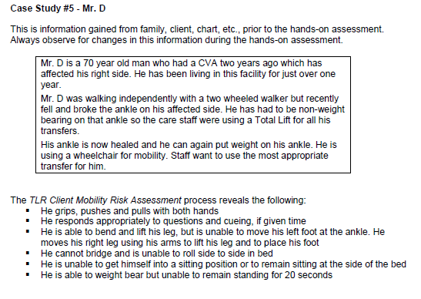
CASE STUDY 5

Slide 82
ANSWER
TOTAL LIFT: IN & OUT OF BED
SIT- STAND LIFT: TO CHAIR
Does not have the ability to get into sitting position or remain sitting on the side of the bed
Has partial weight bearing abilities but not for the full 20 seconds

Slide 83
SUMMARY– STEPS TO A TLR ASSESSMENT
Complete the assessment with the patient
Complete TLR Mobility Record on Cerner
Hand appropriate logo in the patient’s room
Add/ change sticker on Kardex (if applicable)
Ensure proper equipment is in the patient’s room for use (for example, walking aids, slider sheets, TLR belt, sling, etc.)

Slide 84
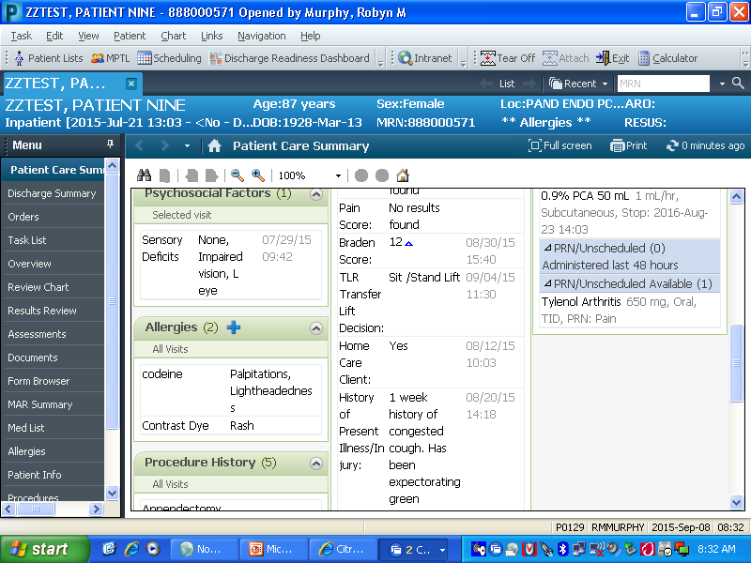
VIEWING TLR DECISION

Slide 85
BED REPOSITIONING LOGOS

Slide 86
INDEPENDENT
CRITERIA:
Patient has the physical and mental capability to reposition self in bed

Slide 87
VERBAL GUIDANCE
CRITERIA
Patient has the physical capability but requires verbal guidance and/ or physical cueing to reposition self in bed

Slide 88
1 PERSON
CRITERIA
Patient requires minimal assistance to reposition self in bed, for example, positioning slide sheet, raising bed rail, adjusting bed position, etc.
Repositioning must be supervised or the side rails must be up

Slide 89
2 PERSON– SLIDE SHEETS ON BED
CRITERIA
Patient requires moderate to total assistance to reposition self in bed and meets the following criteria:
Weighs less than 200 pounds
Does not move a lot in bed

Slide 90
2 PERSON– REMOVABLE SLIDE SHEETS
CRITERIA:
Patient requires moderate to total assistance to reposition self in bed
Weighs less than 250 pounds
Maxi slide sheets are NOT to be left under the patient as they are VERY slippery
Maxi slide sheets are to be removed from under the patient after they are used to reposition the patient

Slide 91
2 PERSON– CEILING LIFT
CRITERIA:
Patient requires total assistance to reposition self in bed and meets one or more of the following criteria:
BMI greater than 34
Weighs more than 250 pounds
Requires frequent repositioning
Fills the width of the bed
Has multiple medical attachments/ complications
Has a mattress that is not conducive to other repositioning devices/ techniques

Slide 92
3 PERSON
CRITERIA:
Requires total assistance to reposition self in bed
Weighs more than 300 pounds
Meets one or more of the following criteria:
Has attachments that need managing during the move
Has a pannus that needs positioning by one or more staff during the move
Has behaviors/ fears that need attention during the move
Their general condition or size warrant extra caution

Slide 93
CLIENT MOVING TECHNIQUES

Slide 94
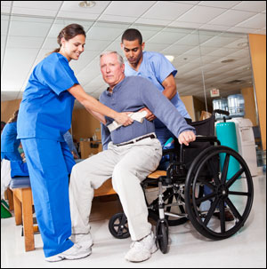
TRANSFERS USING TLR BELTS
Standing transfer
Wheelchair transfers

Slide 95
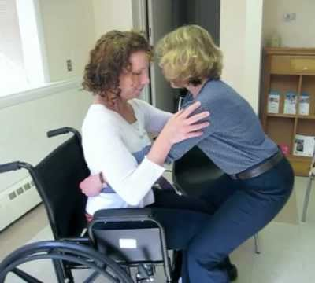
ASSISTING PATIENTS GETTING UP FROM A SURFACE
Use a TLR belt if patient requires hands on assistance
Patient should have shoes on with good grip
Use any gait aids assigned to pt (ie. walker, cane)
Patient’s feet should be about shoulder width apart
Cue patient to scoot to edge of surface with staff close by
Patient’s knees should be over toes
Cue patient to push off surface or bedrail with their hands
Communicate when you will stand (ie. “1-2-3-stand”)
Do not get the patient to take steps away from the surface until you asses their balance
If patient begins to fall, use TLR belt to direct their hips back to surface

Slide 96
ASSISTING PATIENTS: SIT TO STAND
Use a TLR belt if patient requires hands on assistance
Back the patient up until the back of their legs are making contact with the edge of the surface
Cue the patient to reach back to assist with guiding themselves down to surface
Communicate when you will sit (ie. “1-2-3-sit”)
Ensure patient scoots back onto the surface so they aren’t sitting on the edge

Slide 97
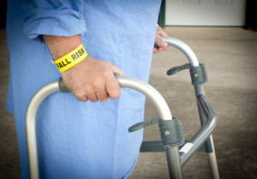
WALKING WITH A PATIENT
Only assist a pt with walking if they can weight bear and are predictable
Always use TLR belt
Walk beside/behind pt with 2 hands on TLR belt
When possible, have co-worker follow close behind pt with wheelchair
Use any gait aids assigned to pt (ie. walker, cane)

Slide 98
MECHANICAL LIFT VS. TRANSFER
Safe Patient Handling – Mobility Flowchart

Slide 99
PREVENTING FALLS

Slide 100
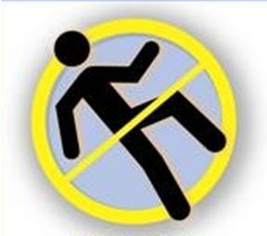
WHAT TO DO WHEN A PATIENT STARTS TO FALL
DO NOT try to stop the fall
If a chair or bed is directly behind the patient, physically direct the patient into a sitting position rather than proceeding with the transfer
Guide the patient to the floor:
Move in as close as possible to the patient
Use the TLR belt to help guide/ slide the patient to the floor while giving priority to protecting the patient’s head
Bend at the hips and knees while keeping the trunk upright

Slide 101
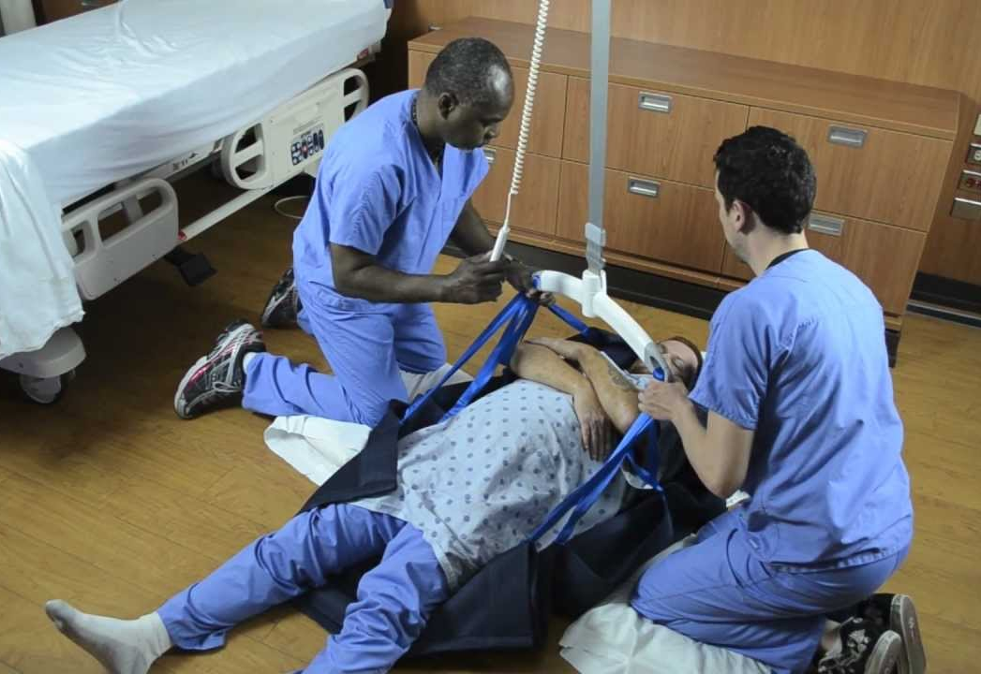
AFTER A PATIENT FALLS
Always follow the site/ program guidelines for assessing a client after a fall
If the patient cannot get up on their own, as for assistance and equipment
If the patient can get up on their own, provide a stool/ chair for the patient to lean or sit on
NEVER attempt to manually lift a patient from the floor
Only in life threatening situations!
Always follow sit/ program guidelines for reporting a fall

Slide 102
REPOSITIONING PATIENTS

Slide 103
REPOSITIONING KEY POINTS
Appropriate equipment is to be used at all times
Teams must consider:
Worker height, weight, arm length
Often requires 2 or more workers
Ensure primary worker is identified
Use 1-2-3-command

Slide 104
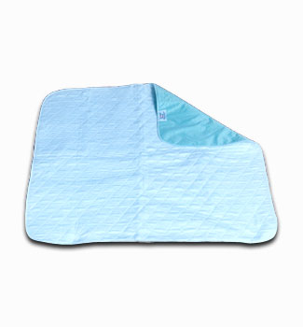
SOAKER PADS
TLR GUIDELINES STATE SOAKER PADS ARE NOT FOR REPOSITIONING!

Slide 105
REPOSITIONING SHEETS VS. SOAKER PADS
 | REPOSITIONING SHEETS | SOAKER PADS
INTENDED USE | Assist the patient in repositioning in bed | Absorb bodily fluids to protect the patient’s skin and keep bed linens dry
PLACEMENT | Under the patients trunk and shoulders | Under the lower part of the patient’s trunk and upper legs
FRICTION PROPERTIES | Up to 60% less force required to reposition a patient | DO NOT have low friction properties– requires great effort
RISK OF INJURY | Reduced | Increased– repositioning patients continues to be the leading cause of injury in HEPI

Slide 106
HPEI POLICY– December 2017
Appropriate uses for soaker pads:
For patients who are unable to use an incontinent system for some reason
To absorb overflow of bodily fluids from patients whose incontinent system is not reliably managing their incontinence
To absorb bodily fluids in laboring and early postpartum patients

Slide 107
HPEI POLICY– December 2017
Inappropriate uses of soaker pads:
To turn, boost or laterally reposition a patient
For all incontinent patients whose incontinent system is reliably managing incontinence
Automatic placement on all beds/ stretchers without assessment
To protect underlying linen for incontinent pad changes or during bed pan changes. Disposable blue pads are to be used in these instances.
During procedures involving drainage of bodily fluids. Disposable blue pads are to be used in these instances.
Placed on top of pressure relieving equipment.

Slide 108
REPOSITIONING EQUIPMENT

Slide 109
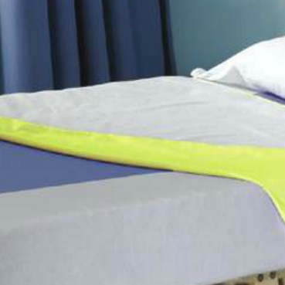
SWIFT SHEETS
Slider sheets that stay on the bed
Used for boosting and turning patients

Slide 110
TIPS WHEN USING SLIDER SHEETS
How to keep your patient from sliding down the bed
Match hip position with bend in the bed
Tuck draw sheet under the mattress on both sides to keep it in place after you have repositioned your patient
Raise the knees of the bed up prior to raising the head of the bed
If your patient moves a lot, try using removable slider sheets for repositioning, rather than the fitted slider sheets (for example, maxi slides)

Slide 111
MAXI SLIDES
Removable slider sheet
Common uses:
Used for boosting up/ down the bed
Used for lateral transfers
Used to position a sling under a patient

Slide 112
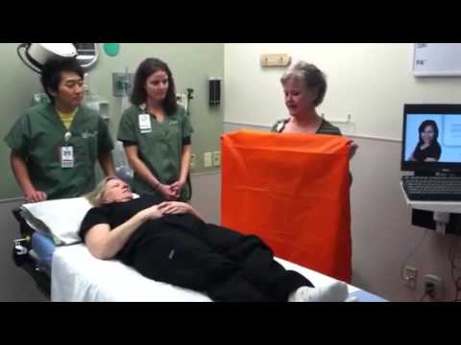
MAXI TUBE
Removable slider sheet
Common uses:
Positioning sling on a patient sitting in a wheelchair
Taking a sling out from under patient’s legs
Reposition patient’s legs in bed
Car transfers

Slide 113
SLINGS

Slide 114
SLING INSPECTIONS
Basic sling inspection prior to using:
Appropriate weight capacity
Appropriate size
Appropriate sling type
Any obvious holes, fraying, loose stitching
TLR Unit Reps complete detailed sling inspections every 3 months

Slide 115
SLING SIZING

Slide 116
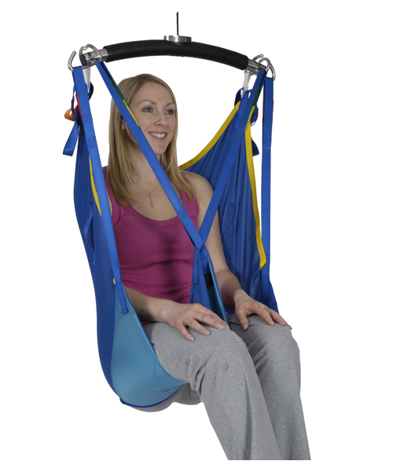
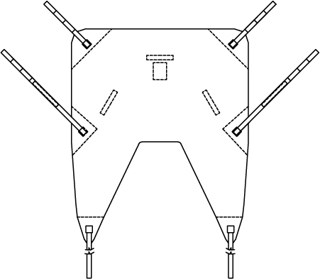
QUICK FIT SLING
No head support
Fits from the tops of the shoulders to the base of the coccyx
ALWAYS cross the leg straps
Remove the sling’s leg supports from under the patient after the transfer

Slide 117
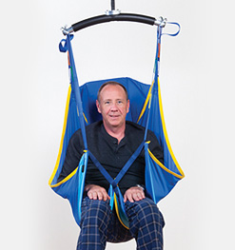
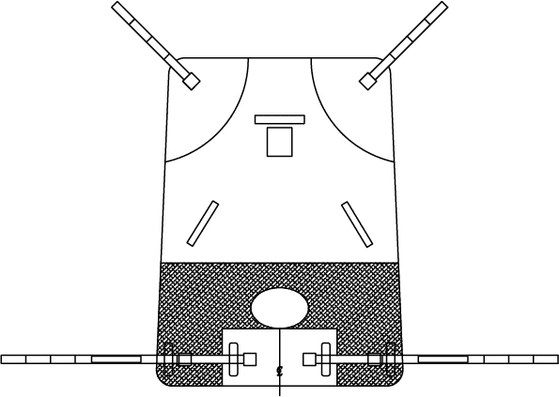
HAMMOCK SLING
Head support
Maximum support to the sacral area
More suitable for patients with poor body tone
Put on the patient while in bed

Slide 118
SIT TO STAND SLING
Used for patients with:
Good trunk control
Good sitting balance
Ability to hold on to handles
Ability to bear weight
Sit- stand lifts and floor lifts are NOT intended to be used for long distances!

Slide 119
HYGIENE/ TOILETING SLING
Designed for toileting and hygiene functions ONLY
Patients MUST:
Have adequate trunk control and sitting ability
Have head and neck control
Have good upper body strength
Be cooperative
Be predictable
OT/PT consult is required
Careful patient assessment is REQUIRED before this sling is used

Slide 120
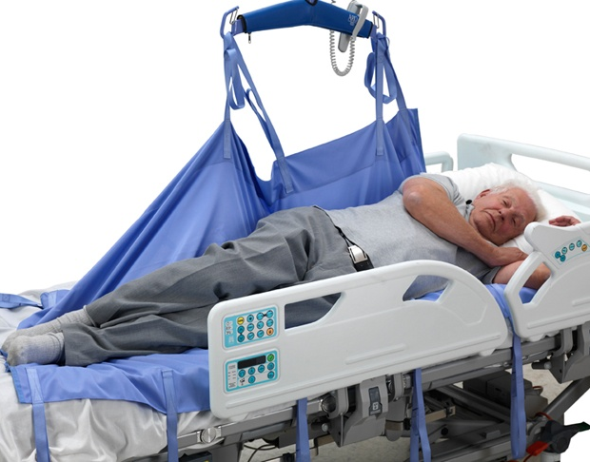
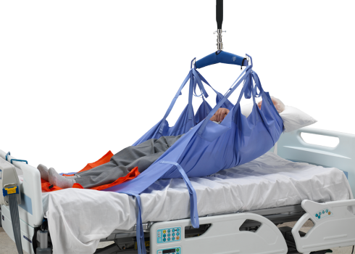
REPOSITIONING SLING
Used for patients who need regular repositioning
Meant to be used as part of bedding as it always stays in place under the patient

Slide 121
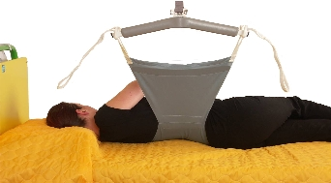
TURNING SLING
Assists with keeping the patient on their side
Could be used to assist with personal cares
Eliminates the need for staff to hold the patient to keep them on their side

Slide 122
PATIENT LIFTING DEVICES

Slide 123
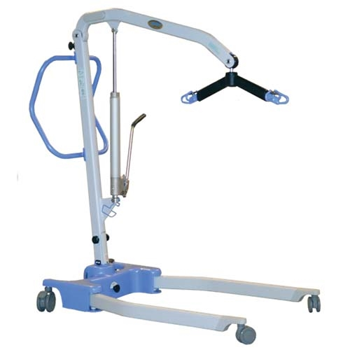
TYPES OF LIFTS
TOTAL LIFTS
SIT STAND LIFTS
CEILING LIFTS

Slide 124
TRAINING & STAFFING
Do not use a mechanical lift if you are not trained to do so
A MINIMUM of 2 staff members are required for all mechanical lifts
1 person manages the controls
1 person manages the patient
Bariatric patients require a minimum of 2 staff

Slide 125
LIFTING DISTANCE
Lifts are designed to be used over a VERY short distance
To reduce the risk of injury:
Reduce the distance between the start and end location as much as possible
Only raise the patient as high as necessary to “clear” the surface
Do not transport the patient in a lift to another room

Slide 126
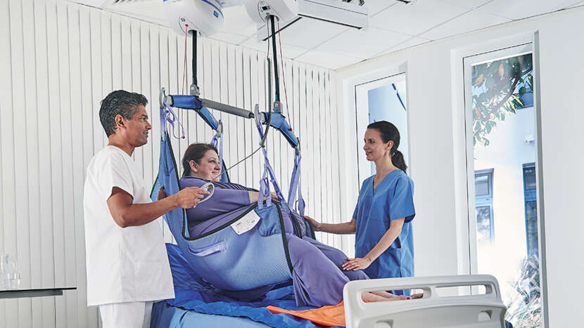
SAFETY
DO NOT EVER leave a patient unattended while suspended in a lift
This also includes when the patient is on a surface and the sling is still attached to the lift

Slide 127
MECHANICAL LIFTS
When using, consider:
Weight capacity
Intended use
Adjustable parts
Body mechanics
Safety features of the lift

Slide 128
WAS YOUR GOAL FOR THE SESSION ACHIEVED?

Slide 129
QUESTIONS?

Slide 130
PLEASE TAKE A FEW MINUTES TO COMPLETE YOUR EVALUATIONS. THANK YOU!

