Slide 1




Occupational Health & Safety Orientation

Slide 2



What is OH&S?
A multidisciplinary field concerned with the safety, health, and welfare of people at work
At Health PEI, we know that being safe and healthy in the workplace involves every one of our employees, in everything they do, every day they are working
Everyone
Everything
Every day

Slide 3


OH&S Act and Regulations
Employer
Responsibility
Employee
Responsibility
All provincially regulated employers must follow the Occupational Health & Safety Act and Regulations – a set of minimum standards to ensure the health and safety of their workers while on the worksite
Everyone in the workplace – employers, supervisors, and workers – is responsible for health and safety
Healthcare workers are essentially the most important part of any safety program

Slide 4






Ensure that every reasonable precaution is taken to protect the health and safety of persons at or near the workplace
Ensure that workers are familiar with workplace hazards and the procedures to minimize risks
Provide and maintain equipment, machines, and materials in a safe manner
Provide and pay for training needed to ensure the worker’s job is performed safely
Ensure that all workers know how to use safety devices and personal protective equipment (PPE) appropriately
Provide adequate supervision to ensure safe working conditions.
Employer Responsibilities

Slide 5
Employee Responsibilities
1
Take precautions to prevent injuries to themselves or co- workers
2
Participate in training provided by the employer
3
Wear and use all protective equipment properly
4
Follow established safe work procedures*
5
Immediately report unsafe conditions or equipment to a supervisor**
*Safe work procedures: specific steps that guide a worker through a task from start to finish with the goal of minimizing risks
**If the employer cannot or does not resolve the problem/concern in a timely fashion, the worker should report it to the site’s OH&S committee/representative

Slide 6

Right to Refuse Unsafe Work
Workers have a right to a safe workplace and the right to refuse work if they believe that it is dangerous to themselves or another worker
If a worker believes that a task or situation is dangerous, they must report the concern to a supervisor immediately and go to a safe place within the workplace
The employer may have the worker do other work
The supervisor must investigate the work refusal immediately with the worker present and follow the procedures outlined in the OH&S Act

Slide 7
OH&S Committees and Representatives
In accordance with the PEI OH&S Act:
Each facility with 20+ employees has an OH&S committee and an OH&S Bulletin Board
Committees meet on a monthly basis unless they have received an exemption from the OH&S division of the Workers Compensation Board
Sites must post:
  the minutes of their last meeting
  a list of its committee members
  other information on health and safety topics
Each facility/worksite with 5 to 19 employees has an OH&S representative
Any OH&S complaints/issues from an employee are communicated to their manager or supervisor prior to being brought forth to an OH&S committee member/representative

Slide 8




Workplace Inspections
To comply with the OH&S Act, the entirety of a worksite must be inspected on a yearly basis, at minimum
Inspections are conducted by members of the OH&S
committee or the site’s OH&S
representative
The purpose is to identify potential problems such blocked exits, missing procedures, out of date fire extinguishers, etc.
Inspectors will also try to speak with staff in the area to see if they have any concerns or questions

Slide 9



After any workplace incident/injury, the manager responsible for that area will investigate to determine the root cause of the incident and determine ways to prevent the same incident from occurring again
The site’s OH&S committee will also review incidents and make recommendations for future prevention
The employee(s) involved in the incident must cooperate with the investigation and may give recommendations for future prevention
Incident & Injury Investigation

Slide 10


Avoiding Injuries & Accidents at Work

Slide 11







Have a positive safety attitude
Check for hazards upon entering work area
Maintain good housekeeping standards
Be Proactive!
Use Personal Protective Equipment (PPE)
Inspect equipment before use
Follow safe work procedures
Report hazards and events as soon as possible

Slide 12

Workplace Hazardous Materials Information System (WHMIS)
Transportation of Dangerous Goods
Hearing Conservation
Ensure you have proper training!
Your supervisor or manager will guide you on what specific courses you will need depending on your job.
Ladder/Working from Heights
Defensive Driving/Machinery Operation Training
Radiation Safety
Non-Violent Crisis Intervention/Gentle Persuasive Approach
Musculoskeletal Injury Prevention (MSIP) – mandatory for all
staff
Equipment training

Slide 13
SMART – Safe Moving and Repositioning Techniques© is
required for all support services staff
MSIP Training Specifics
TLR – Transferring Lifting Repositioning© is required for all nursing and caregiver staff
Workstation/Office Ergonomics training – required for all administrative, technical, and managerial staff
Combination Training – for staff who need a combination of training programs, e.g. diagnostic imaging needs a combination of TLR, SMART & Workstation Ergonomics training

Slide 14

Risks Associated with Working in Healthcare

Slide 15



Musculoskeletal Injuries (MSI’s)
What are MSI’s?
How can they be prevented?
An injury or disorder of the muscles, joints, nerves, or related soft tissue (sprains and strains)
Stay physically fit
Use good mechanics
MSI’s account for over 90% of all injuries within Health PEI with the majority of injuries affecting backs and shoulders
How are they caused?
Follow safe work procedures
Repetitive movements
Ask for and wait for help
Sustained/awkward postures
Use Equipment
Excessive forces/heavy lifting, especially when repositioning patients in bed
Don’t Rush

Slide 16




Slips, Trips and Fall Prevention
01
Be aware of your surroundings and look where you are walking
02
Take short, slow steps to maintain your centre of balance
03
Look for hazards such as icy parking lots, wet floors, torn carpets, or loose cords
04
Wear supportive shoes with good traction

Slide 17

Sharps & Needlestick Injuries
Do not recap, bend, shear or break needles/other sharps
Dispose of sharps and needles at point of use in appropriate container
Change containers when 2/3 full
Sharps & Needlestick injuries can be among the most serious injuries in healthcare due to transmission of diseases!

Slide 18



Blood-Borne Pathogens
Use universal precautions – treat all medical waste and blood as if it were contaminated and take appropriate safety precautions
Be cautious around blood and biohazardous materials
Do not eat, drink, smoke, apply cosmetics, or handle contact lenses in any area where contamination may exist

Slide 19
Hazardous Chemicals
Hazardous chemicals exist in many areas of healthcare facilities, including cleaning/sanitizing products and medications
Ensure that you know where to find Safety Data Sheets, which contain information about the product’s use, proper disposal and first aid measures
When dealing with chemicals:
  Take training seriously
  Read labels & SDS’s
  Use appropriate PPE
  Know your emergency procedures

Slide 20
















1
Check cords for damage before using
2
Don’t use damaged equipment & report to your supervisor immediately
3
Never work around electricity when you/your surroundings are wet
Electrical Safety
4
If you receive a shock from electrical equipment, report
to your supervisor immediately
5
Keep cords away from heat and water
6
Don’t overload power bars or electrical outlets
7
Never run cords under rugs, across walkways, or through doorways
8
Always follow the manufacturer’s instructions

Slide 21
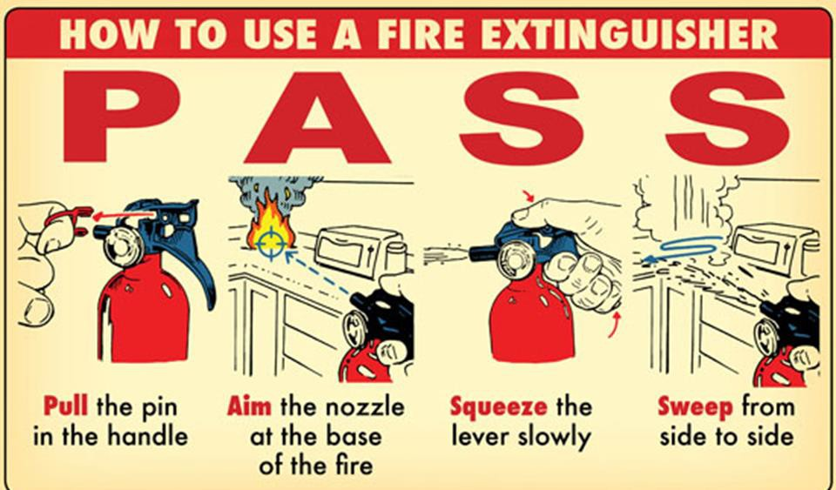
Fire Preparedness
Know the location of all emergency exits and fire alarms
Learn how and when to use fire extinguishers

Slide 22
In Case of Fire – The Four A’s
ACTIVATE | Activate the fire alarm and call 911
ASSIST | Assist people in exiting the building
ATTEMPT | Attempt to extinguish the fire if it’s small and contained
ASSEMBLE | Assemble outside the building

Slide 23

What to do if you’re injured at work

Slide 24




Inform your supervisor/manager of the injury ASAP
Seek first aid or medical attention
Post-injury Procedure
Employee Files WCB Form 6
Employer Files WCB Form 7
Complete “Employee Event” report on PSMS

Slide 25
PSMS is the Provincial Safety Management System where all incidents get reported
If you are reporting a workplace injury, you will need to look for the icon indicating “Employee Event”
On the form:
  Choose severity level from 1-5
  Give a brief and factual description of the event
  Check off primary contributing factors
  Give recommendations for improvements
Event reports should ideally be submitted by the end of your shift, or within 24 hours of occurrence
PSMS Employee Event Reporting

Slide 26

Provides workplace injury and illness insurance for Island workers including medical aid such as physiotherapy, chiropractic treatment, and medications
Covers payment of wages if a worker misses time at work due to a workplace injury
Assists with return to work planning once a worker is ready to return to work
Offers liability protection for Island employers and OH&S services for workplaces
Workers Compensation Board (WCB)

Slide 27
Health PEI’s OH&S Team
OH&S –
Safety & Compliance
OH&S –
Return to Work
902-894-2149
902-438-4531

Slide 28
OH&S Related Policies
For a summary of all Occupational Health & Safety Policies, please visit the
Staff Resource Centre at: https://src.healthpei.ca/orientation-wellness-and-safety
Some policies include:
Violence in the Workplace Employee Event Reporting
Musculoskeletal Injury Prevention Respectful Workplace Immunization and Tb Testing
N95 Respirator Fit Testing
Footwear

Slide 29

Health PEI has both an OH&S policy and program
The program document is found on the “Employee Wellness & Safety” Page on the Staff Resource Centre at https://src.healthpei.ca/occupational-health-and-safety and outlines many of the topics covered in this module
It also provides managers and employees with tools that will improve the health and safety of their workplace

Slide 30

THANK YOU AND BE SAFE!

