Slide 1
SMART BASIC TRAINING

Slide 2
HOUSEKEEPING
Bathroom locations
Cell phones
Evaluation forms

Slide 3
Please take a few minutes and fill in the smart Evaluation Form, “Prior to Session” section.

Slide 4
WHAT IS YOUR GOAL FOR TODAY’S TRAINING SESSION?
What would you like to learn?
What would you like to review?
What do you find most challenging about SMART?
Questions from the content on the online module?

Slide 5
INTRODUCTION TO SMART

Slide 6
SMART TRAINING
The MSIP Policy and PEI’s OH&S regulations require all employees to have injury prevention training
SMART requirements for support service staff:
4 hours of Basic SMART Training
1 hour of Refresher SMART Training every year
SMART is designed to eliminate/ manage the risks of musculoskeletal injuries during object moving

Slide 7
OH&S REGULATIONS
EMPLOYER’S RIGHTS
Provide a safe and healthy workplace
Provide equipment
Provide training
Provide competent supervision
EMPLOYEE’S RESPONSIBILITIES
Use the equipment/ PPR provided
Attend required training and use the skills taught
Report incidents
Protect themselves and their colleagues

Slide 8
OH&S– REFUSAL TO WORK
A worker may refuse to do an act where the worker has reasonable grounds for believing that the act will likely endanger his/ her or another workers’ health or safety
This needs to be communicated to your manager/ supervisor and proper paperwork needs to be filed

Slide 9
HEALTH PEI MSIP POLICY
Employee’s Responsibilities:
Apply principles of injury prevention training to daily work activities
Attend training
Follow safe work procedures
Use equipment provided
Identify and report hazardous tasks/ environments/ equipment or unsafe acts
Not using equipment NOT trained to use

Slide 10
STEPS TO A MOVING TASK

Slide 11
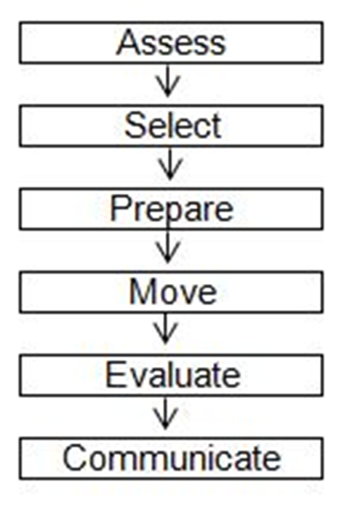
STEPS TO A MOVING TASK

Slide 12
STEP 1– ASSESS
Assessment is the most important part of SMART
Complete a risk assessment:
Self
Environment
Equipment
Object
Always assess “in the moment”

Slide 13
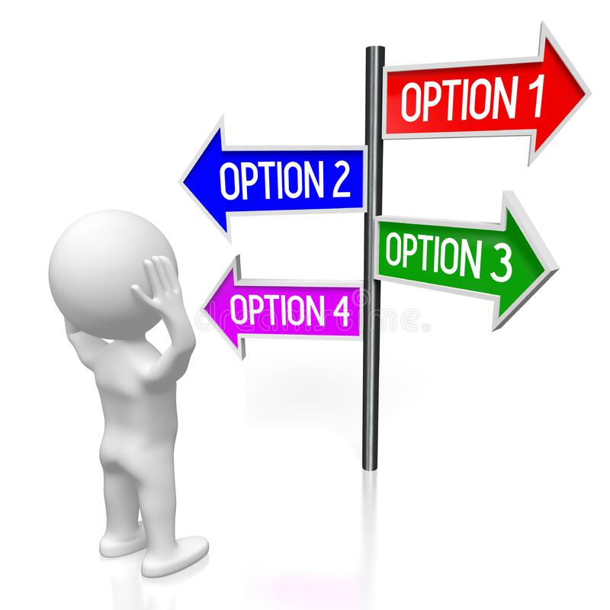
STEP 2– SELECT
Select the safest moving technique based on the risk assessment

Slide 14
STEP 3– PREPARE
If a moving technique is already identified, is it still current?
Eliminate or manage the identified risk:
Remove clutter
Clear a path
Call for assistance if needed
Have all equipment ready and close by

Slide 15
STEP 4– MOVE
Move object using the appropriate safe moving technique
If any new risk(s) arise, attend to them accordingly
DO NOT keep working with the risk(s)
Worker’s Duties:
Providing clear direction
Assistant’s Duties:
Managing the equipment

Slide 16
STEP 5– EVALUATE
What could have been done differently to make the task safer next time?
Ask yourself:
How did the move go?
Are there any ways to improve?

Slide 17
STEP 6– COMMUNICATE
Verbal and written communication
Important for the safety of everyone involved in the move

Slide 18
MUSCULOSKELETAL INJURIES

Slide 19
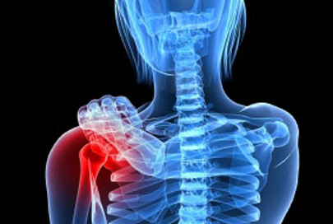
WHAT ARE MUSCULOSKELETAL INJURIES?
Soft tissue injuries
Muscles
Joints
Tendons
Ligaments
Nerves
Repetitive movements with insufficient rest and recovery
Most common areas:
Neck
Shoulder
Low back

Slide 20
CAUSES OF MSI
Repetitive Movements
Sustained & Awkward Postures
Excessive Forces

Slide 21
POSTURE & BODY MECHANICS

Slide 22
BODY MECHANICS

Slide 23
THINK & PLAN AHEAD
Know what the task is from start to finish
Ensure appropriate equipment is available
Seek assistance when needed
Plan a safe route
Listen to your body
Take your time

Slide 24
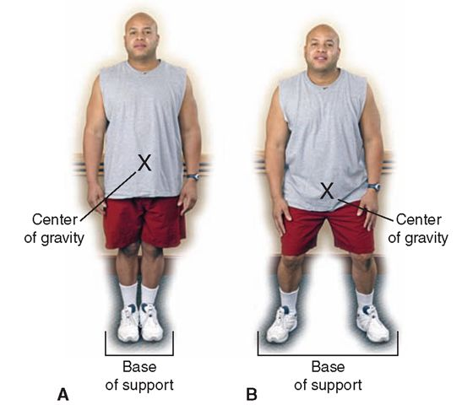
SAFE STANCE
Feet shoulder width apart
Knees slightly bent
Trunk aligned over your center of gravity
Avoid twisting or rotating
Shoulders in line with hips
Head and eyes facing forward

Slide 25
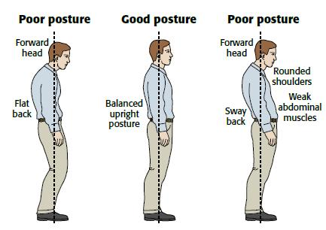
MAINTAIN 2 NATURAL CURVES OF THE SPINE
For the Top:
Ears over shoulders
Shoulders over hips
For the Bottom:
Bend at the knees
Bend at the hips
Tighten core
“sit” into it

Slide 26
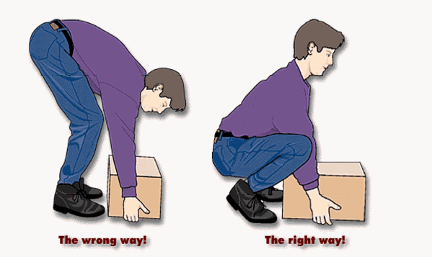
USE YOUR CORE
Core
Stabilize and support lumbar spine for safe dynamic movements
Butt, Thighs & Calves
Provides power and movement to move ensure weight of body
Lowering/ raising body
Standing
Walking
Pushing
Pulling

Slide 27
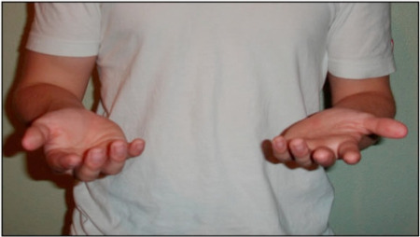
SAFE & EFFECTIVE GRIP
Wrists in a neutral position
Elbows tucked in, close to your side at a 90-degree angle
Thumbs up or out
Bicep= strongest muscle of the arm

Slide 28
WORK WITHIN YOUR COMFORT ZONE
Vertical Zone
Between your shoulder and where your fingertips touch your thighs
Horizontal Zone
Area in front of you when your elbows are at a 90-degree angle and are close to your sides
KEEP THE LOAD CLOSE

Slide 29
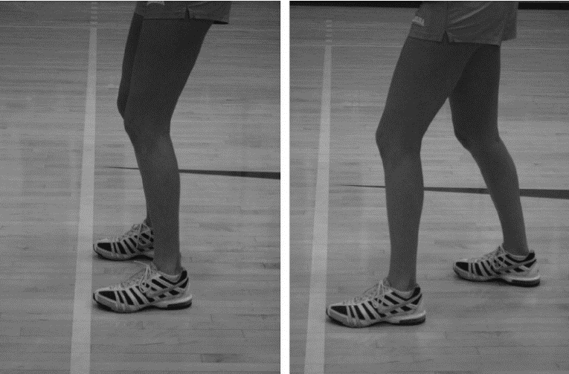
WEIGHT TRANSFER
Transfer weight from one leg to another
Side to side
Front to back
Creates movement/ momentum and helps maintain balance

Slide 30
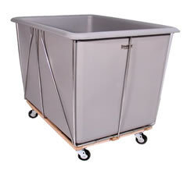
PUSHING VS. PULLING
Always PUSH rather than pull when possible
Initiate the push or pull with weight transfer, rather than using the upper body
DO NOT push one item and pull another at the same time
Push or pull one object at a time
Always use TWO hands instead of one
Lighten the load
Divide the load
Alternate tasks

Slide 31
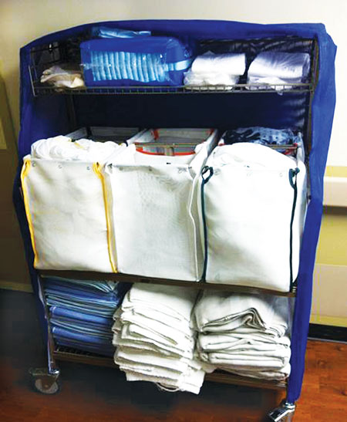
CARRYING OBJECTS
Slide, push or roll, rather than carry when possible
Used for short distances only
Enhance your grip when possible (handles, gloves, etc.)
Use TWO hands instead of one
Lighten the load
Divide the load
Alternate tasks

Slide 32
LIFTING
Able to lift more weight when the load is closer to the body and within your comfort zone
Consider team lifting when you are attempting to manage a large load
Communication is key during team lifting!

Slide 33
WORK SURFACE HEIGHTS
2-4” above elbow | At or slightly below elbow | 4-8” below elbow

Slide 34
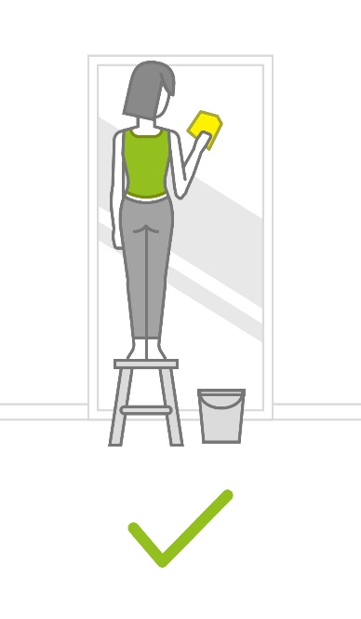
STANDING POSTURE
Tighten core
Bend knees
Work at an appropriate height for the task
Wear appropriate and supportive footwear
Use anti- fatigue mats for extended periods of standing
To relieve prolonged standing, place one foot up on an elevated ledge

Slide 35
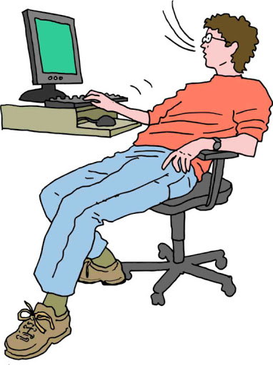
SITTING POSTURE
Ears over shoulders, shoulders over hips
Avoid looking up or down for prolonged periods
Use a chair with good lumbar support
Feet flat on the floor
Thighs at a 90 degree angle with thigh slightly lower than hips
Use footrest if required
Take stretching breaks

Slide 36
BACK VS. LEG MUSCLES
BACK MUSCLES
Keeps the body upright
Short muscles
Stabilizers with very LITTLE power
NOT DESIGNED FOR LIFTING
LEG MUSCLES
Walking
Raising and lowering the body
Getting up/ down
DESIGNED FOR LIFTING

Slide 37
DYNAMIC VS. STATIC MUSCLE ACTION
DYNAMIC
Muscles contract and relax alternately
Good blood flow throughout the muscle and joint
STATIC
Both sides of the joint contract at the same time to keep the joint stable and in a fixed position
Compresses the blood vessels and restricts circulation
Muscles fatigue and cramp easily
Requires more time to recover

Slide 38
RISK OF INJURY
DYNAMIC
Less tiring
Performing same movement repeatedly can be harmful to joints involved
STATIC
Exhausting and uncomfortable
May interfere with blood flow
Avoid prolonged, static postures
The risk of injury increases with DURATION, FREQUENCY AND INTENSITY

Slide 39
Work in pairs.
Identify good body mechanics.
Identify areas of risk.

Slide 40
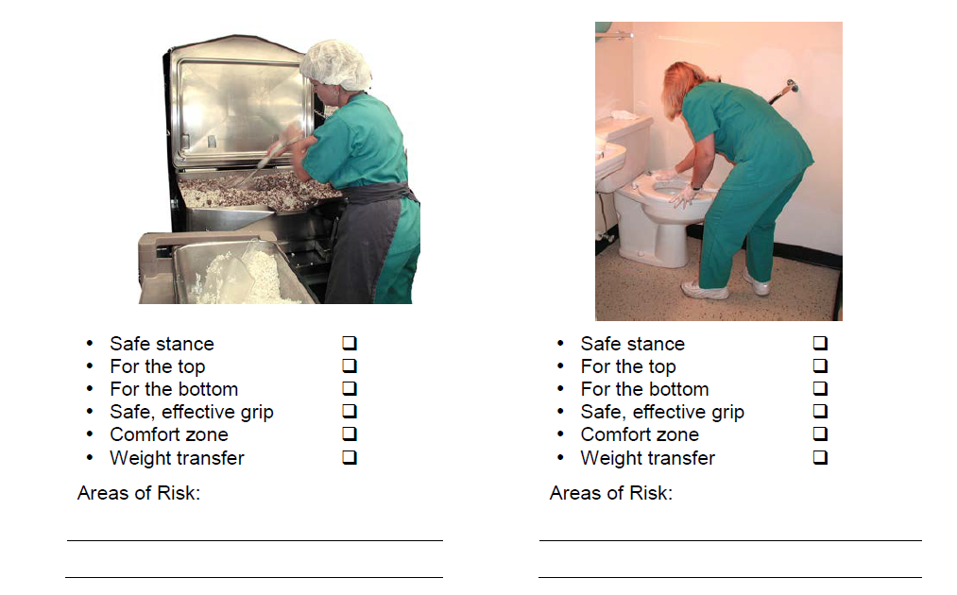

Slide 41
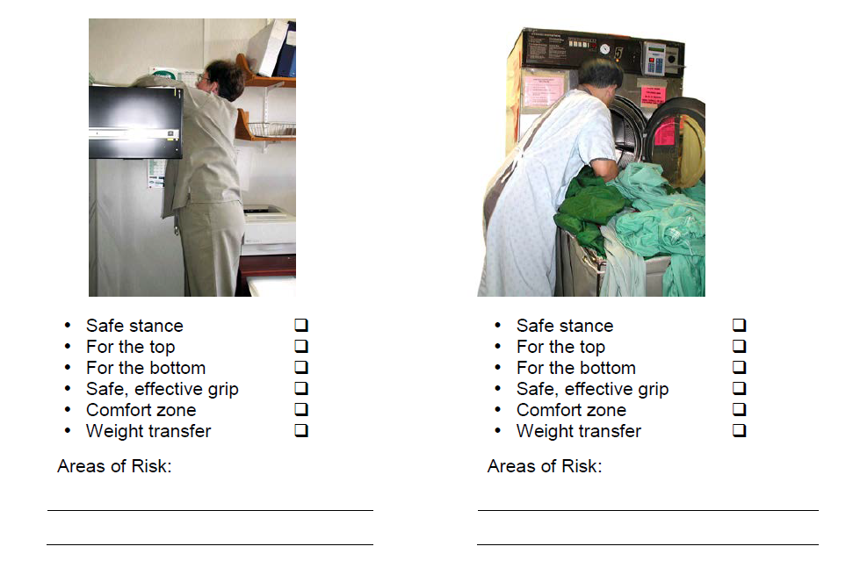

Slide 42
RISK ASSESSMENT

Slide 43
RISK ASSESSMENT
RISK
Any factor that has the potential to jeopardize the safety of the worker(s)
RISK ASSESSMENT
Process used to identify and eliminate or manage risks in order to select the safest moving technique

Slide 44
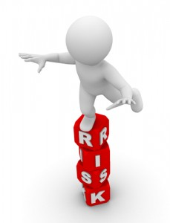
AREAS OF RISK ASSESSMENT
SELF
ENVIRONMENT
EQUIPMENT
OBJECT

Slide 45
PROCESS TO CONDUCT A RISK ASSESSMENT
Identify the risk(s) that would impact the safety of the move
Collect information about risk factors:
Written reports of previous injuries/ risks
Observation of co-workers
Speak with co-workers
Analyze information to determine appropriate course of action to eliminate or manage risk(s)

Slide 46
SELF RISK ASSESSMENT

Slide 47
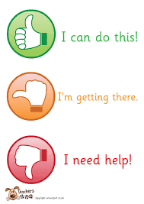
SELF RISK ASSESSMENT
About our own ability to work safe
Before, during and after the move
Risk factors that may impact the safety of the move:
Physical status
Emotional status
Training and experience
Communication skills
workload

Slide 48
SELF RISKS
Self-
Assessment
Physical
Status
Emotional
Status
Training
&
Experience
Communication
Skills
Workload

Slide 49
ENVIRONMENTAL RISK ASSESSMENT

Slide 50
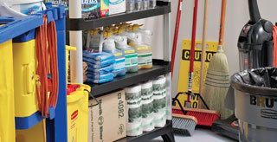
ENVIRONMENT RISK ASSESSMENT
Before, during and after performing the move
The environment may change at any point during the moving task
By making changes to the environment in advance, risks can be eliminated BEFORE the moving task
Problem solve for risks that can’t be eliminated or managed

Slide 51
ENVIRONMENT RISKS
Environment Risk
Assessment
Potential for Violence/
Aggression
Noise/
Distractions
Working
Surfaces
Colors/Lighting
Room/Area

Slide 52
EQUIPMENT RISK ASSESSMENT

Slide 53
EQUIPMENT RISKS
Environment Risk
Assessment
Quantity/
Accessible
Design/
Ergonomics
Manufacturer’s Intended Use
Quality
Capacity/
Ability

Slide 54
OBJECT & TASK RISK ASSESSMENT

Slide 55
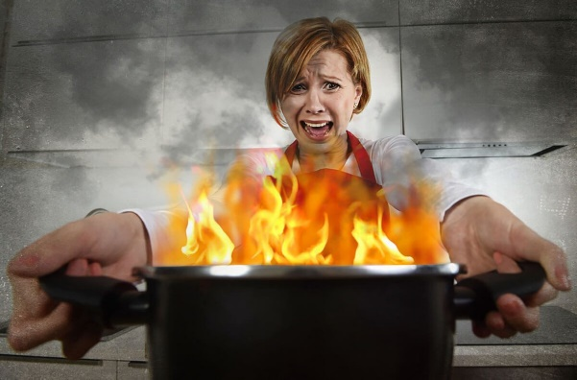
OBJECT RISK ASSESSMENT
Assess risks before, during, and after moving an object
Risk factors may include:
Size/ shape
Weight
Texture
Contents
Handles
Balance
Temperature

Slide 56
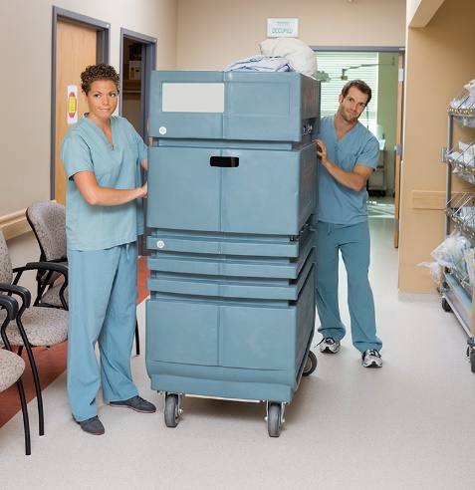
TASK RISK ASSESSMENT
RISK FACTORS
Location
Distance to be moved
Force to initiate, maintain or stop the movement
Frequency
Repetition

Slide 57
OBJECT MOVING TASK REVIEW
Prior to all moves, ask yourself, have I assessed:
Myself for personal risk factors?
The environment?
The equipment I will use?
The object to be moved/ task to be done?

Slide 58
HAZARDS

Slide 59
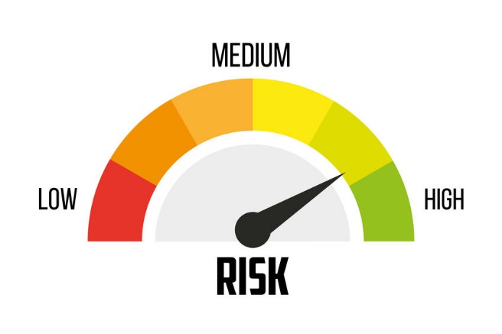
HAZARDS
HAZARD
Situation that poses threat to life, health, property, process or environment
In short, anything that can cause injury or illness
Sources include:
People
Equipment
Materials
Environment

Slide 60
HAZARD PROCESS
HAZARD PROCESS
IDENTIFY HAZARD
ASSESS RISKS
ELIMINATE/ CONTROL
MONITOR

Slide 61
HAZARDS
ROLE OF EMPLOYEE
Recognize workplace hazards
Know how to report hazards to employer
Be involved in the hazard control process
ROLE OF EMPLOYER
Be aware of workplace hazards
Inform workers of potential hazards
Have processes in place to reduce risk of injury
This may include job analysis, workplace inspections, incident investigations

Slide 62
HAZARD CONTROL METHODS

Slide 63
GENERAL MOVING TECHNIQUES

Slide 64
REVIEW!

Slide 65
SAFE LIFTING PROCEDURE
Assess the load
Minimize the load as much as possible
Use equipment
Reduce the size of the load
Reduce the distance the load must be moved
Move the load in stages
Ask for assistance
Clear the lifting area and path
Use the Checkpoints of Safe Body Mechanics
Bend your hips and knees, not your back
Grasp the object with palms up or thumbs up when possible
Keep the object close to your body
Turn your feet, rather than twisting your trunk when you need to change direction

Slide 66
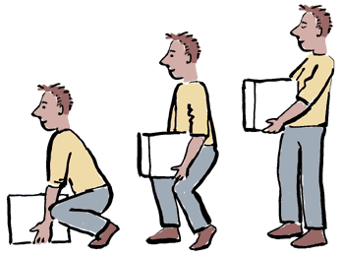
GENERAL MOVING TECHNIQUES
PUSHING/ PULLING
GOLFER’S LIFT
ONE HANDED PARTIAL SQUAT
TRIPOD LIFT
DIAGNOAL LIFT
POWER LIFT

Slide 67
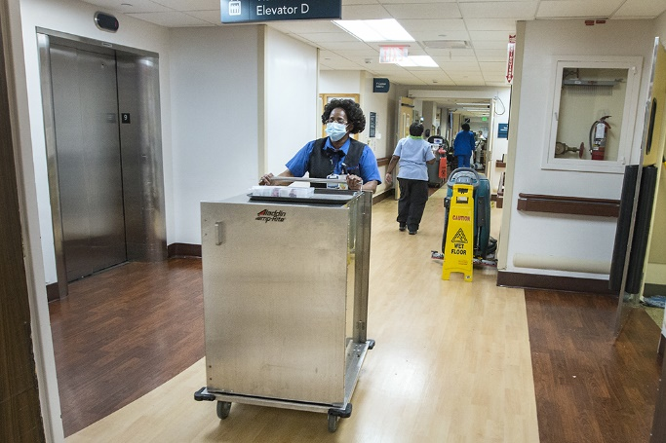
PUSHING & PULLING
Can use wheeled equipment to transport equipment that is too heavy or awkward to carry
Use safe body mechanics
Do not push one object while pulling another!
Adjust equipment if possible, if required
Maintain clear visibility
No twisting
Always ask for help when needed

Slide 68
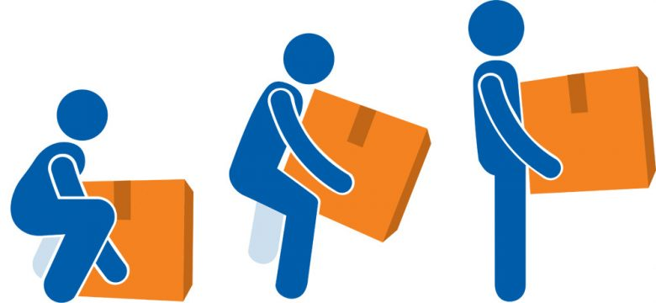
TECHNIQUE TIPS
If the object is on the floor:
Get it closer to you by using the DIAGNOAL LIFT OR TRIPOD LIFT
If the object is light:
Use the GOLFERS LIFT
If the object has a handle:
Use the ONE HANDED PARTIAL SQUAT LIFT
If the object is heavy:
Use the POWER LIFT
If the object is on the same surface:
Use REPOSITIONING

Slide 69
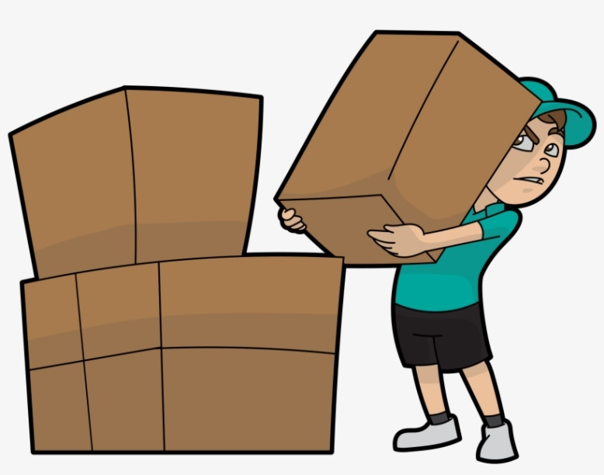
MANUAL HANDLING STRATEGIES
BREAKDOWN
MINIMAL HANDLING
TASK VARIATION
MICRO- BREAKS
TRIP FREQUENCY
PROCEDURE LOGO
STORAGE/ RETRIEVAL STRATEGY
CHUNKING
ASK FOR HELP

Slide 70
BREAKDOWN
Taking larger boxes or items and separating them into smaller/ lighter, more manageable pieces

Slide 71
MINIMAL HANDLING
Identify the minimal number of times possible, that an object/ material must be handled

Slide 72
TASK VARIATION
Alternating isolated repetitive tasks of >60 minutes with other tasks involving different bodily movements for greater than 15 minutes

Slide 73
MICRO-BREAKS
Taking more frequent, shorter breaks involving rest and/ or tasks of a different bodily movement every 20 minutes for 20 to 60 seconds

Slide 74
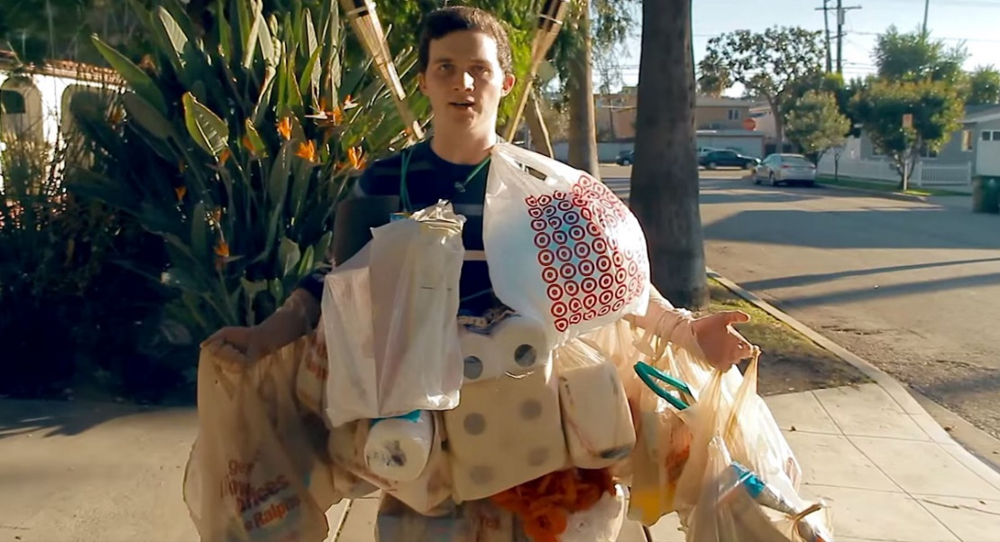
TRIP FREQUENCY
Performing more frequent trips with lighter leads than fewer trips with heavier loads

Slide 75
PROCEDURE LOGO/ SINAGE
Identify and post the safest, most efficient steps to complete a specific manual handling task
It can consist of a series of pictures, written descriptions, or both

Slide 76
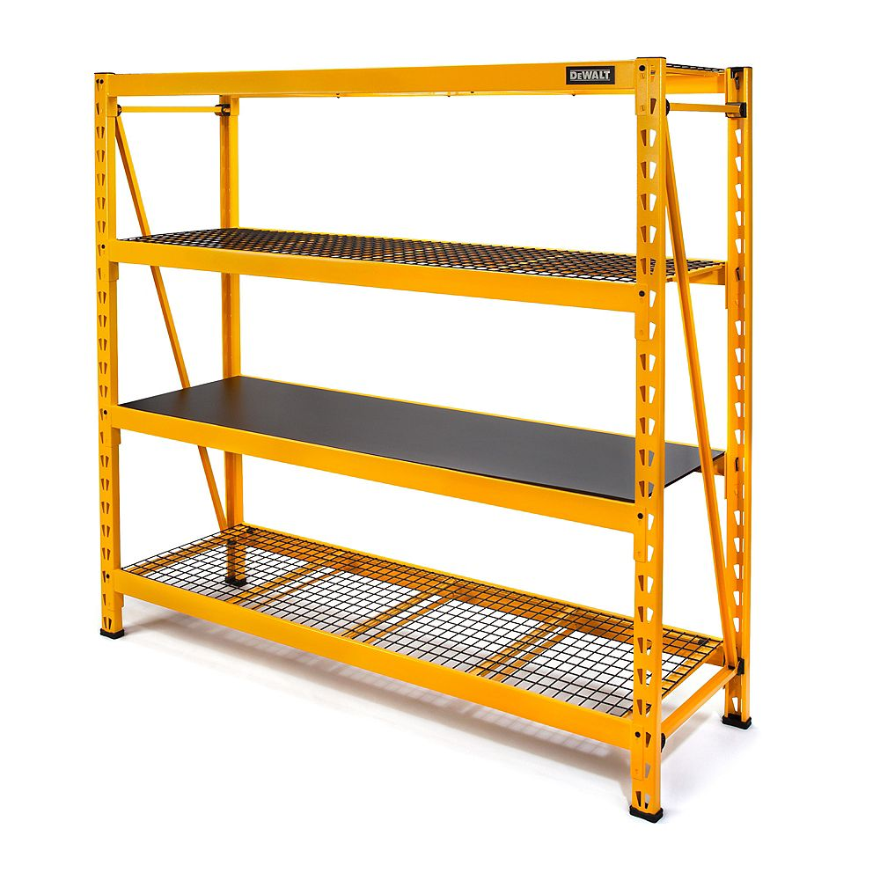
STORAGE/ RETRIEVAL STRATEGIES
Analyze and identify a safe process for storing and retrieving items/ objects based on the following parameters:
Frequency of use
Availability of storage/ retrieval equipment (step stool)
Size/ shape
Weight
Shelf depth/ height
Storage area accessibility

Slide 77
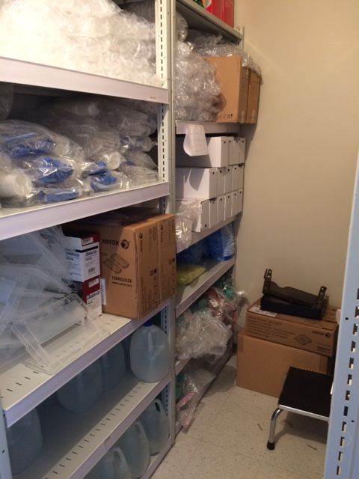
STORAGE/ RETRIEVAL STRATEGIES
HIGH SHELVES
Light items
Infrequently used items
MIDDLE SHELVES
Heaviest items
Frequently used items
Waist= comfort zone
LOW SHELVES
Medium weight
Somewhat frequently used items

Slide 78
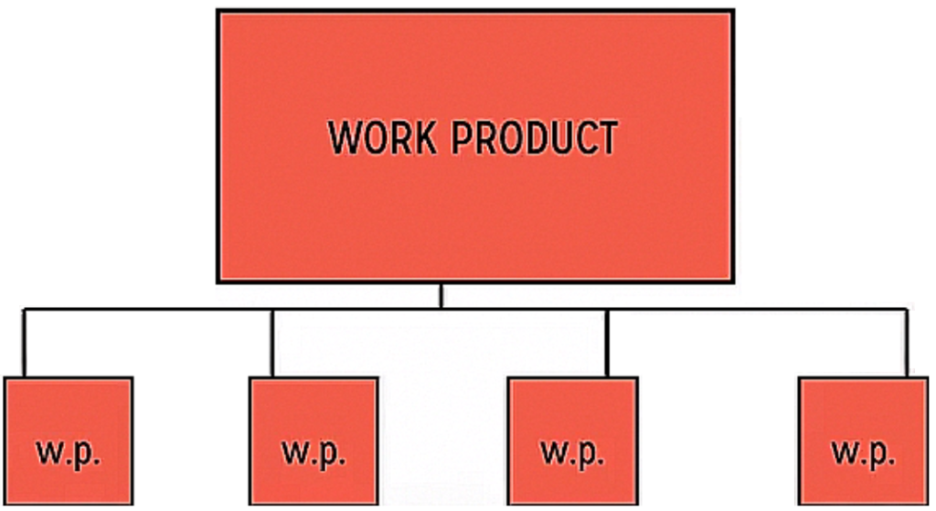
CHUNKING
Analyze and break down a task into the completion of smaller sub tasks
Do not complete the entire task at once

Slide 79
ASK FOR HELP
Early identification for the requirement of physical/ mental assistance from another co-worker to complete a task

Slide 80
CASE STUDIES

Slide 81
CASE #1
Mrs. Smith is a 5’7”, 55 year old laundry worker whose job was to load and unload front load washing machines. Mrs. Smith worked 10 hour shifts, 4 days per week.
The loading process consisted of placing the laundry bin directly in front of the washer. Mrs. Smith would position herself to the side of the cart and laundry bin. She would then bend/ twist at the waist and reach into the bin, pulling the soiled laundry out and then twisting 90 degrees and shoving the laundry into the washer. She would repeat this process until the laundry bin was empty. It would take her approximately 3-5 minutes to load one washer.
When the washer was complete, she would unload the washer by placing the laundry bin directly in front of the opening to the washer. She would then stand to the side of the bin and washer opening, and would twist and reach to grab the laundry and put it into the cart. It would take her 3-5 minutes to unload one washer. She completes this process of loading and unloading the washer 8 times every hour.
How could you make this task safer for Mrs. Smith to perform?

Slide 82
CASE #2
Mrs. Jones is a 5’2”, 23 year old stores keeper in the Materials Management Department. Her job is to receive and ship materials to the local hospitals. She works 8 hours per day, 5 days a week.
Mrs. Jones began working in this position 1 week ago and due to staff shortages, she was thrust into her job duties without an orientation or any formal training, except for the guidance from her co-workers.
Nearing the end of her shift, a very large shipment arrived at the loading dock. Wanting to get the work done prior to going home, Mrs. Jones proceeded to prepare the pallets (stacked 5 feet high) for unloading. While moving one particular pallet, Mrs. Jones decided (due to limited space) to unload the small boxes, 15 lbs. each, of food onto the floor and stack them on top of each other against the wall.
Mrs. Jones placed the pallet adjacent to the empty space on the floor. To complete the lifting task, she positioned the side of her body in between the pallet and the open space. She would then twist her body, reaching and grabbing 2 boxes at one time and then bend over at the waist and place them on the floor. She would repeat this until the pallet was empty.
How could you make this task safer for Mrs. Jones to perform?

Slide 83
WAS YOUR GOAL FOR THE SESSION ACHIEVED?

Slide 84
QUESTIONS?

Slide 85
PLEASE TAKE A FEW MINUTES TO COMPLETE YOUR EVALUATIONS. THANK YOU!

